Slide 1
Deep Learning Final Project
Brain Tumor Classification using MobileNetV2
1
Miguel Angel Soler, Alec Samonte, Joseph Negron
2
Course: CPS*3840: Deep Learning Foundations
3

Slide 2
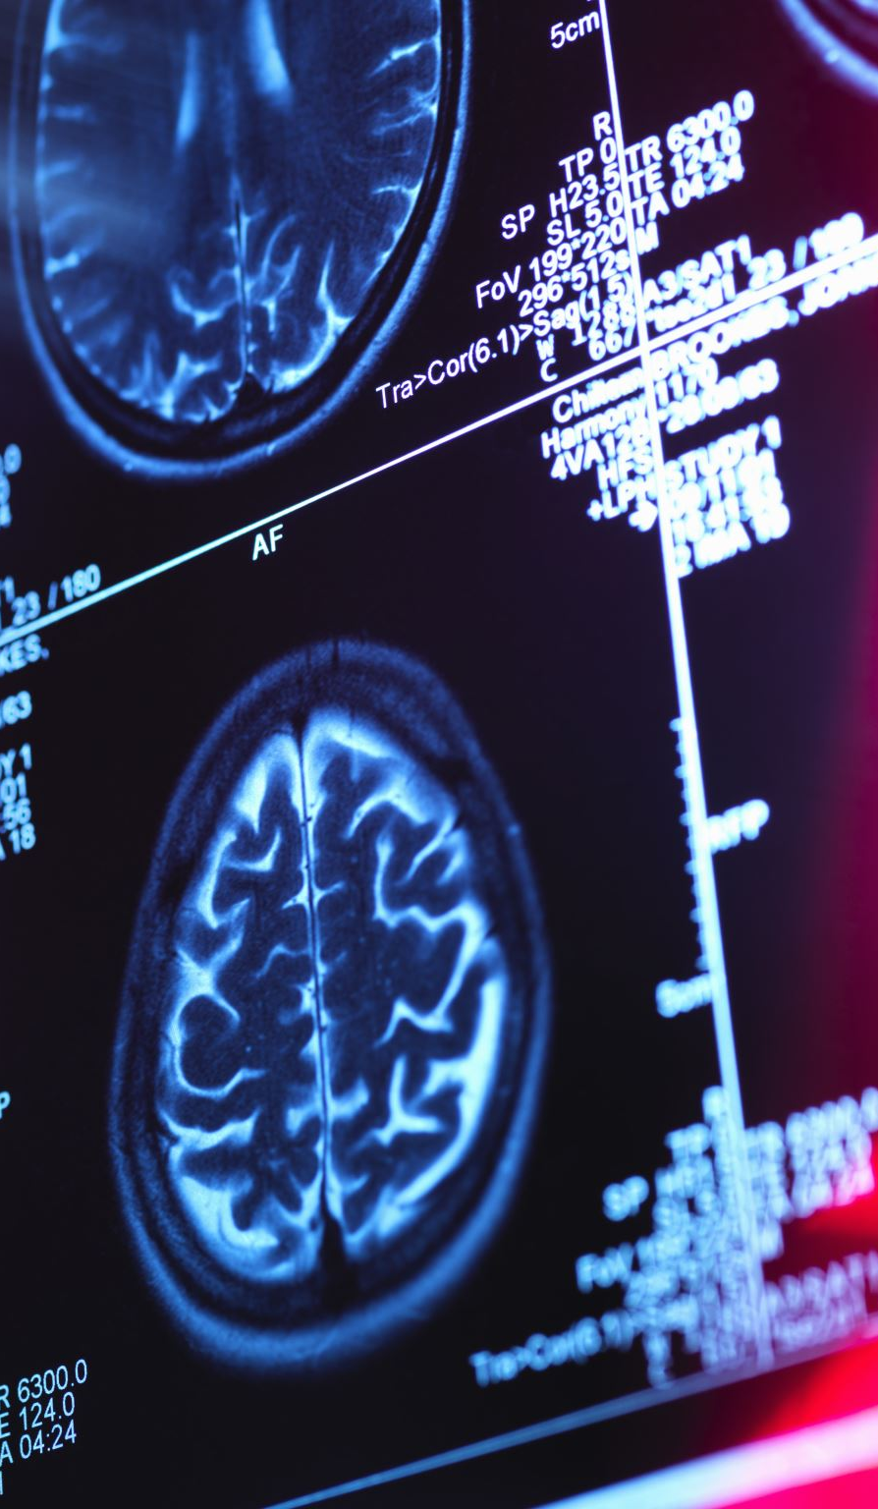
Project Overview
Goal: Classify brain MRI images into tumor categories
Task: Image Classification
Model Type: MobileNetV2 (Transfer Learning)

Slide 3
Person 1 · Data Collection & EDA
Dataset Overview
5,712
1,311
4
224×224
Training Images
Test Images
Tumor Classes
Input Resolution
Class Distribution
Class | Training | Testing | Notes
Glioma | 1,321 | 300 | Most common malignant type
Meningioma | 1,339 | 306 | Often benign, harder to classify
Pituitary | 1,457 | 300 | Largest class — slight imbalance
No Tumor | 1,595 | 405 | Healthy control class

Slide 4
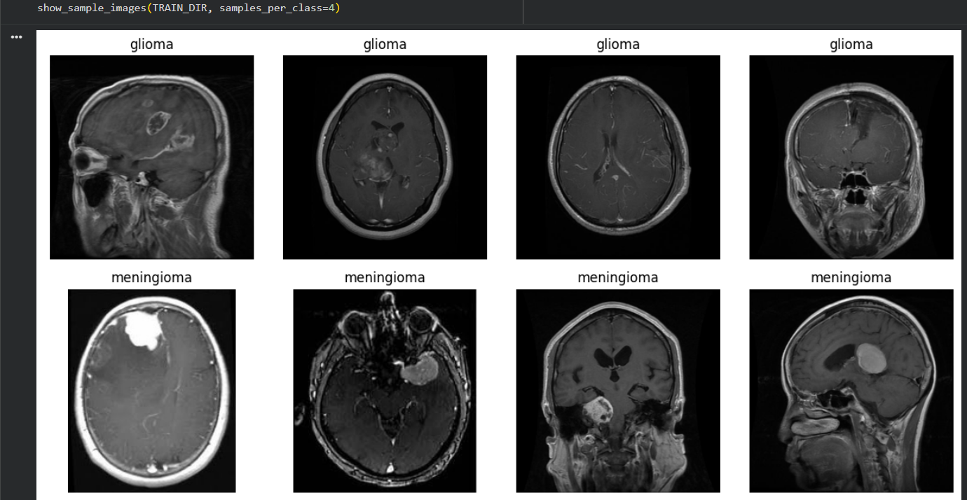
Dataset
Brain MRI Dataset
Classes:
- Glioma
- Meningioma
- Pituitary
- No Tumor

Slide 5
Person 1 · Data Collection & EDA
Exploratory Data Analysis
Key EDA Findings
⚖ Near-balanced: No Tumor class is slightly larger (~23%)
📐 Variable raw sizes — all resized to 224×224 for MobileNetV2
🧠 4-class MRI task: Glioma, Meningioma, Pituitary, No Tumor
📁 Dataset sourced from Kaggle; structured Training/Testing folders
🔀 80/20 train-validation split applied at training time (seed=42)

Slide 6
Data Preparation
Image size: 160x160
Train / Validation / Test split
Preprocessing:
- Rescaling
- Augmentation

Slide 7

Baseline Model
MobileNetV2 (Frozen Base)
Dense Layer + Softmax
Purpose: Establish baseline performance

Slide 8
Improvement 1: Data Augmentation
Added:
- Flip
- Rotation
- Zoom
Goal: Improve generalization

Slide 9

Improvement 2: Attention Module
Added attention layer to focus on important features
Result: Highest performance

Slide 10
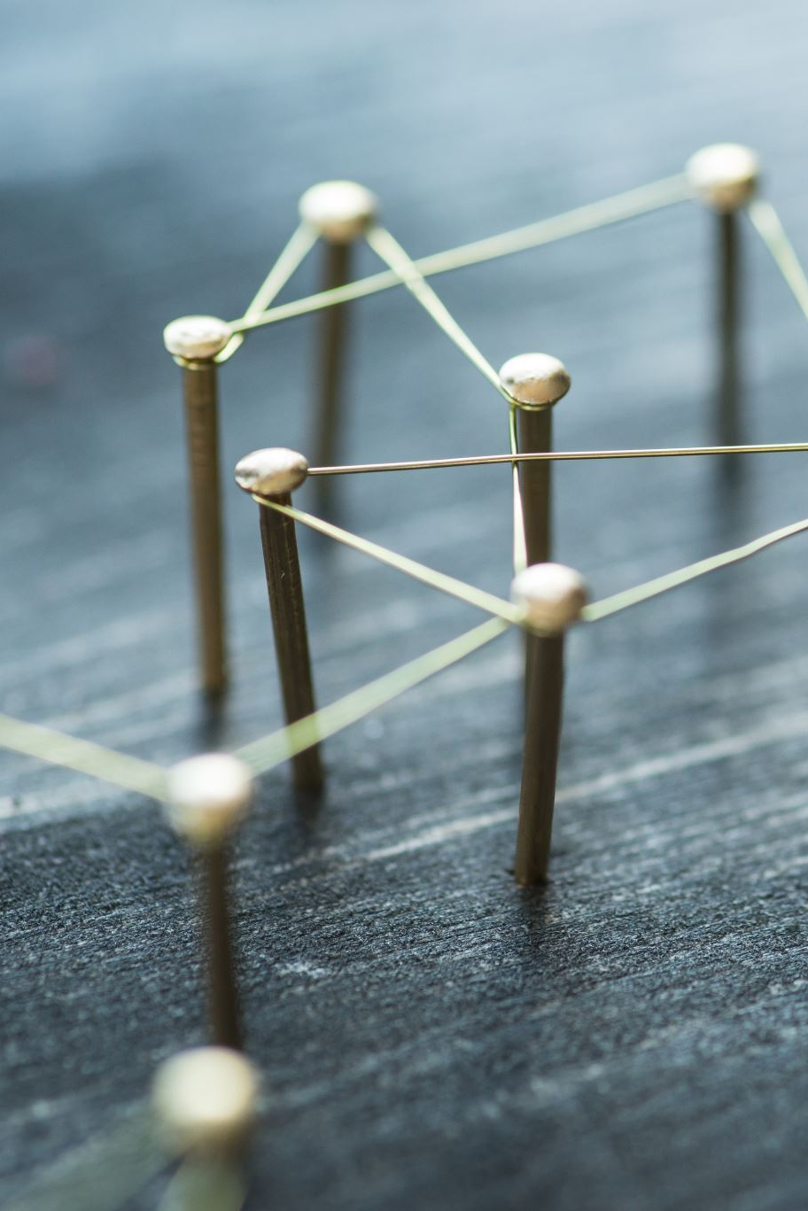
Proposed Model
Final Model:
MobileNetV2 + Attention Module
Selected based on best validation accuracy

Slide 11
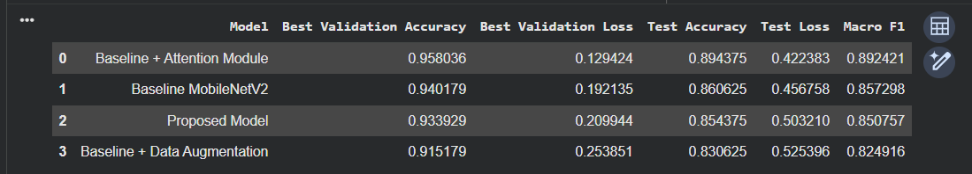
Results

Slide 12
Key Findings
Attention module improved performance significantly
Additional modifications did not improve results further

Slide 13
Conclusion
MobileNetV2 + Attention achieved best results
Deep learning effective for medical imaging tasks

Slide 14
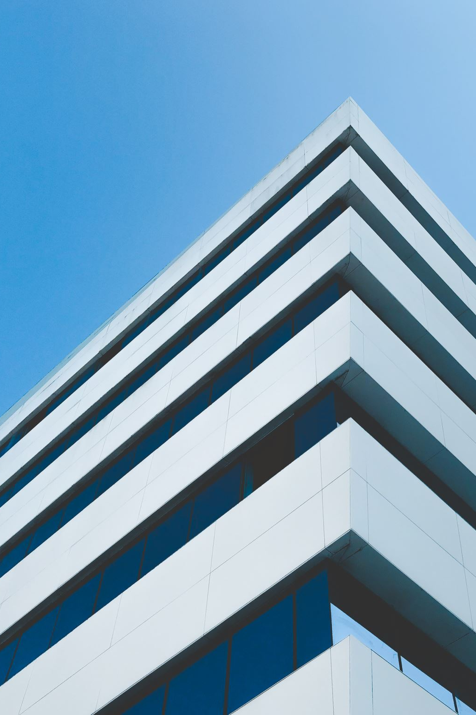
Future Work
- Try larger datasets
- Explore different architectures
- Improve fine-tuning

