Slide 1


Lebanese Canadian University – LCU
Faculty of Arts and Science – FSA
Bachelor in Computer Sciences
Final Project
IFT 371
Presented by
Miguel-Ange el Aaraj
Supervised by
Mr. Johnny Khoury
May,25 ,2021

Slide 2
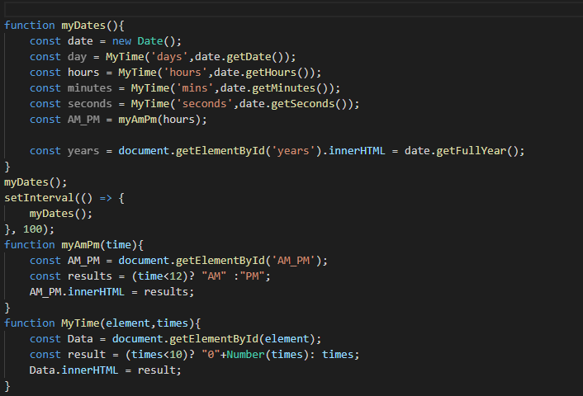
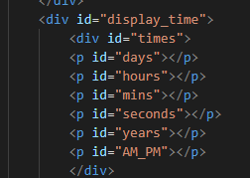
Cover Page
This function display time in the html page which return the day , hours ,mins, seconds , and the year and a another function which called myAmPm which has one parameter the time and return AM or PM depends on the time and an another function called MyTime which takes two parameter first the html id element and the time and check for the time if the time is less than 10 so it will display in html as format of ex: 09 otherwise return the time normally.
SetInterval will call this function every 1000ms to update the time.

Slide 3
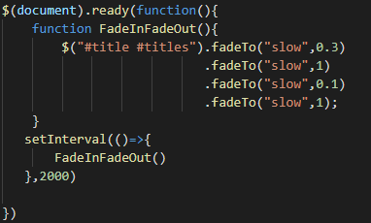
Cover Page (2)
it’s a simple animation with will fadeTo the title and the setInterval method will call this function every 2000ms (Module)

Slide 4
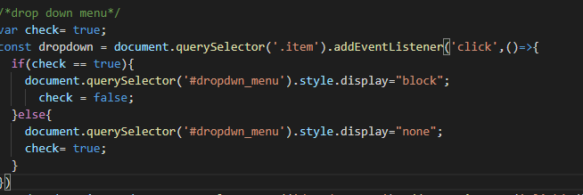
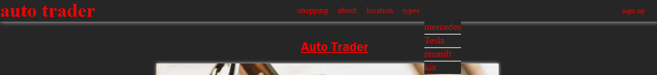
Intro Page (1)
In the intro page first, I initialize the boolean variable to true and the function which has a click event listener every time the user clicks on it the if condition checks for the check value and display the corresponding design and at each time, we have to reverse the check value

Slide 5
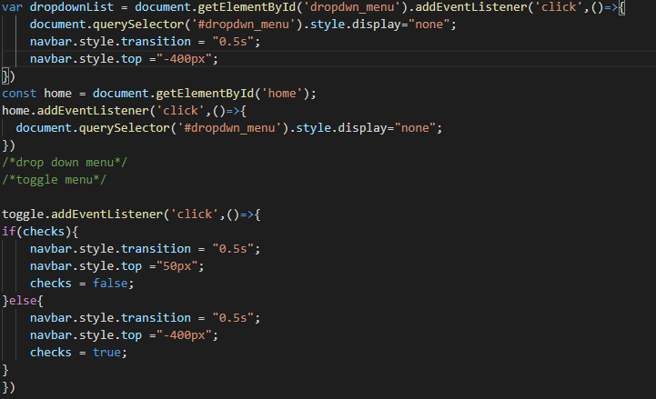
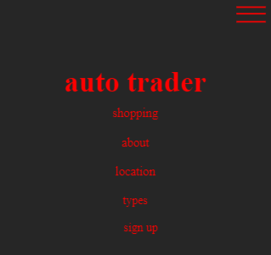
Intro Page (2)
Here another click event which at every time I click on an item in the dropdown menu it will display the dropdown menu to none and the navbar refers to the navbar in the mobile design which will add a transition animation and the top css property to -400px
In the mobile design we have a navbar each time I click on the toggle icon so it will display the menu from the top and change the checks value.

Slide 6
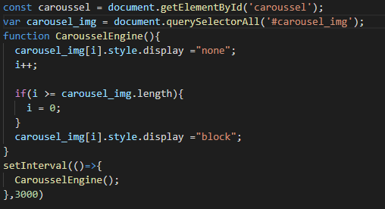
Intro Page (3)
In my html I have 4 images which will be displayed depend on the index in this function and the if condition verified the index length (i) so if it’s reaches the max value which is 4 so it will be initialize to 0 to avoid any error. I call this function every 3000ms in the setInterval method

Slide 7
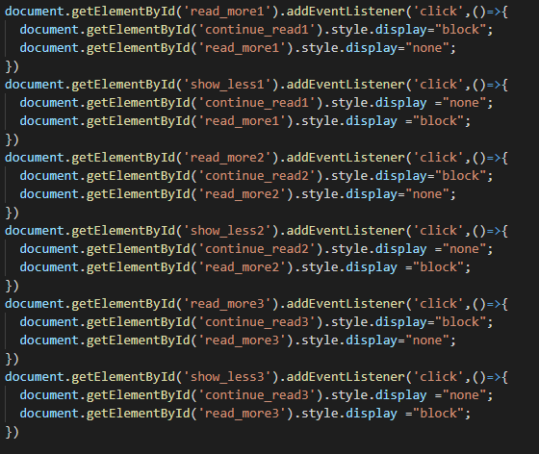
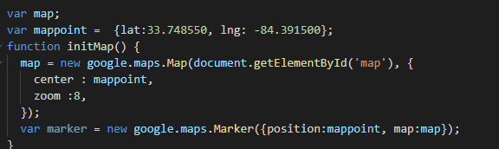
Intro Page (4)
All this work the same the content will appear if I click on the read more button and will disappear if I click on show less button
This function is for google map API the variable mappoint is an object which contain the position of a specific location the lat and the lng and inside the function we are initialize the google map into the html id element map and the marker to display it on the map takes the position and the map.

Slide 8
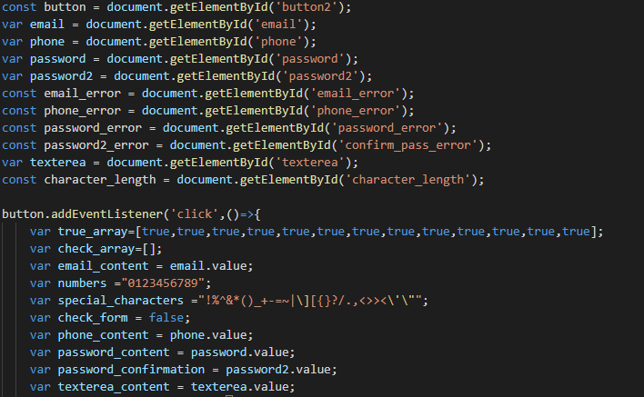
Form Page (1) (Module)
Here I’am define all the id elements to use them in the form and a click event one the button in the click event function I defined an array of true to check in the end for all the condition below and a check_array which will be fielded with true or false Booleans and email_content which will contains the email input in the html numbers to check for the numbers in the number field special_Characters refers to the password field and the others corresponding for the value of each input field in the html form.

Slide 9
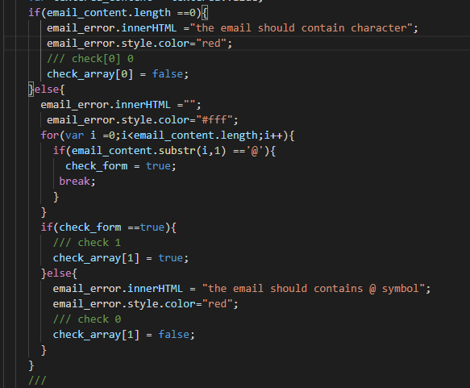
Form Page (2) (Module)
Email validation
The second part of the code is for the email validation first checking for the value if it’s empty will display a message with the color pf red if email value is not empty in the for loop will check for the @ character if there are an @ character so it will return true and break the loop if not found so it will display a message and color it with red and check_array with index 1 will be false

Slide 10
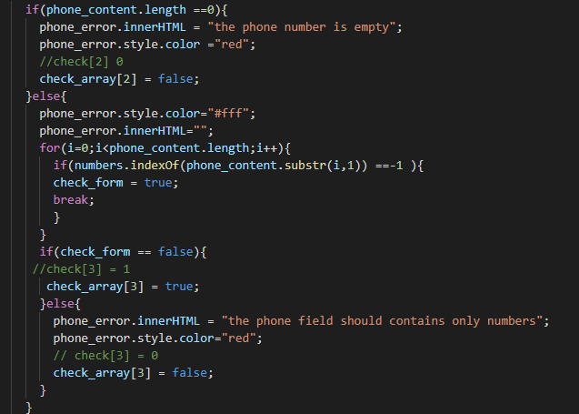
Form Page (3) (Module)
Phone validation
The third part of the form validation we have the phone validation so like the email we are checking for the value in the phone if it’s emptied a message will be displayed and colored in red otherwise in the for loop it will check for every single character in the phone field if the phone field contains a character so it will return true and break the loop and if true check_array index 3 will return true otherwise a message will be displayed and colored in red and check_array is false.

Slide 11
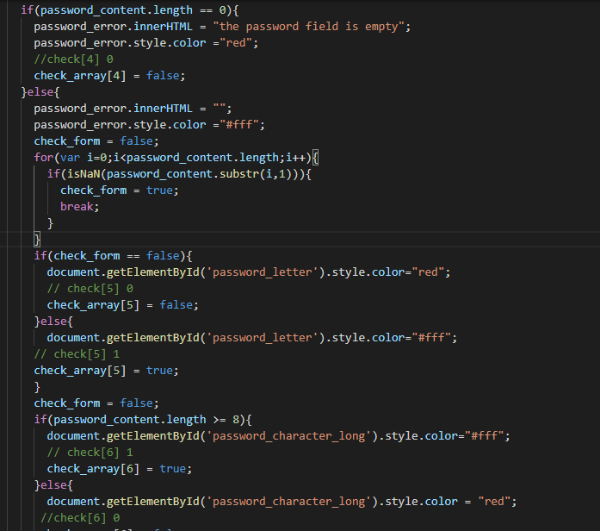
Form Page (4) (Module)
Password validation(1)
In the password field checking for the value if it’s emptied a message will be displayed and colored by red otherwise in the for loop we are checking if the input value has at least one character and color the text depends on the check_form value and the length of the input must be bigger or equal to 8.

Slide 12
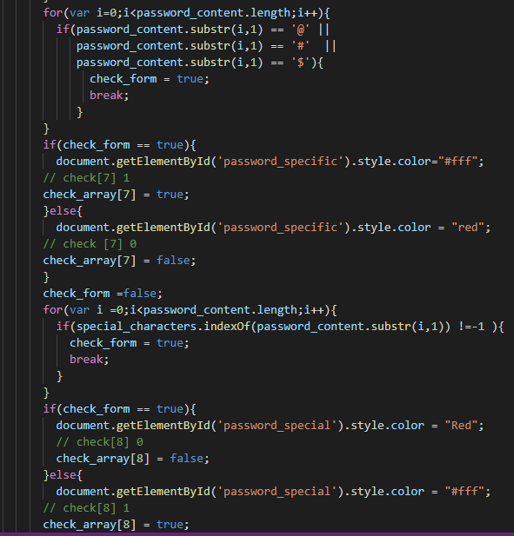
Form Page (5) (Module)
Password validation(2)
In the second part of the password field, we are checking for a specific special_character which are @ # and $ and will color the text depends on the result obtained from the for loop and in the for loop we are checking for the another special_characters defined in the click event in the first picture and color the text depends on the check_form value.

Slide 13
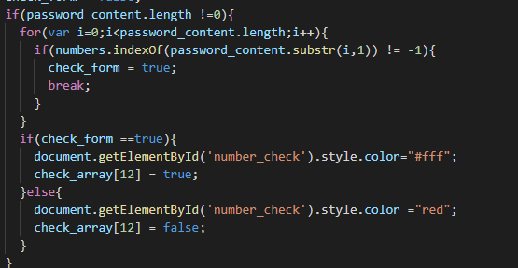
Form Page (6) (Module)
Password validation(3)
Here we are checking for the password field we are checking in the for loop for each character in the password field if it’s contained a number everything is field otherwise it will color the text with red.

Slide 14
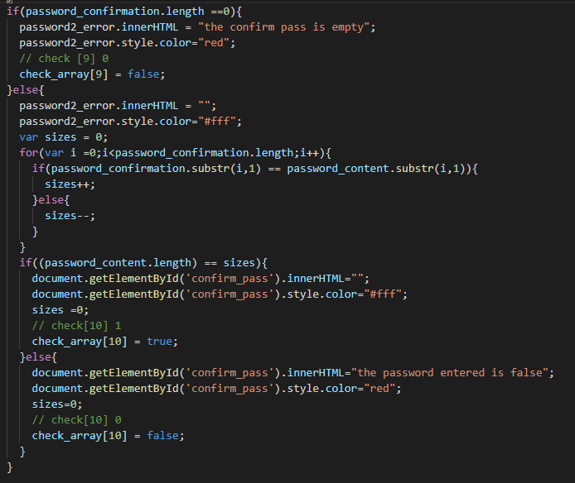
Form Page (7) (Module)
Password confirmation field
Another field in the form which is the confirmation password if the pass confirm value is emptied so it will display a message and color it with red else it will enter the for loop and checks for the character if its match in the end, we got the sizes value and we are checking if the sizes value is equal to the length of the password field so everything is good else a message will be displayed and color it with red.

Slide 15
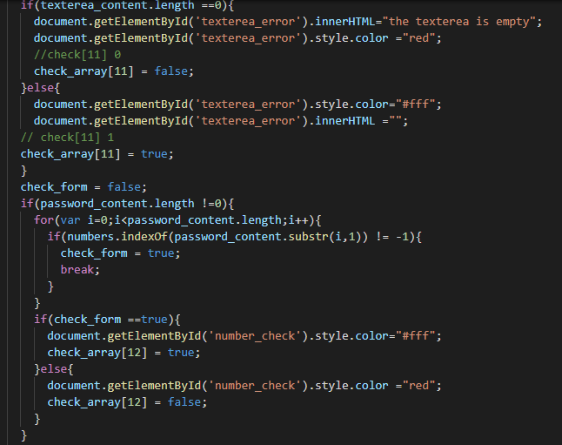
Form Page (8) (Module)
Text area Field
Last field is the text area where we are checking for the value in the text area filed if it’s emptied a message will display and colored with red otherwise everything is good

Slide 16
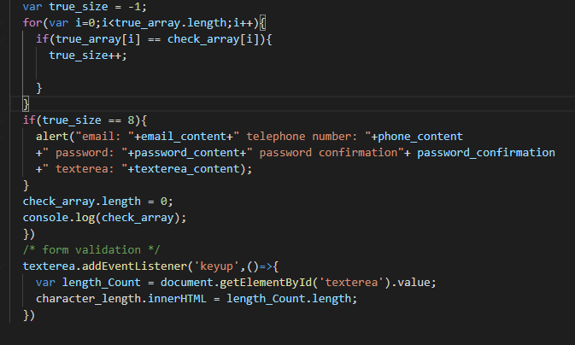
Form Page (9) (Module)
Alert Box
In the end of the form, we are checking all the Booleans values in the two arrays defined in the first page and we have a counter to count the matching two Boolean from the arrays in the end we are checking the size of the counter if it’s equal to 8 an alert box will appear otherwise nothing will happen.
And the key up event is for the text area field to count every character entered by the user and display it in the html.

Slide 17
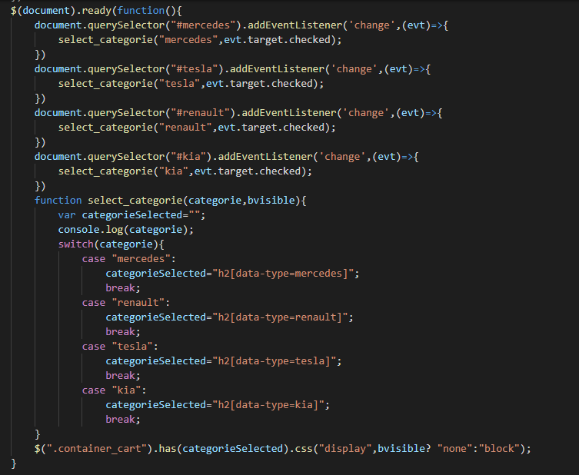
Store Page (1) (Module)
JQuery Gallery Image
In this function we have 4 checkboxes with a change event and check for the target if it’s true or false and the select_category function takes two parameters the category name and Bvisible refers to the checkboxes selected if it’s true or false then it will display the corresponding category depends on the h2[data-type] and display the design from the bvisible.

Slide 18
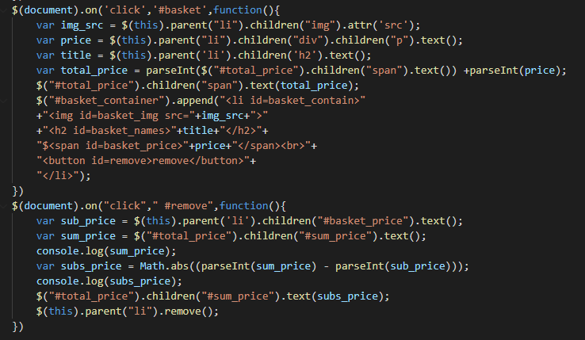
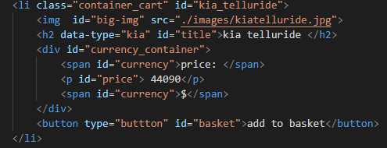
Store Page (2) (Module)
Basket
In the above function we have the basket function the user click on the button with id basket this syntax refers to the id #basket the parent refers to the li in the second picture and children img refers to the img and the src attr for the image source and this function will pick the price of the item selected the title and add them to the ul field with li tag. And if the user wants to remove an item, he clicked on the remove button and remove the li appended and will calculate the new price for all the items in the Basket.

Slide 19
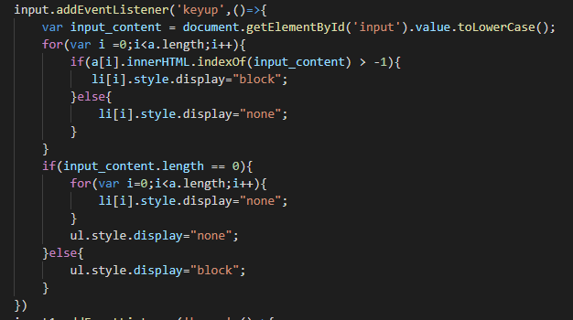
Store Page (3)
In this key up event, we are taking the value of the input field and checking for an array in the anchor tags in the html and if it’s match it will display the li tag it otherwise the other li tags will be displayed none and if the value of the input field is empty so everything will be display none.

Slide 20
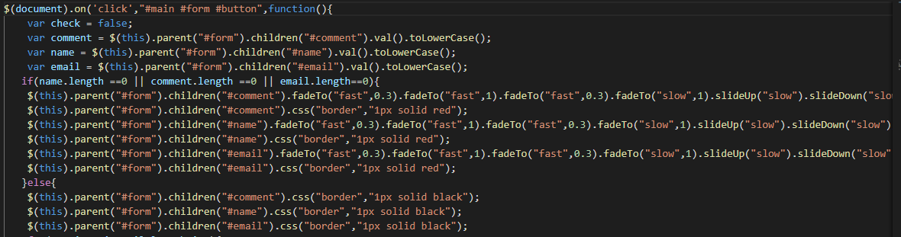
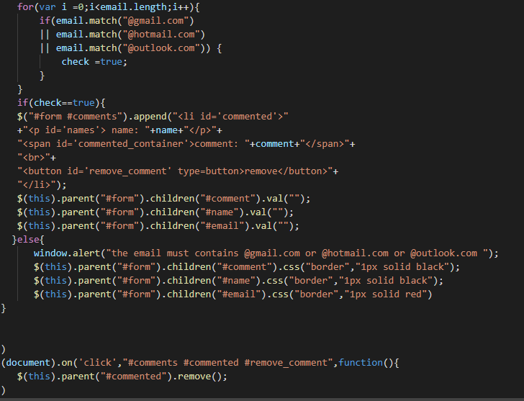
Contact US Page (Animation Module)
Jquery Form
Here we have a new status form with jQuery which checks for the value of each input field if empty so it will make an animation on them using fadeto and the slideup and put a border on them using css property.
Here the second part we are checking for the email validation with @gmail.com and @hotmail.com and @outlook.com in the for loop and return a Boolean if true so it will append the comment in the ul field and he can remove the comment by clicking on the remove button.

