Slide 1
Predict House Prices
Miguel Camara

Slide 2
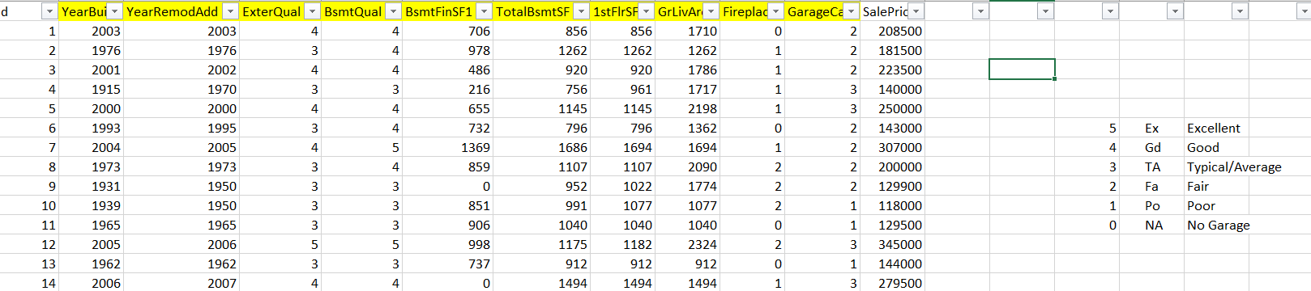
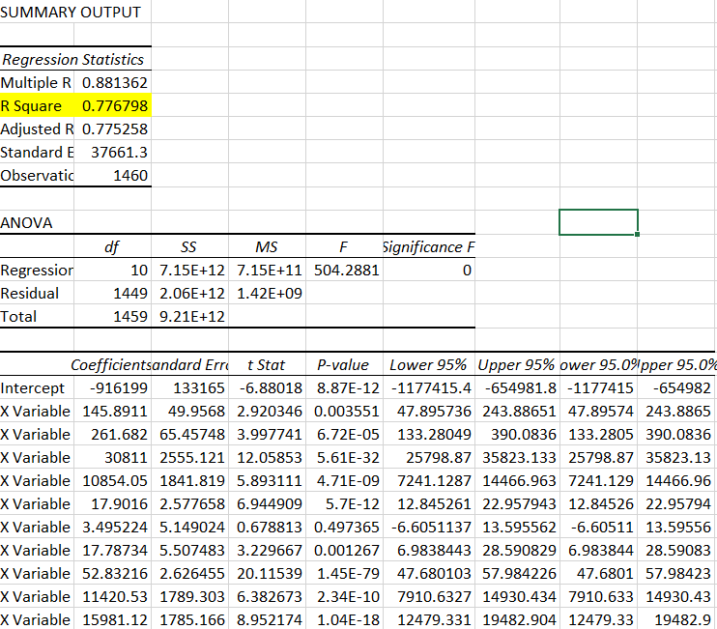
What did you build and how does it work?

Slide 3
What is the purpose and objective of your project? What does this your solution teach us about predicting house prices?

