Slide 1
Hass Avocado Dashboard - Miguel Camara

Slide 2
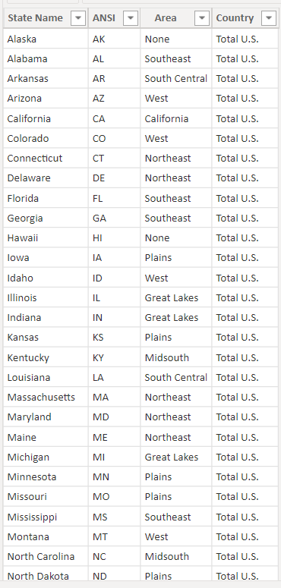
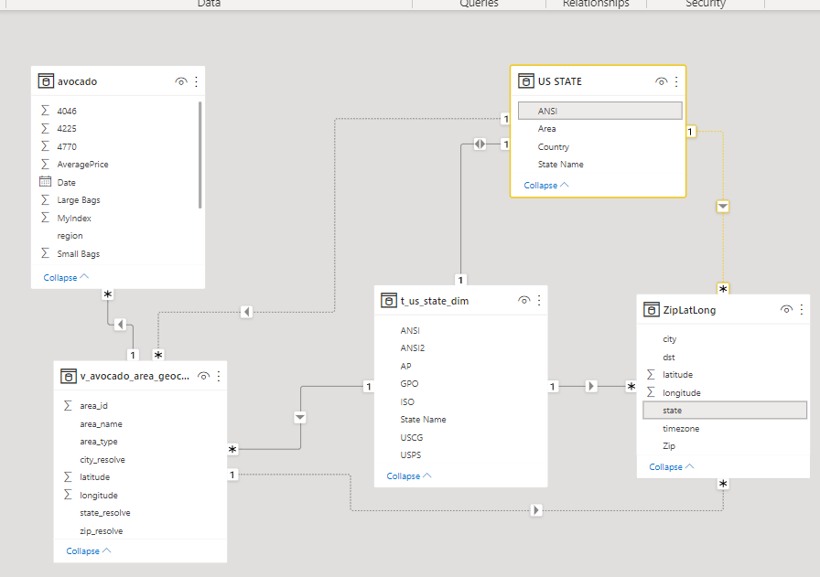
REGION - AREA
ANSI-STATE RESOLVE
STATE NAME-STATE NAME
ANSI-STATE

Slide 3
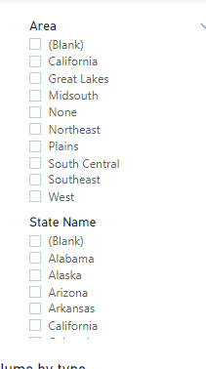
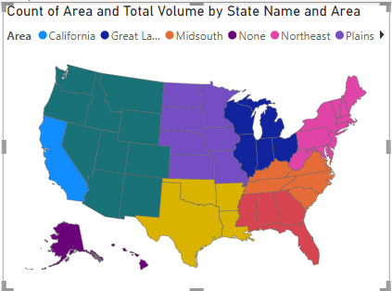
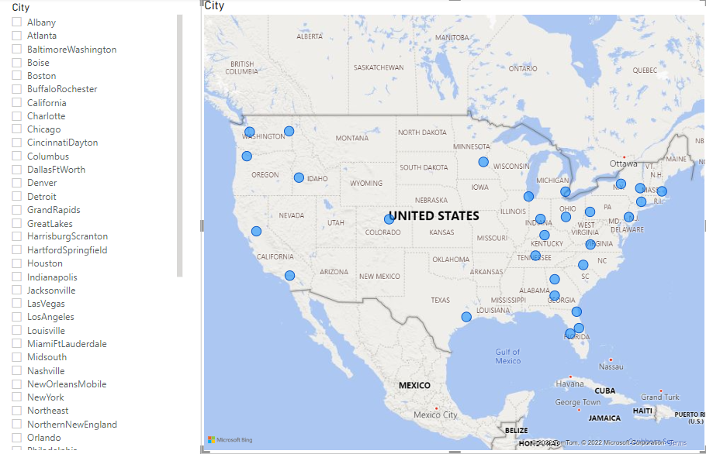
REGION - AREA

Slide 4
Power BI Desktop Dashboard

