Slide 1
Enterprise Developer Camp Jumpstart
Robert Green | Technical Evangelist
Dmitry Lyalin | Product Marketing Manager

Slide 2
03 | Move to the Cloud
Robert Green | Technical Evangelist

Slide 3
Module Overview
Windows Azure
Windows Azure SQL
Windows Azure Web Sites
Windows Azure Active Directory
Windows Azure Service Bus

Slide 4
Expense reporting backlog
Improve architecture, maintainability, and quality
Adopt a services architecture
Improve accessibility, scalability, and operations
Move to the cloud
Update the user experience
Build a more modern-looking user experience
Expand device support
Companion apps for Windows Store and Windows Phone

Slide 5
Windows Azure

Slide 6



















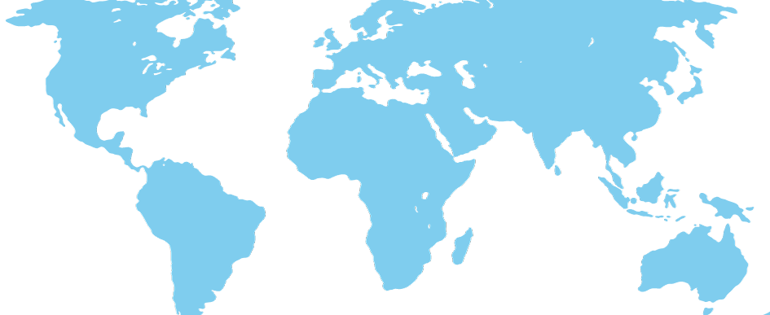
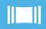


caching
identity
service bus
media
cdn
integration
hpc
analytics
app services
virtual machines
web sites
cloud services
mobile services
SQL database
HDInsight
tables
blob storage
virtual network
traffic manager
compute
data services
networks
Global Physical Infrastructure
servers / network / datacenters
Automated
Managed Resources
Elastic
Usage Based
W. US, East US, N Central US, S Central US, N Europe, W Europe, E Asia, SE Asia + 24 Edge CDN Locations

Slide 7
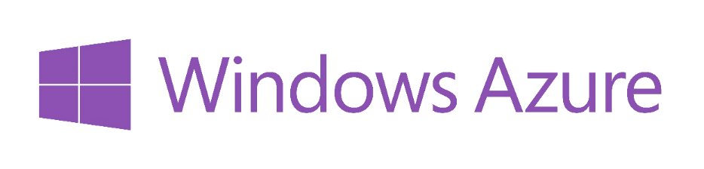





















^{app} ^{services}
cloud services
caching
identity
service bus
media
mobile services
web sites
integration
hpc
analytics
^{data} ^{services}
SQL database
HDInsight
table
blob storage
^{infrastructure} ^{services}
virtual machines
virtual network
vpn
traffic manager
cdn

Slide 8
Windows Azure SQL

Slide 9

Windows Azure data management options
NON-RELATIONAL
RELATIONAL
0100110100101010100101000111010100100101
Blob Storage
Tables
HDInsight
SQL Server in a VM
SQL Database
A cloud storage service offering the simplest way to store large amounts of unstructured text or binary data, such as video, audio and images, and for creating virtual hard drives in the cloud.
A NoSQL key/value store that provides simple access to semi-structured data at a lower cost for applications that do not need robust querying capabilities
A Big Data implementation 100% compatible with Hadoop.
A full-featured instance of SQL Server running in a Windows Azure Virtual Machine for quickly and easily running or testing SQL Server applications in the cloud
A feature-rich, fully managed relational database service that offers a highly productive experience with business-ready capabilities built on SQL Server technology
Best for inexpensive, scalable storage of data
Best for inexpensive, scalable storage of semi-structured data
Best for Big Data Analytics across semi-structured and unstructured data
Best for existing and new applications needing full SQL Server feature set
Best for new cloud applications needing relational capabilities and high availability

Slide 10
Options for relational data services in the cloud
INFRASTRUCTURE AS A SERVICE (IaaS)
PLATFORM AS A SERVICE (PaaS)
SQL Server in a Windows Azure Virtual Machine
Windows Azure SQL Database
DB
Full Control & Flexibility
Simplified Administration
Highly Customized Environment
Eliminate Hardware Costs
Decrease Time to Market
Fully Managed Service
Eliminate Hardware & Administrative Costs
Build Modern Apps

Slide 11
Windows Azure SQL Database
Managed Platform & Infrastructure
Dynamic Scalability
Fast & Flexible Platform
Based on SQL Server Technology
Fully managed (no patching of DB or OS)
Built in HA for Database 99.9% SLA
Simplified Azure Management Portal
Scale Out
Scale via Azure Management Portal
Rapid Application Development
Easy Database Portability
Familiar Development Tools
Choice of Platform
Common Architecture with SQL Server
Insights with SQL Reporting

Slide 12
Move on-prem SQL to Azure SQL
Create the database in Windows Azure SQL
Use SQL Server Management Studio to migrate the DB contents
This automates the process of exporting the data to a local bacpac and importing it to the cloud DB
Verify the Windows Azure SQL DB
Update connection strings to point to the new DB

Slide 13
Windows Azure SQL

Slide 14
Windows Azure Web Sites

Slide 15

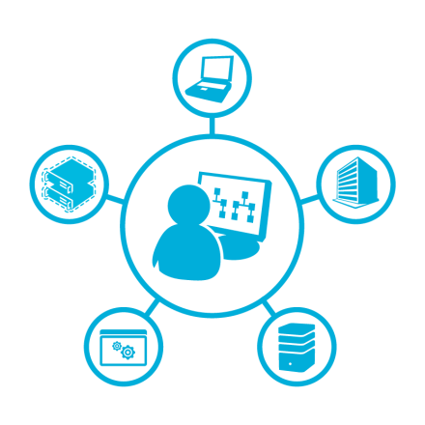

Windows Azure Web Sites
Scalable
Automated
Flexible
High-density and secure web hosting
Open publishing methods and protocols
Integrated and open solution
Lowers customer onboarding costs and streamlines upselling
Upsell from shared to reserved
Support for PHP, Node.js, and ASP.NET
Metering and throttling of resources
Fully integrated into Web App Gallery

Slide 16

Evolving from machine-centric to distributed
Traditional machine-centric model
Distributed model
With multiple web applications, challenges for service providers include:
Increased load and management complexities
Security - Isolating stored data, authentication & authorization mechanisms
Scaling - Auto-scaling platform compute, scaling platform storage
Provisioning tenant resources
Lack of support for multiple SSL web sites; applications have affinity to single servers
Web Sites allocates a web application to a specific process (or processes):
Distributes load by allocating web applications to specific processes
Enhances management by requiring no change to code for existing applications
Provides a scalable and elastic resource pool capable of running an arbitrary set of web applications
Provides multiple SSL Web sites that use unique server certificates for HTTPS binding; applications are freed from affinity to single servers
Worker process
Web
application
Web application content
Web application content
Internet Information Services web server
applicationHost.config
root web.config
Php.ini
applicationHost.config
root web.config
Php.ini
Application databases
Application databases

Slide 17



Publishing in Windows Azure Web Sites
Web Sites cluster
Web workers
Server or virtual machine
Local routing logic
Temporary per-
app file storage
End user
Publishers
Worker process
(w3wp)
Persistent storage
Front-end application request router
HTTP/S Request
Web application databases
FTP Service
Web Deploy
Service
…..
Upstream hardware load-balancers
Cluster topology and run-time state
Web application file directories
Publisher services carry out various file operations against a web application's directory structure.
Front-end application request router
Resource usage data

Slide 18
Development tools and protocols support
Web Sites cluster
Web workers
Server or virtual machine
Local routing logic
Temporary per-
app file storage
End user
Development Tools
Protocols
Worker process
(w3wp)
Persistent storage
Visual Studio,
WebMatrix
FTP, Git, WebDeploy, HTTP
Front-end application request router
Source control integration
HTTP/S Request
Web application databases
Visual Studio Team Foundation Server 2010+
…..
Upstream hardware load-balancers
Cluster topology and run-time state
Web application file directories
Developer tools and protocols
Front-end application request router
Resource usage data

Slide 19
Move on-prem WCF to Azure Web Site
Create the Web Site in Windows Azure
Import the publish settings into Visual Studio
This will help us create a publish profile so we can automate deployments
Publish the application
It will deploy only changed files
Verify the application
Update the WCF service URLs to point to the cloud-hosted service

Slide 20
Windows Azure Web Sites

Slide 21
Windows Azure Active Directory

Slide 22
Windows Azure Active Directory
Azure-hosted directory service
Can be used standalone or with directory sync to mirror on-prem directories
Default directory domain is <unique>.onmicrosoft.com
Custom domains supported
Add users for directory domain
Can use onmicrosoft.com domain, custom domain, or Microsoft account
Enables single sign-on via access control service and/or “applications”

Slide 23
Protocols to connect with WAAD
 | Purpose | Details
REST/HTTP directory access | Create, Read, Update, Delete directory objects and relationships | Compatible with OData V3 Authenticate with OAuth 2.0
OAuth 2.0 | Service to service authentication Delegated access | JWT token format
SAML 2.0 | Web application authentication | SAML 2.0 token format Used with Office 365 Services
WS-Federation 1.3 | Web application authentication | SAML 1.1 token format Used with Office 365 Services

Slide 24
Windows Azure Authentication Library
Makes it easy to add authentication using Windows Azure AD
Takes advantage of OAuth2 code grant
Packaged as a Windows Runtime Component (WinRT for store apps)
Available to both XAML and JavaScript apps
Wraps WebAuthenticationBroker
Web-based authentication flows and single sign on across trusted apps
Uses CredentialVault
Persistent token caching, automatic token refreshing and roaming

Slide 25
Secure WCF service with WAAD
Create the directory in Windows Azure
Add users (or import via sync from on-prem AD)
Create a service application in WAAD
Update the WCF service using the service application settings
It must verify authorization tokens when present in the header
It must return a proper “Unauthorized” with a pointer to the correct login page when a token header is not present

Slide 26
Secure WCF service with WAAD
Create a client application in WAAD and allow it access to the service application’s API
Update the WPF app to use the AD library with the client application settings
This provides all necessary authorization UI and simplifies the access to acquiring the token in code
Verify the authorized experience

Slide 27
Windows Azure Active Directory

Slide 28
Windows Azure Service Bus

Slide 29







Hybrid application needs
CLOUD
ON PREM
Data Synchronization
SQL Data Sync
Application-Layer
Services/Messaging & Identity
Service Bus & Windows Azure Active Directory
Secure Site-to-Machine Connectivity Virtual Network Point-to-Site VPN
Secure Site-to-Site
Network Connectivity
Virtual Network Site-to-Site VPN

Slide 30



Windows Azure Service Bus
EASILY CONNECT APPLICATIONS
Queues for messaging occasionally connected devices like mobile phones
Topics & Subscriptions for publishing notifications to multiple subscribers
CONNECT APPLICATIONS FROM ANYWHERE
Connect applications across:
Public cloud
Public & private cloud
Private to private cloud through public cloud
Relay to securely call private cloud applications hosted behind firewalls and NATs
Clients can run on PCs, mobile devices or browser
Use various languages (.NET, WCF, REST, Java, Node.js, PHP)
ENTERPRISE GRADE CLOUD SERVICE
99.9% monthly SLA
Delivery assurance, reliable messaging, scale and load balancing
Claims based security and identity federation with Active Directory and web identities
No need for IT to change network config or install gateway devices

Slide 31
Windows Azure Service Bus
Connectivity
Rich options for interconnecting apps across network boundaries
Service Relay
Protocol Tunnel Eventing
Messaging
Reliable, transaction-aware cloud messaging infrastructure for business apps
Queuing Pub/Sub
Reliable Transfer
Service Management
Consistent management surface and service observation capabilities
Naming, Discovery
Monitoring
Integration Routing
Content-based routing, document transformation, and process coordination
Coordination Transformation
?

Slide 32
Service Bus Relay
Expose a proxy endpoint
Register your service
ProcessReport
Registry
Consumer
(ANYWHERE)
On-premise
Web service
?
ProcessReport

Slide 33
Windows Azure Service Bus

Slide 34
Summary

Slide 35
Summary
Windows Azure
Windows Azure SQL
Windows Azure Web Sites
Windows Azure Active Directory
Windows Azure Service Bus

Slide 36
Resources
Windows Azure Training Kit - August 2013
http://www.microsoft.com/en-us/download/details.aspx?id=8396
Build Your First Cloud App: An Introduction to Windows Azure Cloud Services
http://channel9.msdn.com/Events/TechEd/NorthAmerica/2013/WAD-B321#fbid=kt1W5OJuY58
Lap Around Windows Azure SQL Database and Microsoft SQL Server in Windows Azure Virtual Machines
http://channel9.msdn.com/Events/TechEd/NorthAmerica/2013/DBI-B201#fbid=kt1W5OJuY58

Slide 37
Resources
Introduction to Windows Azure Active Directory
http://channel9.msdn.com/Events/TechEd/NorthAmerica/2013/WAD-B309#fbid=kt1W5OJuY58
Securing Rich Client Applications Using OAuth 2.0 and Windows Active Directory
http://channel9.msdn.com/Events/TechEd/NorthAmerica/2013/WAD-B307#fbid=kt1W5OJuY58
Connected Clients and Continuous Services with Windows Azure Service Bus
http://channel9.msdn.com/Events/TechEd/NorthAmerica/2013/WAD-B336#fbid=kt1W5OJuY58

