Slide 1
Enterprise Developer Camp Jumpstart
Robert Green | Technical Evangelist
Dmitry Lyalin | Product Marketing Manager

Slide 2
03 | Modernize Your App
Dmitry Lyalin | Product Marketing Manager

Slide 3
Module Overview
Modernize your platform
.NET & WPF improvements since 4.0
Modernize your tools
Visual Studio 2013
Modernize your user experience
Touch, toast, 3rd party controls

Slide 4
Expense reporting backlog
Improve architecture, maintainability, and quality
Adopt a services architecture
Improve accessibility, scalability, and operations
Move to the cloud
Update the user experience
Build a more modern-looking user experience
Expand device support
Companion apps for Windows Store and Windows Phone

Slide 5
Modernize your Tools

Slide 6
.NET & WPF improvements since 4.0
Since .NET 4.0
async/await & PLINQ
Portable Class Libraries
Zip compression
Web Bootstrapper replaces Client Profile Installer for online scenarios
SQL connection resiliency
Since WPF 4.0
Collections support modification from non-UI threads
Improved support for Weak References to events
Async data validation
Binding to static properties
Ribbon control

Slide 7
Visual Studio 2013 XAML improvements
IntelliSense for data binding and resources
Go to definition (F12) for resources and types
Commenting markup supports nesting of comments
Renaming a start tag also renames matching end tag
Support for adding XAML code snippets
All these improvements now also available for WPF, Silverlight and Windows Phone

Slide 8
Visual Studio 2013

Slide 9
Modernize your User Experience

Slide 10
Touch
Windows 8 is the best Windows operating system for touch input
Windows Store & Windows Phone apps are optimized for touch input and provide the best touch experience
Desktop Applications such as WPF can be enhanced for better touch support through custom code or 3rd party controls

Slide 11

Windows 8 toast notifications
Pop-up notifications in the upper right corner of the screen
A user can select the toast (touch or click) to launch the associated action
Toast notifications can be sent by Windows Store and Windows Desktop applications

Slide 12
DevExpress WPF Controls
Optimized for desktops, ready for mobile
Built so you can deliver elegant line-of-business applications that emulate the touch-first Windows 8 UX and maintain backward compatibility with previous versions of the Windows operating system.
https://www.devexpress.com/products/net/controls/wpf/
http://www.devexpress.com/touch

Slide 13
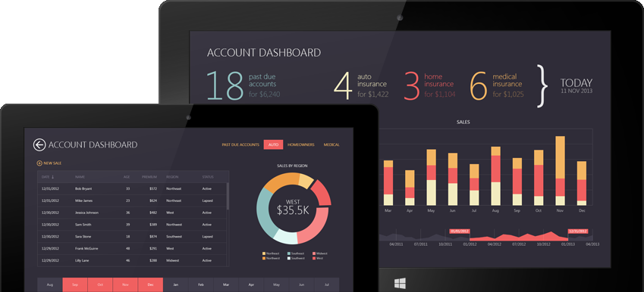
DevExpress WPF Controls
Touch-Enabled Controls Used in this App
Data Grid
Charts
Range Control

Slide 14
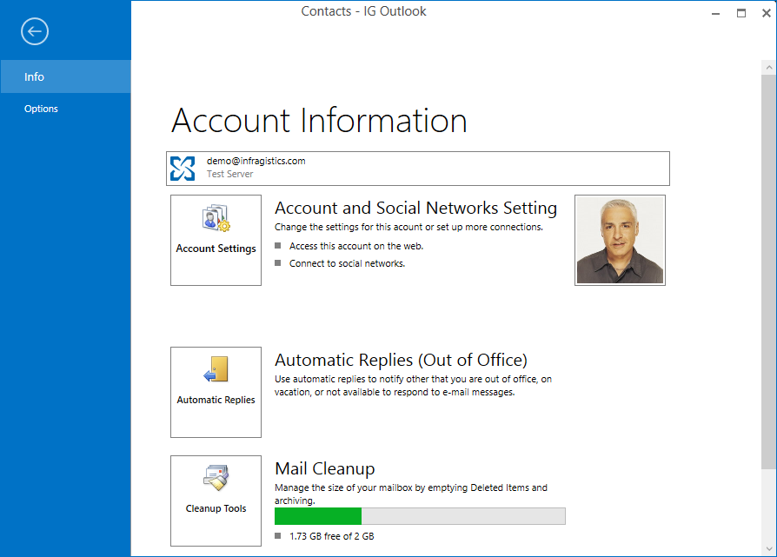
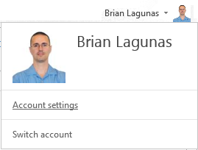
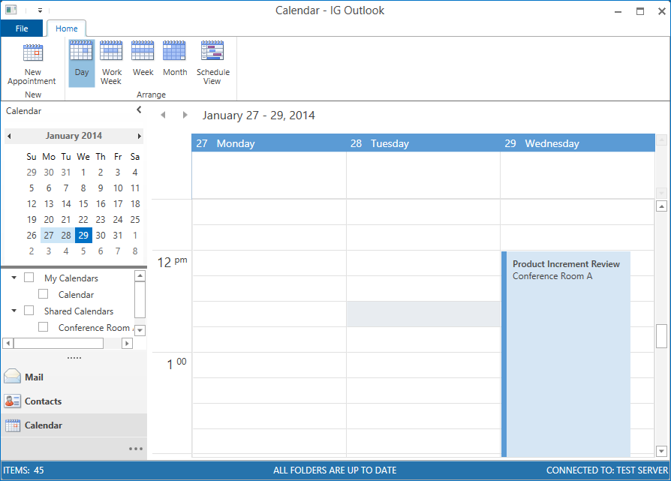
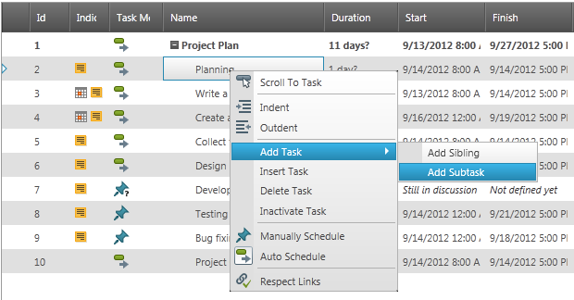
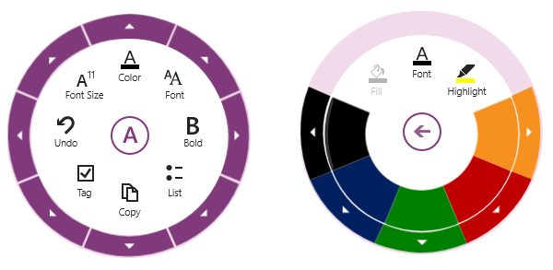
Infragistics – Office Inspired Applications
Office 2013 Theme
Office 2013 Ribbon
Modern window chrome
Full window backstage
Tab-level toolbar
Outlook Navigation
Rich Text Editor
Gantt Chart
Scheduling
Radial Menu
Built for touch
MVVM friendly
http://www.infragistics.com/products/wpf/

Slide 15
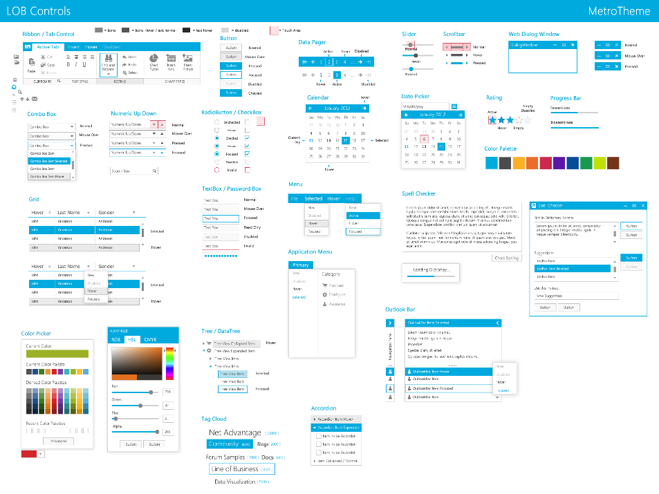
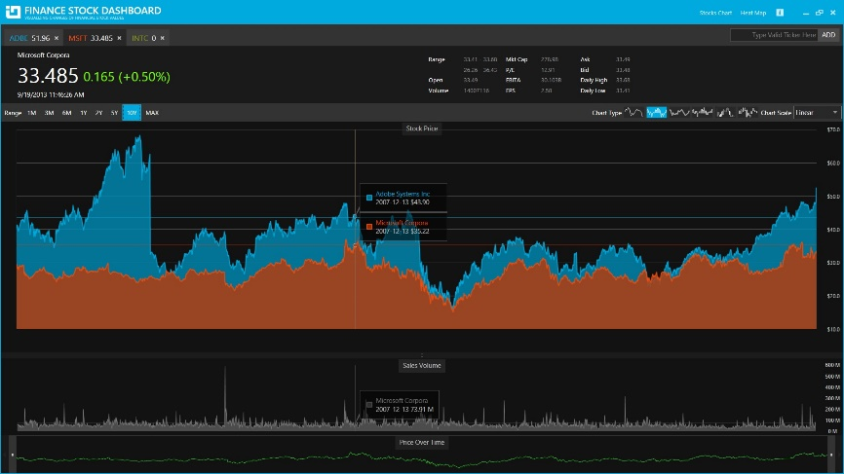
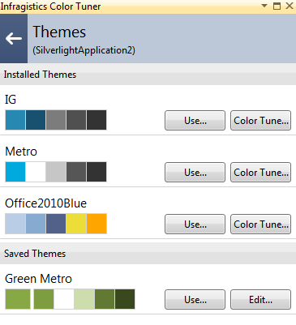
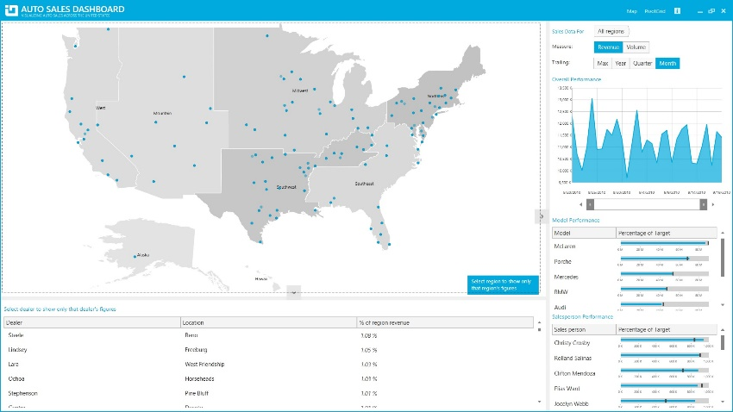
Infragistics – Modern Themes
Modern Themes
Metro Light Theme
Metro Dark Theme
Office 2013 Theme
Theme Color Tuner
VS Add-in
One click application
Customize theme colors
Save custom themes

Slide 16
ComponentOne Studio for WPF
Touch-enabled WPF controls with modern themes
Inertial Scrolling for DataGrids/ListBoxes
Pinch Scaling for Maps/Viewers
Five Modern Themes for all controls, even standard ones
http://www.componentone.com/SuperProducts/StudioWPF/

Slide 17
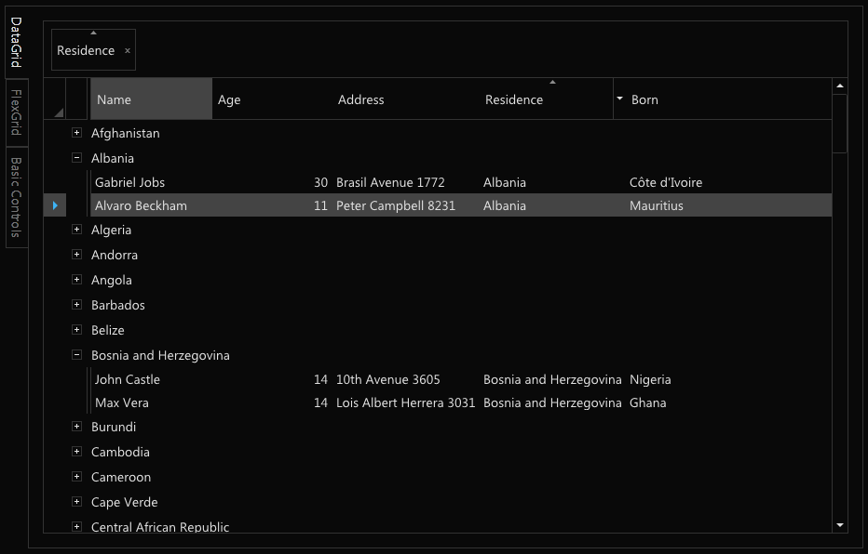
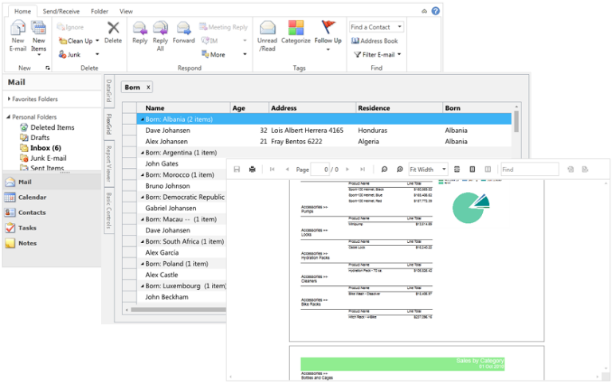
ComponentOne Studio for WPF
Five Modern Themes
Cosmopolitan
Cosmopolitan Dark
Office 2013 White
Office 2013 Light Gray
Office 2013 Dark Gray

Slide 18

The Telerik Portfolio
Made for developers. Strong enough for the enterprise.
Build
Connect
Test
Deliver
Plan
http://www.telerik.com/products/wpf/overview.aspx

Slide 19
3rd Party Controls

Slide 20
Summary

Slide 21
Summary
Modernize your platform
.NET & WPF improvements since 4.0
Modernize your tools
Visual Studio 2013
Modernize your user experience
Touch, toast, 3rd party controls

Slide 22
Resources
XAML Editor Improvements in Visual Studio 2013
http://blogs.msdn.com/b/visualstudio/archive/2013/08/09/xaml-editor-improvements-in-visual-studio-2013.aspx
Modernizing WPF Line-of-Business Applications
http://channel9.msdn.com/Events/TechEd/NorthAmerica/2013/DEV-B325#fbid=kt1W5OJuY58
DevExpress Controls for XAML Developers
http://channel9.msdn.com/Shows/Visual-Studio-Toolbox/DevExpress-Controls-for-XAML-Developers

Slide 23
Resources
Infragistics Controls for XAML Developers
http://channel9.msdn.com/Shows/Visual-Studio-Toolbox/Infragistics-Controls-for-XAML-Developers
Telerik Controls for XAML Developers
http://channel9.msdn.com/Shows/Visual-Studio-Toolbox/Telerik-Controls-for-XAML-Developers
ComponentOne Controls for XAML Developers
http://channel9.msdn.com/Shows/Visual-Studio-Toolbox/ComponentOne-Controls-for-XAML-Developers

