Slide 1
Enterprise Developer Camp Jumpstart
Robert Green | Technical Evangelist
Dmitry Lyalin | Product Marketing Manager

Slide 2
05 | Build for Multiple Devices
Robert Green | Technical Evangelist

Slide 3
Module Overview
Windows Store apps
Windows Phone apps
Building for both

Slide 4
Expense reporting backlog
Improve architecture, maintainability, and quality
Adopt a services architecture
Improve accessibility, scalability, and operations
Move to the cloud
Update the user experience
Build a more modern-looking user experience
Expand device support
Companion apps for Windows Store and Windows Phone

Slide 5
Windows Store Apps

Slide 6
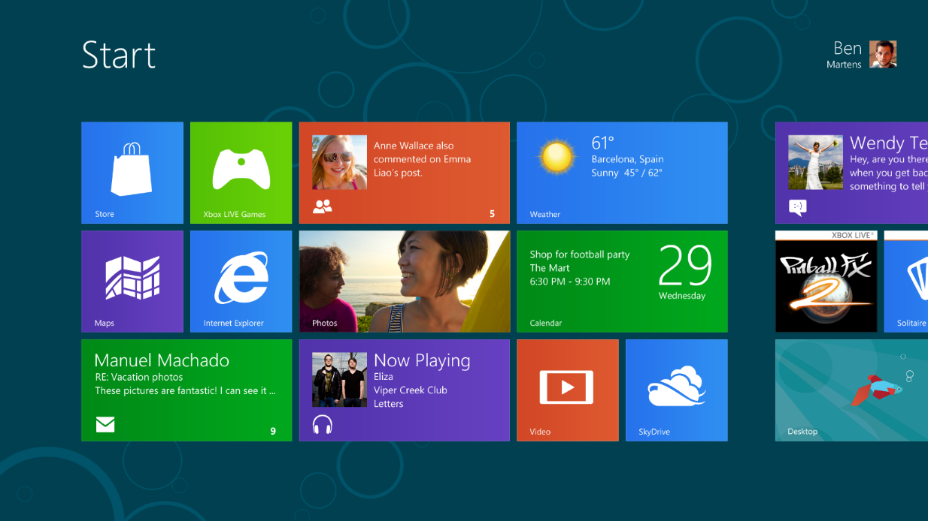

Windows reimagined
New fast and fluid Start screen
Touch,
mouse, keyboard
Everything great about Windows 7 we made even better

Slide 7
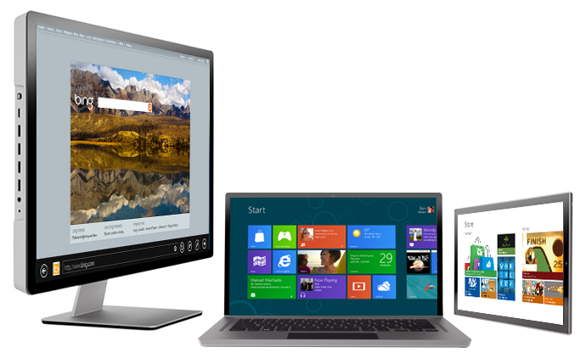
Great experience across all hardware
Tablets to laptops to all-in-ones
Touch,
mouse, keyboard
Highest power to the most efficient chipset

Slide 8
Windows 8 Experience
Fast and fluid user experience
Responsive, alive, beautiful
Immersive and full-screen
Focuses attention on your apps
Touch-first with full keyboard and mouse
Enables your choice of interaction
Web of apps working together
Apps are connected to each other and the cloud
Experience for all PC devices and architectures
No compromise across new form factors, desktops and laptops

Slide 9
Windows 8 Platform
Windows Store Apps
Desktop Apps
View
XAML
HTML / CSS
HTML
JavaScript
Model Controller
C
C++
C#
VB
JavaScript
(Chakra)
C
C++
C#
VB
WinRT APIs
System Services
Communication
& Data
Graphics & Media
Devices & Printing
Application Model
Internet Explorer
Win32
.NET / SL
Core
Windows Core OS Services

Slide 10
Windows Runtime APIs
User Interface
HTML5/CSS
XAML
DirectX
Controls
Data Binding
SVG
Tiles
Input
Accessibility
Printing
Devices
Communications & Data
Geolocation
Portable
Sensors
NFC
Contracts
Local & Cloud Storage
Web
Media
Notifications
Streams
Playback
Capture
PlayTo
Visual Effects
Memory Management
XML
Networking
SMS
Fundamentals
Application Services
Threading/Timers
Memory Management
Authentication
Cryptography
Globalization

Slide 11
Language projections
Windows
Runtime
Object
(or Component)
Written
in C++, C#, VB
C++ App
Projection
Projection
C#/VB App
CLR
Chakra
HTML App
Projection
Windows Metadata

Slide 12
The C# code you have to write today…
[DllImport("avicap32.dll", EntryPoint="capCreateCaptureWindow")] static extern int capCreateCaptureWindow( string lpszWindowName, int dwStyle, int X, int Y, int nWidth, int nHeight, int hwndParent, int nID); [DllImport("avicap32.dll")] static extern bool capGetDriverDescription( int wDriverIndex, [MarshalAs(UnmanagedType.LPTStr)] ref string lpszName, int cbName, [MarshalAs(UnmanagedType.LPTStr)] ref string lpszVer, int cbVer); // more and more of the same

Slide 13
The C# code you get to write on Windows 8
using Windows.Media.Capture; var ui = new CameraCaptureUI(); ui.PhotoSettings.CroppedAspectRatio = new Size(4, 3); var file = await ui.CaptureFileAsync(CameraCaptureUIMode.Photo); if (file != null) { var bitmap = new BitmapImage() ;
bitmap.SetSource(await file.OpenAsync(FileAccessMode.Read));
Photo.Source = bitmap; }

Slide 14
Flexibility of the Windows experience
Maximum reach to your users across platforms
Native apps
Build for new, mobile scenarios
Leverage search, share and new capabilities
Websites
Broad reach across OSes
Desktop apps
Keep software investments already made

Slide 15
Build a Windows Store App

Slide 16
Windows Phone Apps

Slide 17
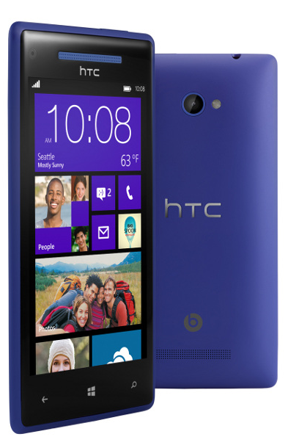
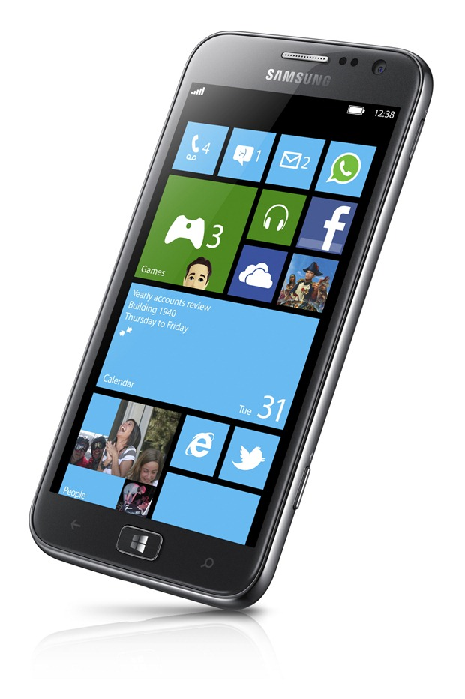
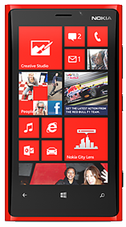
Windows Phone 8 Hardware
Beautiful new hardware from Nokia, HTC, Samsung and more…

Slide 18
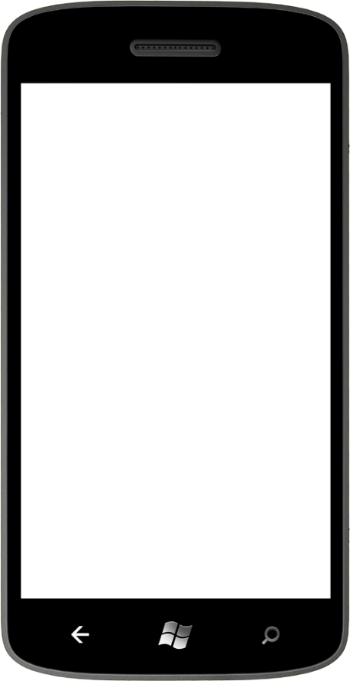
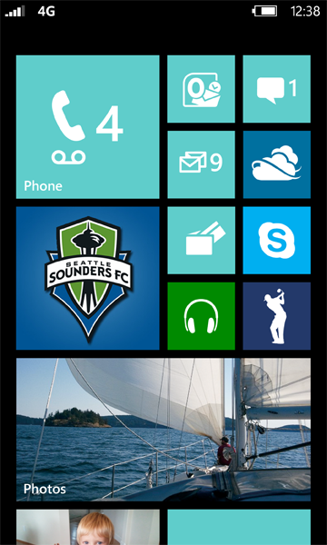


Modern Smartphone Platform
New multicore chipset
New graphics processor
Increased RAM: 1GB or 512MB
More Screen resolutions
Removable, encryptable storage
NFC

Slide 19
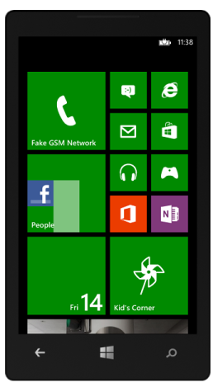
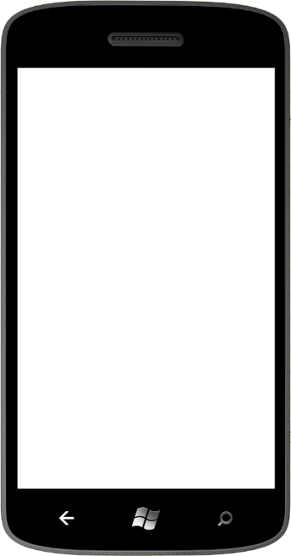
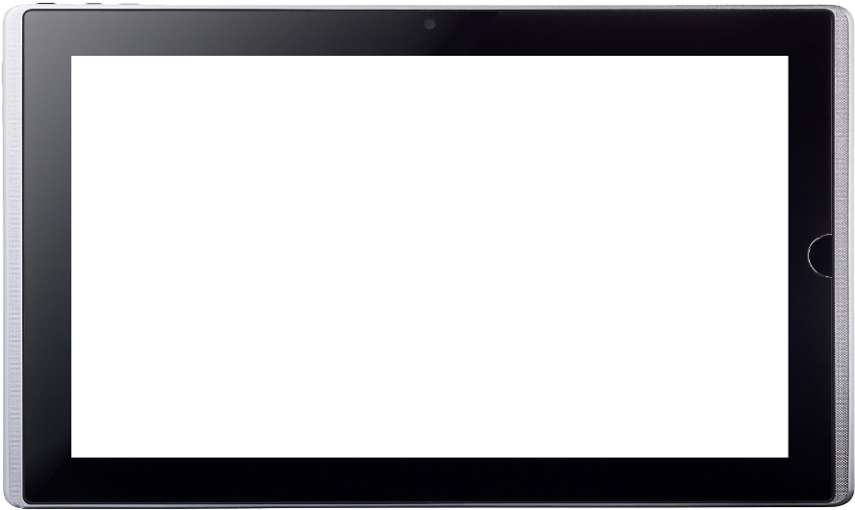
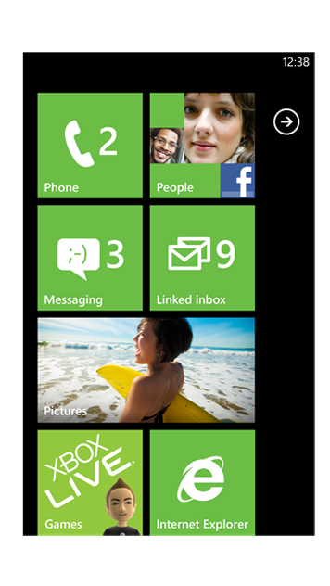
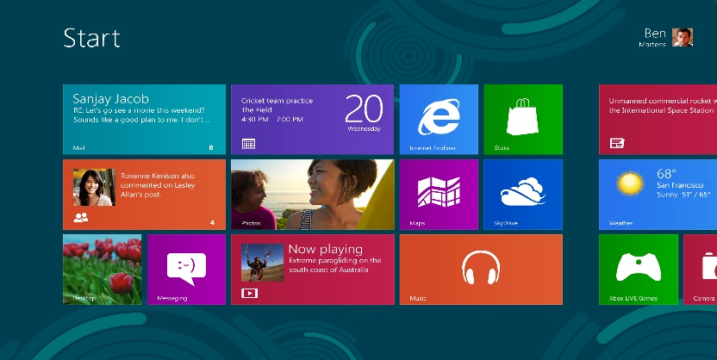
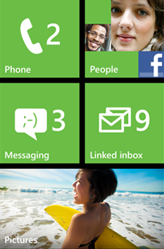
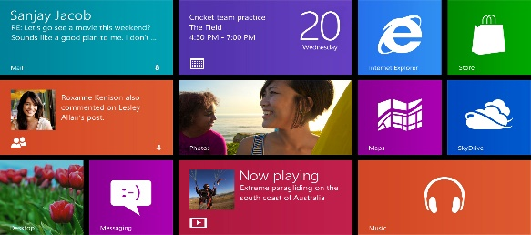
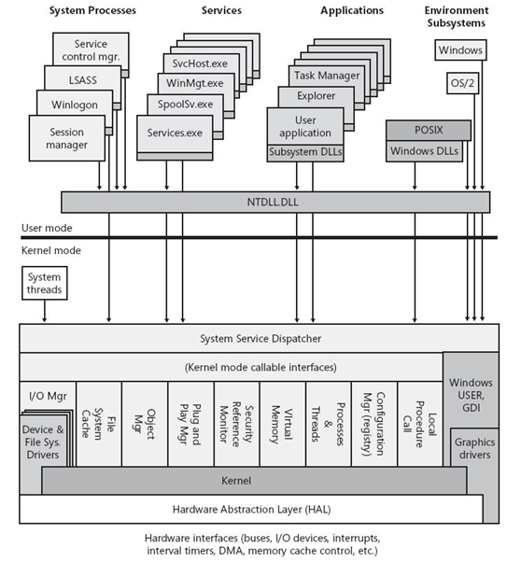

Shared Windows Core
Windows 8 and Windows Phone 8 share many components at the operating system level

Slide 20
Shared Windows Core
Shared Core means
OS components such as the kernel, networking, graphics support, file system and multimedia are the same on both Windows 8 and Windows Phone 8
Hardware manufacturers work with the same driver model on both platforms
Windows Phone gets the support for multi-core and other hardware features that Windows has had for years
These solid, common foundations makes it easier to extend the Windows Phone platform into the future

Slide 21
Shared Windows Core
It doesn’t mean
Windows 8 and Windows Phone 8 developers work to exactly the same APIs
(though you will see more commonality as new features are introduced to both platforms in the future)

Slide 22
Windows Phone Platform
Windows Phone 8 Developer Platform
XAML Apps |  |  |  | Direct3D Apps
XAML | Maps | Geolocation | Sensors |  | In-App Purchase | Direct3D
HTML | XML | Threading | Touch |  | Speech | XAudio2
Phone Features | Push | Camera | Video |  | Proximity | Media Foundation
Calendar | Wallet | Contacts | Core Types |  | VoIP | STL
Multitasking | Live Tiles | Memory | Async |  | Enterprise | CRT
C# and VB |  | C#, VB, and C++ |  |  |  | C++
File system, Networking, Graphics, Media
Core Operating System

Slide 23
Windows Phone 8 Programming APIs
Managed app dev using the WP7.1, WP8.0 .NET and WinPRT APIs
Native app dev using WinPRT and Win32
Games dev using the WP7.1 XNA framework
Games dev using Direct3D or DirectX
WP8.0 Games DirectX/Direct 3D & C++
WP8.0 XAML & C#/VB with Direct3D Graphics
+ C++
WP8.0 XAML & C#/VB
+ C++
WP7.1 XNA & C#/VB
WP7.1 XAML & C#/VB
.NET API for Windows Phone
Windows Phone Runtime
Win32 & COM
Managed
Managed & Native
Native

Slide 24
.NET API for Windows Phone
.NET API for Windows Phone
Windows Phone Runtime
Win32 & COM
Managed
Managed & Native
Native
The .NET API for Windows Phone is the primary managed API
Includes *all* the types and APIs from Windows Phone OS 7.1
Contains classes and types from the System and Microsoft.Phone namespaces
New classes added for Windows Phone 8.0
Microsoft.Phone.Wallet
Microsoft.Phone.Tasks.ShareMediaTask
Microsoft.Phone.Tasks.MapsTask
Microsoft.Phone.Storage.ExternalStorage
Microsoft.Phone.Networking.Voip
Many more…!

Slide 25
Windows Phone Runtime API
.NET API for Windows Phone
Windows Phone Runtime
Win32 & COM
Managed
Managed & Native
Native
Windows Phone Runtime is a subset of the full WinRT, plus some phone-specific additions
Windows (Phone) Runtime is implemented in C++ and projected into C#, VB.NET, and C++
HTML5/JavaScript projection not available on Windows Phone 8
Phone-specific additions to Windows Phone Runtime include
Speech synthesis and recognition
Windows.Phone.Networking.Voip
Windows.Phone.PersonalInformation
LockScreen and LockScreenManager
More…
Full WinRT (around 11,000 members)
Subset adopted for Windows Phone Runtime (around 2,800 members)
New for Windows Phone Runtime (around 600 members)

Slide 26
API Choices for Managed Code Developers
Many of the APIs in Windows Phone Runtime exist to provide new functionality to Windows Phone
Other APIs exist to expose Windows Phone capabilities to both native and managed code developers and provide equivalent functionality to the .NET APIs
Managed code developers can use whichever API they like
Developers targeting WP7.1 and WP8 devices will prefer the .NET API
Developers sharing code between WP8 and W8 targets will tend to use the Windows Phone Runtime API
.NET API | Windows Phone Runtime API
System.IO.IsolatedStorage | Windows.Storage
System.NET.Sockets | Windows.Networking.Sockets
System.Threading.ThreadPool | Windows.System.Threading.ThreadPool
Microsoft.Devices.Sensors | Windows.Devices.Sensors
System.Device.Location | Windows.Devices.GeoLocation

Slide 27
Win32 and COM API
.NET API for Windows Phone
Windows Phone Runtime
Win32 & COM
Managed
Managed & Native
Native
In addition to .NET and Windows Phone Runtime, you have access to some Win32 APIs
Winsock for low-level networking
Camera APIs for native code apps
COM APIs such as CoInitializeEx, CoTaskMemAlloc, CoTaskMemFree, CreateFile2, ReadFile, WriteFile, HeapAlloc, CreateMutexExW, WaitForSingleObjectW,…many others…
Mainly of interest to native code developers
Managed applications could call these by adding a native project to the solution, but there are few situations where this will be used

Slide 28
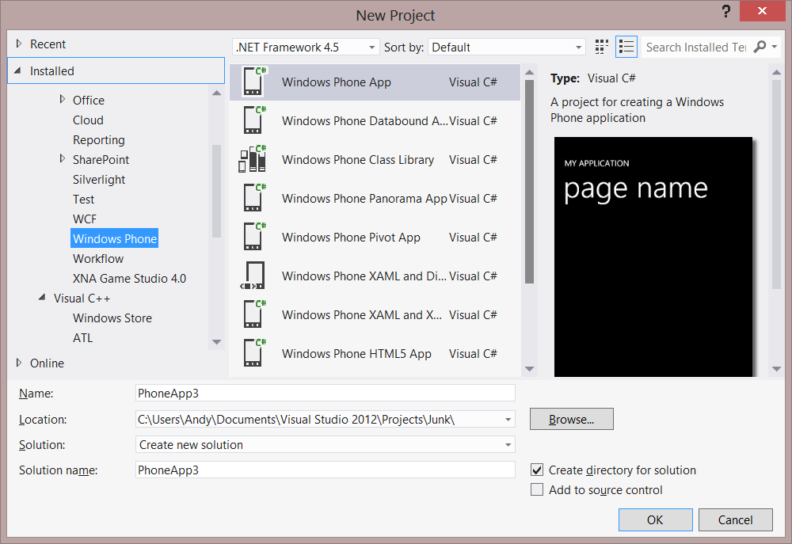
XAML UI with Managed Code
The most common way to build apps for Windows Phone
UI defined using XAML
Logic written using C# or Visual Basic .NET
Access .NET APIs and Windows Phone Runtime APIs
XAML & C#/VB
.NET API for Windows Phone
Windows Phone Runtime
Managed
Managed

Slide 29
Build a Windows Phone App

Slide 30
Building for Both

Slide 31
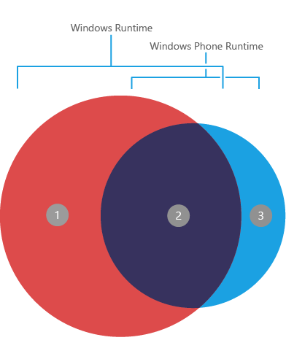
Shared Platform
Windows Runtime
Windows Phone Runtime
Networking
Proximity
In-App Purchase
Sensors
Location
File System
Core app model
Threading

Slide 32
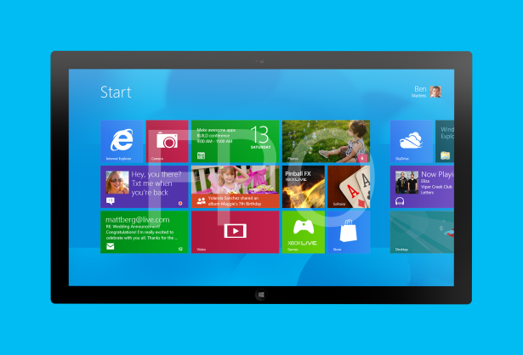
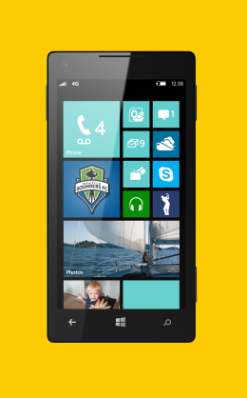
Form Factors
Windows 8
1024x768+
Landscape, Portrait, Snapped, Filled
10 inch screens+
Windows Phone 8
800x480, 1280x720, 1280x768
Portrait, Landscape
<5 inch screen most common

Slide 33
User experience considerations Design a native UX for each platform!
Windows 8
One or two-handed touch, mouse
No guarantee of any specific hardware, must check at runtime
Rows and columns of content can work well
Scroll horizontally for more content
Significant room on the app bar
On-screen back button
Semantic zoom
Windows Phone 8
One-handed touch most common
Guaranteed hardware, such as camera and accelerometer
Avoid multiple columns of content
Scroll vertically for more content
Very limited room on the app bar
Hardware back button
No semantic zoom

Slide 34
XAML
Avoid reusing XAML across Windows Store and Windows Phone apps
Major differences in the platforms make this difficult anyway:
User experience
Screen space
Page layout / orientation
XAML namespaces
XAML controls

Slide 35
Using Portable Class Libraries

Slide 36
Windows Store and Windows Phone Expenses Apps

Slide 37
Summary

Slide 38
Summary
Windows 8 and Windows Store apps
Windows Phone apps
Building for both

Slide 39
Resources
Windows 8 Camp Training Kit
http://www.microsoft.com/en-us/download/details.aspx?id=29854
Build your first Windows Store app
http://channel9.msdn.com/Series/Build-your-first-Windows-Store-app
Windows Store apps for Absolute Beginners with C#
http://channel9.msdn.com/Series/Windows-Store-apps-for-Absolute-Beginners-with-C-
Windows Store apps for Absolute Beginners with JavaScript
http://channel9.msdn.com/Series/Windows-Store-apps-for-Absolute-Beginners-with-JavaScript

Slide 40
Resources
Windows Phone 8 Training Kit
http://www.microsoft.com/en-us/download/details.aspx?id=38782
Windows Phone 8 Development for Absolute Beginners
http://channel9.msdn.com/Series/Windows-Phone-8-Development-for-Absolute-Beginners
Building Apps for Windows Phone 8 Jump Start
http://channel9.msdn.com/Series/Building-Apps-for-Windows-Phone-8-Jump-Start

Slide 41
Resources
Building Apps for Both Windows 8 and Windows Phone 8 Jump Start
http://channel9.msdn.com/Series/Building-Apps-for-Both-Windows-8-and-Windows-Phone-8-Jump-Start

