Slide 1
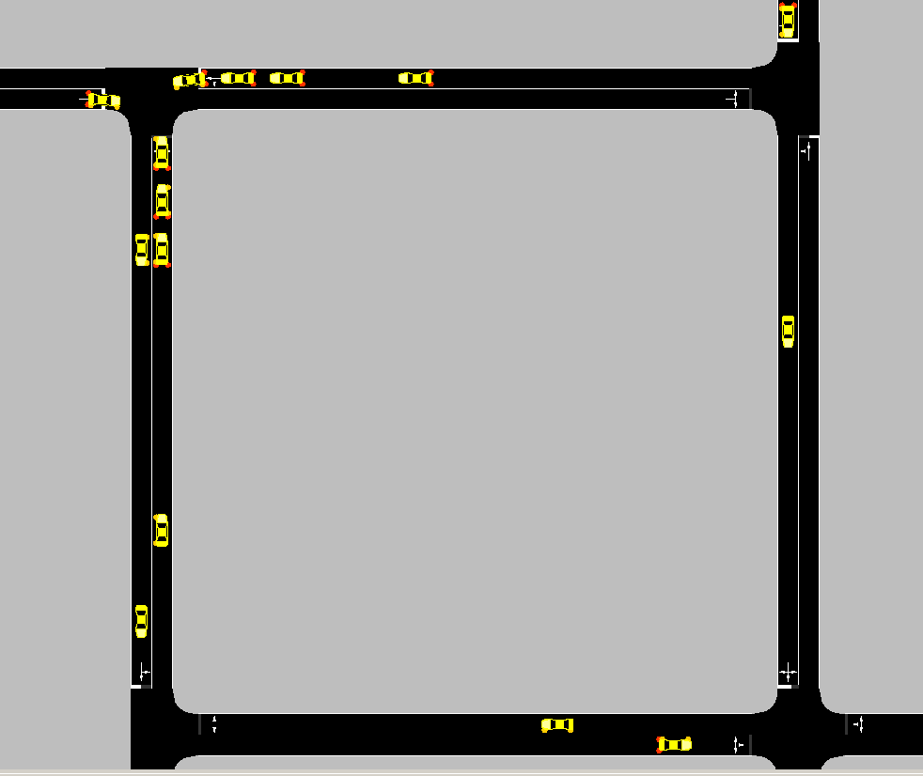

TRAFFIC SIMULATION WITH
IRRATIONAL DRIVERS
Miguel Ángel
Donado Fernández
Polytechnic University of Catalonia
07/10/2026
Notes:
This file presents an assertion-evidence template for making effective slides for scientific presentations. Although much about the layout and typography contrasts sharply with the defaults of PowerPoint, these changes are done so to make the slides more effective at communicating technical information. The design advocated by this template arises from Chapter 4 of The Craft of Scientific Presentations, 2nd edition (Springer, 2013). The homepage for this template exists at the following website:
http://writing.engr.psu.edu/assertion_evidence.html
Right now you are viewing the notes pages. To work on the slides, click on “Slide” under “View.” Tip: When creating a new presentation, save this file as the name of your presentation. Warning: You are more than welcome to use this template for your presentation slides. You may not, though, distribute this template for profit or distribute this template without giving credit to the source: http://writing.engr.psu.edu/
This slide is for the title slide of a presentation. Consider inserting an image that helps orient the audience to the title. You should not leave this slide until the audience feel comfortable with the title. Forcing yourself to spend more time with this slide is good because a common mistake in presentations is to leave the title slide too soon. Because of this mistake, many in the audience do not have the chance to comprehend the key details of the title. See pages 172-184 in The Craft of Scientific Presentations, 2nd ed. (CSP).
This template shows one layout for the slide. You might want to rearrange the placement of the body’s wording to accommodate a different sized image. On the next slide is a sample title slide. You should delete the examples after you create your own slides.

Slide 2
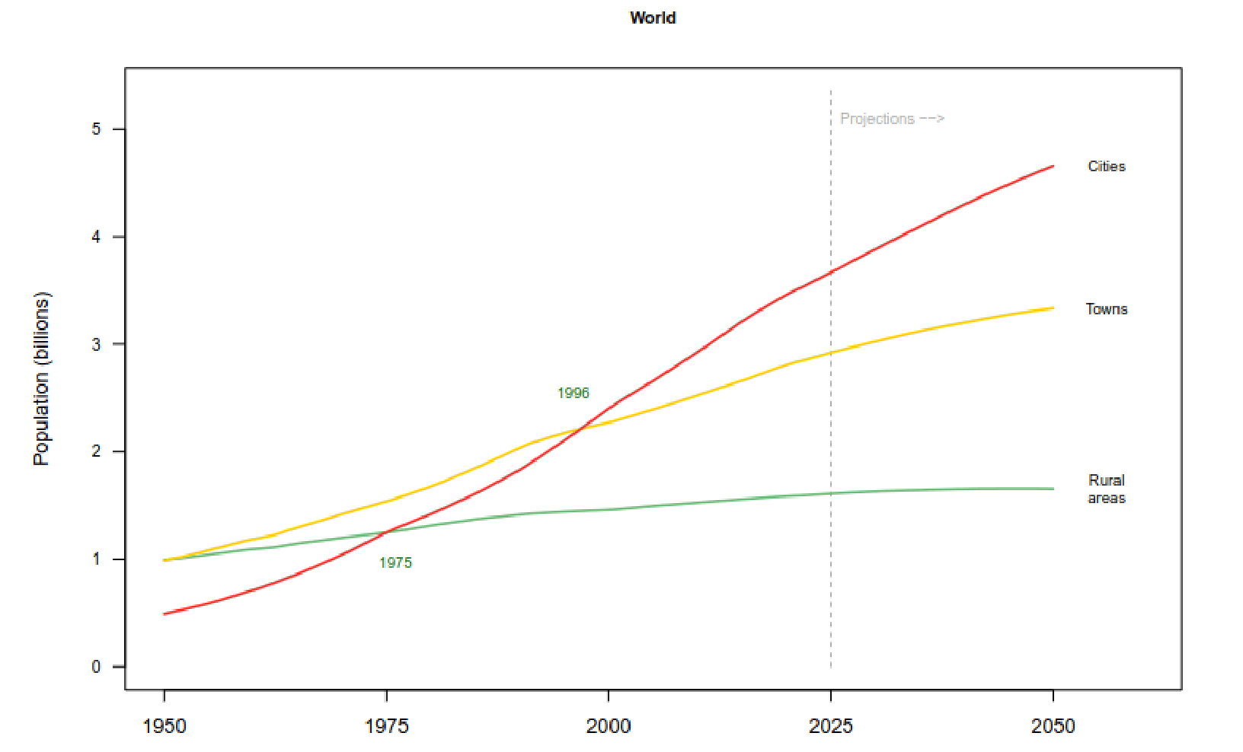
Traffic congestion is expected to grow
Source: Reproduced from World Urbanization Prospects 2025.
Notes:
Body slide from the first section of the presentation’s middle. Consider having the first-topic image from the mapping slide repeated here. Use the headline (no more than two lines) to make an assertion about this topic. In the body of the slide, support that headline with images and with words, if necessary. See Chapter 4 of The Craft of Scientific Presentations, 2nd ed.
This slide shows one orientation for the image and text in the body of the slide. Other orientations appear in this template. Choose the one that best supports your headline assertion.
Some institutions will insist that you place an institutional logo on each slide. Other institutions recommend a logo on the first slide and the last. If you do place a logo on each slide, make sure that logo is at the bottom of the slide rather than the top. Placing the logo at the top (the place on a slide that receives the most emphasis) shifts the emphasis away from the work.

Slide 3
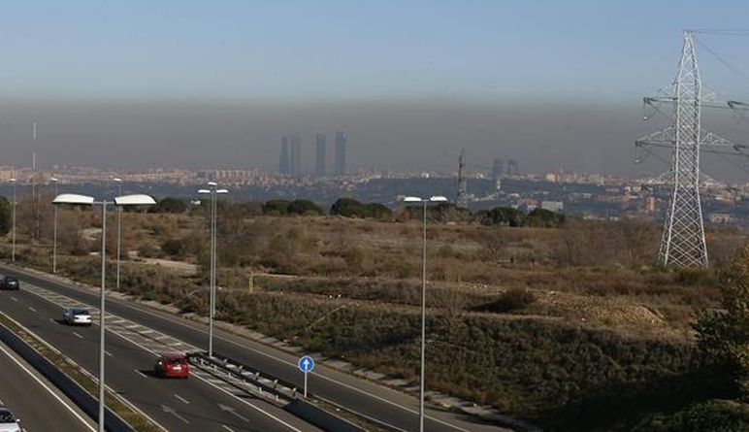
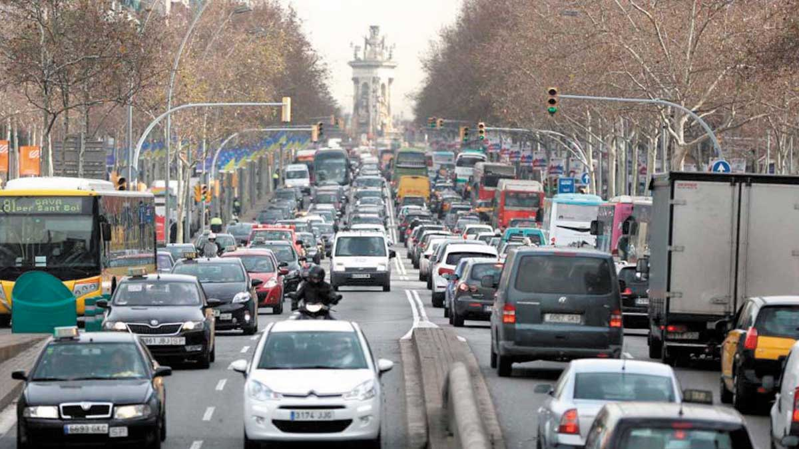
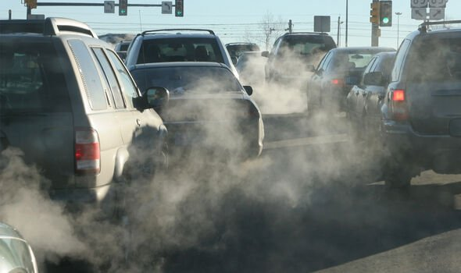
Traffic congestion has negative consequences
Pollution
Additional travel times
Increased fuel consumption
Notes:
Sample mapping slide.
Reference:
Katrina Aspmo, Torunn Berg, and Grethe Wibetoe, “Atmospheric Mercury Depletion Events (AMDEs) in Polar Regions During Arctic Spring,” presentation (Oslo, Norway: University of Oslo, 16 June 2004).

Slide 4
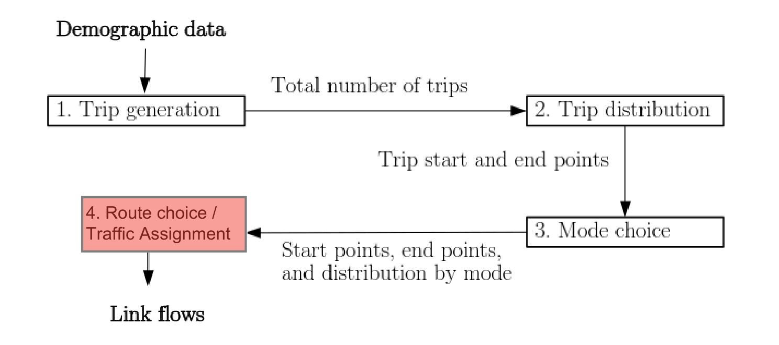
Transportation planning becomes essential for addressing traffic congestion
Source: Adapted from Boyles et al. (2025), Static and Dynamic Traffic Assignment.
Notes:
Body slide from the first section of the presentation’s middle. Consider having the first-topic image from the mapping slide repeated here. Use the headline (no more than two lines) to make an assertion about this topic. In the body of the slide, support that headline with images and with words, if necessary. See Chapter 4 of The Craft of Scientific Presentations, 2nd ed.
This slide shows one orientation for the image and text in the body of the slide. Other orientations appear in this template. Choose the one that best supports your headline assertion.
Some institutions will insist that you place an institutional logo on each slide. Other institutions recommend a logo on the first slide and the last. If you do place a logo on each slide, make sure that logo is at the bottom of the slide rather than the top. Placing the logo at the top (the place on a slide that receives the most emphasis) shifts the emphasis away from the work.

Slide 5
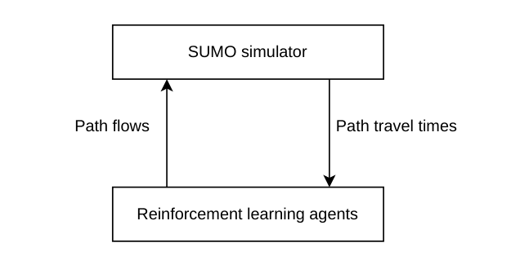
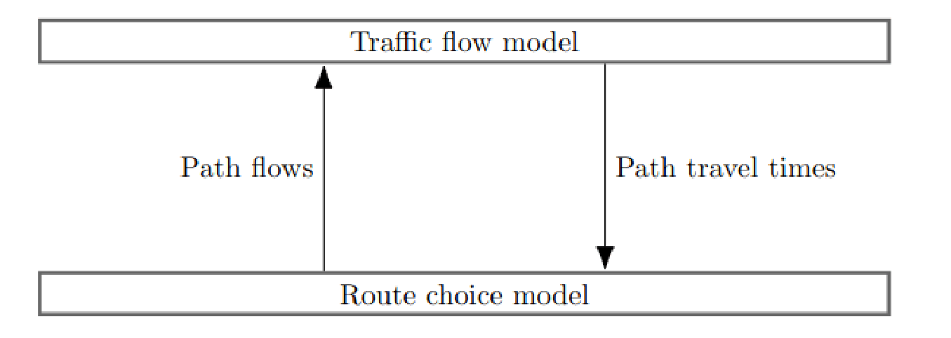
Traffic assignment model
Generic version
Implemented version
Source: Adapted from Boyles et al. (2025), Static and Dynamic Traffic Assignment.
User Equilibrium: Drivers have perfect information and choose routes that minimize their travel time.
Notes:
Sample mapping slide.
Reference:
Katrina Aspmo, Torunn Berg, and Grethe Wibetoe, “Atmospheric Mercury Depletion Events (AMDEs) in Polar Regions During Arctic Spring,” presentation (Oslo, Norway: University of Oslo, 16 June 2004).

Slide 6
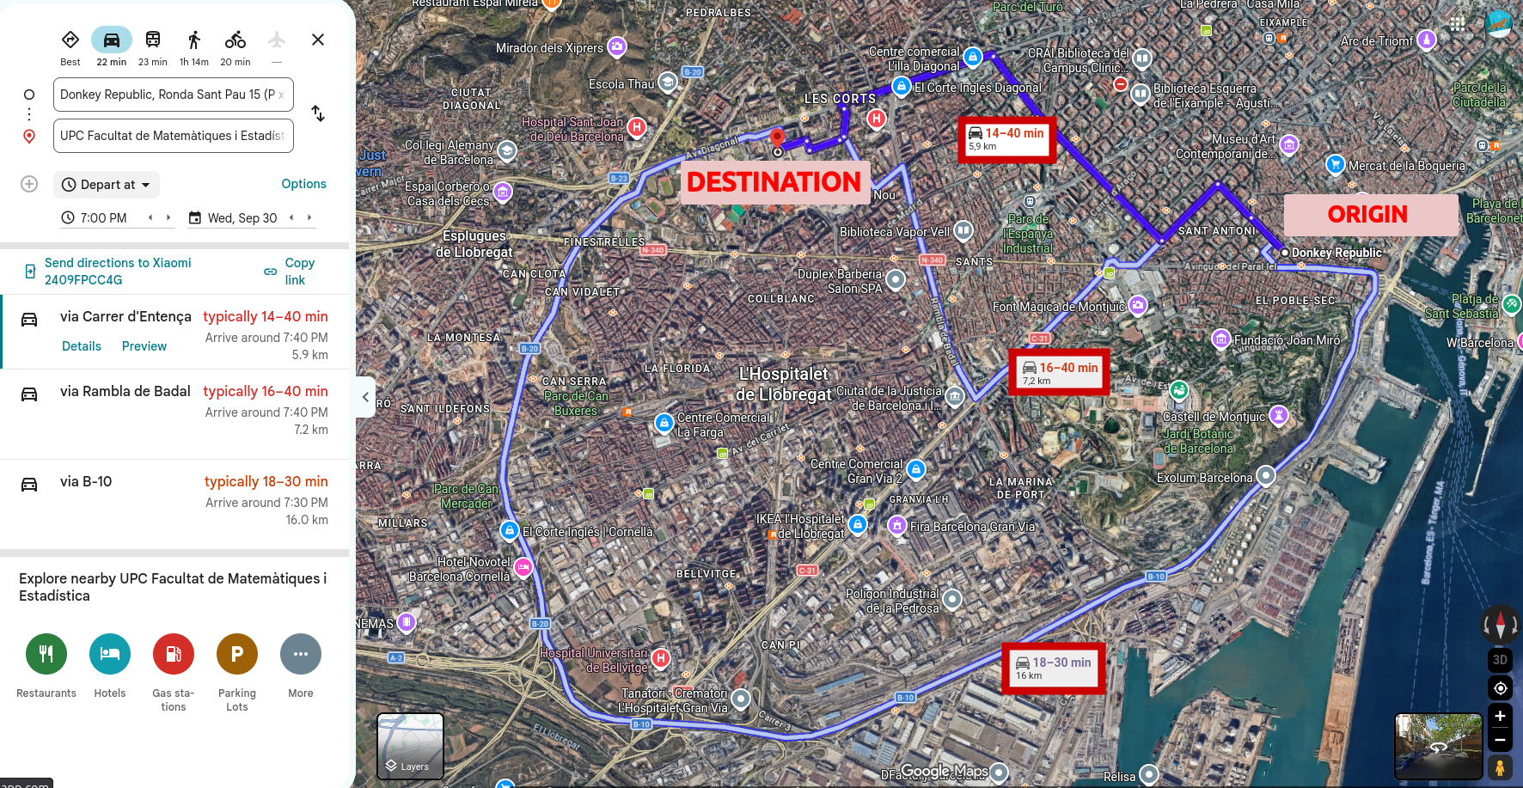
Bounded rationality captures the limitations of human decision-making

Slide 7
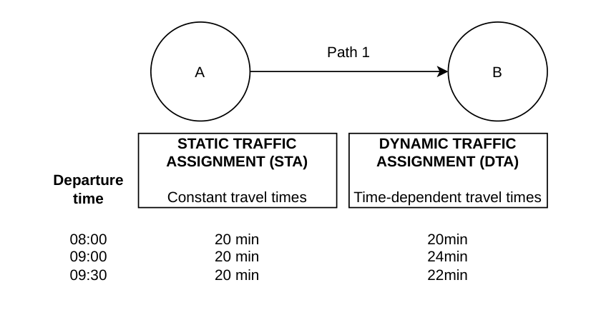
Dynamic traffic assignment models are more realistic

Slide 8
This thesis examines the impact of bounded rational agents on traffic
Usually: Perfect rationality -> Conventional approaches -> DUE
Goals:
(Small degree) Bounded rationality -> MARL approach -> DUE??
2) (High degree) Bounded rationality -> MARL approach -> DUE??

Slide 9
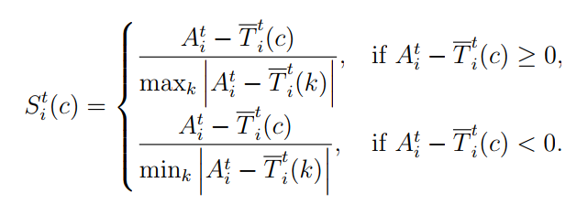
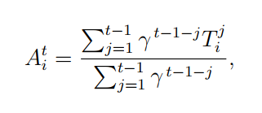
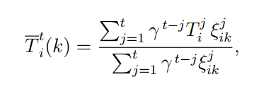

Bush–Mosteller RL models boundedly rational route choice
Expected travel time (ET) (route-agnostic)
Perceived travel time (PT) (route-specific)
Stimulus
Probability update (chosen route)
Notes:
Sample slide from the middle of a presentation. Notice how animation works to allow the speaker to present fairly complex connections in a way that the audience can digest. Notice how the arrows show connections—something that bullets could not achieve.
Reference
This slide is a composite slide from a number of mechanical engineering seniors in ME 4006, a laboratory course at Virginia Tech. These presentations occurred during the Fall 2004 semester.

Slide 10
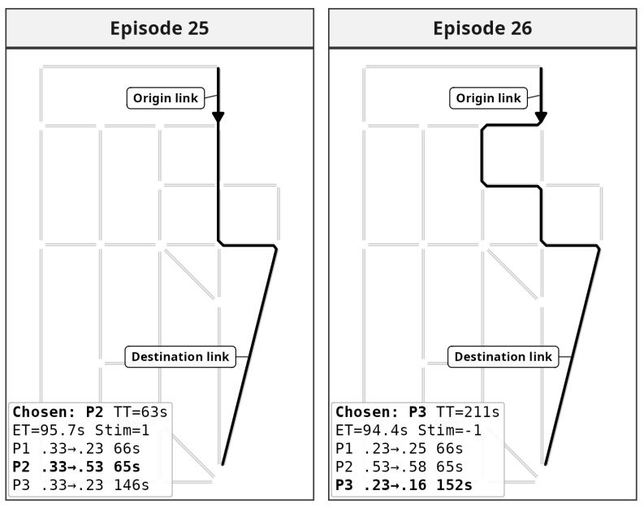
Example of a Bush-Mosteller driver: reinforces positive actions and penalizes negative actions

Slide 11
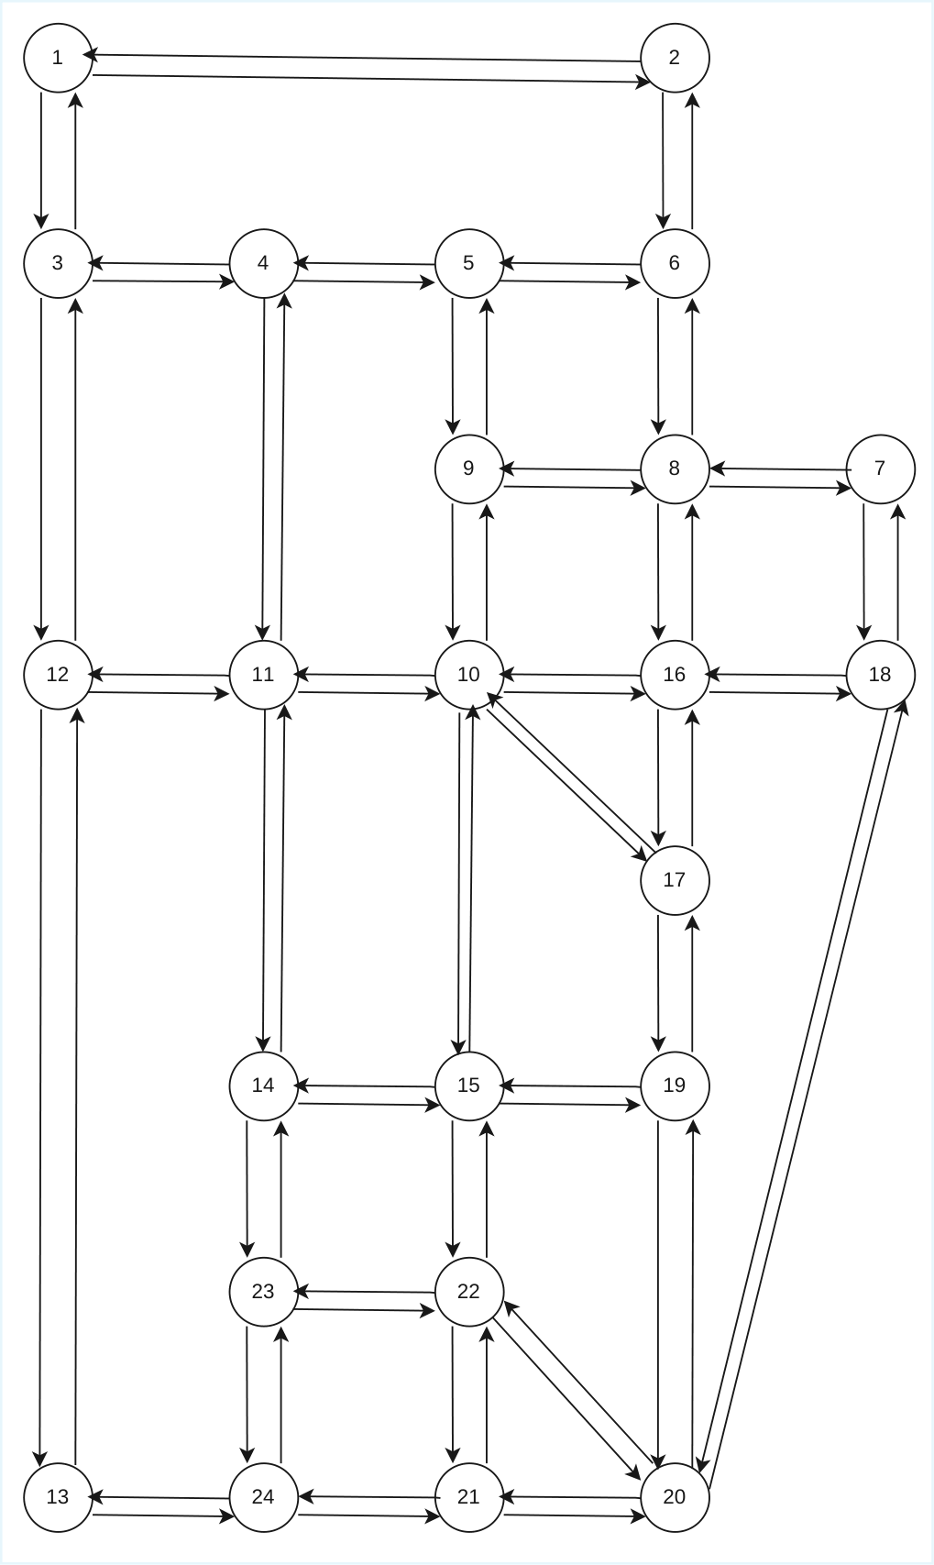
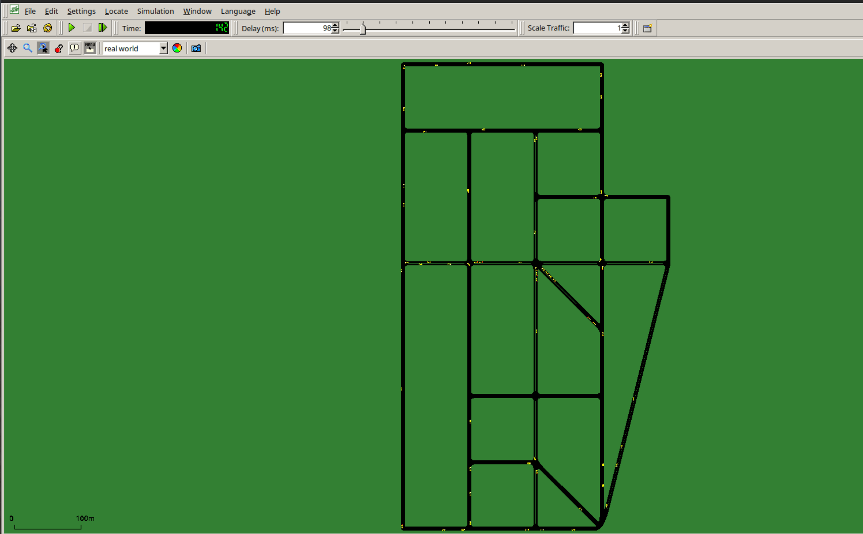
Traffic dynamics are simulated using SUMO, an open-source microscopic simulator
SUMO-GUI
Sioux Falls network
Notes:
Mapping slide for the presentation (note that a background slide or a slide justifying the importance might precede this slide). A common mistake with mapping slides is to give the audience simply an unmemorable bulleted list of topics (including the names “Introduction” and “Conclusion” and “Questions”). Such a list is quickly forgotten after the slide is removed.
On a mapping slide, take the opportunity to show a key image or perhaps a representative image for each major section of the presentation. In the second case, each image would be repeated on the first visual of the corresponding section and would remind the audience that they have arrived to a major section of the presentation’s middle.
In regards to the names “Introduction” and “Conclusion,” every talk has those sections, and the names are ignored by audiences. So why state them? Also, for the divisions that you do have, find a logical and parallel grouping. Note that groups of two’s, three’s, and four’s are much easier to remember and are not so nearly intimidating as groups of five’s, six’s, and seven’s. See the discussion of mapping slides in The Craft of Scientific Presentations, 2nd ed. (pages 177-181).

Slide 12
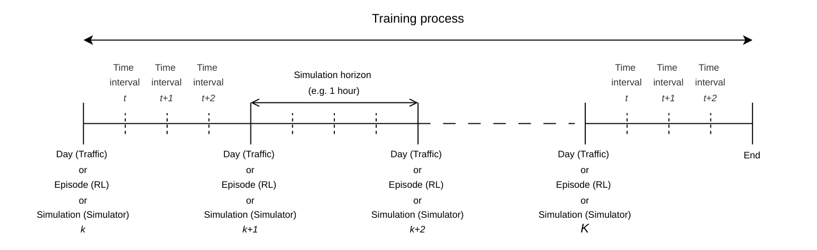
Two notions of convergence and key simulation-time concepts
Notions of convergence:
Convergence of agents policies
Convergence of the network state towards a DUE (using the R-gap metric)
Simulation-time concepts:

Slide 13
Experiments and results
Rational agents
Spatial traffic comparison
Disruption recovery
Risk-aversion
Bounded rationality
extensions
Waiting-time aversion
Non-linear response

Slide 14
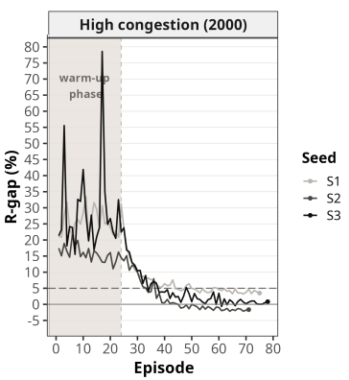
Rational agents converge towards DUE

Slide 15
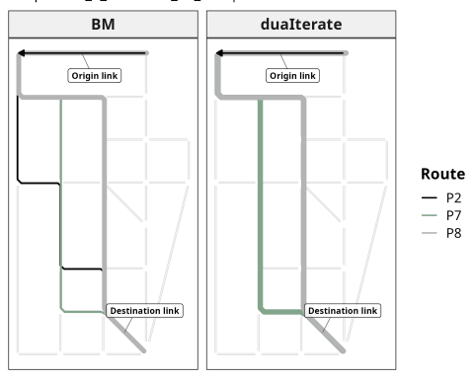
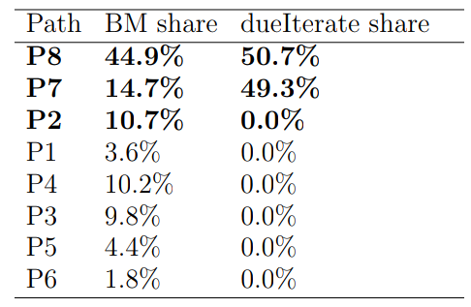
The proposed Bush–Mosteller MARL approach appears to generate more dispersed traffic than the benchmark

Slide 16
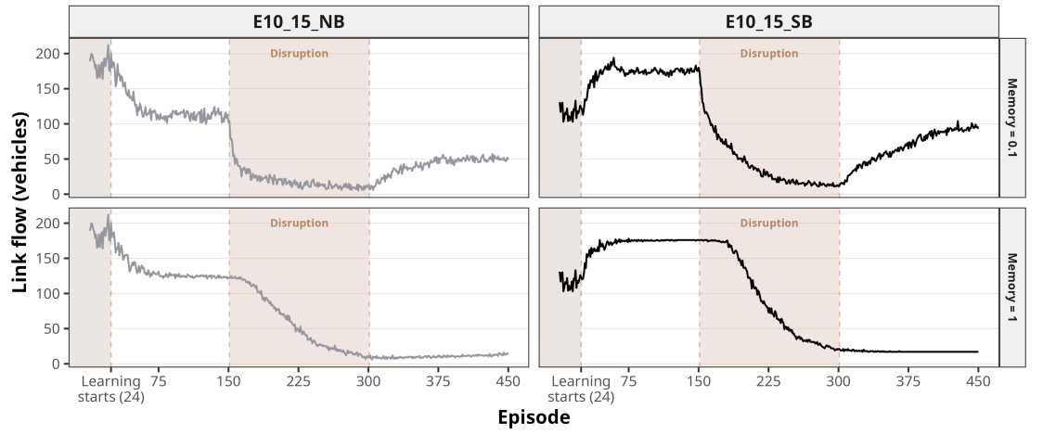
Perfect memory prevents recovery from disrupted edges , whereas lower memory enables partial recovery

Slide 17
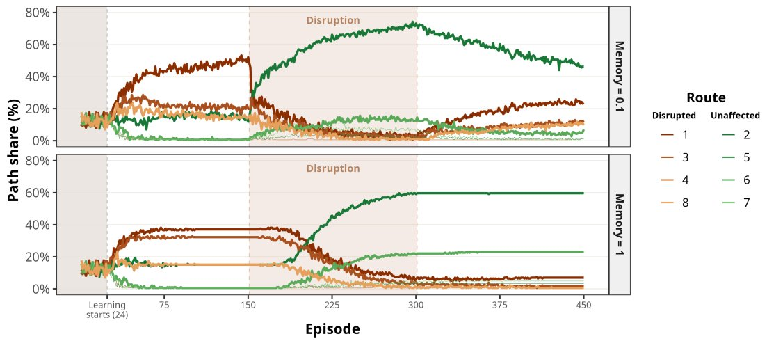
Perfect memory prevents recovery from disrupted routes, whereas lower memory enables partial recovery

Slide 18
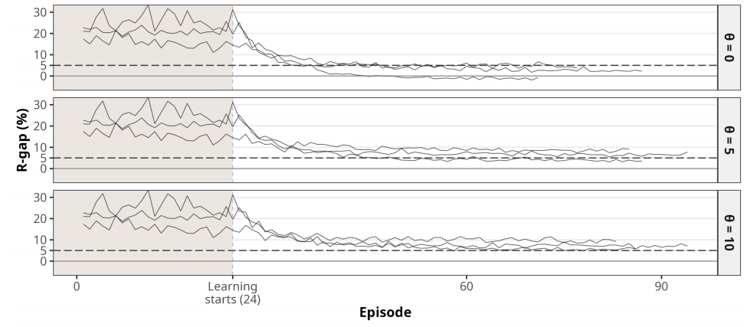
Risk-averse drivers may prevent convergence towards DUE

Slide 19
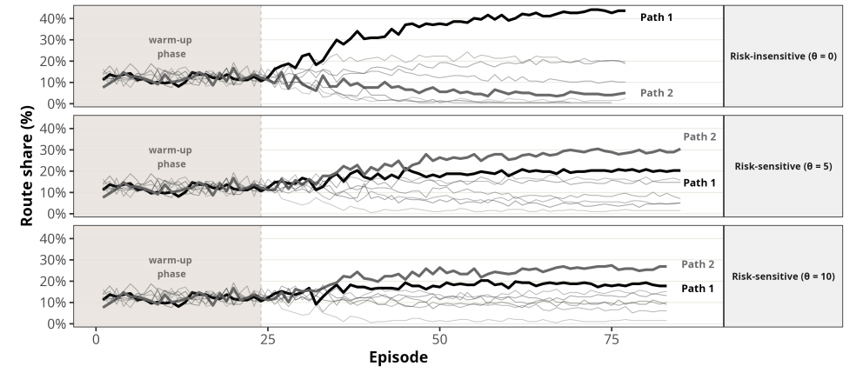
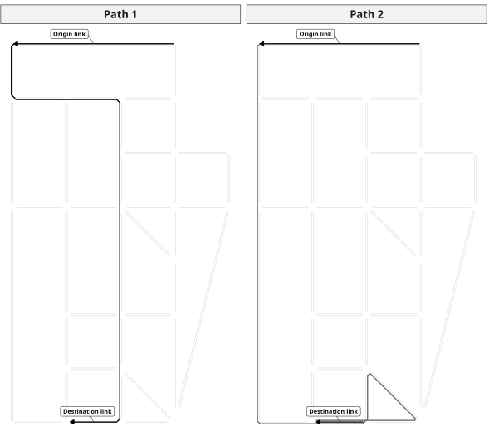
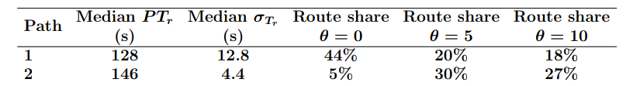
Risk-averse drivers may prefer longer but more reliable routes

Slide 20
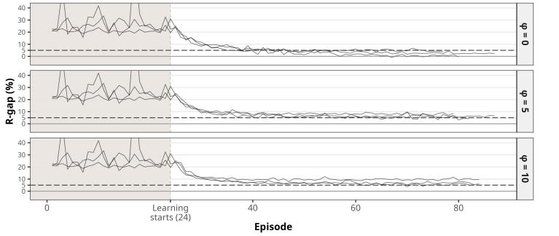
Waiting-time-averse drivers may prevent convergence towards DUE

Slide 21
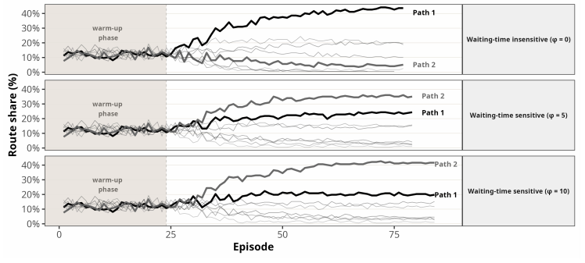
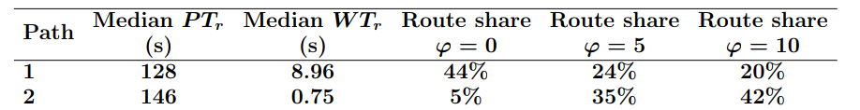
Waiting-time-averse drivers may favor longer routes to reduce time spent stopped

Slide 22
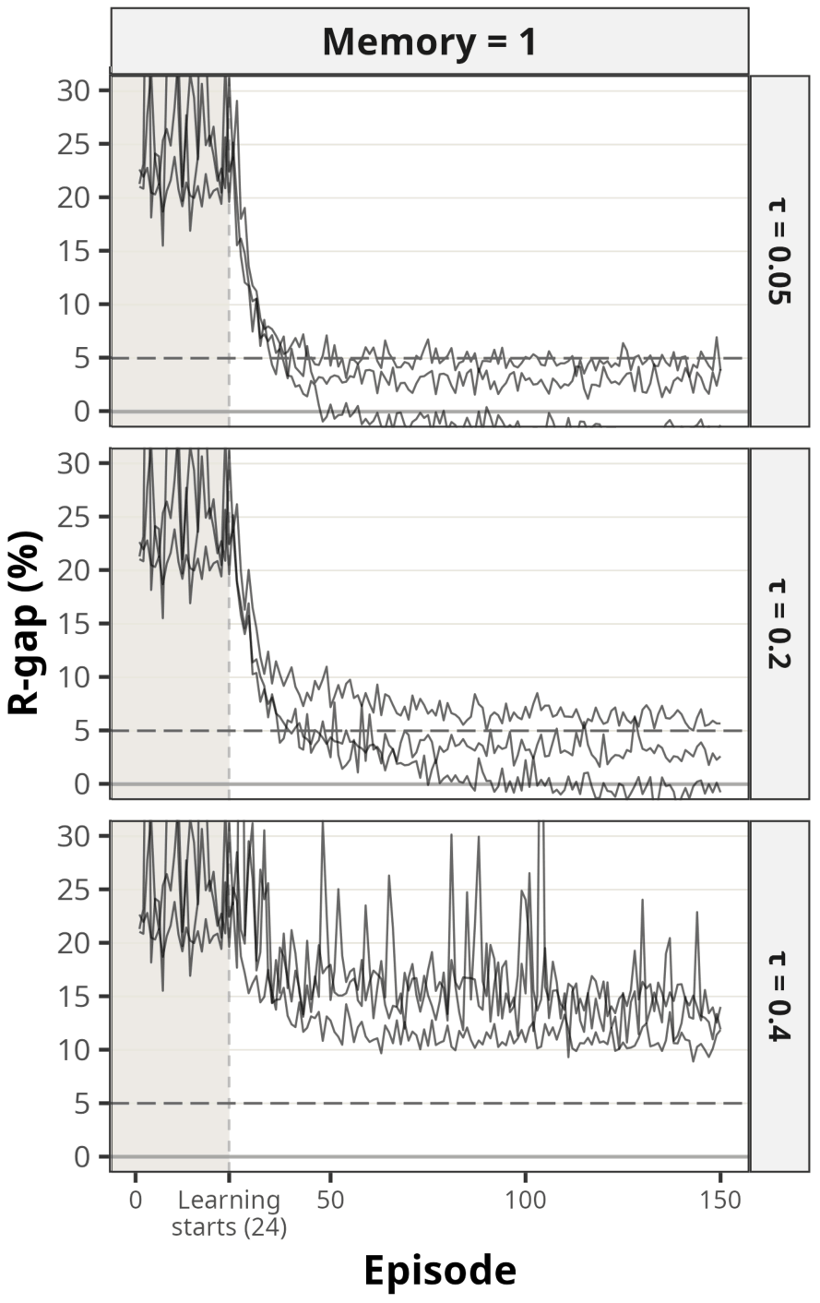
A nonlinear response may prevent convergence towards DUE

Slide 23
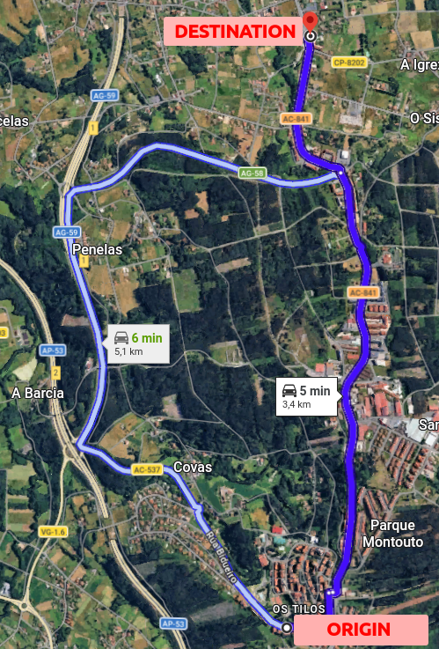
In summary, more realistic agent behavior may prevent convergence to DUE
Behavioral extensions such as risk-aversion, waiting-time aversion and nonlinear response
May give higher R-gap
May prevent convergence to DUE
Questions?
Notes:
Conclusion slide. Use the headline (no more than two lines) to state your most important conclusion. Begin the headline with In summary or In conclusion to ensure that the audience knows they have come to the presentation’s end. Support that headline with an image and parallel points.
This slide should be your last slide. Audiences lose patience when they believe that they have come to the end, but other slides follow.
Notice that the word Questions appears at the bottom of this slide. That strategy is much more effective than burning a slide with just the word Questions. This slide allows the audience to look at the most important slide of the presentation during the question period. See The Craft of Scientific Presentations, 2nd ed., pages 182-183.

Slide 24
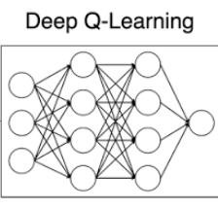
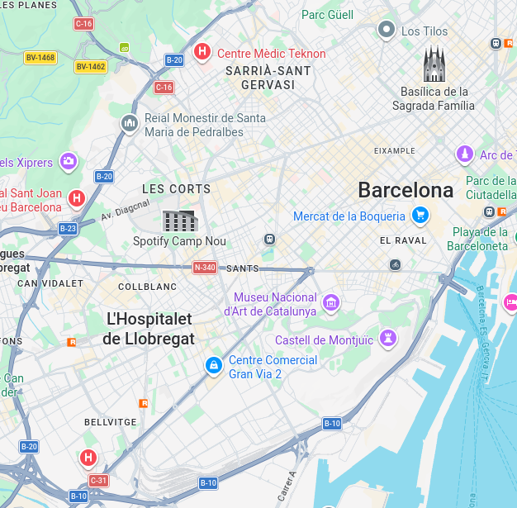
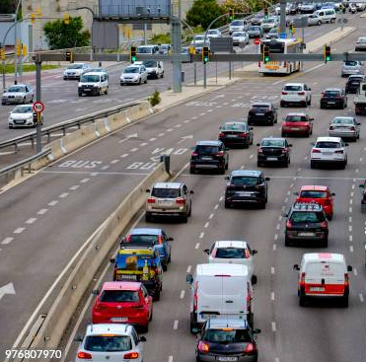
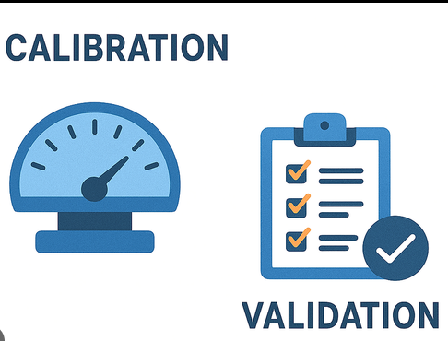
Future work
More modern RL algorithms
More complex networks
More complex demand

