Slide 1
Bayesian Analysis Final Project
Multi-Armed Bandit Problems, Thompson Sampling and Route Choice

Slide 2
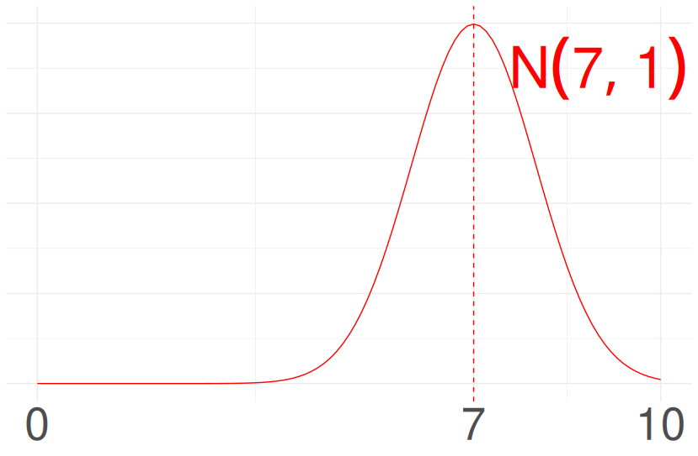
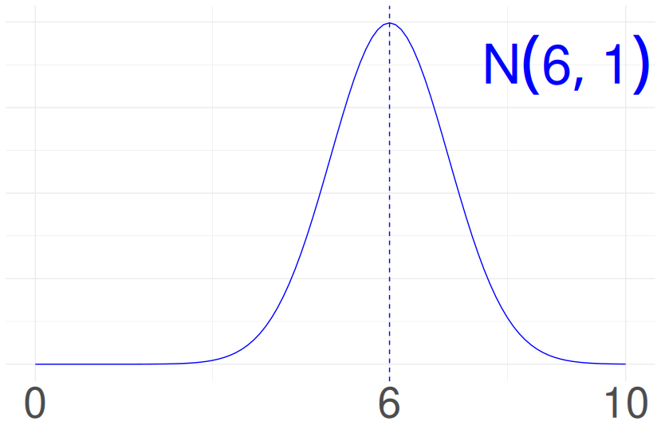
Introduction: Multi-Armed Bandit Problems
Student
Based on how we do exploration, there are several strategies:
Explore only
Exploit only
Epsilon-greedy
Thompson Sampling
...
Bayesian
Frequentist
How to evaluate a strategy:
Regret
Exploration vs Explotation

Slide 3



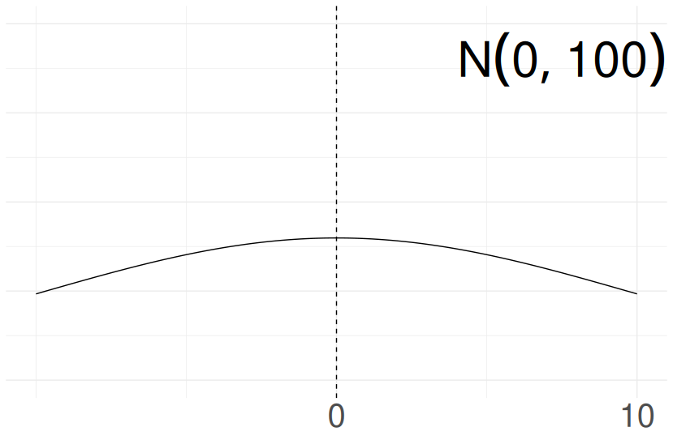
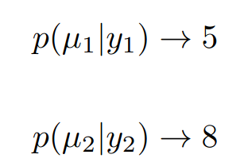
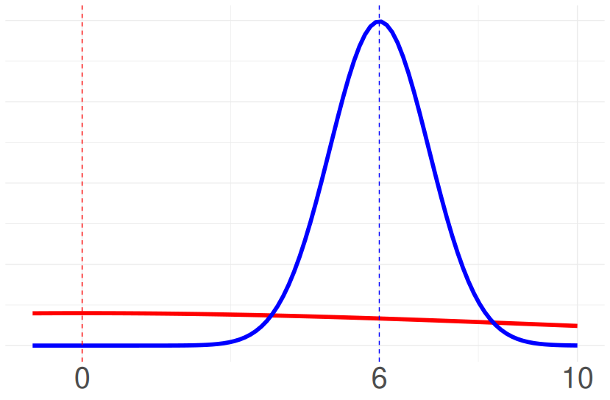
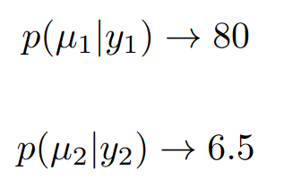
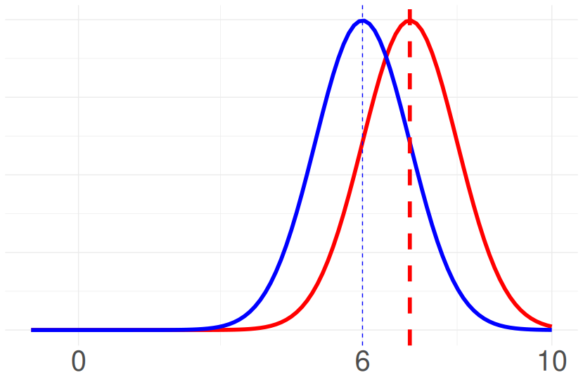
Introduction: Thompson Sampling
Student
Bayesian model
Posterior
μ unknown
σ known
Algorithm
1.Bayesian
Day 0
Posterior
Posterior draws
Action
Frequentist
class
Reward
6
Update posteriors
2.Frequentist
Day 1
Reward 7
Action
Bayesian
class

Slide 4
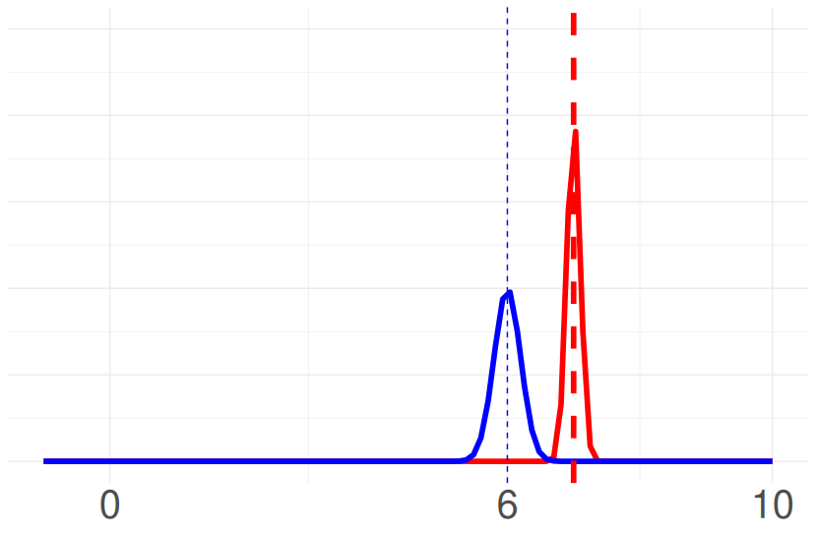
Introduction: Thompson Sampling
After a few iterations
Very likely to pick Bayesian class (red) in the next day
Posterior distribution for Bayesian class mean, will get more and more peaked.
Hence, finding Bayesian class was the correct answer

Slide 5
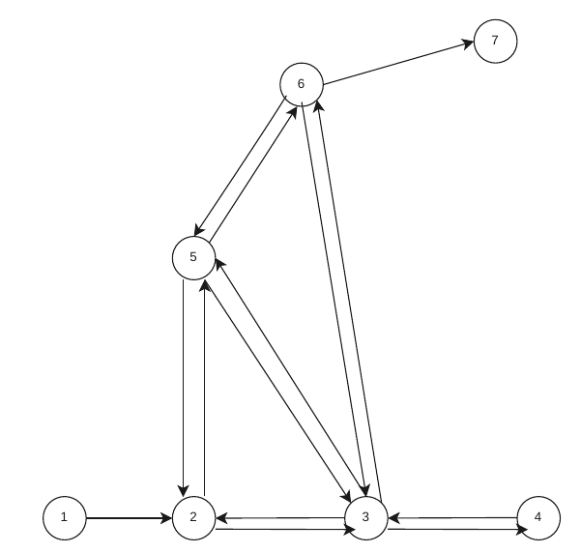

Project: Thompson Sampling for Route Choice
Software: SUMO simulator
Actions: Routes
Reward: Negative Travel Time
Goal: Learn which route is the shortest (has the higher expected reward) balancing exploration/explotation through Thompson Sampling.
Data: Travel times of vehicle's agent (generated using the simulator)
Evaluation metric: Regret (compares avg reward under optimal strategy with avg reward with our strategy)
Intuition Reward:
Route A = 20 min
Route B = 10 min
Reward A = -20
Reward B = -10

Slide 6
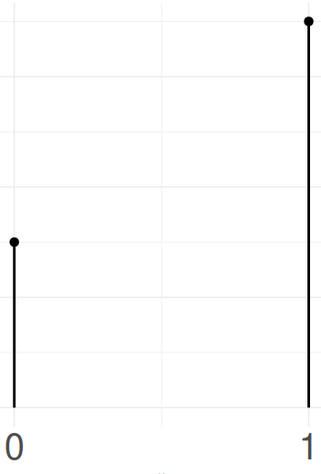
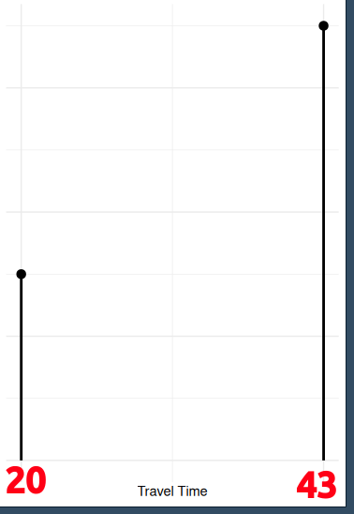
Project: Thompson Sampling for Route Choice
1st scenario
Hidden reward distributions are known
Only one vehicle (the agent)
Beta-Bernoulli conjugate model (each route will have two possible travel times). Discrete Travel Times.
Logic: Very similar to previous example
Route A
X
T (travel time)

Slide 7
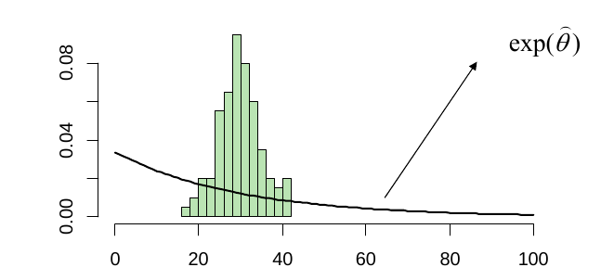
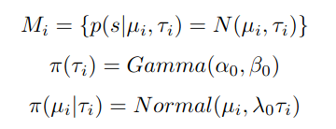
Project: Thompson Sampling for Route Choice
2nd scenario
Hidden reward distributions are unknown.
They will be approximated using Monte Carlo Simulation
Random background traffic plus one agent vehicle
Workflow:
Environment generation (random traffic). This induces unknown reward distributions for each route.
Run many simulations for each route. The histogram of all the travel times is an approximation of the unknown reward distribution.
Model validation (check under which distributions the data is likely to have been generated)
Choose Bayesian Model (appropiate likelihood and non informative conjugate priors). Continous Travel Times.
Apply same logic than before
Model Validation. Source Bayesian Analisis Slides UPC
Normal-Gamma
conjugate prior

