Slide 1
Dissertation Preparation
Comparing JSON and ProtoBuf in HTTP based REST architectures: performance and energy efficiency
Miguel Alves Ferreira nº 1230199
Preparação para dissertação
Engenharia Informática
Área de Especialização em Engenharia de software

Slide 2
Index
Introduction
Background
Planning
Literature Review
Research Methodology

Slide 3
Introduction
Problem Description
Research Questions
Ethical Considerations

Slide 4
Introduction – Problem Description
JSON offers simplicity
Protocol buffers offer performance
Complexity in implementations or refactoring of REST to gRPC
Underutilized or poorly optimized systems lead to Higher costs due to resource wastage and scalability issues
Energy Efficiency directly influences design decisions and is important for different system environments (Mobile devices, IoT and data centers)

Slide 5
Introduction – Research Questions
RQ1: How does using ProtoBufs impact the performance of HTTP-based REST architectures compared to JSON?
RQ2: To what extent can ProtoBufs improve energy efficiency in HTTP-based REST architecture communications compared to JSON?

Slide 6
Introduction – Ethical Consideration
Data Privacy
Transparency and Reproducibility
Benchmarking Practices

Slide 7
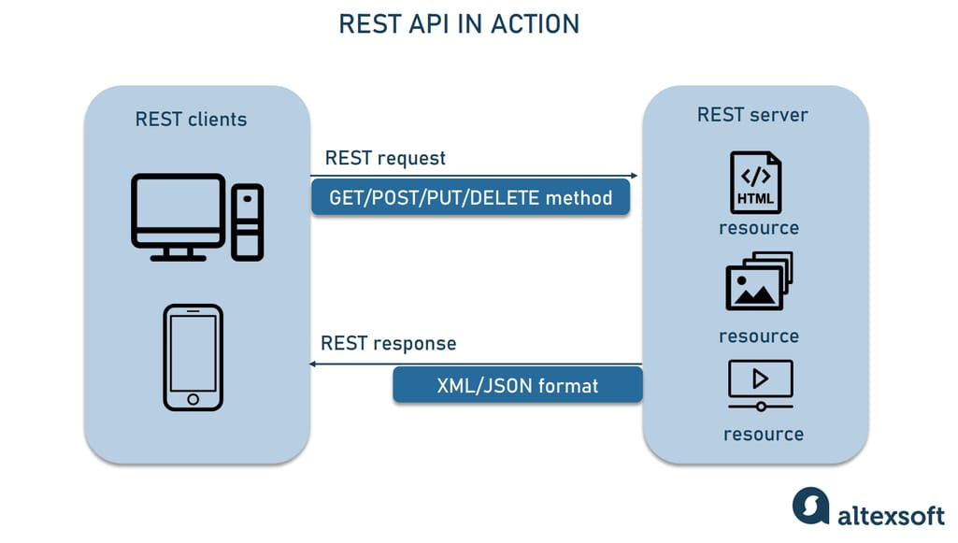
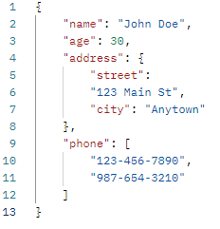
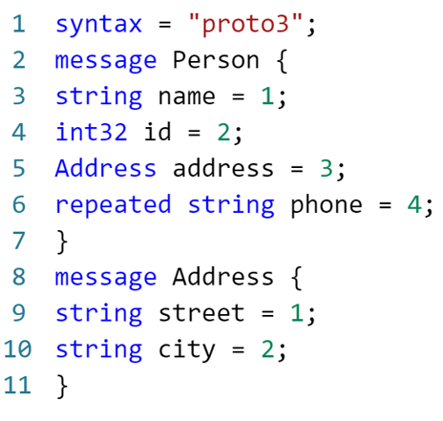


Background
REST
JSON
Protocol Buffers
Performance and energy analysis tools
Figure 1 – Example of a REST architecture taken from [1]
Figure 2 – Example of a JSON object
Figure 3 – Example of a Proto file
Figure 4 – JMeter Logo taken from [2]
Figure 5 – Kepler Logo taken from [3]

Slide 8
Planning
Stakeholders
Scope
Objectives
Benefits
Deliverables
Time
Costs
Assumptions and Restrictions
Risks
WBS
Timeline
Skills

Slide 9
Planning - Stakeholders
People who might benefit from the research.
Interests range from knowledge gains to monetary gains.
Name | Power | Interest
Developers | Low | Medium
Software development companies | Medium | High
Students | Low | Medium
Researchers | High | High
Advisor | High | High
Table 1 – Power Interest Matrix

Slide 10
Planning - Scope
Modern problems require modern solutions
Trade-offs between JSON and ProtoBuf
Give Insight to developers and architects

Slide 11
Planning - Objectives
Analyze performance
Analyze Scalability
Energy consumption
Resource Efficiency

Slide 12
Planning - Benefits
Cost Reduction
Improved Application Performance
Minimized Refactoring
Advancements in Software Development
Scalability Insight

Slide 13
Planning – Deliverables and Time
Milestones:
GQM (Goal Question Metric) – 15/01/2025
Hypothesis Test – 24/01/2025
Control Project – 13/02/2025
Data From Control Project – 14/03/2025
Changed Project – 14/03/2025
Data from changed project – 09/04/2025
Finished analysis – 09/04/2025
Report 1.0 delivery – 17/04/2025
Final Report Delivery – 30/04/2025
Presentation Date – 26/06/2025
Mandatory Dates:
Prepd review delivery – 06/12/2024
Report and Presentation Delivery – 04/01/2024
Final Delivery – 26/06/2024
Project Plan
Dissertation Report
Software Code
Testing Reports
Data Collected
Presentation and Discussion

Slide 14
Planning – Costs and Risk
For the time being no costs were identified
The project will rely on open-source tools
Institution-provided infrastructure
The only identified cost is time
High-Priority Risks:
Synthetic data bias.
Time constraints.
Medium-Priority Risks:
Tool incompatibility.
Data loss due to accidental corruption.

Slide 15
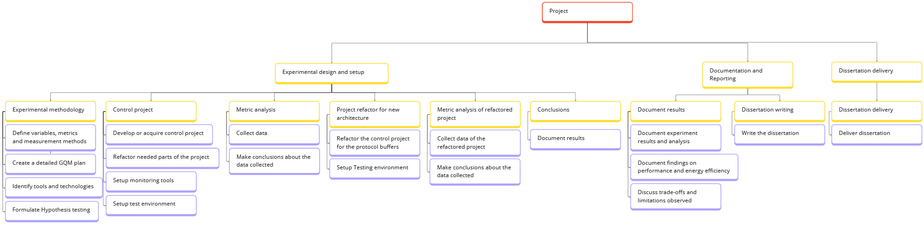
Planning - WBS
Figure 6 - WBS

Slide 16
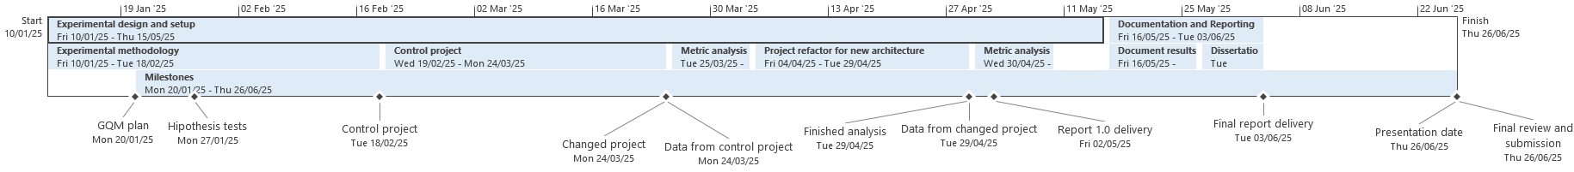
Planning - Timeline
Figure 7 – Complete timeline

Slide 17
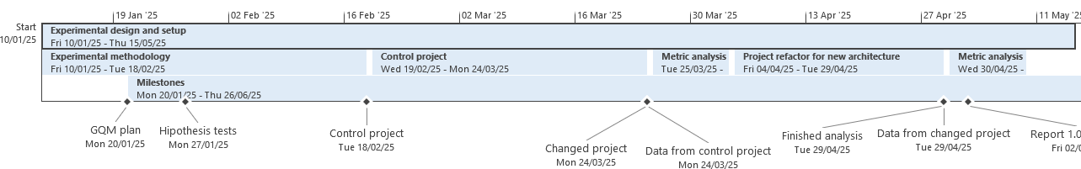
Planning - Timeline
Figure 8 –Timeline with better resolution part 1/2

Slide 18
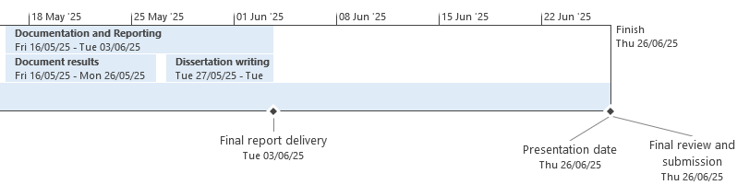
Planning - Timeline
Figure 9 –Timeline with better resolution part 1/2

Slide 19
Planning - Skills
Skill | Required Proficiency | Current Proficiency | Comments
Springboot | 8 | 7 | Springboot might have some features that are destined for Protobuf and might require some review.
Prometheus | 7 | 3 | With mild knowledge of the tool, it was only used for Kubernetes to gather simple usage data. For this project, its use is going to be central to extract data, and it needs further review.
Grafana | 7 | 1 | No prior knowledge of Grafana, and as such requires a lot of learning.
Java | 9 | 8 | There might be some useful functionalities in it that might prove useful for Protobuf, and these may require some attention and search.
Gradle | 4 | 2 | Some knowledge comes from the Jenkins pipeline and as such is basic and might require some further reading of the documentation.
Protobuf | 10 | 4 | Somewhat of a new concept for me that will require further reading of documentation and articles to bring the most out of the tool.
JSON | 10 | 10
Docker | 5 | 5
Kubernetes | 7 | 5 | Decent knowledge of Kubernetes, but never used it to gather energy consumption, so it requires further learning.
JMeter | 9 | 9 | The needed knowledge for JMeter has already been worked on before and most of the features are already known.
Kepler | 9 | 1 | Basic understanding of the tool. Also, another one that I have never worked on.
Soft Skills
Technical skills
Table 2 – Technical Skills

Slide 20
Literature Review
Data sources
Search terms
Eligibility Criteria
Prisma
Important studies

Slide 21
Literature Review – Data source
Identifier | Database | URL
DS1 | Google Scholar | https://scholar.google.com/
DS2 | ACM Digital Library | https://dl.acm.org/
DS3 | B-ON | https://www.b-on.pt/
DS4 | IEEE Xplore | https://ieeexplore.ieee.org/Xplore/home.jsp
Table 3 – Used data sources

Slide 22
Literature Review – Search Terms and Eligibility Criteria
Inclusion Criteria:
IC1: Studies examining Protocol Buffers, JSON, as data serialization.
IC2: Research measuring energy consumption, CPU power usage, battery consumption, or memory usage associated with REST API communication
IC3: Studies providing serialization, deserialization, transmission efficiency, or resource usage metrics directly related to energy consumption
IC4: Studies covering programming languages and platforms relevant to REST APIs
Exclusion Criteria:
EC1: Studies focusing on unrelated aspects such as security, data integrity, or accuracy without addressing energy consumption or efficiency.
EC2: Studies in non-REST API environments, or using protocols such as gRPC or SOAP, unless specifically measuring Protocol Buffers.
EC3: Studies using outdated versions of Protocol Buffers, or JSON libraries that are no longer relevant to current REST API technology.
{
("Protocol Buffers" OR “Protobufs”)
AND "REST"
AND ("serialization" OR "deserialization")
AND ("JSON" OR "XML ")
AND ("performance" OR "latency" OR "resource consumption" OR "efficiency" OR “energy consumption”)
AND ("web applications" OR "mobile" OR "IoT" OR "microservices")
AND ("experimental study" OR "benchmark" OR "simulation")
}

Slide 23
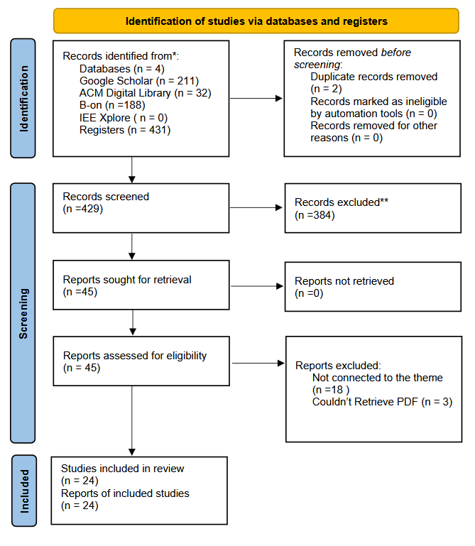
Literature Review - Prisma
Figure 10 – Prisma systematic literature Review altered from [4]

Slide 24
Literature Review - Discussion
ProtoBufs have increased advantages over JSON in performance and efficiency
Increasingly better if there are large and complex data structures.
But they have more CPU energy consumption
 | XML | JSON | ProtoBuf | Thrift
Book | 22.842 | 4.177 | 2.339 | 2.315
Video | 17.884 | 4.097 | 1.800 | 1.747
Table 4 – Average Serialization Time in ms taken from [5]
 | XML | JSON | ProtoBuf | Thrift
Book | 7.908 | 1.199 | 0.298 | 0.732
Video | 6.7.4.2 | 0.755 | 0.197 | 0.310
Table 5 – Average Deserialization Time in ms taken from [5]

Slide 25
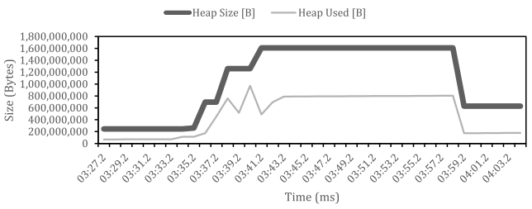
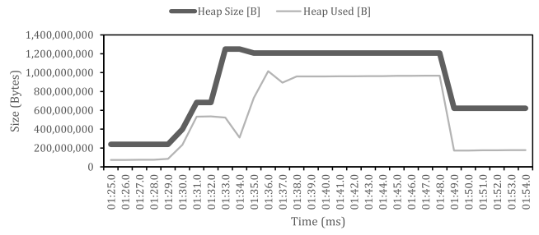
Literature Review - Discussion
ProtoBufs have increased advantages over JSON in performance and efficiency
Increasingly better if there are large and complex data structures.
But they have more CPU energy consumption
Figure 11 – Memory analysis of JSON serialization taken from [6]
Figure 12 – Memory analysis of Protocol Buffers serialization taken from [6]

Slide 26
Research Methodology
Controlled experiment

Slide 27
Research Methodology – Controlled experiment
Gives a precise evaluation of causal relationships
Most of the studies compare Protocol Buffers with JSON using different architectures
Gives quantifiable metrics enabling direct comparisons
REST architecture is the control variable
JSON and Protocol Buffers are independent variables
Performance and Energy efficiency are the dependent variables

Slide 28
References
[1] “What is a REST API? Beginner’s Guide.” Accessed: Nov. 28, 2024. [Online]. Available: https://www.altexsoft.com/blog/rest-api-design/
[2] Index of /images. (n.d.). Retrieved January 4, 2025, from https://jmeter.apache.org/images/
[3] Deploy using Manifests - Kepler. (n.d.). Retrieved December 26, 2024, from https://sustainable-computing.io/installation/kepler/
[4] “PRISMA 2020 flow diagram — PRISMA statement.” Accessed: Dec. 04, 2024. [Online]. Available: https://www.prisma-statement.org/prisma-2020-flow-diagram
[5] A. Sumaray and S. K. Makki, “A comparison of data serialization formats for optimal efficiency on a mobile platform,” Proceedings of the 6th International Conference on Ubiquitous Information Management and Communication, ICUIMC’12, 2012, doi: 10.1145/2184751.2184810.
[6] V. Buono, P. Petrovic Author Vincenzo Buono Petar Petrovic, and S. Fredrik Stridh Examiner, “Enhance Inter-service Communication in Supersonic K-Native REST-based Java Microservice Architectures,” 2021, Accessed: Nov. 02, 2024. [Online]. Available: https://urn.kb.se/resolve?urn=urn:nbn:se:hkr:diva-22135

