Slide 1
Introduction to Biostatistics and R
Lecture 1 Miguel Fudolig

Slide 2
Outline
Introduction to Biostatistics
Introduction to R

Slide 3
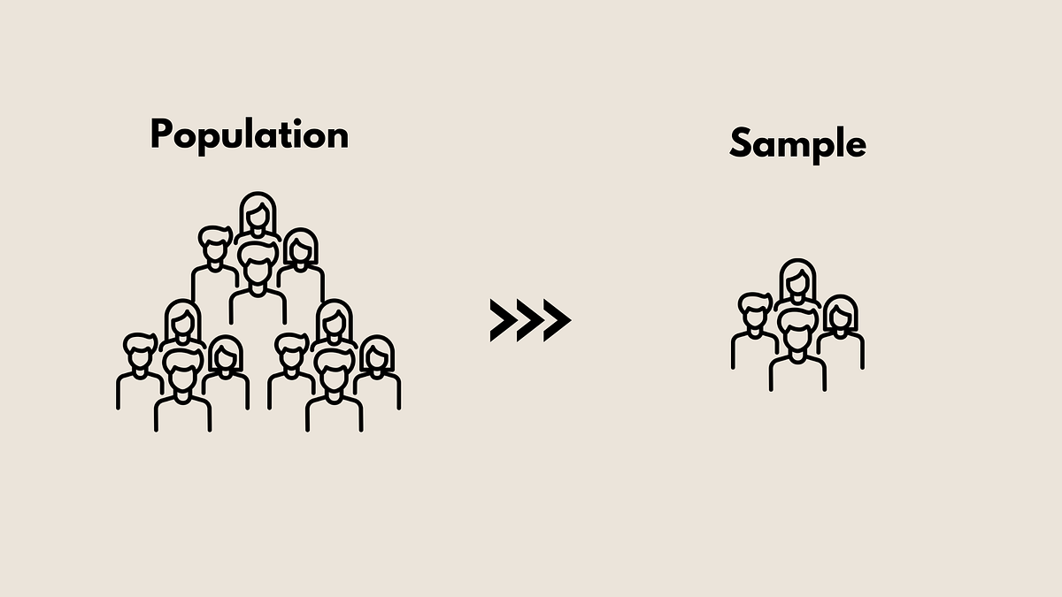
Introduction to Biostatistics
How to Sample
Sampling can be grouped into two broad categories: probability-based/random sampling and convenience sampling.
Random Samples
A sample is a random sample when the probability with which every respondent was sampled is known. These probabilities are not necessarily equal. Types of random sampling include:
Simple random sampling
Stratified random sampling
Cluster sampling
Convenience Samples
A sample is a convenience sample when the respondents are selected based on ease of access or availability. This could be a potential source of bias.
Scientific Method
The scientific method is a process by which scientific information is collected, analyzed, and reported in order to produce unbiased and replicable results in an effort to provide an accurate representation of observable phenomena.
Datafication
The field of statistics has grown in recent years primarily due to the datafication of the world.
Important
98% of all stored information is digital. Collected data is increasing even at this very moment.
Why statistics?
Statistics
Statistics is a field of study concerned with:
The collection, organization, summarization, and analysis of data
The drawing of inferences about a body of data when only a part of the data is observed.
Data $→$ Numbers $→$ Information $→$ Investigation $→$ Communication
Statistical Thinking
How is statistical thinking different from mathematical thinking?
Statistical Thinking
Statistical thinking involves understanding and analyzing data while accounting for uncertainty!
Activity
Flip a coin 10 times. If you don’t have a coin, search “coin flip” on Google.
Note
How many times did you get heads? Do you think the coin you flipped was fair?
Extensions of Statistics
Biostatistics
Biostatistics involves applying statistical concepts to data from the biological sciences, health sciences, and medicine.
Data Science
Data science is the study of how to extract useful information from data using quantitative methods and theories from many fields. The field focuses on large data sets that were not originally designed or collected to address the question of interest.
Sources of Data
Available data usually come from the following sources:
Records
Surveys
Experiments
Data Banks
Prior Literature
Categories of Statistics
Descriptive Statistics
Descriptive statistics are used to describe properties of complex sets of numbers. Summary statistics are a good example of descriptive statistics.
Inferential Statistics
Inferential statistics are used to infer information from a smaller group (sample) to a more general group (population).
Random Variables
Random variables have values obtained arise as a result of chance factors, so that they cannot be exactly predicted in advance. Values of random variables resulting from measurement procedures are referred to as observations/measurements.
Note
Random variables could be classified as qualitative or quantitative.
Random Variable Types
Quantitative Variables
Quantitative variables are variables that can be measured or characterized with a numerical value.
Discrete Random Variables
A discrete variable is characterized by gaps or interruptions in the values that it can assume.
Example: Customer counts at Cafe Rio, Number of missing teeth, Likert Scale scores
Continuous Random Variables
A continuous variable is characterized by gaps or interruptions in the values that it can assume.
Example: Speed, Weight, Time
Qualitative Variables
Qualitative variables cannot be measured numerically, but can be described categorically. Discrete and qualitative variables are also known as categorical variables.
Data Types
Nominal Data
As the name implies, nominal data consist of “naming” observations or classifying them into various mutually exclusive and collectively exhaustive categories.
Examples: Assigned sex at birth (male,female); HHS Regions (HHS Regions 1-10)
Important
Nominal data are typically qualitative in nature and does not account for any ordering in variable levels.
Ordinal Data
Ordinal data are for variables with values with inherent ordering.
Examples: Shirt size (Small, Medium, Large, XL); Socioeconomic status (Low, Medium, High)
Important
Ordinal data can include discrete variables and some qualitative variables.
Interval Data
Interval data includes measurements that can be ordered and a distance metric can be defined between two measurements. Interval scales have equal intervals between values with arbitrary zero points.
Examples: Temperature, IQ
Ratio Data
Ratio data is similar to interval data, but with an absolute zero measurement defined as the “absence” of the variable being measured.
Examples: Weight, Height
Exercise
Question
Identify the type of data/variable for the following:
BMI
Satisfaction Scale (Unsatisfied, Moderately Satisfied, Satisfied, Very Satisfied)
Eye Color
Credit Rating
Answers
BMI (ratio)
Satisfaction Scale (Unsatisfied, Moderately Satisfied, Satisfied, Very Satisfied) (ordinal)
Eye Color (nominal)
Credit Score (interval)
Population vs. Sample
Population
A population is the largest collection of entities for which we have an interest at a particular time. Measurements of some variable from these entities would generate a population of values for that variable.
An exact value calculated from a population is referred to as a parameter.
Sample
A sample is a part of the population.
An exact value calculated from a sample is referred to as a statistic.
Population vs. Sample
Taken from: https://medium.com/@ritusantra/population-v-s-sample-f17c40967257

Slide 4
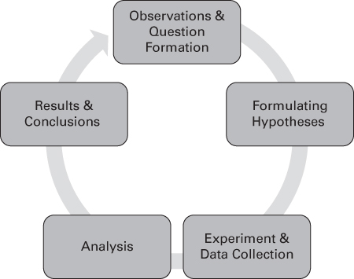

Slide 5
Introduction to R
Installation
You can install R and RStudio on your personal computers and laptops by following the instructions on this page: https://posit.co/download/rstudio-desktop/
RStudio is currently installed on the classroom computers.
Basic Programming Terminology
Source Code: A text listing of commands to be compiled or assembled into an executable computer program.
Running Code: The act of telling R to perform an act by giving it commands through source code.
Console Pane: Where R commands are entered
Important
There are different types of programming data types such as integers, doubles/numerics, logicals, and characters.
Integers (int) have values like -1,0,2
Numerics (dbl, num) are numbers including integers and decimals,
Logicals (logi) are either TRUE or FALSE
Characters (chr)are text variables such as “Hello, World”, “Female”, “Yes”
Basic Programming Terminology
Vectors
Vectors are a series of values. These can be created using the c() function, known as the combine/concatenate function.
[1] 1 2 3
[1] "A" "B" "C"
Variables
You can store different data types to variables using the <- sign.
[1] 1 2 3
[1] 3 4 5
[1] "A" "B" "C"
Factors
Categorical data are commonly represented in R as factors.
[1] 18-39 40-59 60+ Levels: 18-39 40-59 60+
[1] "Disagree" "Strongly Disagree" "Agree" [4] "Neutral" "Strongly Agree"
[1] Disagree Strongly Disagree Agree Neutral [5] Strongly Agree Levels: Strongly Disagree Disagree Neutral Agree Strongly Agree
Basic Programming Technology
Data Frames
Data frames are rectangular spreadsheets. Data are typically imported as data frames.
Note
Rows correspond to observations and the columns correspond to variables.
Example:
mpg cyl disp hp drat wt qsec vs am gear carb Mazda RX4 21.0 6 160 110 3.90 2.620 16.46 0 1 4 4 Mazda RX4 Wag 21.0 6 160 110 3.90 2.875 17.02 0 1 4 4 Datsun 710 22.8 4 108 93 3.85 2.320 18.61 1 1 4 1 Hornet 4 Drive 21.4 6 258 110 3.08 3.215 19.44 1 0 3 1 Hornet Sportabout 18.7 8 360 175 3.15 3.440 17.02 0 0 3 2 Valiant 18.1 6 225 105 2.76 3.460 20.22 1 0 3 1
Conditionals
You can test for mathematical relations such as equality/inequality, resulting in a TRUE or FALSE value.
[1] TRUE
[1] FALSE
[1] TRUE TRUE FALSE FALSE FALSE
Functions
Functions are commands in R. c() is a function that combines different values. You can create a function or use functions built for R.
Example: seq() is a function that generates a sequence of numbers. The resulting sequence of numbers can be changed by changing the attributes of the function
[1] 1 2 3 4 5
[1] 1 3 5
[1] 1.000000 1.444444 1.888889 2.333333 2.777778 3.222222 3.666667 4.111111 [9] 4.555556 5.000000
To learn more about what a specific R function does, type ?function_name in the console. (Ex:?seq, ?c)
Errors, Warnings, and Messages
Errors
When you input a legitimate error, R will warn you using a sentence starting with “Error in” and includes a sentence explaining what went wrong.
Error in add(1, 2, 3): could not find function "add"
Error in c("A", "B") + 1: non-numeric argument to binary operator
Note
If the text starts with “Error”, figure out what’s causing it. Think of errors as a red traffic light: stop and assess for anything wrong in the code (missing parenthesis, adding characters to numbers, non-existent functions, etc.)
Important
Encountering errors in your code is normal even for an experienced coder. Don’t be afraid to review your code if you made an error! This process is called “debuggging”.
Warnings
When R produces a warning, your code will still be implemented albeit with some caveats.
The plot is displayed, but a warning was raised regarding a missing value. Note that the data frame for_plotting has a missing value for y denoted by NA.
Messages
If the output text does not start with an error or a warning, it’s just a friendly message from R telling you about the output. These messages are typically seen when loading R packages or data sets from external sources.
R packages
R packages extend the functionality of R by providing additional functions, data, and documentation. These packages are written by R users around the world and can be downloaded for free!
Note
Think of R as a new phone. R packages are apps that you can download to use your phone in many different ways.
Installing and Loading R Packages
Like apps on a phone, R packages also need to be installed. These packages can be installed by running the following code snippet install.packages("PackageName"). For example, to install the package tidyverse used for data manipulation and cleaning, you can run the following code:
install.packages("tidyverse")
To load this package in R, you can use the following syntax:
Important
You must have an active internet connection to install R packages to your device.
Exercise
Exercise
Install and load the following packages: readxl, nycflights23 and knitr.
Answer
install.packages("readxl") install.packages("nycflights23") install.packages("knitr")
Exploring Data Sets
The nycflights23 package includes some data sets saved as data frames. These data sets are related to all domestic flights departing from one of New York City’s three main airports in 2023: Newark Liberty International (EWR), John F. Kennedy International (JFK), and LaGuardia Airport (LGA).
One of the data sets in this package is the flights data set.
# A tibble: 435,352 × 19 year month day dep_time sched_dep_time dep_delay arr_time sched_arr_time <int> <int> <int> <int> <int> <dbl> <int> <int> 1 2023 1 1 1 2038 203 328 3 2 2023 1 1 18 2300 78 228 135 3 2023 1 1 31 2344 47 500 426 4 2023 1 1 33 2140 173 238 2352 5 2023 1 1 36 2048 228 223 2252 6 2023 1 1 503 500 3 808 815 7 2023 1 1 520 510 10 948 949 8 2023 1 1 524 530 -6 645 710 9 2023 1 1 537 520 17 926 818 10 2023 1 1 547 545 2 845 852 # ℹ 435,342 more rows # ℹ 11 more variables: arr_delay <dbl>, carrier <chr>, flight <int>, # tailnum <chr>, origin <chr>, dest <chr>, air_time <dbl>, distance <dbl>, # hour <dbl>, minute <dbl>, time_hour <dttm>
Note
A tibble is a special type of data frame! The dimensions show the number of rows x number of columns. Each row corresponds to an observation, while each column corresponds to the variables describing each observation.
Exploring the flights data set.
You can use the following functions to explore a data set.
View()
View() brings up RStudio’s built in data viewer. That is, if you want to view data like an Excel sheet.
View(flights)
glimpse()
The glimpse() function from the package dplyr (part of tidyverse) provides us with a different view of the data set. It includes the data type of each variable defined by the columns of the data frame.
Rows: 435,352 Columns: 19 $ year <int> 2023, 2023, 2023, 2023, 2023, 2023, 2023, 2023, 2023, 2… $ month <int> 1, 1, 1, 1, 1, 1, 1, 1, 1, 1, 1, 1, 1, 1, 1, 1, 1, 1, 1… $ day <int> 1, 1, 1, 1, 1, 1, 1, 1, 1, 1, 1, 1, 1, 1, 1, 1, 1, 1, 1… $ dep_time <int> 1, 18, 31, 33, 36, 503, 520, 524, 537, 547, 549, 551, 5… $ sched_dep_time <int> 2038, 2300, 2344, 2140, 2048, 500, 510, 530, 520, 545, … $ dep_delay <dbl> 203, 78, 47, 173, 228, 3, 10, -6, 17, 2, -10, -9, -7, -… $ arr_time <int> 328, 228, 500, 238, 223, 808, 948, 645, 926, 845, 905, … $ sched_arr_time <int> 3, 135, 426, 2352, 2252, 815, 949, 710, 818, 852, 901, … $ arr_delay <dbl> 205, 53, 34, 166, 211, -7, -1, -25, 68, -7, 4, -13, -14… $ carrier <chr> "UA", "DL", "B6", "B6", "UA", "AA", "B6", "AA", "UA", "… $ flight <int> 628, 393, 371, 1053, 219, 499, 996, 981, 206, 225, 800,… $ tailnum <chr> "N25201", "N830DN", "N807JB", "N265JB", "N17730", "N925… $ origin <chr> "EWR", "JFK", "JFK", "JFK", "EWR", "EWR", "JFK", "EWR",… $ dest <chr> "SMF", "ATL", "BQN", "CHS", "DTW", "MIA", "BQN", "ORD",… $ air_time <dbl> 367, 108, 190, 108, 80, 154, 192, 119, 258, 157, 164, 1… $ distance <dbl> 2500, 760, 1576, 636, 488, 1085, 1576, 719, 1400, 1065,… $ hour <dbl> 20, 23, 23, 21, 20, 5, 5, 5, 5, 5, 5, 6, 5, 6, 6, 6, 6,… $ minute <dbl> 38, 0, 44, 40, 48, 0, 10, 30, 20, 45, 59, 0, 59, 0, 0, … $ time_hour <dttm> 2023-01-01 20:00:00, 2023-01-01 23:00:00, 2023-01-01 2…
kable()
The kable() function is part of the package knitr. In this example, we will use another data set in the nycflights23 package: the airlines data set.
$
The $ operator allows us to extract and then explore a single variable within a data frame.
[1] "Endeavor Air Inc." "American Airlines Inc." "Alaska Airlines Inc." [4] "JetBlue Airways" "Delta Air Lines Inc." "Frontier Airlines Inc." [7] "Allegiant Air" "Hawaiian Airlines Inc." "Envoy Air" [10] "Spirit Air Lines" "SkyWest Airlines Inc." "United Air Lines Inc." [13] "Southwest Airlines Co." "Republic Airline"
Exercise
Exercise
Can you provide me with two qualitative variables and two quantitative variables in the dataset planes in the nycflights23 package?
Answer
Rows: 4,840 Columns: 9 $ tailnum <chr> "N101DQ", "N101DU", "N101HQ", "N101NN", "N102DN", "N102DU… $ year <int> 2020, 2018, 2007, 2013, 2020, NA, 2007, 2013, 1998, NA, 2… $ type <chr> "Fixed wing multi engine", "Fixed wing multi engine", "Fi… $ manufacturer <chr> "AIRBUS", "C SERIES AIRCRAFT LTD PTNRSP", "EMBRAER-EMPRES… $ model <chr> "A321-211", "BD-500-1A10", "ERJ 170-200 LR", "A321-231", … $ engines <int> 2, 2, 2, 2, 2, 2, 2, 2, 2, 2, 2, 2, 2, 2, 2, 2, 2, 2, 2, … $ seats <int> 199, 133, 80, 379, 199, 133, 80, 379, 182, 133, 199, 80, … $ speed <int> 0, 0, 0, 0, 0, 0, 0, 0, 0, 0, 0, 0, 0, 0, 0, 0, 0, 0, 0, … $ engine <chr> "Turbo-fan", "Turbo-fan", "Turbo-fan", "Turbo-fan", "Turb…
Columns made up of characters are categorical variables. Quantitative variables are those marked as integers.
Important
NA means that the data point is missing. This is not the same as “NA”, which is a character.
Exercise
Exercise
Explore the data set iris.
How many observations does iris have?
How many variables does iris have?
Use glimpse() to determine the type of data of each column of iris.
Use the $ operator to extract the species variable in iris
Answer
Rows: 150 Columns: 5 $ Sepal.Length <dbl> 5.1, 4.9, 4.7, 4.6, 5.0, 5.4, 4.6, 5.0, 4.4, 4.9, 5.4, 4.… $ Sepal.Width <dbl> 3.5, 3.0, 3.2, 3.1, 3.6, 3.9, 3.4, 3.4, 2.9, 3.1, 3.7, 3.… $ Petal.Length <dbl> 1.4, 1.4, 1.3, 1.5, 1.4, 1.7, 1.4, 1.5, 1.4, 1.5, 1.5, 1.… $ Petal.Width <dbl> 0.2, 0.2, 0.2, 0.2, 0.2, 0.4, 0.3, 0.2, 0.2, 0.1, 0.2, 0.… $ Species <fct> setosa, setosa, setosa, setosa, setosa, setosa, setosa, s…
[1] setosa setosa setosa setosa setosa setosa [7] setosa setosa setosa setosa setosa setosa [13] setosa setosa setosa setosa setosa setosa [19] setosa setosa setosa setosa setosa setosa [25] setosa setosa setosa setosa setosa setosa [31] setosa setosa setosa setosa setosa setosa [37] setosa setosa setosa setosa setosa setosa [43] setosa setosa setosa setosa setosa setosa [49] setosa setosa versicolor versicolor versicolor versicolor [55] versicolor versicolor versicolor versicolor versicolor versicolor [61] versicolor versicolor versicolor versicolor versicolor versicolor [67] versicolor versicolor versicolor versicolor versicolor versicolor [73] versicolor versicolor versicolor versicolor versicolor versicolor [79] versicolor versicolor versicolor versicolor versicolor versicolor [85] versicolor versicolor versicolor versicolor versicolor versicolor [91] versicolor versicolor versicolor versicolor versicolor versicolor [97] versicolor versicolor versicolor versicolor virginica virginica [103] virginica virginica virginica virginica virginica virginica [109] virginica virginica virginica virginica virginica virginica [115] virginica virginica virginica virginica virginica virginica [121] virginica virginica virginica virginica virginica virginica [127] virginica virginica virginica virginica virginica virginica [133] virginica virginica virginica virginica virginica virginica [139] virginica virginica virginica virginica virginica virginica [145] virginica virginica virginica virginica virginica virginica Levels: setosa versicolor virginica
iris has 150 observations and 5 variables: Sepal Length, Sepal Width, Petal Length, Petal Width, and Species. Species is a factor, while all the other variables are numeric (dbl) in nature.

Slide 6
Summary
Summary
Introduced biostatistics and its importance
Introduced R
Explored data sets
What’s next?
We will be using R to work with data and perform statistical analysis. We will also explore how to use R to explore and describe data from external sources (.csv files).

