Slide 1
LABEL RANKING FOR ELECTION OUTCOME PREDICTION
Miguel Jorge Gonçalves Pereira
February 16, 2018
Supervisor: Cláudio Rebelo de Sá
Second Supervisor: Carlos Soares
Mestrado Integrado em Engenharia Informática
Faculdade de Engenharia da Universidade do Porto

Slide 2
Presentation Structure
LABEL RANKING FOR ELECTION OUTCOME PREDICTION
pageNumber / totalPagesCount
Introduction
Election Prediction
Association Rules Mining
Label Ranking
Pairwise Association Rules
Experimental setup
Results and Analysis
Conclusions

Slide 3
Introduction
LABEL RANKING FOR ELECTION OUTCOME PREDICTION
pageNumber / totalPagesCount
1

Slide 4
2. Association Rules Mining| LABEL RANKING FOR ELECTION OUTCOME PREDICTION
pageNumber / totalPagesCount
Introduction
Context
Problem
Motivation / Goals

Slide 5
2. Association Rules Mining| LABEL RANKING FOR ELECTION OUTCOME PREDICTION
pageNumber / totalPagesCount
Introduction
Context
Election prediction and approaches
Problem
Motivation / Goals

Slide 6
2. Association Rules Mining| LABEL RANKING FOR ELECTION OUTCOME PREDICTION
pageNumber / totalPagesCount
Introduction
Problem
Current methods face complex challenges
Context
Motivation / Goals

Slide 7
2. Association Rules Mining| LABEL RANKING FOR ELECTION OUTCOME PREDICTION
pageNumber / totalPagesCount
Introduction
Motivation / Goals
LR for Election Outcome Prediction
Context
Problem
Adapt PAR for prediction
Study the accuracy trade-off between the prediction of complete rankings vs incomplete rankings

Slide 8
Election Prediction
LABEL RANKING FOR ELECTION OUTCOME PREDICTION
pageNumber / totalPagesCount
2

Slide 9
1. Problem definition | LABEL RANKING FOR ELECTION OUTCOME PREDICTION
pageNumber / totalPagesCount
Election prediction
Polls
Expert
opinions
Predefined set of Methods
Election Outcome
Data Mining and Machine Learning
Subgroup Discovery
Sentiment Analysis

Slide 10
Association Rules Mining
LABEL RANKING FOR ELECTION OUTCOME PREDICTION
pageNumber / totalPagesCount
3

Slide 11
2. Association Rules Mining| LABEL RANKING FOR ELECTION OUTCOME PREDICTION
pageNumber / totalPagesCount
Formalization
A ⟶ C
𝑖 instance
𝕏 instance space
desc(𝕏) descriptors of 𝕏 i.e. ⟨attribute, value⟩ pairs
𝒜 independent variable
𝑥_{𝑖} vector of values of 𝒜 that describe 𝑖
D {⟨𝑥_{𝑖}⟩} data
A antecedent
C consequent
A∩C = ∅
A,C ⊆ desc(𝕏)

Slide 12
2. Association Rules Mining| LABEL RANKING FOR ELECTION OUTCOME PREDICTION
pageNumber / totalPagesCount
Example
𝑖 instance region of Porto
𝕏 instance space all the regions in Portugal
desc(𝕏) descriptors of 𝕏 {⟨ unemployment, high ⟩,…}
𝒜 independent variable unemployment
𝑥_{𝑖} vector of values of 𝒜 that describe 𝑖 Porto: {⟨ unemployment, high ⟩,…}
D {⟨𝑥_{𝑖}⟩} data {Porto: {…}, Lisbon: {…},…}

Slide 13
2. Association Rules Mining| LABEL RANKING FOR ELECTION OUTCOME PREDICTION
pageNumber / totalPagesCount
Example
(For instance 𝑖₁ = Porto)
(For independent variable 𝒜 ₁ = unemployment)
𝒜₁ = high ⟶ left-wing party wins elections

Slide 14
2. Association Rules Mining| LABEL RANKING FOR ELECTION OUTCOME PREDICTION
pageNumber / totalPagesCount
Interest Measures
support percentage of instances in D that contain A and C
confidence percentage of instances that contain C from the set of instances that contain A
lift measures the independence of the consequent, C, relative to the antecedent, A

Slide 15
2. Association Rules Mining| LABEL RANKING FOR ELECTION OUTCOME PREDICTION
pageNumber / totalPagesCount
Interest Measures
Improvement measure of the improvement (difference in confidence) that a certain rule yields in comparison to it’s predecessor
e.g. improvement = 2
Rule 1
Rule 1
𝒜₁ = a ⟶ C
confidence = 90%
𝒜₁ = a ⟶ C
confidence = 90%
Rule 2
Rule 2
𝒜₁ = a & 𝒜₂ = b ⟶ C
𝒜₁ = a & 𝒜₂ = b ⟶ C
confidence = 91%
confidence = 92%

Slide 16
2. Association Rules Mining| LABEL RANKING FOR ELECTION OUTCOME PREDICTION
pageNumber / totalPagesCount
Rules Generation
Item-set based
APRIORI
hashing
Rule based
FP-Growth
...
Dynamic itemset countin
Parallel and distributed mining
...

Slide 17
Label Ranking
LABEL RANKING FOR ELECTION OUTCOME PREDICTION
pageNumber / totalPagesCount
4

Slide 18
2. Association Rules Mining| LABEL RANKING FOR ELECTION OUTCOME PREDICTION
pageNumber / totalPagesCount
Preference Learning
Label Ranking
Label Ranking Association Rules (LRAR)
Pairwise Association Rules (PAR)

Slide 19
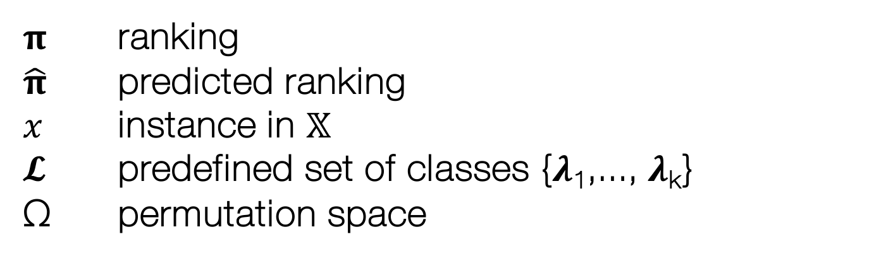
2. Association Rules Mining| LABEL RANKING FOR ELECTION OUTCOME PREDICTION
pageNumber / totalPagesCount
Formalization
goal : find the $\hat{\text{π}}$ of 𝓛 associated with 𝑥
$\text{π}$ ranking
$\hat{\text{π}}$ predicted ranking
𝑥 instance in 𝕏
𝓛 predefined set of classes {𝝀₁,..., 𝝀_{k}}
Ω permutation space

Slide 20
2. Association Rules Mining| LABEL RANKING FOR ELECTION OUTCOME PREDICTION
pageNumber / totalPagesCount
Formalization
complete
ranking
partial
incomplete

Slide 21
2. Association Rules Mining| LABEL RANKING FOR ELECTION OUTCOME PREDICTION
pageNumber / totalPagesCount
Formalization
ranking
can be represented as an
order

Slide 22
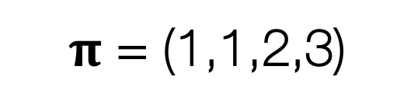
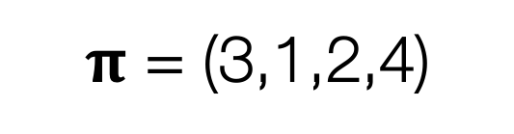
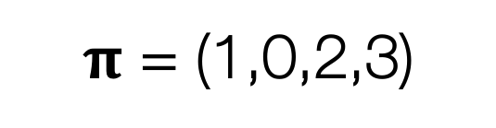
2. Association Rules Mining| LABEL RANKING FOR ELECTION OUTCOME PREDICTION
pageNumber / totalPagesCount
Formalization
ranking
complete
partial
incomplete
strict total order
non-strict total order
non-strict partial order
𝝀₂≻ 𝝀₃ ≻ 𝝀₁ ≻ 𝝀₄
𝝀₁= 𝝀₂ ≻ 𝝀₃ ≻ 𝝀₄
𝝀₁≻ 𝝀₃ ≻ 𝝀₄
$\text{π}$ = (3,1,2,4)
$\text{π}$ = (1,1,2,3)
$\text{π}$ = (1,0,2,3)

Slide 23
2. Association Rules Mining| LABEL RANKING FOR ELECTION OUTCOME PREDICTION
pageNumber / totalPagesCount
Label Ranking methods
Decomposition
PAR
Rule-Based Label Ranking
Direct
LRAR
k-Nearest Neighbors
...
...

Slide 24

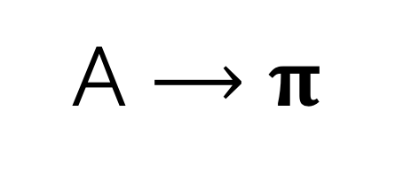
2. Association Rules Mining| LABEL RANKING FOR ELECTION OUTCOME PREDICTION
pageNumber / totalPagesCount
Label Ranking Association Rules
A ⟶ $\text{π}$
A ⊆ 𝕏
$\text{π}$ ∈ Ω

Slide 25
2. Association Rules Mining| LABEL RANKING FOR ELECTION OUTCOME PREDICTION
pageNumber / totalPagesCount
Label Ranking Association Rules
Example
𝒜₁ = high ∧ 𝒜₂ = low ⟶ C ≻ A ≻ B ≻ D

Slide 26
Pairwise Association Rules
LABEL RANKING FOR ELECTION OUTCOME PREDICTION
pageNumber / totalPagesCount
5

Slide 27
2. Association Rules Mining| LABEL RANKING FOR ELECTION OUTCOME PREDICTION
pageNumber / totalPagesCount
Formalization
A ⟶ {𝝀_{a} ⪰ 𝝀_{b} ⨁ 𝝀_{b} ⪰ 𝝀_{a} ⨁ 𝝀_{a} = 𝝀_{b} ⨁ 𝝀_{a} ⟘ 𝝀_{b} | 𝝀_{a},𝝀_{b} ∈ 𝓛}

Slide 28
2. Association Rules Mining| LABEL RANKING FOR ELECTION OUTCOME PREDICTION
pageNumber / totalPagesCount
Pairwise Association Rules
Example
𝒜₁ = high ∧ 𝒜₂ = low ⟶ 𝝀₃ ≻ 𝝀₁ ∧ 𝝀₂ ≻ 𝝀₄

Slide 29
2. Association Rules Mining| LABEL RANKING FOR ELECTION OUTCOME PREDICTION
pageNumber / totalPagesCount
Example Comparison
LRAR
𝒜₁ = high ∧ 𝒜₂ = low ⟶ 𝝀₃ ≻ 𝝀₁ ≻ 𝝀₂ ≻ 𝝀₄
PAR
𝒜₁ = high ∧ 𝒜₂ = low ⟶ 𝝀₃ ≻ 𝝀₁ ∧ 𝝀₂ ≻ 𝝀₄

Slide 30
2. Association Rules Mining| LABEL RANKING FOR ELECTION OUTCOME PREDICTION
pageNumber / totalPagesCount
Evaluation
LRAR
Kendall Tau normalized difference between the number of concordant and discordant pairs
PAR
Gamma measure of correlation between two incomplete rankings or between 2 incomplete and complete or partial rankings

Slide 31
2. Association Rules Mining| LABEL RANKING FOR ELECTION OUTCOME PREDICTION
pageNumber / totalPagesCount
PAR for prediction
Rule selection
Maximum Pairwise
Completeness

Slide 32
2. Association Rules Mining| LABEL RANKING FOR ELECTION OUTCOME PREDICTION
pageNumber / totalPagesCount
PAR for prediction
Rule selection
𝑥 instance
𝓡 generated rules
applicableRules(𝑥)
Maximum Pairwise
Completeness

Slide 33
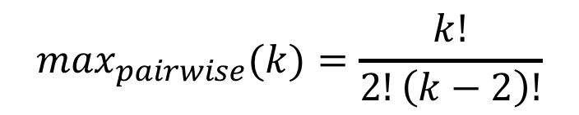
2. Association Rules Mining| LABEL RANKING FOR ELECTION OUTCOME PREDICTION
pageNumber / totalPagesCount
PAR for prediction
Maximum Pairwise
$$\max_{pairwise}(k)=\frac{k!}{2!\left(k−2\right)!}$$
Rule Selection
Completeness
=1
A ⟶ 𝝀₁ ≻ 𝝀₂
=2
A ⟶ 𝝀₁ ≻ 𝝀₂ ∧ 𝝀₃ ≻ 𝝀₄

Slide 34
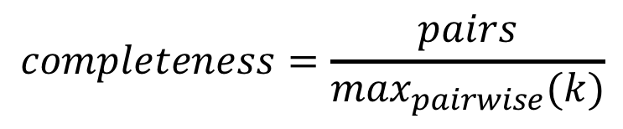
2. Association Rules Mining| LABEL RANKING FOR ELECTION OUTCOME PREDICTION
pageNumber / totalPagesCount
PAR for prediction
Completeness
$$completeness=\frac{pairs}{\max_{pairwise}(k)}$$
Rule Selection
Maximum Pairwise

Slide 35
Experimental setup
LABEL RANKING FOR ELECTION OUTCOME PREDICTION
pageNumber / totalPagesCount
6

Slide 36
Data
LABEL RANKING FOR ELECTION OUTCOME PREDICTION
pageNumber / totalPagesCount

Slide 37
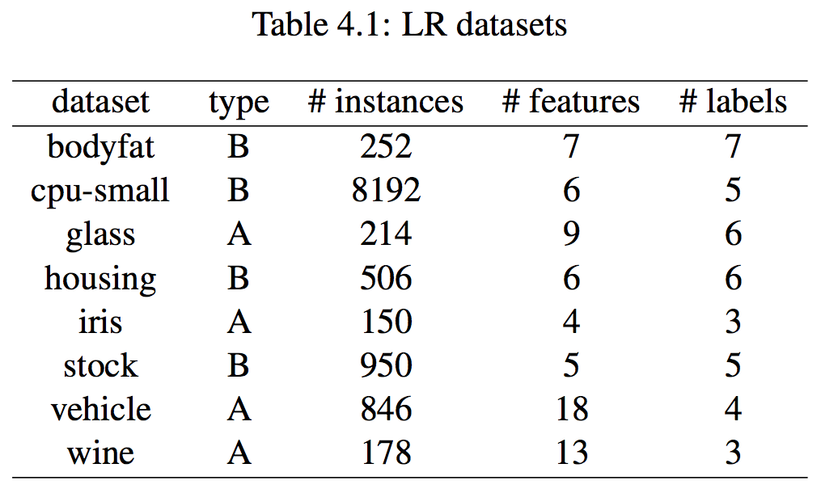
LABEL RANKING FOR ELECTION OUTCOME PREDICTION
pageNumber / totalPagesCount

Slide 38
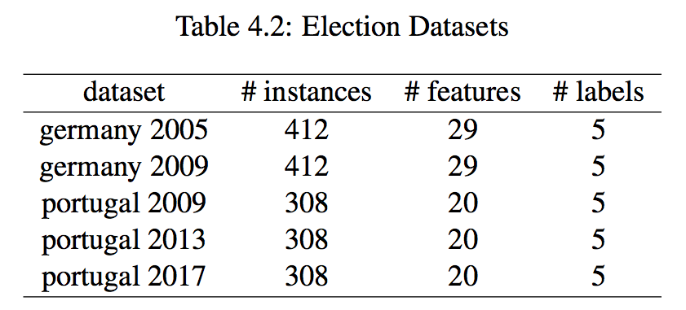
LABEL RANKING FOR ELECTION OUTCOME PREDICTION
pageNumber / totalPagesCount

Slide 39
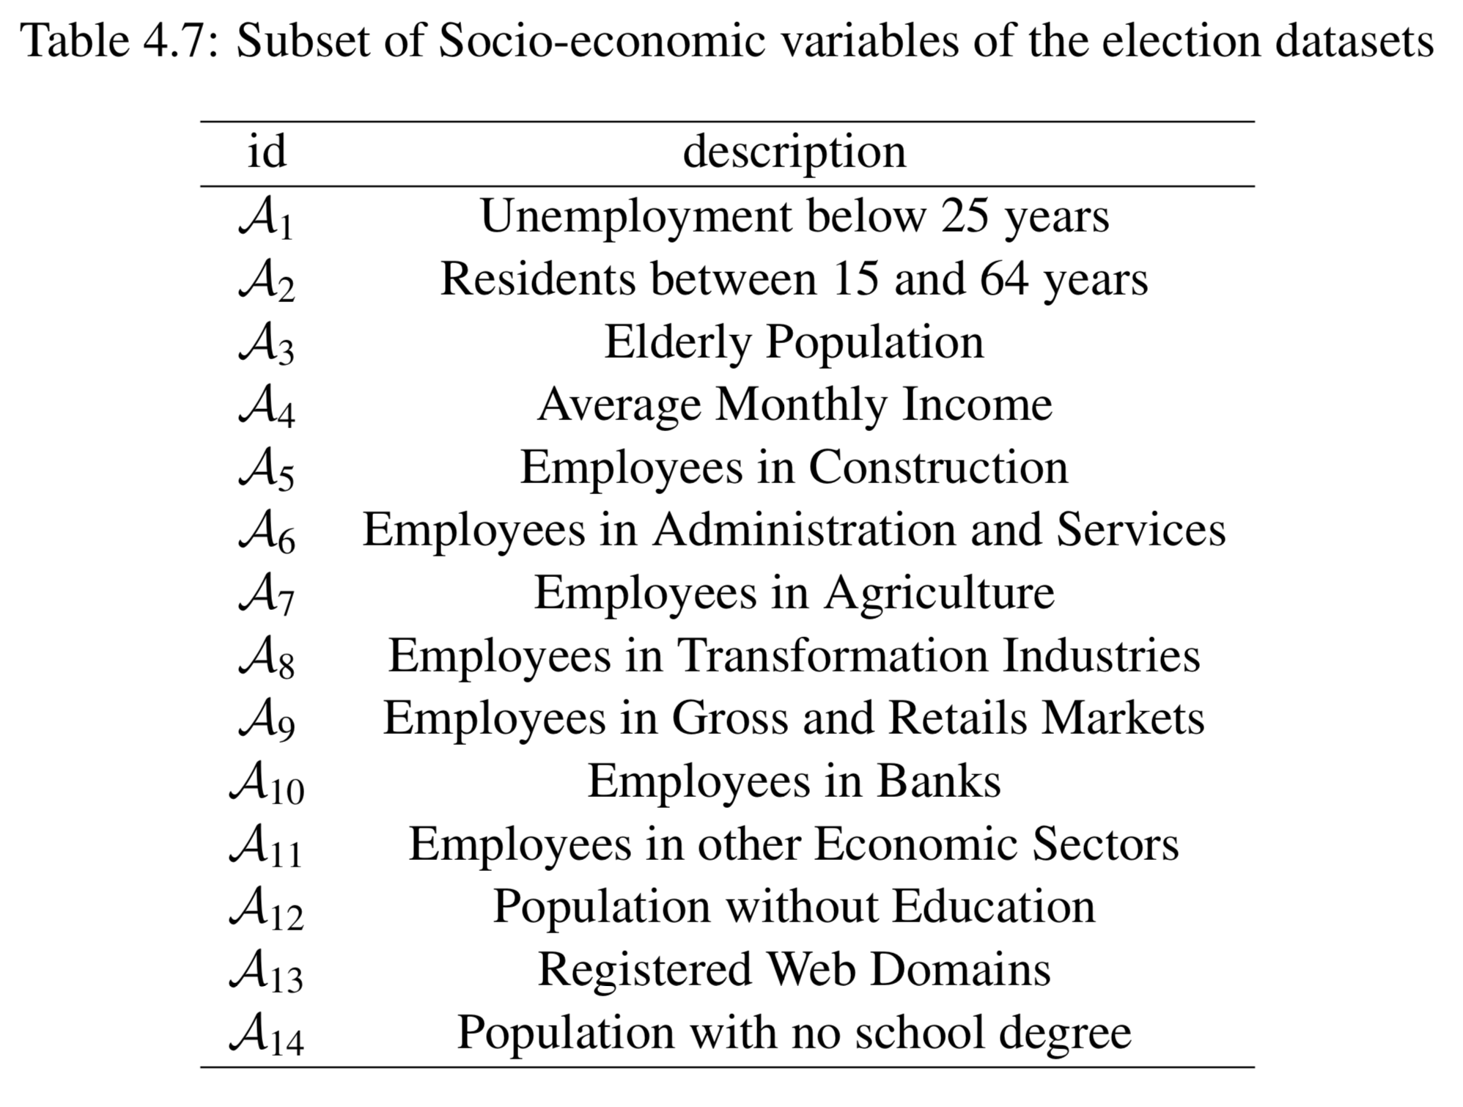
LABEL RANKING FOR ELECTION OUTCOME PREDICTION
pageNumber / totalPagesCount

Slide 40
Experimental setup
LABEL RANKING FOR ELECTION OUTCOME PREDICTION
pageNumber / totalPagesCount

Slide 41
min support = 1%
LABEL RANKING FOR ELECTION OUTCOME PREDICTION
pageNumber / totalPagesCount
A minimum support
1. generates better predictions
2. minimizes the use of the default ranking

Slide 42
LABEL RANKING FOR ELECTION OUTCOME PREDICTION
pageNumber / totalPagesCount
min confidence = 70%
We do not want to limit the rules generation
However
Predicting with a high confidence is desired

Slide 43
LABEL RANKING FOR ELECTION OUTCOME PREDICTION
pageNumber / totalPagesCount
min improvement = 0
We do not want to limit the generation of sub-rules

Slide 44
Generation of PAR and Prediction
LABEL RANKING FOR ELECTION OUTCOME PREDICTION
pageNumber / totalPagesCount

Slide 45
LABEL RANKING FOR ELECTION OUTCOME PREDICTION
pageNumber / totalPagesCount
CAREN
𝓡 rules

Slide 46
LABEL RANKING FOR ELECTION OUTCOME PREDICTION
pageNumber / totalPagesCount
Consequent e.g.: 𝝀₂ ≻ 𝝀₁ ∧ 𝝀₂ ≻ 𝝀₄
𝝀_{line} > 𝝀_{column}
𝝀_{line} < 𝝀_{column}
𝝀_{line} = 𝝀_{column}
𝝀_{line} ⟘ 𝝀_{column}
⇒
⇒
⇒
⇒
1
-1
0
NA
 | 𝝀₁ | 𝝀₂ | 𝝀₃ | 𝝀₄ | 𝝀₅
𝝀₁ | 0 | -1 | NA | NA | NA
𝝀₂ | 1 | 0 | NA | 1 | NA
𝝀₃ | NA | NA | 0 | NA | NA
𝝀₄ | NA | -1 | NA | 0 | NA
𝝀₅ | NA | NA | NA | NA | 0

Slide 47
Prediction ⇒ best rule
LABEL RANKING FOR ELECTION OUTCOME PREDICTION
pageNumber / totalPagesCount

Slide 48
Evaluation
LABEL RANKING FOR ELECTION OUTCOME PREDICTION
pageNumber / totalPagesCount

Slide 49
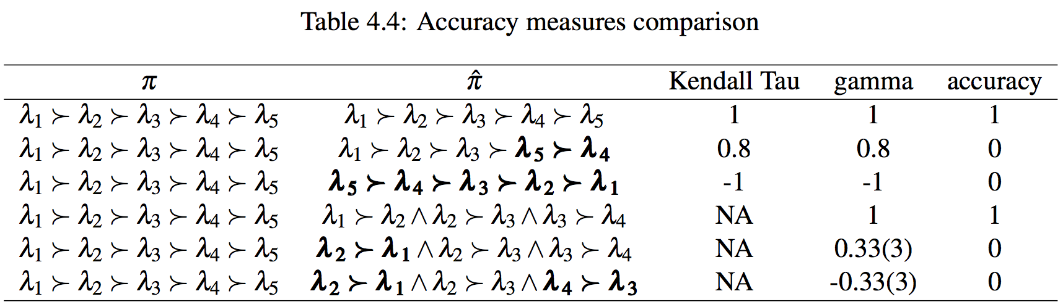
LABEL RANKING FOR ELECTION OUTCOME PREDICTION
pageNumber / totalPagesCount

Slide 50
Results and Analysis
LABEL RANKING FOR ELECTION OUTCOME PREDICTION
pageNumber / totalPagesCount
7

Slide 51
Experimental results with typical LR datasets
LABEL RANKING FOR ELECTION OUTCOME PREDICTION
pageNumber / totalPagesCount

Slide 52
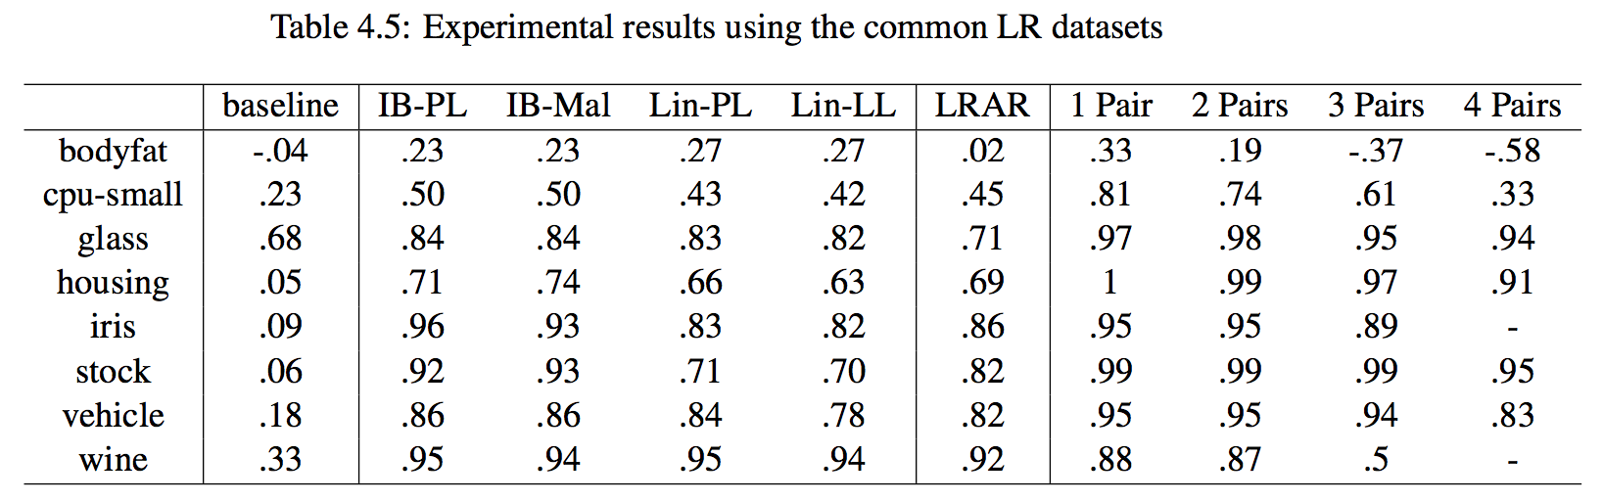
LABEL RANKING FOR ELECTION OUTCOME PREDICTION
pageNumber / totalPagesCount

Slide 53
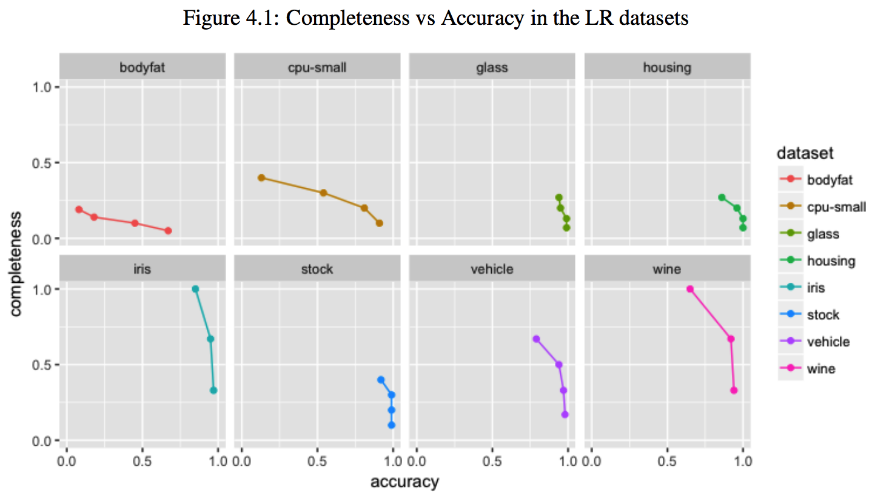
LABEL RANKING FOR ELECTION OUTCOME PREDICTION
pageNumber / totalPagesCount

Slide 54
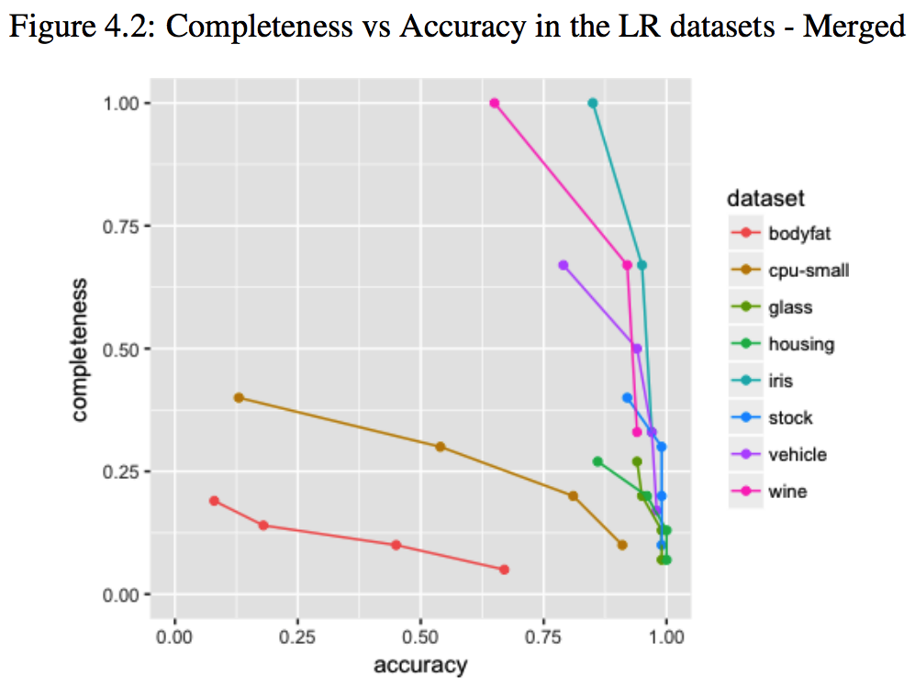
LABEL RANKING FOR ELECTION OUTCOME PREDICTION
pageNumber / totalPagesCount

Slide 55
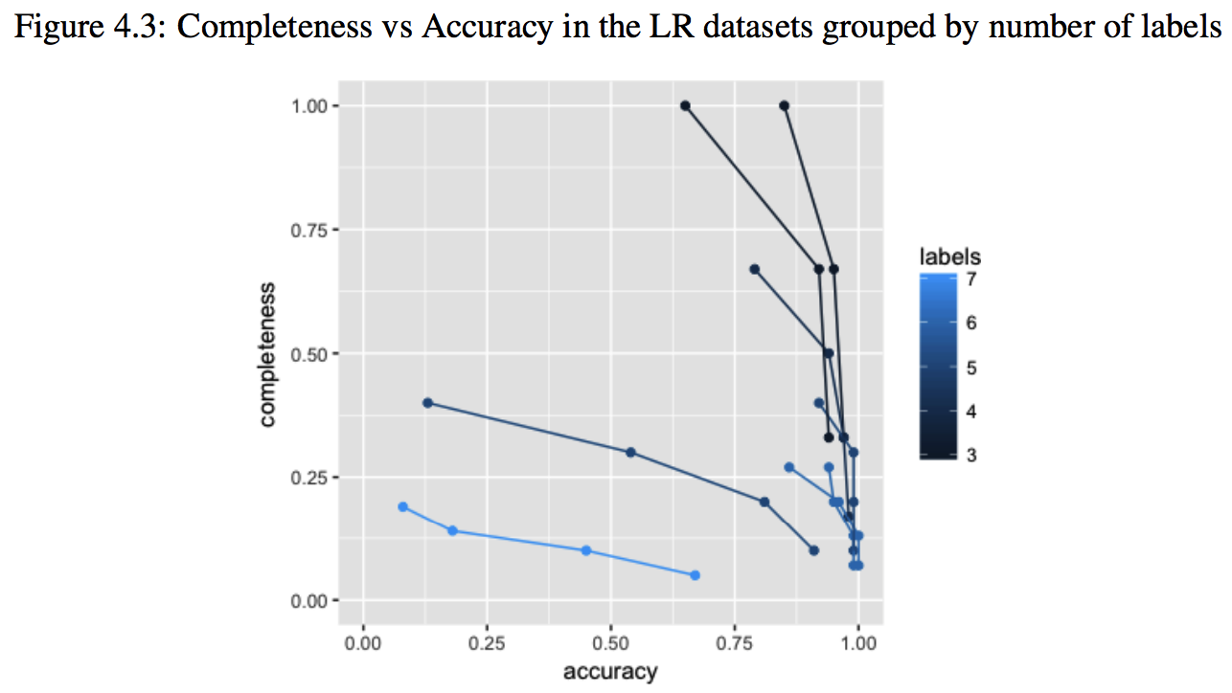
LABEL RANKING FOR ELECTION OUTCOME PREDICTION
pageNumber / totalPagesCount

Slide 56
Experimental results with LR elections datasets
LABEL RANKING FOR ELECTION OUTCOME PREDICTION
pageNumber / totalPagesCount

Slide 57
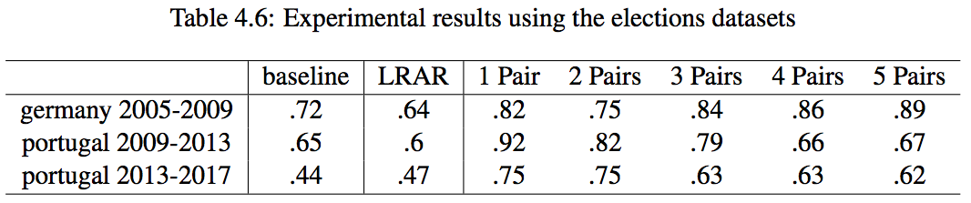
LABEL RANKING FOR ELECTION OUTCOME PREDICTION
pageNumber / totalPagesCount

Slide 58
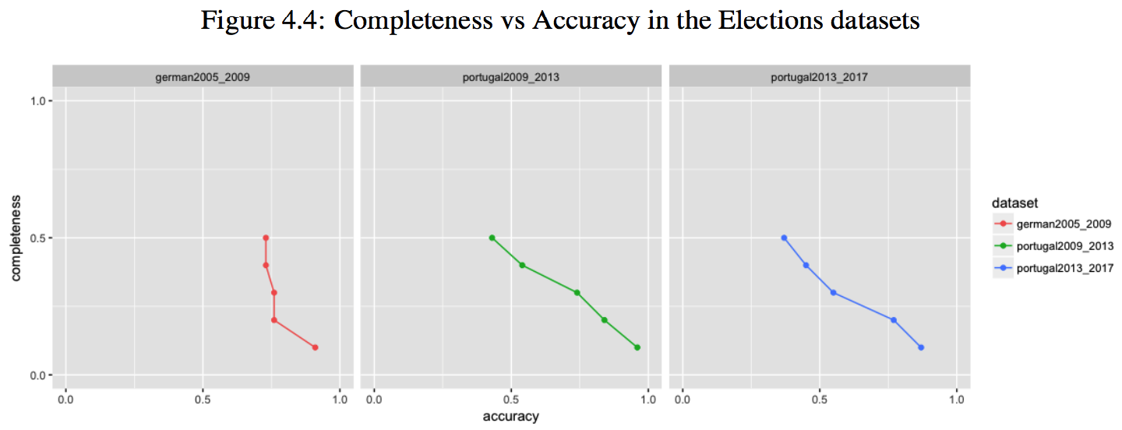
LABEL RANKING FOR ELECTION OUTCOME PREDICTION
pageNumber / totalPagesCount

Slide 59
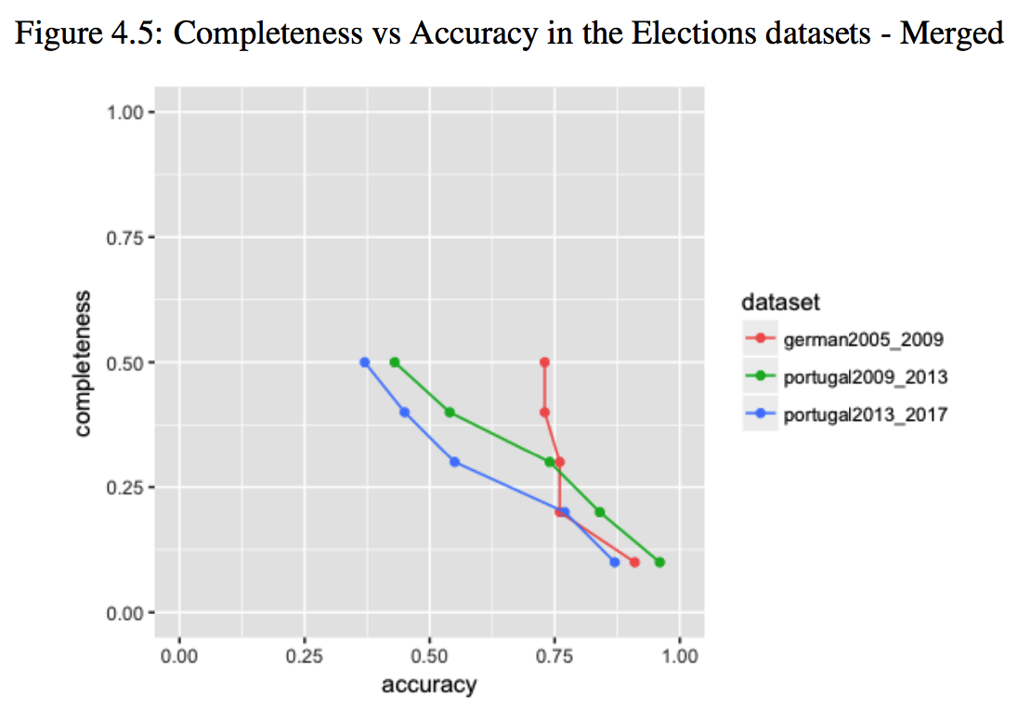
LABEL RANKING FOR ELECTION OUTCOME PREDICTION
pageNumber / totalPagesCount

Slide 60
Rule analysis
LABEL RANKING FOR ELECTION OUTCOME PREDICTION
pageNumber / totalPagesCount

Slide 61
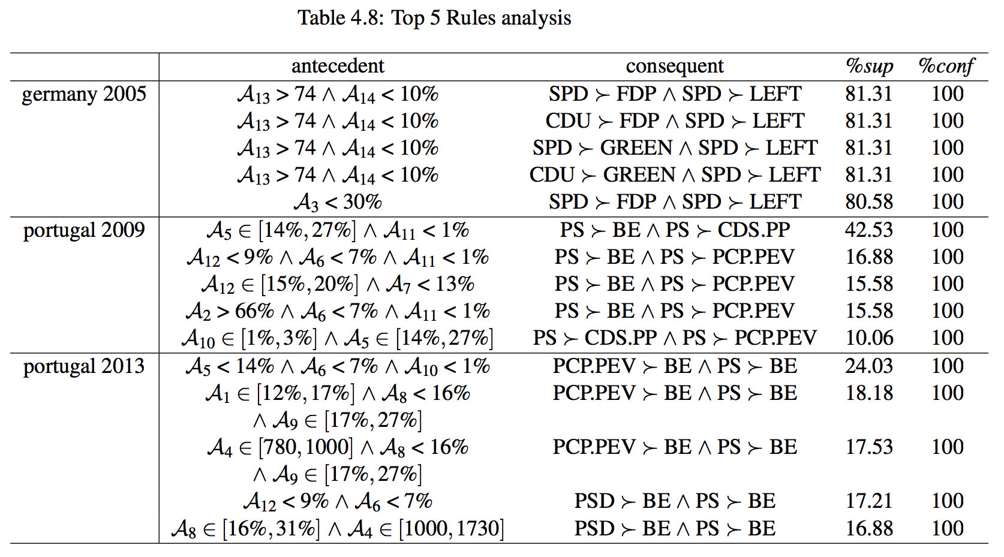
LABEL RANKING FOR ELECTION OUTCOME PREDICTION
pageNumber / totalPagesCount

Slide 62
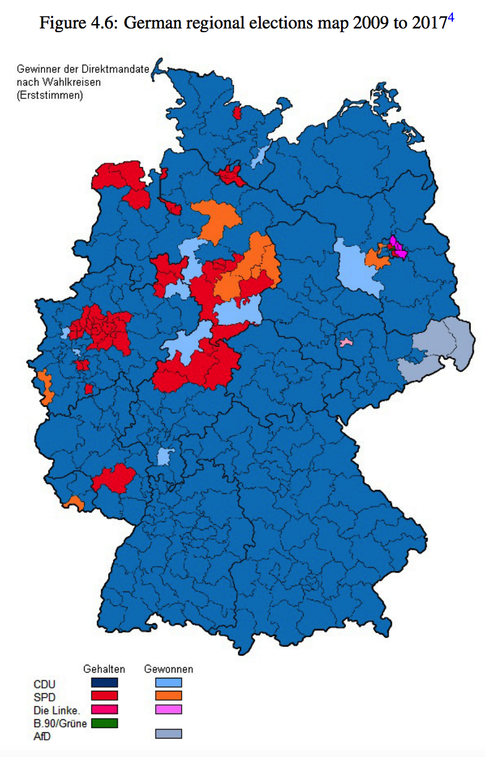
LABEL RANKING FOR ELECTION OUTCOME PREDICTION
pageNumber / totalPagesCount

Slide 63
Conclusions
LABEL RANKING FOR ELECTION OUTCOME PREDICTION
pageNumber / totalPagesCount
8

Slide 64
LABEL RANKING FOR ELECTION OUTCOME PREDICTION
pageNumber / totalPagesCount
1. PAR are a solid alternative to solve complex LR problems
2. The completeness versus accuracy trade-off is clear
3. The less information it is required, the better PAR is at predicting without mistakes
4. In situations where it is more important to have an accurate rather than more complete prediction, PAR can provide a meaningful contribution
5. It appears that in smaller rankings the accuracy is less affected
6. We contributed to the Label Ranking community with 3 real-world label ranking datasets
7. PAR finding obvious information validates our approach but does not gives much valuable information for election prediction
8. Some parties clearly dominating the political scenario lead to unbalanced ranking data
9. Computationally heavy processes of discretization and mining of LRAR and PAR limit some experimental approaches
10. As future work in PAR, we suggest improving the generation of rules with multiple items in the consequent
11. Also in PAR, we suggest studying the aggregation of rules by their consequent
12. Lastly, we suggest the application of PAR for prediction in a more balanced real-world use-case

Slide 65
LABEL RANKING FOR ELECTION OUTCOME PREDICTION
pageNumber / totalPagesCount
1. PAR are a solid alternative to solve complex LR problems
2. The completeness versus accuracy trade-off is clear
3. The less information it is required, the better PAR is at predicting without mistakes
4. In situations where it is more important to have an accurate rather than more complete prediction, PAR can provide a meaningful contribution
5. It appears that in smaller rankings the accuracy is less affected
6. We contributed to the Label Ranking community with 3 real-world label ranking datasets
7. PAR finding obvious information validates our approach but does not gives much valuable information for election prediction
8. Some parties clearly dominating the political scenario lead to unbalanced ranking data
9. Computationally heavy processes of discretization and mining of LRAR and PAR limit some experimental approaches
10. As future work in PAR, we suggest improving the generation of rules with multiple items in the consequent
11. Also in PAR, we suggest studying the aggregation of rules by their consequent
12. Lastly, we suggest the application of PAR for prediction in a more balanced real-world use-case

Slide 66
LABEL RANKING FOR ELECTION OUTCOME PREDICTION
pageNumber / totalPagesCount
1. PAR are a solid alternative to solve complex LR problems
2. The completeness versus accuracy trade-off is clear
3. The less information it is required, the better PAR is at predicting without mistakes
4. In situations where it is more important to have an accurate rather than more complete prediction, PAR can provide a meaningful contribution
5. It appears that in smaller rankings the accuracy is less affected
6. We contributed to the Label Ranking community with 3 real-world label ranking datasets
7. PAR finding obvious information validates our approach but does not gives much valuable information for election prediction
8. Some parties clearly dominating the political scenario lead to unbalanced ranking data
9. Computationally heavy processes of discretization and mining of LRAR and PAR limit some experimental approaches
10. As future work in PAR, we suggest improving the generation of rules with multiple items in the consequent
11. Also in PAR, we suggest studying the aggregation of rules by their consequent
12. Lastly, we suggest the application of PAR for prediction in a more balanced real-world use-case

Slide 67
LABEL RANKING FOR ELECTION OUTCOME PREDICTION
pageNumber / totalPagesCount
1. PAR are a solid alternative to solve complex LR problems
2. The completeness versus accuracy trade-off is clear
3. The less information it is required, the better PAR is at predicting without mistakes
4. In situations where it is more important to have an accurate rather than more complete prediction, PAR can provide a meaningful contribution
5. It appears that in smaller rankings the accuracy is less affected
6. We contributed to the Label Ranking community with 3 real-world label ranking datasets
7. PAR finding obvious information validates our approach but does not gives much valuable information for election prediction
8. Some parties clearly dominating the political scenario lead to unbalanced ranking data
9. Computationally heavy processes of discretization and mining of LRAR and PAR limit some experimental approaches
10. As future work in PAR, we suggest improving the generation of rules with multiple items in the consequent
11. Also in PAR, we suggest studying the aggregation of rules by their consequent
12. Lastly, we suggest the application of PAR for prediction in a more balanced real-world use-case

Slide 68
LABEL RANKING FOR ELECTION OUTCOME PREDICTION
pageNumber / totalPagesCount
1. PAR are a solid alternative to solve complex LR problems
2. The completeness versus accuracy trade-off is clear
3. The less information it is required, the better PAR is at predicting without mistakes
4. In situations where it is more important to have an accurate rather than more complete prediction, PAR can provide a meaningful contribution
5. It appears that in smaller rankings the accuracy is less affected
6. We contributed to the Label Ranking community with 3 real-world label ranking datasets
7. PAR finding obvious information validates our approach but does not gives much valuable information for election prediction
8. Some parties clearly dominating the political scenario lead to unbalanced ranking data
9. Computationally heavy processes of discretization and mining of LRAR and PAR limit some experimental approaches
10. As future work in PAR, we suggest improving the generation of rules with multiple items in the consequent
11. Also in PAR, we suggest studying the aggregation of rules by their consequent
12. Lastly, we suggest the application of PAR for prediction in a more balanced real-world use-case

Slide 69
LABEL RANKING FOR ELECTION OUTCOME PREDICTION
pageNumber / totalPagesCount
1. PAR are a solid alternative to solve complex LR problems
2. The completeness versus accuracy trade-off is clear
3. The less information it is required, the better PAR is at predicting without mistakes
4. In situations where it is more important to have an accurate rather than more complete prediction, PAR can provide a meaningful contribution
5. It appears that in smaller rankings the accuracy is less affected
6. We contributed to the Label Ranking community with 3 real-world label ranking datasets
7. PAR finding obvious information validates our approach but does not gives much valuable information for election prediction
8. Some parties clearly dominating the political scenario lead to unbalanced ranking data
9. Computationally heavy processes of discretization and mining of LRAR and PAR limit some experimental approaches
10. As future work in PAR, we suggest improving the generation of rules with multiple items in the consequent
11. Also in PAR, we suggest studying the aggregation of rules by their consequent
12. Lastly, we suggest the application of PAR for prediction in a more balanced real-world use-case

Slide 70
LABEL RANKING FOR ELECTION OUTCOME PREDICTION
pageNumber / totalPagesCount
1. PAR are a solid alternative to solve complex LR problems
2. The completeness versus accuracy trade-off is clear
3. The less information it is required, the better PAR is at predicting without mistakes
4. In situations where it is more important to have an accurate rather than more complete prediction, PAR can provide a meaningful contribution
5. It appears that in smaller rankings the accuracy is less affected
6. We contributed to the Label Ranking community with 3 real-world label ranking datasets
7. PAR finding obvious information validates our approach but does not gives much valuable information for election prediction
8. Some parties clearly dominating the political scenario lead to unbalanced ranking data
9. Computationally heavy processes of discretization and mining of LRAR and PAR limit some experimental approaches
10. As future work in PAR, we suggest improving the generation of rules with multiple items in the consequent
11. Also in PAR, we suggest studying the aggregation of rules by their consequent
12. Lastly, we suggest the application of PAR for prediction in a more balanced real-world use-case

Slide 71
LABEL RANKING FOR ELECTION OUTCOME PREDICTION
pageNumber / totalPagesCount
1. PAR are a solid alternative to solve complex LR problems
2. The completeness versus accuracy trade-off is clear
3. The less information it is required, the better PAR is at predicting without mistakes
4. In situations where it is more important to have an accurate rather than more complete prediction, PAR can provide a meaningful contribution
5. It appears that in smaller rankings the accuracy is less affected
6. We contributed to the Label Ranking community with 3 real-world label ranking datasets
7. PAR finding obvious information validates our approach but does not gives much valuable information for election prediction
8. Some parties clearly dominating the political scenario lead to unbalanced ranking data
9. Computationally heavy processes of discretization and mining of LRAR and PAR limit some experimental approaches
10. As future work in PAR, we suggest improving the generation of rules with multiple items in the consequent
11. Also in PAR, we suggest studying the aggregation of rules by their consequent
12. Lastly, we suggest the application of PAR for prediction in a more balanced real-world use-case

Slide 72
LABEL RANKING FOR ELECTION OUTCOME PREDICTION
pageNumber / totalPagesCount
1. PAR are a solid alternative to solve complex LR problems
2. The completeness versus accuracy trade-off is clear
3. The less information it is required, the better PAR is at predicting without mistakes
4. In situations where it is more important to have an accurate rather than more complete prediction, PAR can provide a meaningful contribution
5. It appears that in smaller rankings the accuracy is less affected
6. We contributed to the Label Ranking community with 3 real-world label ranking datasets
7. PAR finding obvious information validates our approach but does not gives much valuable information for election prediction
8. Some parties clearly dominating the political scenario lead to unbalanced ranking data
9. Computationally heavy processes of discretization and mining of LRAR and PAR limit some experimental approaches
10. As future work in PAR, we suggest improving the generation of rules with multiple items in the consequent
11. Also in PAR, we suggest studying the aggregation of rules by their consequent
12. Lastly, we suggest the application of PAR for prediction in a more balanced real-world use-case

Slide 73
LABEL RANKING FOR ELECTION OUTCOME PREDICTION
pageNumber / totalPagesCount
1. PAR are a solid alternative to solve complex LR problems
2. The completeness versus accuracy trade-off is clear
3. The less information it is required, the better PAR is at predicting without mistakes
4. In situations where it is more important to have an accurate rather than more complete prediction, PAR can provide a meaningful contribution
5. It appears that in smaller rankings the accuracy is less affected
6. We contributed to the Label Ranking community with 3 real-world label ranking datasets
7. PAR finding obvious information validates our approach but does not gives much valuable information for election prediction
8. Some parties clearly dominating the political scenario lead to unbalanced ranking data
9. Computationally heavy processes of discretization and mining of LRAR and PAR limit some experimental approaches
10. As future work in PAR, we suggest improving the generation of rules with multiple items in the consequent
11. Also in PAR, we suggest studying the aggregation of rules by their consequent
12. Lastly, we suggest the application of PAR for prediction in a more balanced real-world use-case

Slide 74
LABEL RANKING FOR ELECTION OUTCOME PREDICTION
pageNumber / totalPagesCount
1. PAR are a solid alternative to solve complex LR problems
2. The completeness versus accuracy trade-off is clear
3. The less information it is required, the better PAR is at predicting without mistakes
4. In situations where it is more important to have an accurate rather than more complete prediction, PAR can provide a meaningful contribution
5. It appears that in smaller rankings the accuracy is less affected
6. We contributed to the Label Ranking community with 3 real-world label ranking datasets
7. PAR finding obvious information validates our approach but does not gives much valuable information for election prediction
8. Some parties clearly dominating the political scenario lead to unbalanced ranking data
9. Computationally heavy processes of discretization and mining of LRAR and PAR limit some experimental approaches
10. As future work in PAR, we suggest improving the generation of rules with multiple items in the consequent
11. Also in PAR, we suggest studying the aggregation of rules by their consequent
12. Lastly, we suggest the application of PAR for prediction in a more balanced real-world use-case

Slide 75
LABEL RANKING FOR ELECTION OUTCOME PREDICTION
pageNumber / totalPagesCount
1. PAR are a solid alternative to solve complex LR problems
2. The completeness versus accuracy trade-off is clear
3. The less information it is required, the better PAR is at predicting without mistakes
4. In situations where it is more important to have an accurate rather than more complete prediction, PAR can provide a meaningful contribution
5. It appears that in smaller rankings the accuracy is less affected
6. We contributed to the Label Ranking community with 3 real-world label ranking datasets
7. PAR finding obvious information validates our approach but does not gives much valuable information for election prediction
8. Some parties clearly dominating the political scenario lead to unbalanced ranking data
9. Computationally heavy processes of discretization and mining of LRAR and PAR limit some experimental approaches
10. As future work in PAR, we suggest improving the generation of rules with multiple items in the consequent
11. Also in PAR, we suggest studying the aggregation of rules by their consequent
12. Lastly, we suggest the application of PAR for prediction in a more balanced real-world use-case

Slide 76
Thank you
Obrigado

