Slide 1
Blockchain 101
1# Security Fundamental Concepts

Slide 2
About me
My name is Miguel Garcia
My background is on intrusion-tolerant systems
I am a cryptocurrency skeptic, but I am a Blockchain enthusiast (however, I don't think it solves all the problems in the world)

Slide 3
About Blockchain101
This is not a course on cryptocurrencies, I will not teach you how to become a bitcoin millionaire or create a mining pool.
This course is a about the blockchain technology – which happens to be the core of the Bitcoin.
It should provide you theoretical and practical knowledge about Blockchain.

Slide 4
Blockchain101: contents
Security Fundamental Concepts
Secure Distributed Systems
Blockchain in a Nutshell
Assembling the pieces: Blockchain prototype

Slide 5
Blockchain core parts
Blockchain technology has three key parts:
Security
Cryptography
Fault-tolerance
Structure
Ledger
P2P
Network

Slide 6
Security Properties
A system is said secure if it guarantees the following properties
Confidentiality
Integrity
Authenticity
Availability

Slide 7
Security Properties
Confidentiality:
Only authorized people can see the data
Imagine that we have Bob, Alice and Trent
Bob sends as letter to Alice and only Alice should read the text
Therefore, we need to ensure that Trent cannot read the text

Slide 8
Security Properties
Integrity:
Data cannot be modified without authorization or undetected.
Imagine that we have Bob, Alice and Trent
Bob sends as letter to Alice
Trent takes the letter and change some words
The data should avoid this modification OR Alice should be able to detect this modification

Slide 9
Security Properties
Authentication:
The one that sends data can prove that he or she is the author of the data
Bob sends as letter to Alice
Alice knows that Bob sent the letter
Trent cannot send a letter to Alice saying that he is Bob

Slide 10
Security Properties
Availability:
Data or services should be always available

Slide 11
How can we guarantee these properties?

Slide 12
Cryptography
Long time ago, Cryptography was synonym of encryption
The idea was to send text messages that adversaries couldn't read
The main classical ciphers were based on transposition:
Hello world ehlol owrdl
And substitution:
Hello world Ijmmp xpsme
A more advanced cipher was the Caeser Cipher, that applied substitution cipher based on a fixed number of shifts

Slide 13
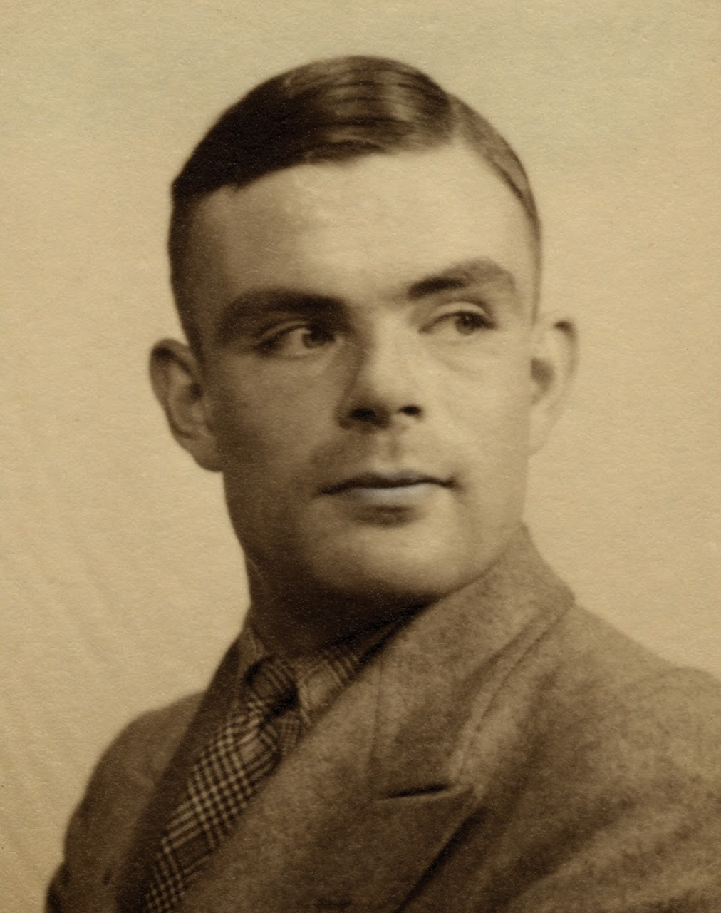
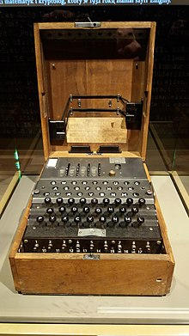
Cryptography
During the WWII the Enigma Machine was one of the weapons of the Nazis that could communicate without the allies discover the meaning of the messages
Thanks to Allan Turing that cracked the Enigma Machine it was possible to uncover the encoded messages and defeat the Nazis

Slide 14
Cryptography (computer era)
Terminology
Method | Function | Output
Encrypt | E(Clear Message, Key) | Ciphered Message
Decrypt | D(Ciphered Message, Key) | Clear Message
Hash | H(Message) | Message Digest
Sign | S(Message) | Signture
Validate | V(Signature) | Boolean (true or false)

Slide 15


Symetric-key Cryptography
Symetric-key cryptography uses the same key to encrypt and decrypt
Therefore, is also called secret-key or shared-key cryptography
Alice
Bob
Hello
A!D$#
A!D$#
Hello

Slide 16
Symetric-key Cryptography
Properties:
E(K,M) = c , then D(K,c) = M
D(K, (E(K,M)) = M
Attributes:
Given E(K,M) is infeasible to find M without K
Given E(K,M)=c is infeasible to find K

Slide 17
Symetric-key Cryptography
E ( Key, Data ) = ciphered data
Encrypt
Variable size key
VByCFfclNy+OXk96fA3PpnlG03Rgm+rItxLTN8N0hXY+BuSpYwpjEItbFhgUE33RN0qlxLbIB0FnH/xqs9yWn6h7GlZlEo/cpSNlpfU7Ezd7XWTjtt2JlpHidIvBGYhAkpA5OhWp8GgryVB+….......
Input data: text, bytes
This a clear text message
Ciphered data: bytes
ASDadkasERLDLASck495$%!"#

Slide 18
Symetric-key Cryptography
D( Key, Ciphered data) = data
Decrypt
Variable size key
VByCFfclNy+OXk96fA3PpnlG03Rgm+rItxLTN8N0hXY+BuSpYwpjEItbFhgUE33RN0qlxLbIB0FnH/xqs9yWn6h7GlZlEo/cpSNlpfU7Ezd7XWTjtt2JlpHidIvBGYhAkpA5OhWp8GgryVB+….......
Input data: bytes
ASDadkasERLDLASck495$%!"#
Clear data: text, bytes
This a clear text message

Slide 19

Asymetric Cryptography
Asymetric-key cryptography uses two keys
Public key is used to encrypt and private key to decrypt
Alice uses Bob' public key to encrypt, Bob uses its private key to decrypt
Alice
Bob
Hello
A!D$#
A!D$#
Hello
Bob's public key
Bob's private key

Slide 20

Discussion slide
Could we use the private key to encrypt and the public key to decrypt?

Slide 21
Asymetric Cryptography
Properties:
E(Ku,M) = c , then D(Kp,c) = M
D(Ku, (E(Kp,M)) = M
Attributes:
Given E(Ku,M) is infeasible to find M without Kp

Slide 22
Asymetric-key Cryptography
E ( Public Key, Data ) = ciphered data
Encrypt
Variable size key
VByCFfclNy+OXk96fA3PpnlG03Rgm+rItxLTN8N0hXY+BuSpYwpjEItbFhgUE33RN0qlxLbIB0FnH/xqs9yWn6h7GlZlEo/cpSNlpfU7Ezd7XWTjtt2JlpHidIvBGYhAkpA5OhWp8GgryVB+….......
Input data: text, bytes
This a clear text message
Ciphered data: bytes
ASDadkasERLDLASck495$%!"#

Slide 23
Asymetric-key Cryptography
D( Private Key, Ciphered data) = data
Decrypt
Variable size key
ASDldoweifkf++33$32llapjrlçajERKFJas´++r+a#$$klasdçaspjpamkasligellasllERASllfiElfELasṕro4lc-.fo39$$332ças004#"o23''0400lliff//flaslrpprp+asçept.....
Input data: bytes
ASDadkasERLDLASck495$%!"#
Clear data: text, bytes
This a clear text message

Slide 24

Cryptography properties
Confusion:
The adversary should not detect changes in the ciphered text if we change one symbol in the clear text.
Therefore, it should be a complex relation between the clear text and the ciphered text
Hello world
Hello world!
A$%DftDF
A$%DftDFD

Slide 25
Cryptography properties
Diffusion:
The clear text information should be spread all over the ciphered text
Therefore, an attacker must collect a lot of ciphered text data to figure out how the cipher works
Hello world
Hello world!
A$%DftDF
%TdasDLD

Slide 26
Symetric-key vs Asymetric-key Cryptography
Symetric-key Cryptography:
The security relies on the shared key, once is lost the security is broken
Key distribution: (n (n-1) / 2) keys for n participants
10 participants need 45 keys, one key for each pair of participants
Asymetric-key Cryptography :
There is no need for key distribution, the public key is public so anyone can use it to encrypt data
The security relies on the protection of the private key
Is slower than symetric-key cryptography

Slide 27

Meeting point slide
To guarantee confidentiality, we need cryptography
In particular, by using secret-key or public-key cryptography
Secret-key cryptography uses one shared key to encrypt and decrypt
Public-key cryptography uses the destination public key to encrypt, and destination private key to decrypt – only the private-key owner can decrypt the message
Symetric-key cryptography = Secret-key cryptography
Asymetric-key cryptography = Public-key cryptography

Slide 28
We already know how to guarantee confidentiality. How can we guarantee authenticity and integrity?

Slide 29
Digital Signatures
Digital signatures are very similar to asymetric-key cryptography, however, instead of using public key to ecnrypt we use private key to sign
Very important: Signing a message is not the same as encrypting a message
Another important note: it is assumed that only the owner has access to the private key
Signatures (alone) do not provide confidentiality but provide authenticity and integrity (and other properties)

Slide 30
Digital Signatures extra properties
Authenticity: who signed the message is uniquely identifiable by his/her signature.
Tamperproof: who signed, signed deliberatily
Integrity: A valid signature guarantees that a message is not modified without being noticed
No-reuse: A signture, or part of it, is not reusable in another message
No-repudiation: the signer cannot deny his/her signature

Slide 31

Digital Signatures
Sender: sign(M, Kp) = S (signture)
Sender: sends message and signature
Receiver: verify(M, S, Ku) = true or false
Hello
Hello
Bob
Alice
Hello
A!D$#
A!D$#
Bob's private key
Bob's public key

Slide 32
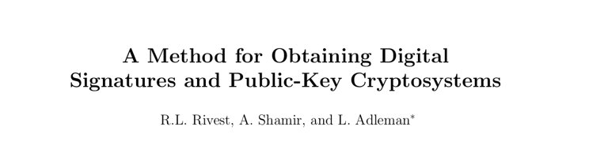
Digital Signatures: RSA
It was published in 1978 by Rivest,, Shamir and adleman (RSA)
RSA can be used for both cipher and signatures
It is the most used algorithm on the web.
É muito utilizado em aplicações de comércio electrónico

Slide 33
Digital Signatures: RSA: Key generation
Public Key: (n, e)
Private Key: d
Step 1: Choose two large prime numbers p and q

Slide 34
Digital Signatures: RSA: Key generation
A prime number is a natural number greater than 1 that is not a product of two smaller natural numbers.
Public Key: (n, e)
Private Key: d
Step 1: Choose two large prime numbers p and q

Slide 35
Digital Signatures: RSA: Key generation
A prime number is a natural number greater than 1 that is not a product of two smaller natural numbers.
Public Key: (n, e)
Private Key: d
Step 1: Choose two large prime numbers p and q
p = 43
q = 47

Slide 36
Digital Signatures: RSA: Key generation
Public Key: (n, e)
Private Key: d
Step 2: Compute n = p x q
n = 43 x 47
n = 2021

Slide 37
Digital Signatures: RSA: Key generation
Euler's phi function is the number of integers k in the range 1 ≤ k ≤ n for which the greatest common divisor gcd(n, k) is equal to 1
Public Key: (n, e)
Private Key: d
Step 3: Compute ϕ(n)
ϕ(n) = ϕ(p-1)(q-1)

Slide 38
Digital Signatures: RSA: Key generation
Public Key: (n, e)
Private Key: d
Step 3: Compute ϕ(n)
ϕ(n) = ϕ(p-1)(q-1)
ϕ(2021) = (43-1)(47-1)

Slide 39
Digital Signatures: RSA: Key generation
Public Key: (n, e)
Private Key: d
Step 3: Compute ϕ(n)
ϕ(n) = ϕ(p-1)(q-1)
ϕ(2021) = (43-1)(47-1)
ϕ(2021)=1932

Slide 40
Digital Signatures: RSA: Key generation
The greatest common divisor (gcd) of two integers is the largest positive integer that divides each of the integers.
For example, the gcd of 8 and 12 is 4
Public Key: (n, e)
Private Key: d
Step 4: Select e, e is the public exponent
Such that e ∈ { 1, … , ϕ(n-1) } gcd(e, 1932) = 1
For example: e = 155

Slide 41
Digital Signatures: RSA: Key generation
This equation can be solved using the Extended Euclidean Algorithm (see references)
Public Key: (n, e)
Private Key: d
Step 5: Compute private key d
d x e ≡ 1 mod ϕ(n)
d x 155 ≡ 1 mod 1932
d = 1583

Slide 42
Digital Signatures: RSA: Sign
Now Bob wants to send a signed message to Alice
Bob's Public Key: (2021,155)
Bob's Private Key: 1583
The message m ∈ { 1, … , n-1 }, e.g., m = 411
Remember that we are using small prime numbers for the sake of simplicity.
n-1 should accommodate any messages with larger prime numbers.

Slide 43
Digital Signatures: RSA: Sign
Now Bob wants to send a signed message to Alice
Bob's Public Key: (2021,155)
Bob's Private Key: 1583
M: 411
Signature algorithm
S = 411¹⁵⁸³ mod 2021
S=402

Slide 44
Digital Signatures: RSA: Sending M
Now Bob wants to send a signed message to Alice
Bob's Public Key: (2021,155)
Bob's Private Key: 1583
M: 411
S=402
411
411
Bob
Alice
1583
(2021,155)
411
402
402
Bob's private key
Bob's public key

Slide 45
Digital Signatures: RSA: Validating S
Now Bob wants to send a signed message to Alice
Bob's Public Key: (2021,155)
Bob's Private Key: 1583
M: 411
S=402
Validating algorithm
M' = 402¹⁵⁵ mod 2021
M'=402
If M'=M, return true
If M'!=M, return false

Slide 46
Meeting point slide
Signatures provide message authenticity and integrity
Only the owner of the private key can sign a message
Anyone with his/her public key can verify the message
The signature depends on the data, therefore a signature cannot be used to other data/messages
It is not the same as a human handwritten signture
The sender needs to send the signature and the message
The receiver needs to use the public key, the signature and the message to validate the integrity and authenticity

Slide 47
Signtures guarantee integrity and authentication. Can we guarantee integrity with a simple solution?

Slide 48
Hash Function
Hash functions also provide integrity
They are cheaper – but don't provide authenticity
A Hash function receives as an input an arbitrary size and outputs a fixed sized string
The most important feature of these functions is that they are deterministic
In other words, for the same input they produce always the same ouput

Slide 49
Hash Function
input
output
Hello world
OD%O$ASL&/DFOR4562ODL"%
Hello World
OP#$kfjr4%&DASCdlfkgg4$(/F

Slide 50
Discussion slide
Can you think of a hash function solution?

Slide 51
Cryptographic Hash Function
It is a one-way function; it is infeasible to find the inverse function of the hash function
If you change one bit in the input the output should change drastically (this is called the avalanche effect)
A few important properties that these functions guarantee:
Given M it should be easy to compute H(M) = hash
Given the hash it is infeasible to find M
It is hard to find M' and M such that H(M') = H(M)

Slide 52
Cryptographic Hash Function: SHA256
The SHA (Secure Hash Algorithm) is cryptographic hash function.
A cryptographic hash is like a signature for a data set, or like the fingerprints of the data.
SHA256 algorithm generates an almost-unique, fixed size 256-bit (32-byte) hash.
It is suitable for checking integrity of your data, challenge hash authentication, anti-tamper, digital signatures, blockchain.

Slide 53
Cryptographic Hash Function: SHA256
The SHA (Secure Hash Algorithm) is cryptographic hash function.
A cryptographic hash is like a signature for a data set, or like the fingerprints of the data.
SHA256 algorithm generates an almost-unique, fixed size 256-bit (32-byte) hash.
It is suitable for checking integrity of your data, challenge hash authentication, anti-tamper, digital signatures, blockchain.
MD5 is no longer secure!

Slide 54
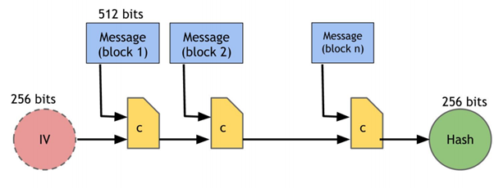
Cryptographic Hash Function: SHA256
Input: any size
Block: 512 bits
Output: 256 bits
Rounds: 64
This Photo by Unknown author is licensed under CC BY-SA.

Slide 55
Cryptographic Hash Function: SHA256
Step1 add the padding to the input message
M + P + 64 = n x 512
M = length of original message P = padded bits
Nx512 bits
Message
1000000....
M
M bits
64 bits

Slide 56
Cryptographic Hash Function: SHA256
Step1 add the padding to the input message
M + P + 64 = n x 512
M = length of original message P = padded bits
The appended bit begin with ‘1’ and the following bits must be ‘0’ till we are exactly 64 bits less than the multiple of 512.
Nx512 bits
Message
1000000....
M
M bits
64 bits

Slide 57
Cryptographic Hash Function: SHA256
Step1 add the padding to the input message
M + P + 64 = n x 512
M = length of original message P = padded bits
Length bits which is equivalent to 64 bits, to the overall message to make the entire thing an exact multiple of 512
Nx512 bits
Message
1000000....
M
M bits
64 bits

Slide 58
Cryptographic Hash Function: SHA256
a = 0x6a09e667 b = 0xbb67ae85 c = 0x3c6ef372 d = 0xa54ff53a e = 0x510e527f f = 0x9b05688c g = 0x1f83d9ab h = 0x5be0cd19
Step2 Initialize the buffers
k[0..63] := 0x428a2f98, 0x71374491, 0xb5c0fbcf, 0xe9b5dba5, 0x3956c25b, 0x59f111f1, 0x923f82a4, 0xab1c5ed5, 0xd807aa98, 0x12835b01, 0x243185be, 0x550c7dc3, 0x72be5d74, 0x80deb1fe, 0x9bdc06a7, 0xc19bf174, 0xe49b69c1, 0xefbe4786, 0x0fc19dc6, 0x240ca1cc, 0x2de92c6f, 0x4a7484aa, 0x5cb0a9dc, 0x76f988da, 0x983e5152, 0xa831c66d, 0xb00327c8, 0xbf597fc7, 0xc6e00bf3, 0xd5a79147, 0x06ca6351, 0x14292967, 0x27b70a85, 0x2e1b2138, 0x4d2c6dfc, 0x53380d13, 0x650a7354, 0x766a0abb, 0x81c2c92e, 0x92722c85, 0xa2bfe8a1, 0xa81a664b, 0xc24b8b70, 0xc76c51a3, 0xd192e819, 0xd6990624, 0xf40e3585, 0x106aa070, 0x19a4c116, 0x1e376c08, 0x2748774c, 0x34b0bcb5, 0x391c0cb3, 0x4ed8aa4a, 0x5b9cca4f, 0x682e6ff3, 0x748f82ee, 0x78a5636f, 0x84c87814, 0x8cc70208, 0x90befffa, 0xa4506ceb, 0xbef9a3f7, 0xc67178f2

Slide 59
Cryptographic Hash Function: SHA256
Step3 Compression function
The entire message (n x 512 bits long) is divided into n chunks of 512 bits.
Each of these 512 bits, are then put through 64 rounds of operations.
The output is the input for the chunk
32bits
128bits
W[0] & K[0]
Round 1
512 bit chunk 1
W[i] & K[i]
Round i
W[63] & K[63]
Round 64
512 bit chunk 2
Output for the next chunk

Slide 60
Cryptographic Hash Function: SHA256
Step3 Compression function
W(i) = Wⁱ⁻¹⁶ + σ⁰ + Wⁱ⁻⁷ + σ¹ where: σ⁰ = (Wⁱ⁻¹⁵ ROTR⁷(x)) XOR (Wⁱ⁻¹⁵ ROTR¹⁸(x)) XOR (Wⁱ⁻¹⁵ SHR³(x)) σ¹ = (Wⁱ⁻² ROTR¹⁷(x)) XOR (Wⁱ⁻² ROTR¹⁹(x)) XOR (Wⁱ⁻² SHR¹⁰(x)) ROTRⁿ(x) = Circular right rotation of 'x' by 'n' bits SHRⁿ(x) = Circular right shift of 'x' by 'n' bits
The entire message (n x 512 bits long) is divided into n chunks of 512 bits.
Each of these 512 bits, are then put through 64 rounds of operations.
The output is the input for the chunk
32bits
128bits
W[0] & K[0]
Round 1
512 bit chunk 1
W[i] & K[i]
Round i
W[63] & K[63]
Round 64
512 bit chunk 2
Output for the next chunk

Slide 61
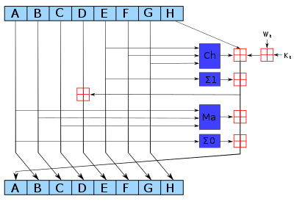
Cryptographic Hash Function: SHA256
Step3 Compression function
Ch(E, F, G) = (E AND F) XOR ((NOT E) AND G) Ma(A, B, C) = (A AND B) XOR (A AND C) XOR (B AND C) ∑(A) = (A >>> 2) XOR (A >>> 13) XOR (A >>> 22) ∑(E) = (E >>> 6) XOR (E >>> 11) XOR (E >>> 25) = addition modulo 2
This Photo by Unknown author is licensed under CC BY-SA.

Slide 62
Cryptographic Hash Function: SHA256
Step3 Compression function
In a near future, SHA256 may no longer be secure. People are slowly moving to SHA512.
Ch(E, F, G) = (E AND F) XOR ((NOT E) AND G) Ma(A, B, C) = (A AND B) XOR (A AND C) XOR (B AND C) ∑(A) = (A >>> 2) XOR (A >>> 13) XOR (A >>> 22) ∑(E) = (E >>> 6) XOR (E >>> 11) XOR (E >>> 25) = addition modulo 2
This Photo by Unknown author is licensed under CC BY-SA.

Slide 63
Meeting point slide
Cryptographic hash functions are one-way functions
This means it (should be) is impossible to find the input based on the output
They are also deterministic
This means that for the same input the output is always the same
The hash function output has a fixed size output, the input can have any size
It guarantees integrity, it can be used – with caution – to encrypt data

Slide 64

Coding time
Python overview
Basic structures
Signature example: RSA
Hash function example: SHA256

