Slide 1
Target-Mediated Drug Disposition models
Miguel Gómez García
Notes:
Modelos de disposición de fármacos mediada por diana

Slide 2
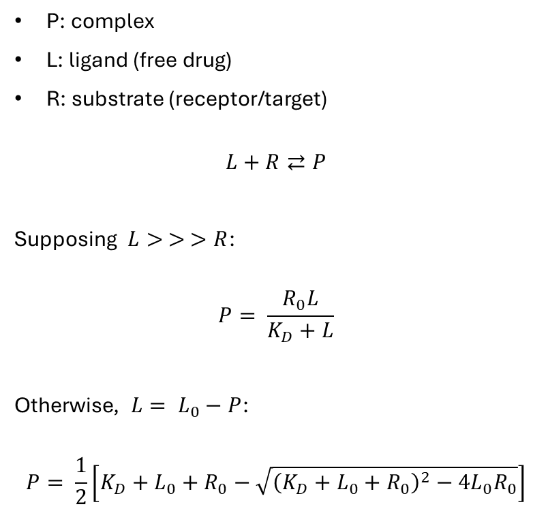
Sationary state
P: complex
L: ligand (free drug)
R: substrate (receptor/target)
$$L+R⇄P$$
Supposing $L> > >R$:
$$P= \frac{R_{0}L}{K_{D}+L}$$
Otherwise, $L= L_{0}−P$:
$$P= \frac{1}{2}\left[K_{D}+L_{0}+R_{0}−\sqrt{{\left(K_{D}+L_{0}+R_{0}\right)}^{2}−4L_{0}R_{0}}\right]$$

Slide 3
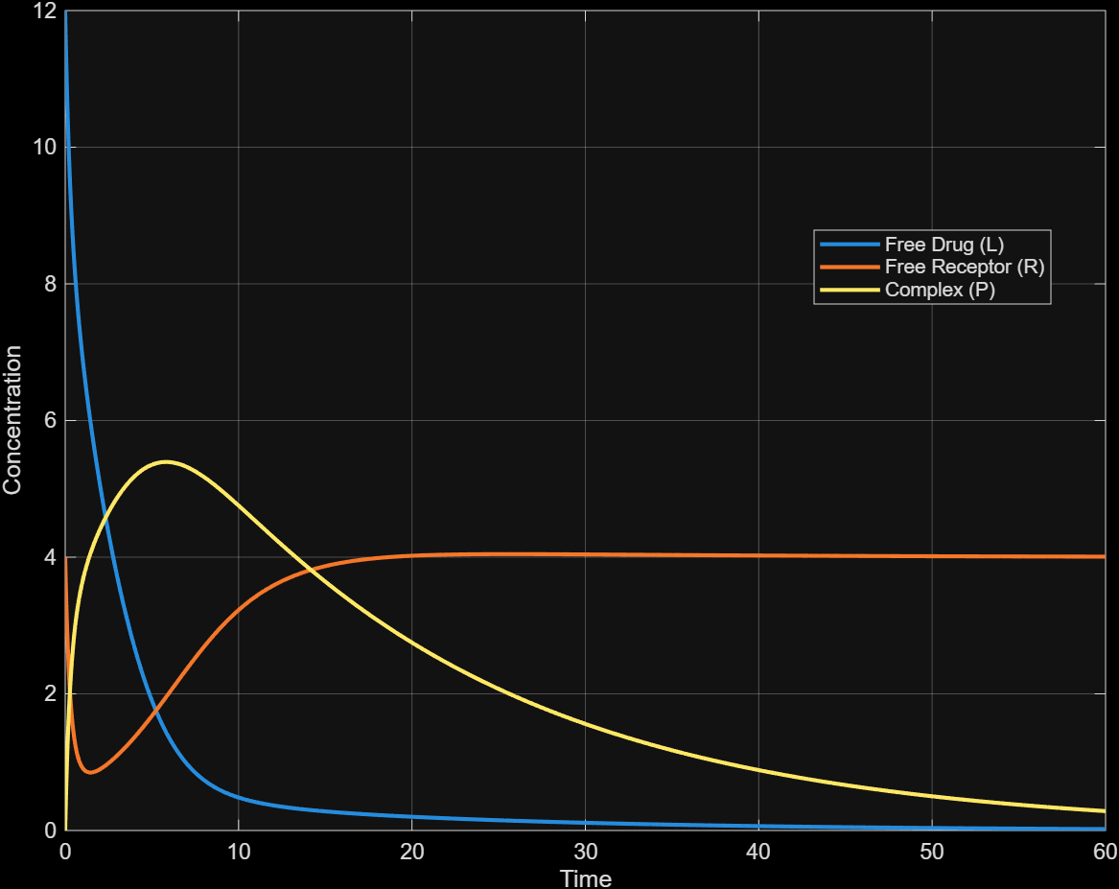
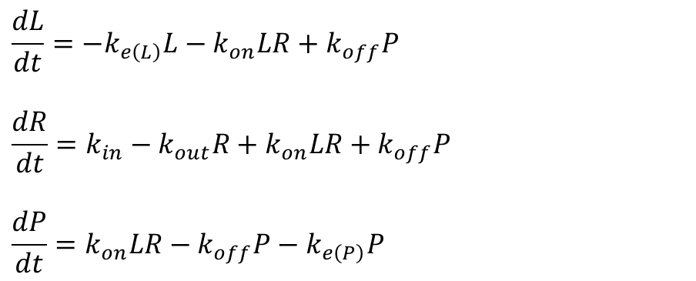
One-compartment model
$$\frac{dL}{dt}=−k_{e\left(L\right)}L−k_{on}LR+k_{off}P$$
$$\frac{dR}{dt}=k_{in}−k_{out}R+k_{on}LR+k_{off}P$$
$$\frac{dP}{dt}=k_{on}LR−k_{off}P−k_{e\left(P\right)}P$$
$k_{e\left(L\right)} =0.15$ $k_{out}=0.30$ $k_{e\left(P\right)}=0.05$

Slide 4
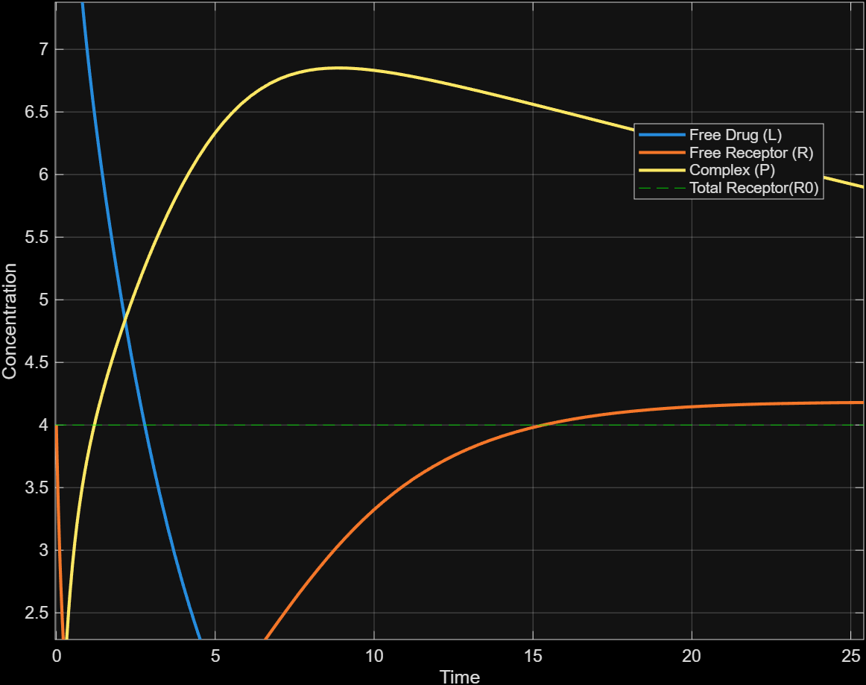

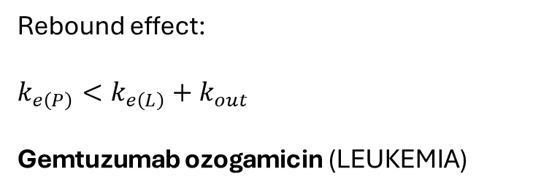
One-compartment model
Rebound effect:
$$k_{e\left(P\right)}<k_{e\left(L\right)}+k_{out}$$
Gemtuzumab ozogamicin (LEUKEMIA)
$k_{e\left(L\right)} =0.15$ $k_{out}=0.30$ $k_{e\left(P\right)}=0.001$

Slide 5
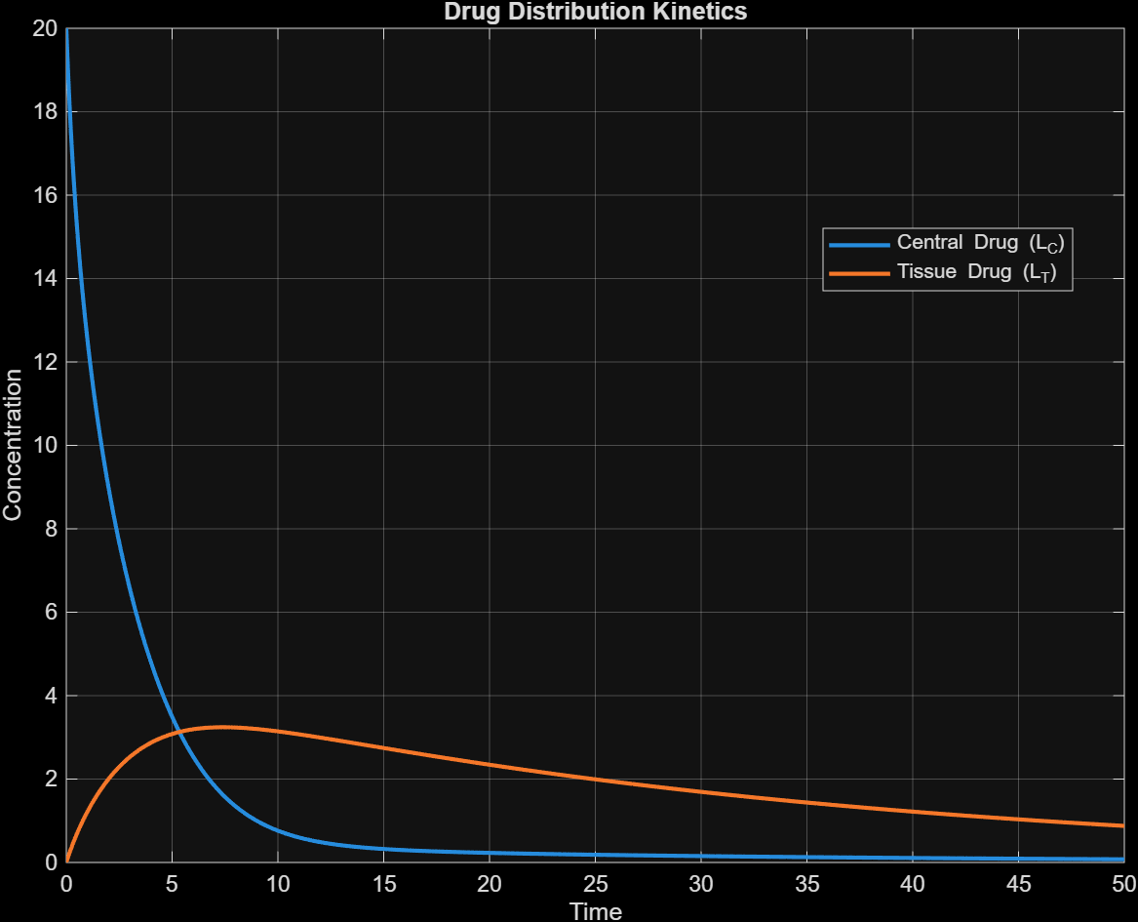
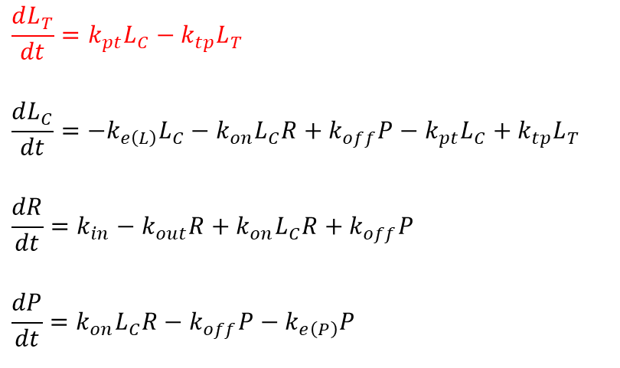
Two-compartment model
$$\frac{dL_{T}}{dt}=k_{pt}L_{C}−k_{tp}L_{T}$$
$$\frac{dL_{C}}{dt}=−k_{e\left(L\right)}L_{C}−k_{on}L_{C}R+k_{off}P−k_{pt}L_{C}+k_{tp}L_{T}$$
$$\frac{dR}{dt}=k_{in}−k_{out}R+k_{on}L_{C}R+k_{off}P$$
$$\frac{dP}{dt}=k_{on}L_{C}R−k_{off}P−k_{e\left(P\right)}P$$

Slide 6
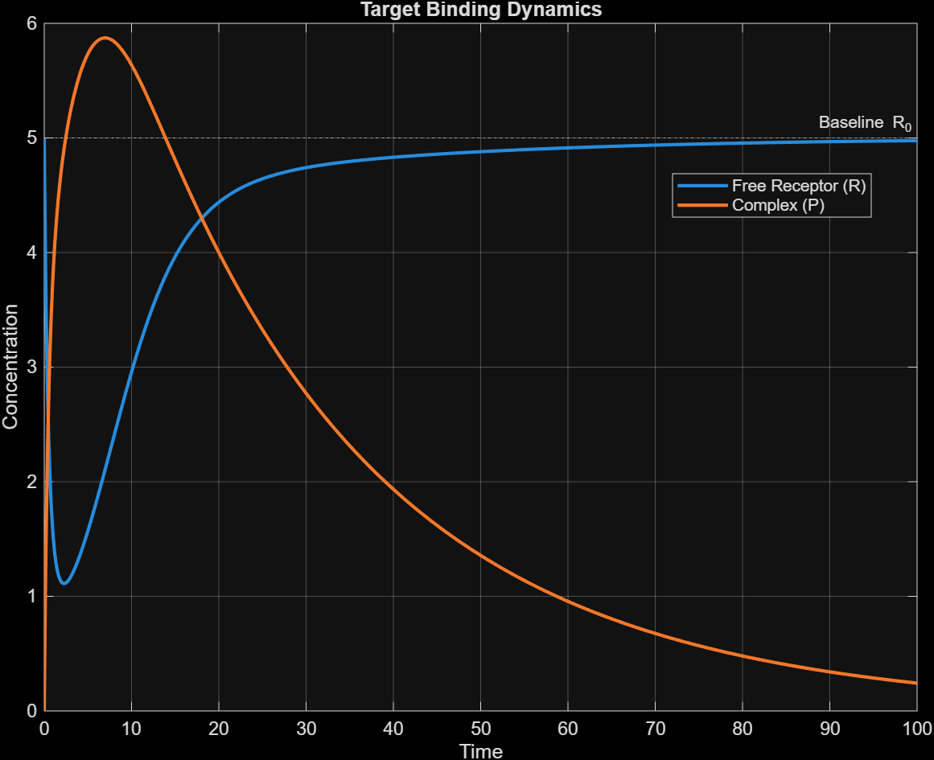
Two-compartment model
Vildagliptin (DIABETES)

Slide 7
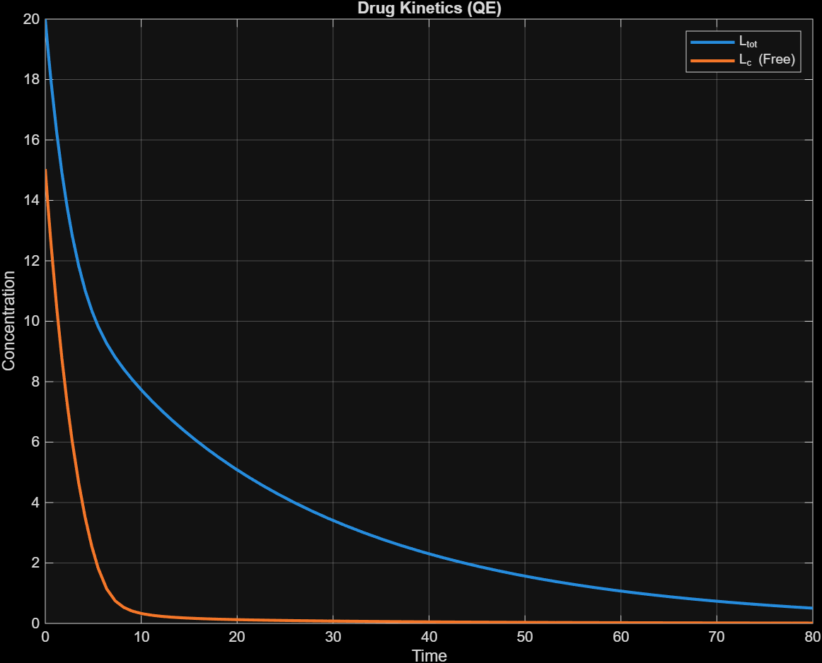
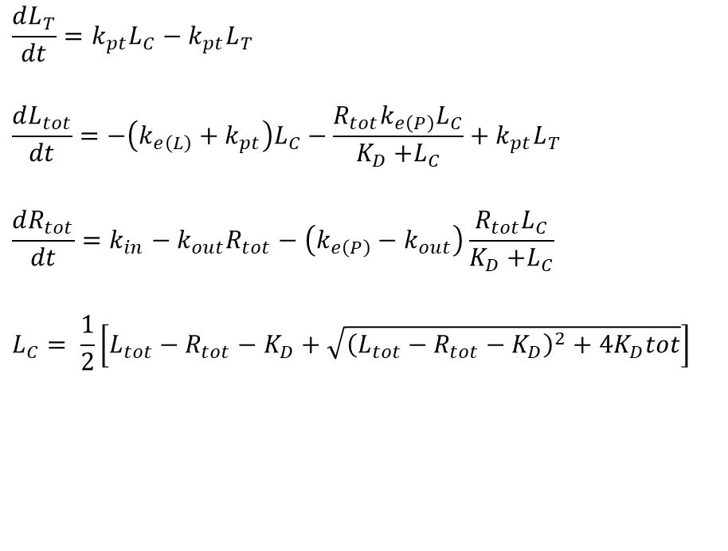
Quasi-Equilibrium approximation
$$\frac{dL_{T}}{dt}=k_{pt}L_{C}−k_{pt}L_{T}$$
$$\frac{dL_{tot}}{dt}=−\left(k_{e\left(L\right)}+k_{pt}\right)L_{C}−\frac{R_{tot}k_{e\left(P\right)}L_{C}}{K_{D}{+L}_{C}}+k_{pt}L_{T}$$
$$\frac{dR_{tot}}{dt}=k_{in}−k_{out}R_{tot}−\left(k_{e\left(P\right)}−k_{out}\right)\frac{R_{tot}L_{C}}{K_{D}{+L}_{C}}$$
$$L_{C}= \frac{1}{2}\left[L_{tot}−R_{tot}−K_{D}+\sqrt{{\left(L_{tot}−R_{tot}−K_{D}\right)}^{2}+4K_{D}tot}\right]$$

Slide 8
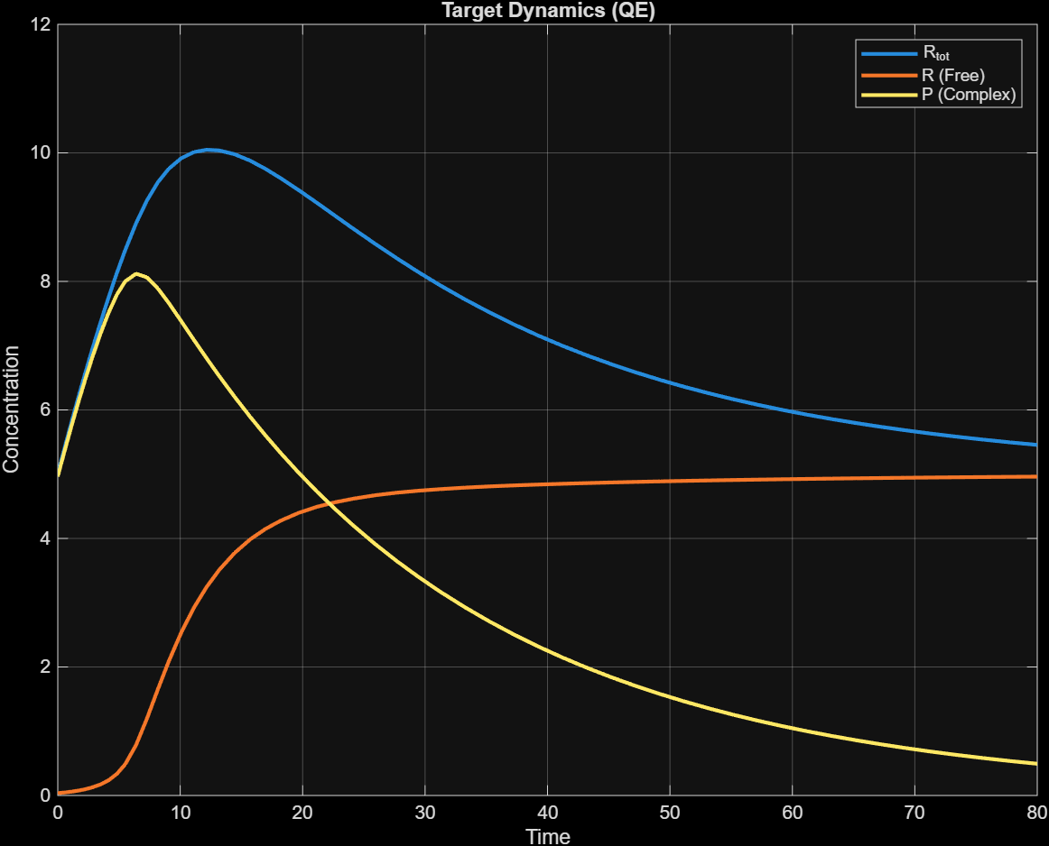
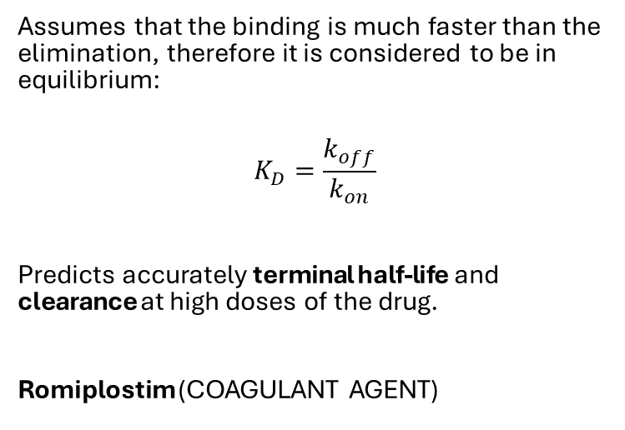
Quasi-Equilibrium approximation
Assumes that the binding is much faster than the elimination, therefore it is considered to be in equilibrium:
$$K_{D}=\frac{k_{off}}{k_{on}}$$
Predicts accurately terminal half-life and clearance at high doses of the drug.
Romiplostim (COAGULANT AGENT)

Slide 9
Extensions to two-compartment models
Two drugs competing for the same receptor site.

Slide 10
Extensions to two-compartment models
Drug-receptor binding occurs in both compartments.
Canakinumab (AUTOINFLAMATORY CONDITIONS)

