Slide 1

Introduction to data science project
Group X: - Marta Duarte nº202008344
- Miguel Gonçalves nº202107127
- Rodrigo Couto nº202104696

Slide 2
Predicting health insurance
Millions of people lack health insurance, which results in financial instability and limited access to medical care. Identifying the factors that determine weather individuals have health insurance is critical.
In this project we aim to build a machine learning model to predict if a given costumer has or not a health insurance.
We are using a database of US customers, but it has some issues, including missing values, unbalanced data, incorrectly assigned missing values, and unnormalized data.

Slide 3
Data Preprocessing
Our database initially contained 72,458 observations and 15 features. We removed the columns ‘Unnamed: 0’, ‘custid’, and ‘code_column’ since they didn’t contribute to understanding the target variable.
Before addressing missing values, we encoded the variable ‘is_employed’, as the null values in this variable represented retired individuals.
Next, we removed all missing values, ensuring that this step did not disproportionately exclude observations without health insurance. If such cases had been significant, we would have retained them.

Slide 4
Data Preprocessing
We applied the logarithmic function to the income and gas usage, since they were highly skewed. Then we normalized all numerical features and subsequently removed outliers, applying the same careful consideration as with the handling of missing values.
We applied One-Hot Encoding (OHE) to all categorical variables and renamed them for better readability. Since ‘health_ins’ is our target column, we positioned it as the last column in the dataset.

Slide 5
Data Preprocessing
Next, we analyzed correlations between all variables and between the variables and the target column. No leaky features were identified. Finally, we checked for columns with no variability and found none, so all columns were retained.
After preprocessing, our dataset consists of 70695 rows and 70 columns.
Approximately 90.9% of the values indicate having health insurance, making the response variable highly imbalanced. This imbalance requires careful consideration when applying certain models to ensure reliable results.

Slide 6
Model Selection
We tested several machine learning models to identify the ideal one for our dataset. The models included Logistic Regression, Decision Tree, SVM (Support Vector Machines) , Random Forest, and KNN (K-Nearest Neighbors).
Initially, we applied the basic algorithms without addressing the class imbalance, which resulted in poor performance due to the highly imbalanced nature of the data.
To deal with that, we used SMOTE, Grid Search and hyper parameter tuning.

Slide 7
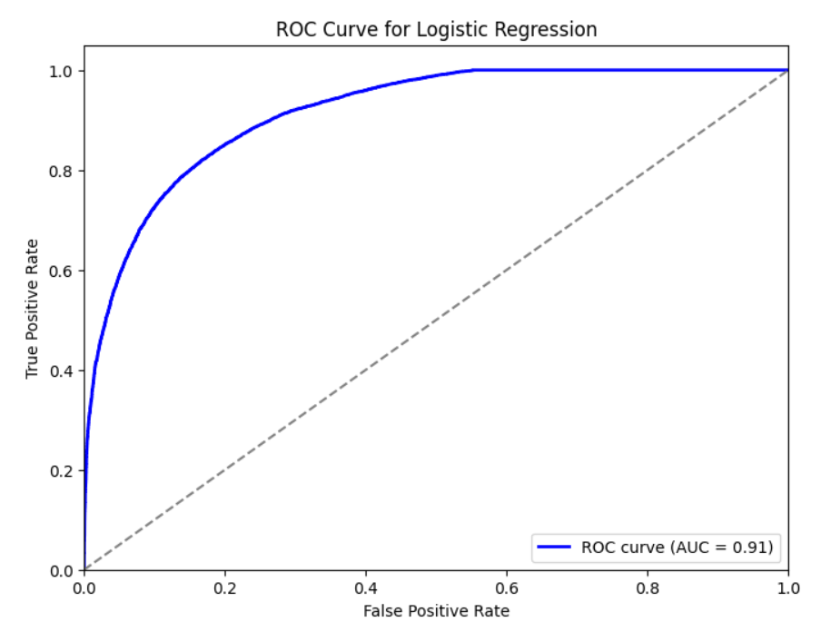
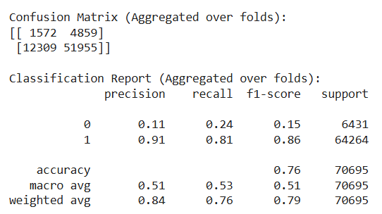
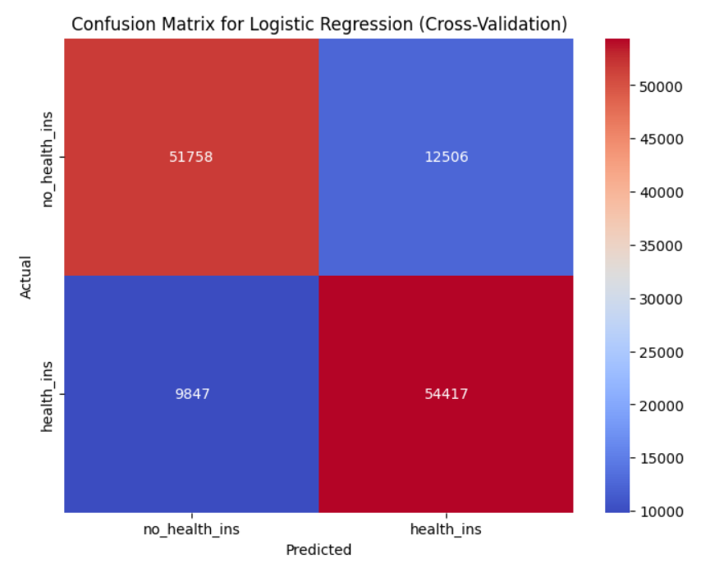
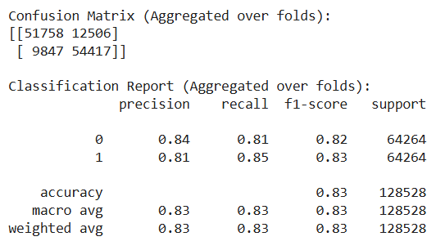
Logistic regression
before
after

Slide 8
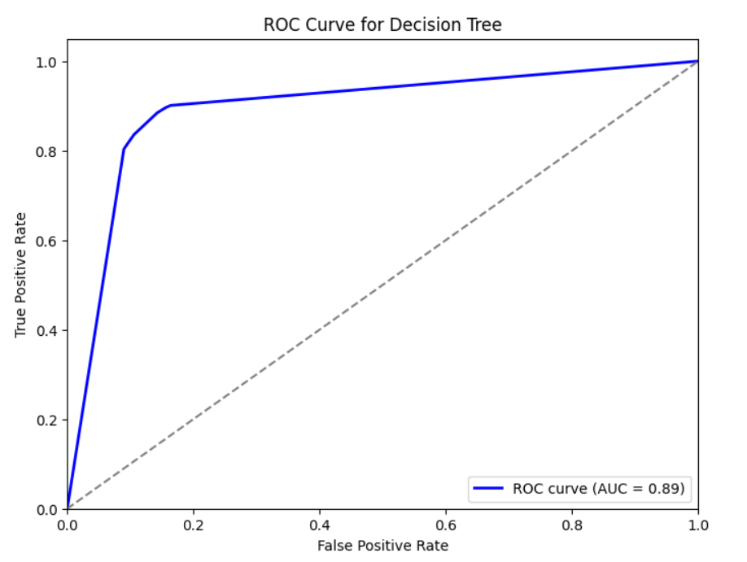
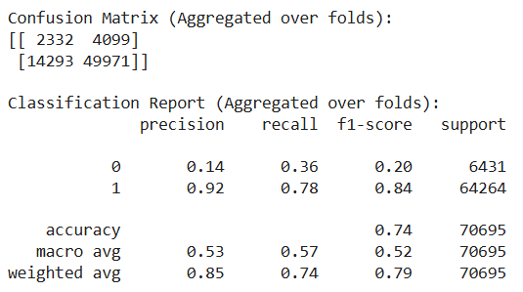
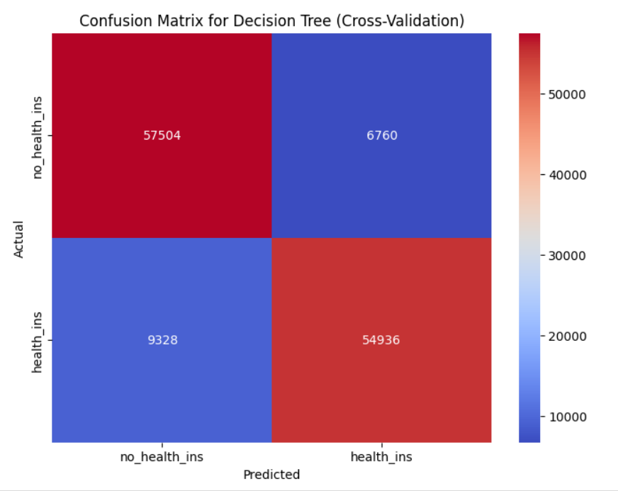
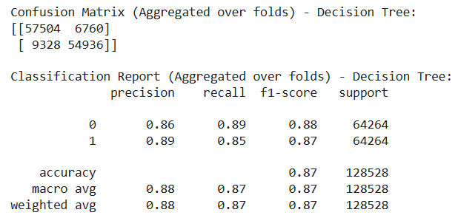
Decision tree
before
after

Slide 9
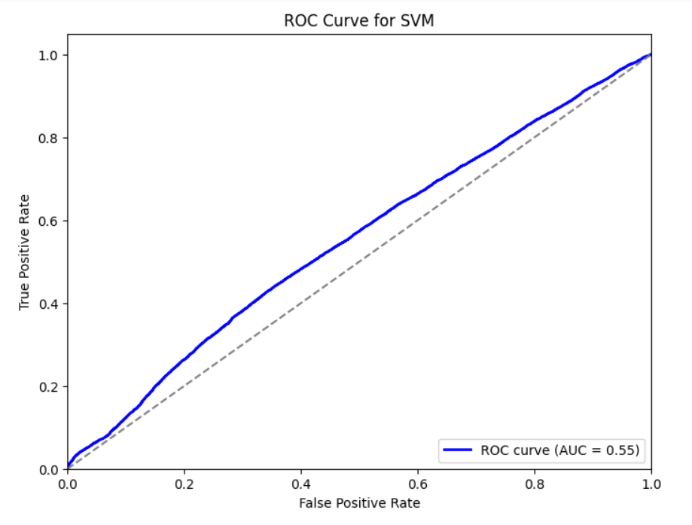
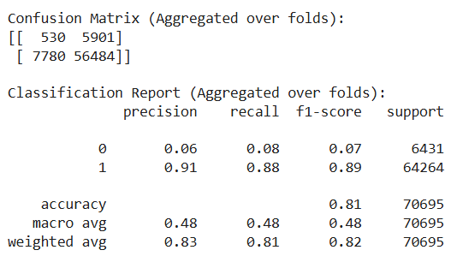
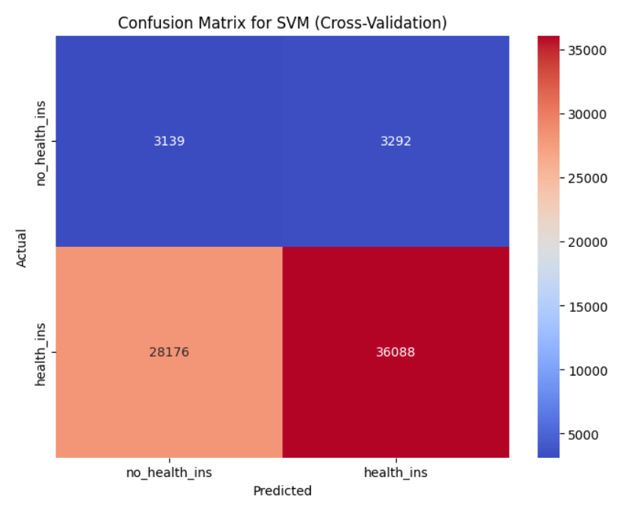
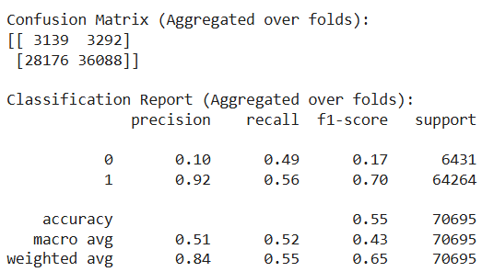
SVM
before
after

Slide 10
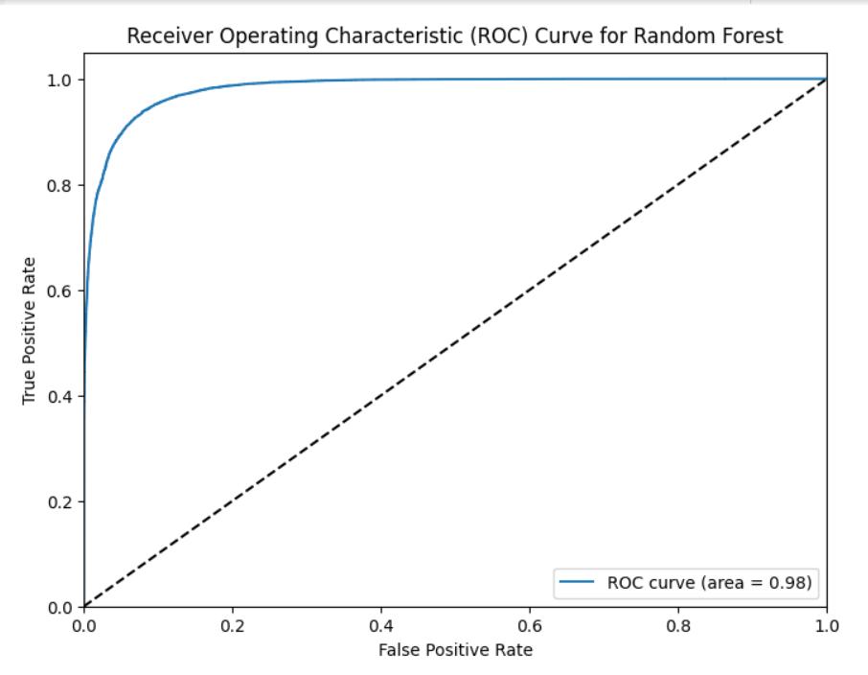
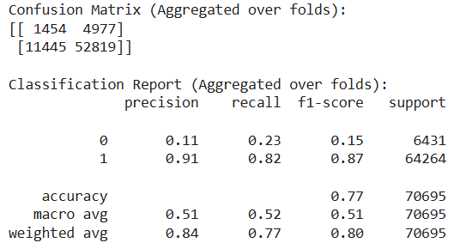
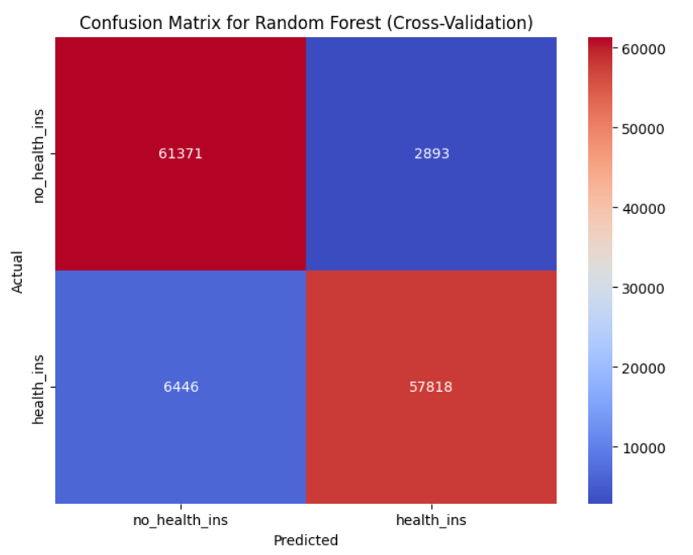
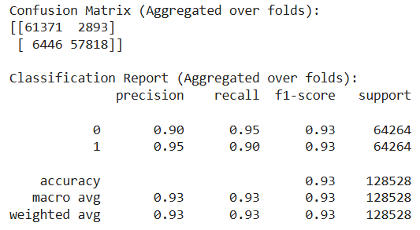
Random forest
before
after

Slide 11
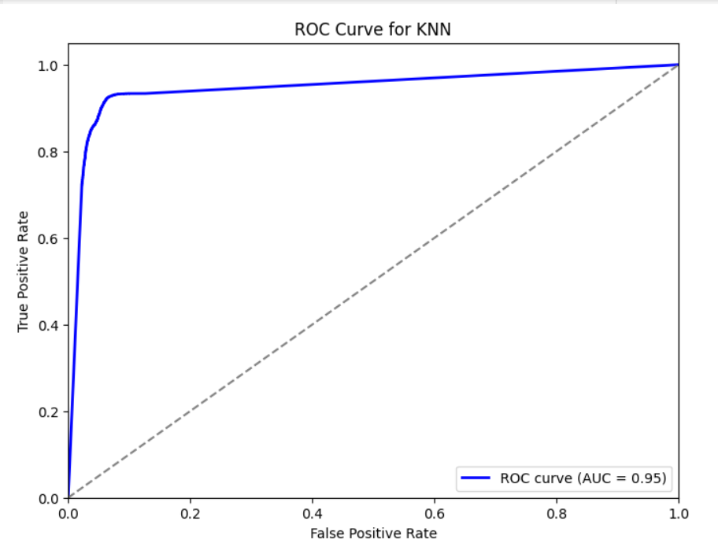
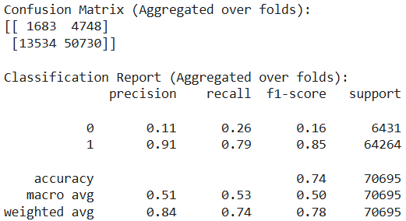
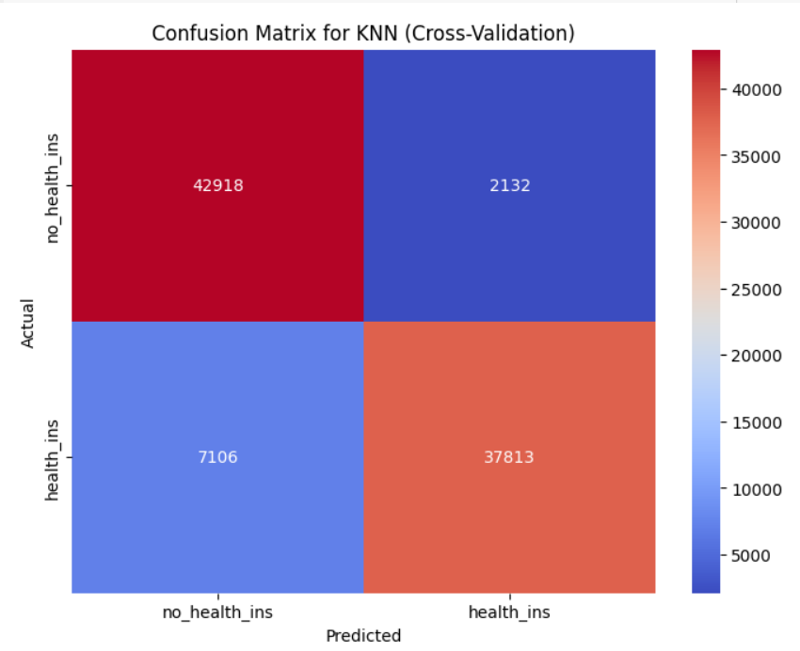
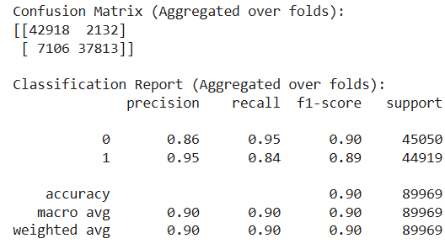
knn
before
after

Slide 12
Model Comparison
Model | Grid-search | SMOTE | F1-score
Logistic Regression | ❌ | ❌ | 0.06 | 0.95
Decision Tree | ❌ | ❌ | 0.24 | 0.92
SVM | ❌ | ❌ | 0.00 | 0.95
Random Forest | ❌ | ❌ | 0.10 | 0.95
KNN | ❌ | ❌ | 0.14 | 0.95
Logistic Regression | ✅ | ❌ | 0.15 | 0.86
Decision Tree | ✅ | ❌ | 0.20 | 0.84
SVM | ✅ | ❌ | 0.07 | 0.89
Random Forest | ✅ | ❌ | 0.15 | 0.87
KNN | ✅ | ❌ | 0.16 | 0.85
Logistic Regression | ✅ | ✅ | 0.82 | 0.83
Decision Tree | ✅ | ✅ | 0.88 | 0.87
SVM | ✅ | ✅ | 0.17 | 0.70
Random Forest | ✅ | ✅ | 0.92 | 0.92
KNN | ✅ | ✅ | 0.90 | 0.89
0
1

Slide 13
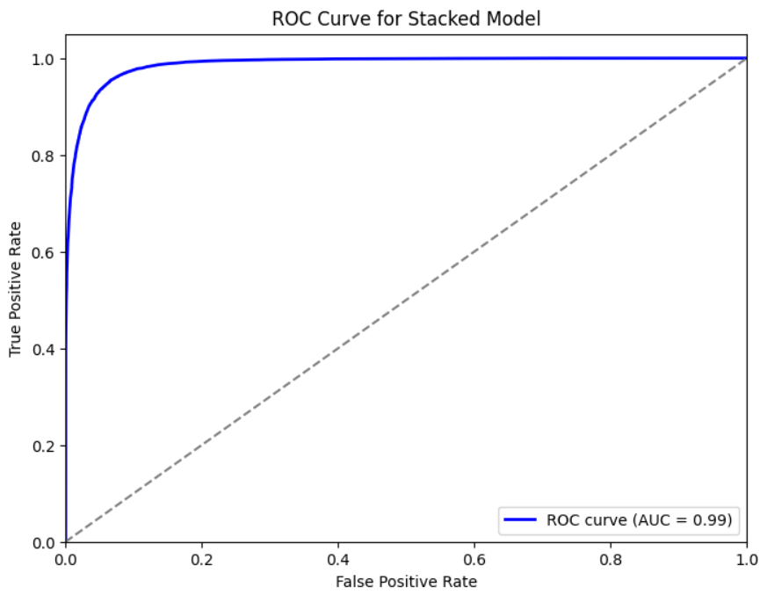
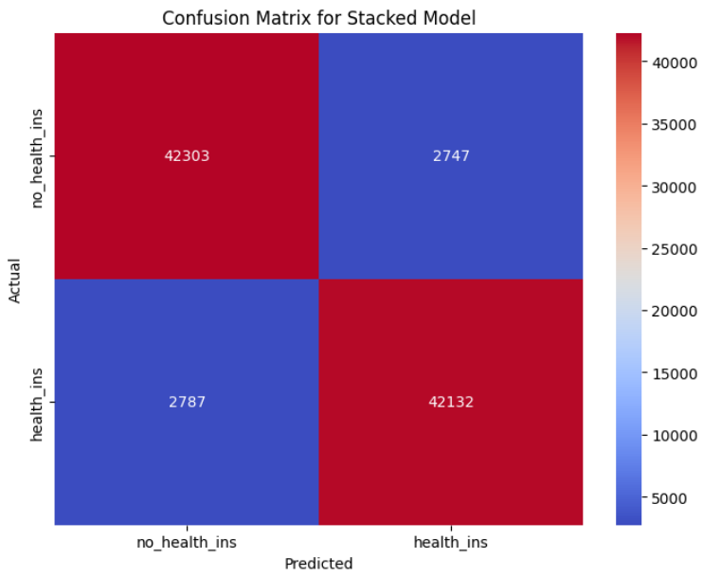
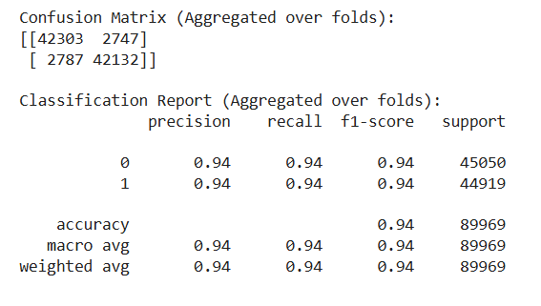
Final Model
We created a stacked model combining the best-performing classifiers: Decision Tree, Random Forest, and K-Nearest Neighbors (KNN). This approach leverages the strengths of each model to improve overall performance.

Slide 14
Conclusion
To predict health insurance coverage effectively, we started by addressing data quality issues in a large US customer dataset. Our preprocessing steps included encoding missing values in key variables, normalizing numerical features, applying a logarithmic transformation to skewed income data, and using One-Hot Encoding for categorical variables. We also handled outliers carefully and ensured no leaky features or low-variability columns remained in the dataset.
For model selection, we evaluated Logistic Regression, Decision Tree, SVM, Random Forest, and KNN. Initially, the unbalanced data resulted in poor performance across all models. However, combining SMOTE with Grid-Search optimization improved individual model results significantly. Ultimately, the best-performing approach was a stacked model that combined Decision Tree, Random Forest, and KNN, achieving an F1-score of 0.94 for both classes.

