Slide 1
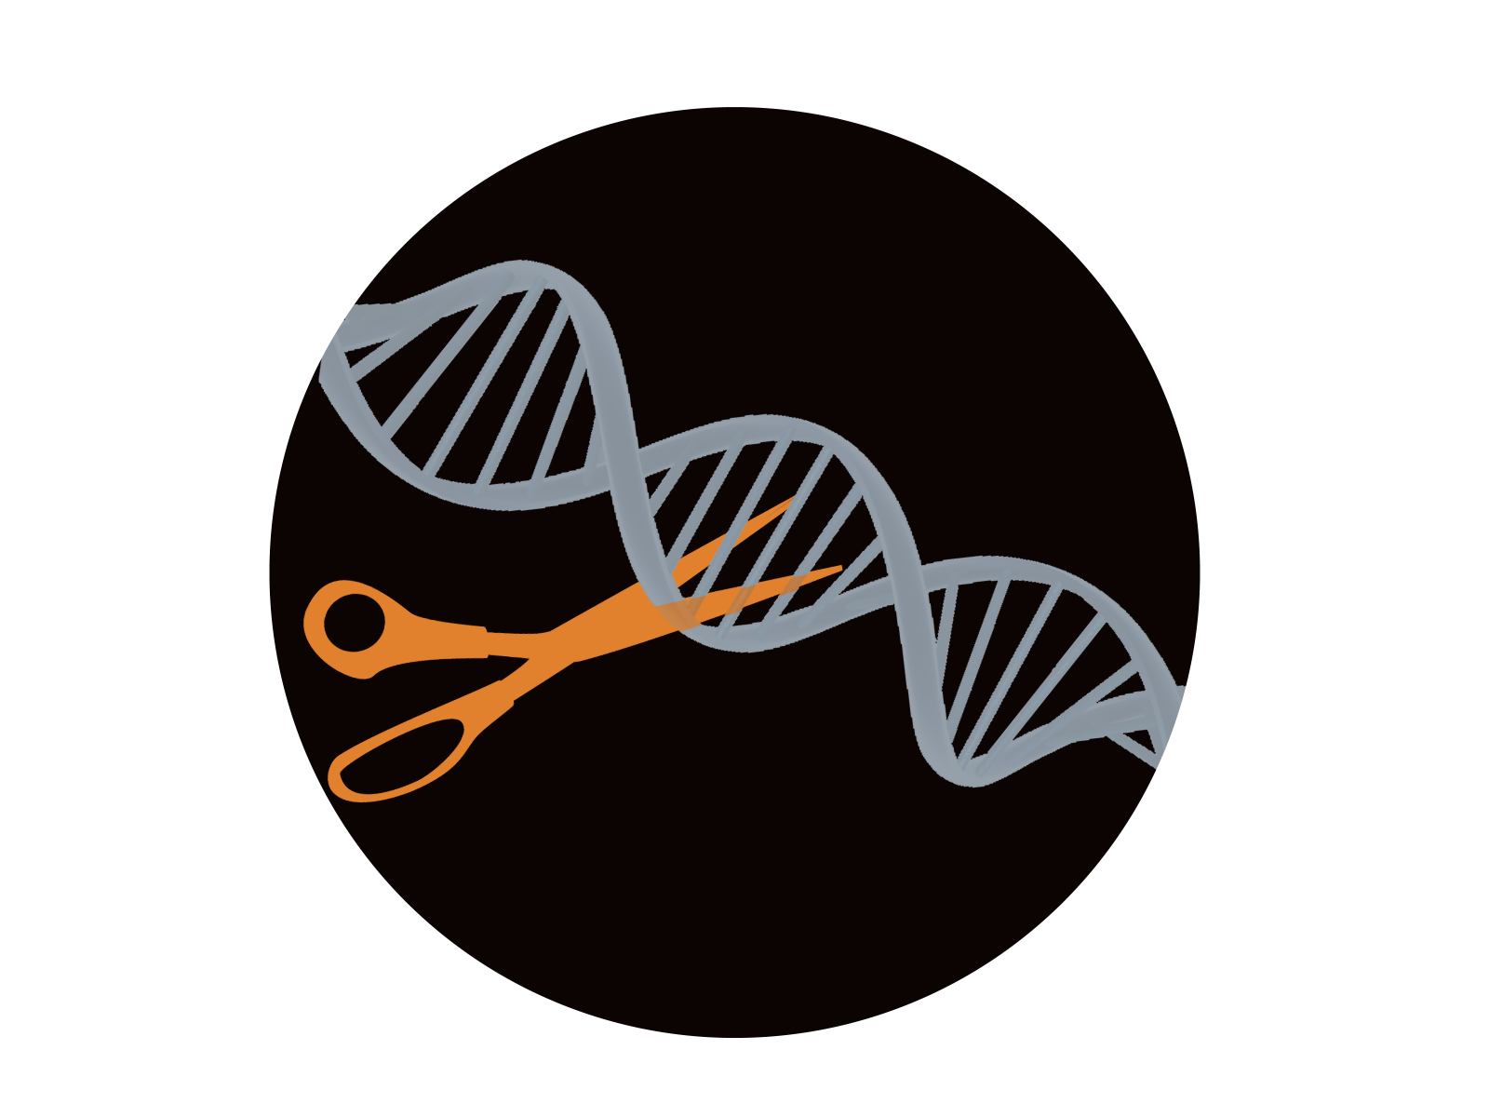

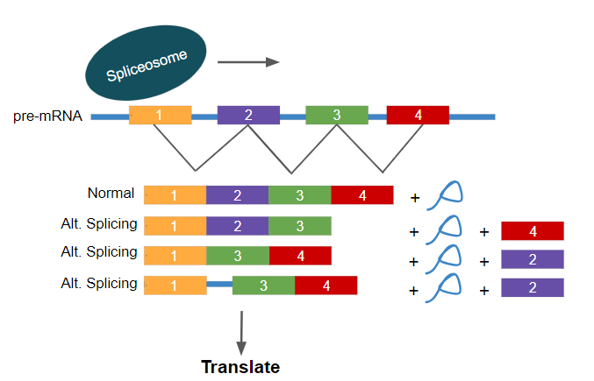
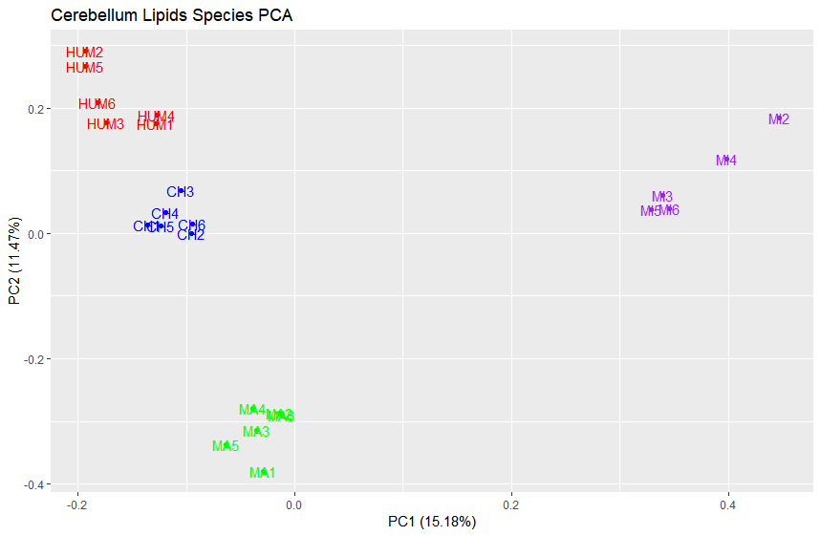
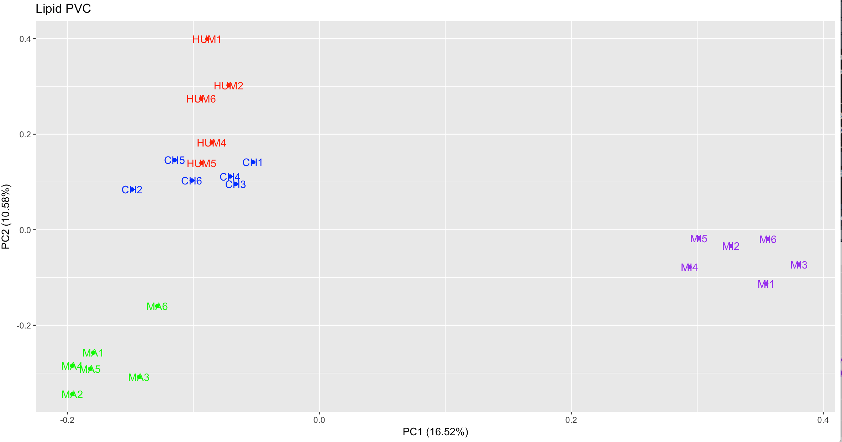
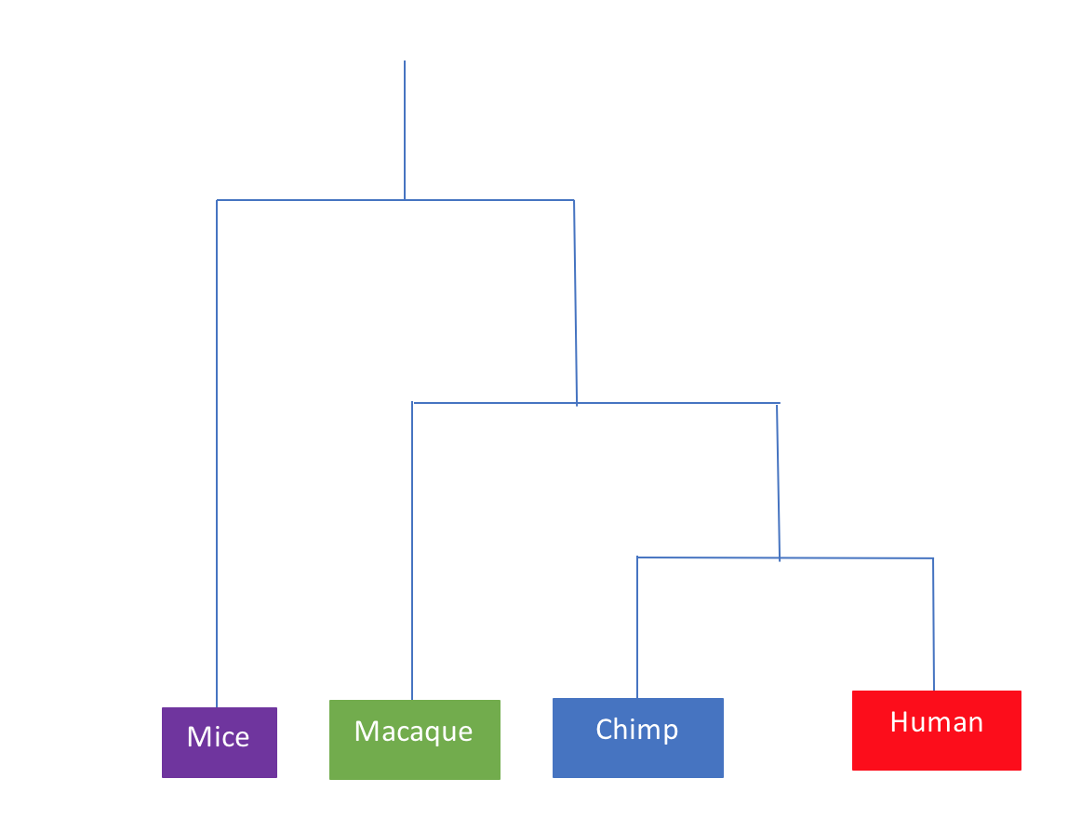
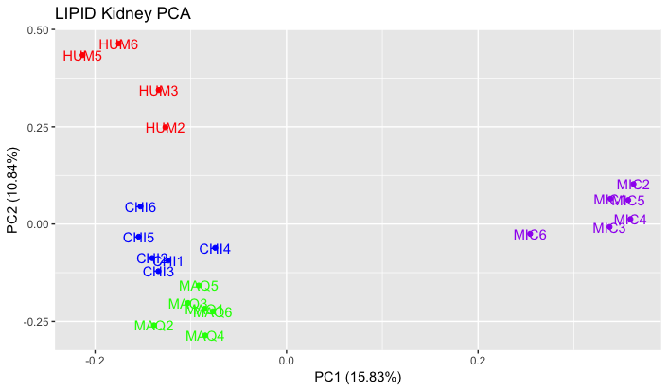
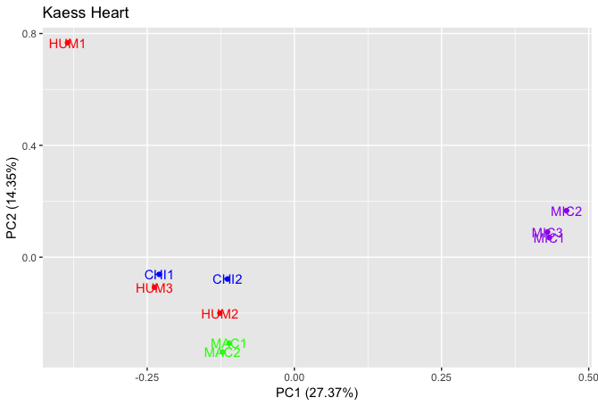
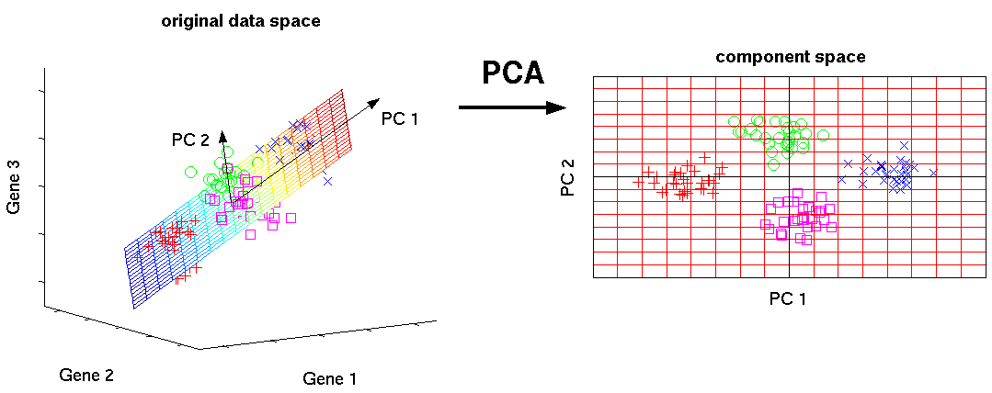
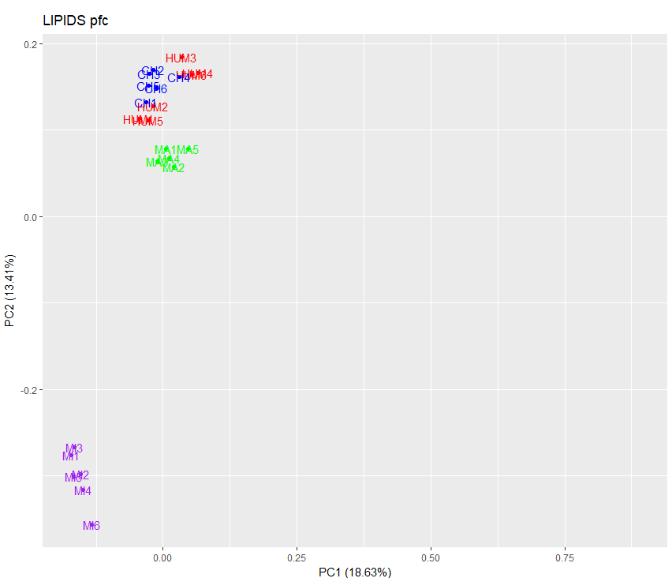
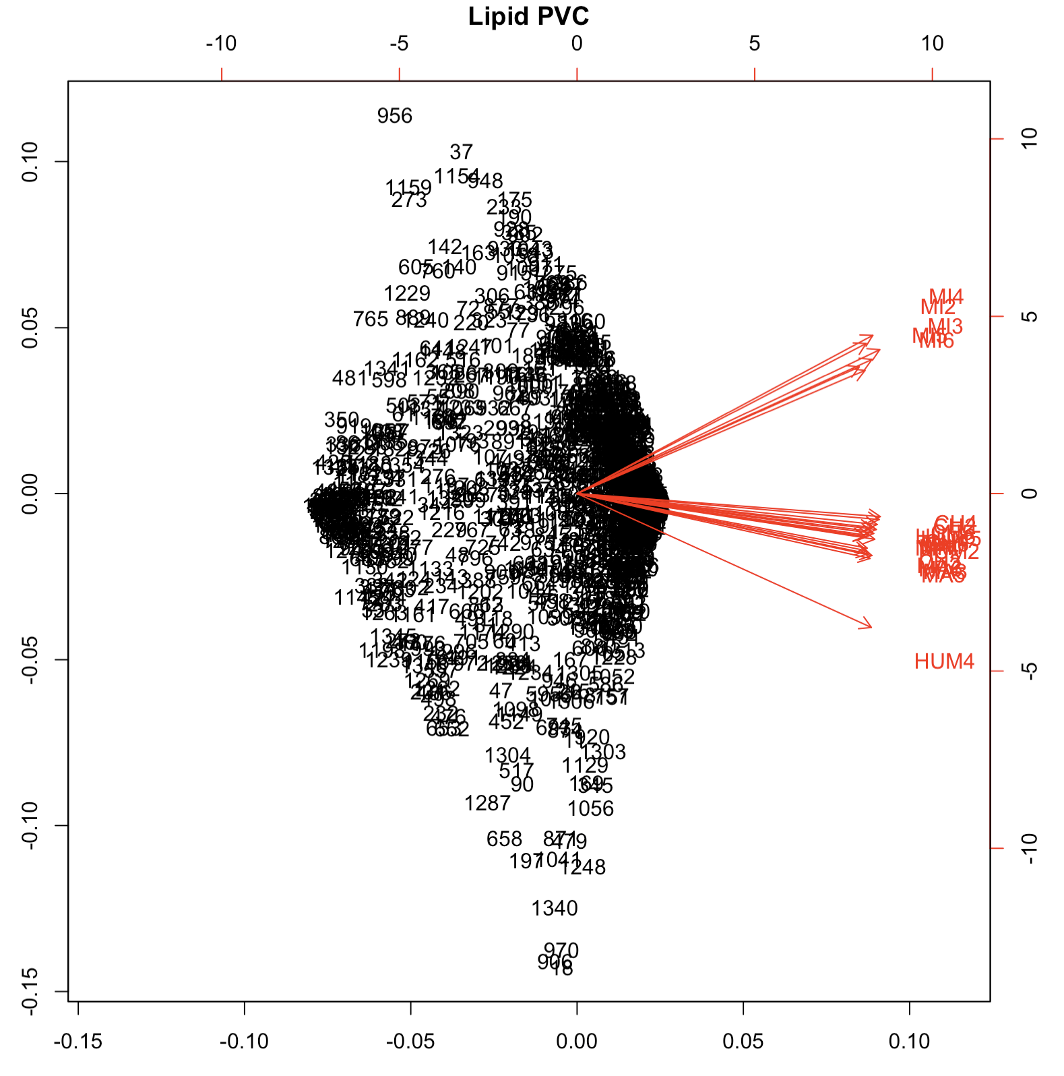
BDSP: Analyzing the evolution of PSI profiles using Principal Component Analysis
Splicing and Dicing
Carmen Le, Carina Kalaydjian, Claire Mayfield, Miguel Guardado, Alia Edington,
Jeanice Nyung, Rori Rohlfs
Background
Results
Conclusions
Blue -> Chimpanzees
Red -> Humans
Green -> Macaques
Purple -> Mice
Our results suggest that mice are not as closely related to humans, chimpanzees, and macaques as they are to each other due to the great distance between the mice and other species on each plot.
We also believe that there is a strong relation between chimpanzees and humans based on the close clumping patterns in all of the PCA plots.
We believe that the divergence seen in the PVC and the cerebellum analysis between primates and mice is due to the differences in location of the eyes on the head and because mice are quadrupeds.
We believe that the divergence seen in the PVC and the cerebellum analysis between apes and old world monkeys such as macaques could be due to difference in daily activities that require amplified depth perception and balance.
LIPIDS Cerebellum
LIPID PVC (Primary Visual Cortex)
Pro
Promet
Met
Ana
Telo
C
Figure 1. Schematic of Alternative Splicing
Genetic information is the template for formation of a functional products called proteins. An essential component of this process is translation, which uses three ribonucleic acid (RNA) nucleotides , called codons, where each codon corresponds to a specific amino acid. The connected amino acids then form a protein. The initial RNA (pre-mRNA) strand will have two parts; non-coding regions (introns) and coding regions (exons). Before constructing the protein, RNA must be primed with only exons through a mechanism called splicing. During splicing, a protein complex called the spliceosome will excise the introns; therefore, leaving the new mature RNA (mRNA) ready for translation. Another way of excising exons is through a process called alternative splicing, which will rearrange the exons in different order to form different proteins. Our project involved examining the degree to which various exons are included in mature RNA transcripts, better known as Percent Spliced In (PSI) values in four species.
LIPID Kidney
Kaessmann Heart
Figure 4. This phylogenetic tree was produced to explain the evolutionary relationship between mice, macaques, chimpanzees, and humans.
This tree also supports our findings that humans and chimps share a more recent common ancestor than they do with macaques or mice.
LIPID PFC(Prefrontal Cortex)
Future Directions
Further analyze Lipid and Kaessmann datasets using the Expression Variance and Evolution (EVE) model, a program that tests for divergence and diversity in exon expression levels using phylogenetic data. Additionally, this model shows expression evolution within and between different species (Rohlfs, 2018).
Analyze exon clusters found in previous PCA performed on individual exons (left). Black represents individual exons by number and the red arrows represent the diverging species.
Figure 2. Schematic of Principal Component Analysis (PCA).
PCA is the statistical process of reducing the dimensions of large datasets into smaller datasets to help get a better picture of what the overall data set looks like. We achieve this by getting the principal components of the data by use of the dataset’s orthogonal transformation. Using this statistical procedure for looking at PSI values inside exons can help take the large data of values and help cluster them together. This will highlight what types of species and tissues will be closely related to each other. Analyzed by tissue, we can then predict that the closer the species clustering is to each other the more closely related each individual species are to one another. (Prakhar, 2018)
PC2
Figure 3. PCA plots of various tissues from Lipid and Kaessman datasets. Each plot is from one of five tissues with four species. The number of individuals from each species is dependent on the data set and tissue.
In each figure, mice are clustered together and are further away from the other three species: humans, chimpanzees, and macaques. Each species has a unique clustering pattern in each tissue, but there is a trend where all the individuals within each species remain clustered together. An exception for this is in the Kaessmen heart plot where HUM1 appears to be an outlier. When looking at the plots that represent different lobes of the brain, there are significant clustering among primates. In the Cerebellum, PVC, and PFC, the humans and chimpanzees are closely clustered together and, at some points, overlap one another. The old world monkey, the macaque, is not closely clustered to the other primates; therefore, suggesting that human and chimpanzees have more similar splicing patterns than macaques do within primates.
Hypothesis
PC1
References
Percent spliced in (PSI) values identify the frequency at which a particular exon is present in the mature RNA transcript in a specific tissue. We hypothesize that the PSI profiles for humans, chimps, and macaques will have higher similarities to each other than to mice.
Mishra, Prakhar. 2018. “A Layman’s Introduction to Principal Components – Hacker Noon.” Hackernoon. 2018. https://hackernoon.com/a-laymans-introduction-to-principal-components-2fca55c19fa0.
Rohlfs, Rori V., and Rasmus Nielsen. “Phylogenetic ANOVA: The Expression Variance and Evolution Model for Quantitative Trait Evolution.” Systematic Biology 64.5 (2015): 695–708. PMC. Web. 24 July 2018.

