Slide 1
TELCOM CHURN ANALYSIS

Slide 2
92%
MODEL PERFORMANCE ACHIVED
Model accuracy
Predicted churn out of actual
Actual churn out of predicted
70%
81%

Slide 3
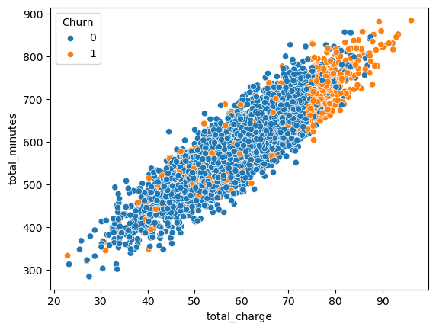
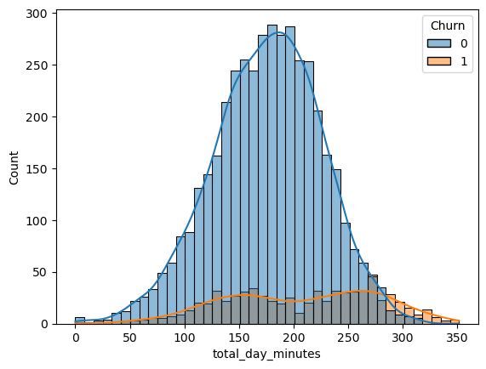
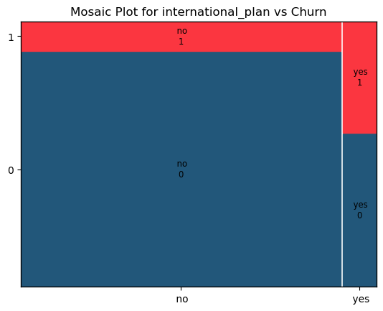
FINDINGS pt.1
01
02
03
TOTAL CHARGE AS MAIN CHRUN DRIVER
FOCUS IN DAY MINUTES
CHURN & INTERNATIONAL PLAN CORRELATION
Especially from 250 mintues, due to higher rates
Additional bill without advantages

Slide 4
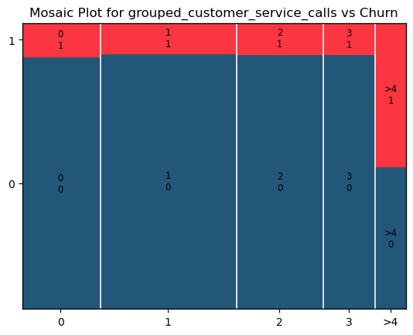
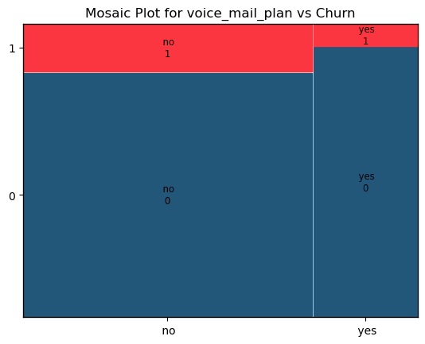
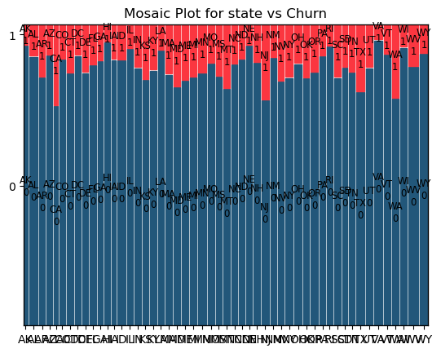
FINDINGS pt.2
04
05
06
CHURN & VOICE MAIL PLAN CORRELATION
DIFFERENT CHURN RATES ACROSS STATES
50% CHURN FOR > 4 CALLS TO CUSTOMER SERVICE
Differences in service quality or competition
Linked to customer dissatisfaction

Slide 5
RECOMMENDATIONS
1
2
3
Offer flat rates beyond a certain cost.
Pay special attention to morning users and offer discounts for users beyond 250 minutes.
Offer reduction in international charge per minute.
4
5
6
Further reasearch to offer focused solution.
Research on problems per state (network, competition). Improve service or offer discounts.
Track customer satisfaction for every customer service call. Pay special attention to frequent callers.

Slide 6
THANKS

