Slide 1
Reunião
14/04/2024

Slide 2
Metodologia de avaliação em Séries Temporais

Slide 3
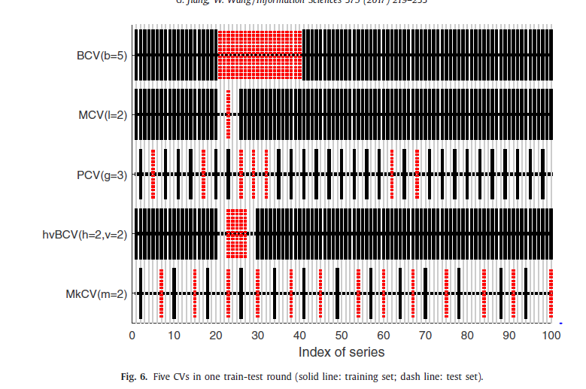
Markov CV (2016)
No other papers have experimented with this method;
Authors claim that it performs better than other time series CV techniques (block CV, modified CV, randomized CV and hv-Block CV)
Properties:
Each sample is trained and tested only once;
There is no overlap between training set and test set;
The distance between training set and test set is bigger than the autocorrelation order;
They claim to that this CV considers the periodicity, overlapping or correlation of series.
The number of partitions is dependent on the correlation order (which helps with parameter tuning, however it also makes it dependent on the accuracy of the estimation of autocorrelation order.

Slide 4
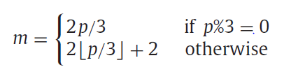



CV – Markov CV
time
Train
$$t=1$$
$$t=T$$
Test
$$i=0$$
2-fold CV
$$⋯$$
$$i=2m$$
2-fold CV

Slide 5


OOS – Fixed-origin/Holdout
time
Train
$$t=1$$
origin ($θ$)
$$t=T$$
Test
$$i=0$$

Slide 6





OOS – Rolling-origin-update
time
Train
$$t=1$$
origin ($θ$)
$$t=T$$
Test
$$i=0$$
$$θ+1$$
$$i=1$$
$$⋯$$
$$T−1$$
$$i=T−θ−1$$

Slide 7
OOS – Rolling-origin-recalibration
time
Train
$$t=1$$
origin ($θ$)
$$t=T$$
Test
$$i=0$$
$$θ+1$$
$$i=1$$
$$⋯$$
$$T−1$$
$$i=T−θ−1$$

Slide 8



OOS – Fixed-size rolling window
time
Train
$$t=1$$
origin ($θ$)
$$t=T$$
Test
$$i=0$$
$$1$$
$$θ+1$$
$$i=1$$
$$⋯$$
$$T−θ−1$$
$$T−1$$
$$i=T−θ−1$$

Slide 9

Repeated Hold-out
time
Train
$$t=1$$
$$a_{0}$$
$$t=T$$
Test
$$i=0$$
$$a_{1}$$
$$i=1$$
$$⋯$$
$$a_{r}$$
$$i=r$$
Interval of random splits

Slide 10



Prequential – Growing window
time
Train
$$t=1$$
$$t=T$$
Test
$$i=0$$
$$i=1$$
$$i=2$$
$$i=3$$
Fold 1
Fold 2
Fold 3
Fold 4
Fold 5

Slide 11
Prequential – Rolling window
time
Train
$$t=1$$
$$t=T$$
Test
$$i=0$$
$$i=1$$
$$i=2$$
$$i=3$$
Fold 1
Fold 2
Fold 3
Fold 4
Fold 5

Slide 12
Prequential – Gap Rolling window
time
Train
$$t=1$$
$$t=T$$
Test
$$i=0$$
$$i=1$$
$$i=2$$
Fold 1
Fold 2
Fold 3
Fold 4
Fold 5

Slide 13

CV – Blocked CV (K-fold)
time
Train
$$t=1$$
$$t=T$$
Test
$$i=0$$
$$i=1$$
$$i=2$$
$$i=3$$
$$i=4$$
Fold 1
Fold 2
Fold 3
Fold 4
Fold 5

Slide 14
CV – hv-Blocked CV
time
Train
$$t=1$$
$$t=T$$
Test
$$i=0$$
$$i=1$$
$$i=2$$
$$i=3$$
$$i=4$$
Fold 1
Fold 2
Fold 3
Fold 4
Fold 5

Slide 15
CV – Modified CV
time
Train
$$t=1$$
$$t=T$$
Test
$$i=0$$
$$i=1$$
$$i=2$$
$$i=3$$
$$i=4$$
Fold 1
Fold 2
Fold 3
Fold 4
Fold 5

Slide 16
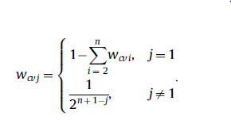
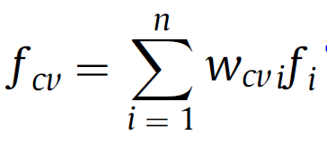
CV – “Weighted Blocked CV”
time
Train
$$t=1$$
$$t=T$$
Test
$$i=0$$
$$w_{1}$$
$$i=1$$
$$w_{2}$$
$$i=2$$
$$w_{3}$$
$$i=3$$
$$w_{4}$$
$$i=4$$
$$w_{5}$$
Fold 1
Fold 2
Fold 3
Fold 4
Fold 5
Ainda não incluído nas reviews que vimos

Slide 17
CV – “Weighted Growing window CV”
New!
time
Train
$$t=1$$
$$t=T$$
Test
$$i=0$$
$$i=1$$
$$i=2$$
$$i=3$$
Fold 1
Fold 2
Fold 3
Fold 4
Fold 5

Slide 18

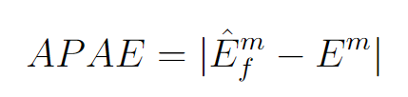
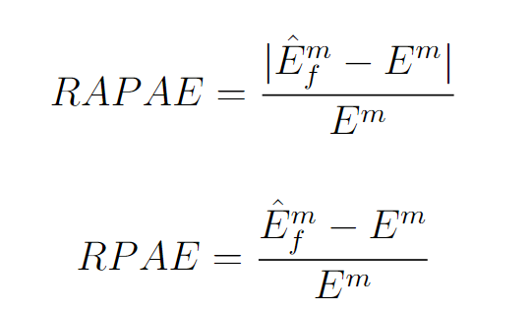



Metrics to use
1.
7.
Standard deviation between folds
2.
3.
New!
4.
New!
5.
6.
$$\frac{Nb. experiments with under \left(over\right) estimation}{Total nb. datasets}$$

Slide 19
Experiments & Data
Experiments
Data Characteristics to explore/
Metrics to Measure them
Stationarity
Frequency:
Peak frequency
Spectral centroid
Spectral Entropy
System Dynamics
Stability
Lumpiness
Max level shift
Maximum variance shift
Peak-to-peak amplitude
Trends
Linear trend: Fit linear regression and get slope
“Strength of trend”
Zero-crossing rate
What validation method is best and for what time series characteristics?
Other questions:
Impact of Stationarity vs Non-stationarity on the validation method performance
Impact of the number of partitions/partition size on the validation method performance
Impact of shifts levels/change in dynamics in each partition on the validation method performance
Impact of validating on older folds vs newer folds
Impact of training in the “future” and test in the “past”
Frequency:
Impact of Number of cycles in each fold
Impact of noise
System dynamics
Impact of stability and lumpiness between folds or/and between methods

Slide 20
Experiments & Data
Experiments
Number of partitions/partition size

Slide 21
Data Generation
1.
Functions to combine:
Sinusoid
Step functions
Linear trends
Impulse functions
Exponential trends
Time-varying sinusoid
White noise
2.
Data generation methods from Bergmeir and Cerqueira

