Slide 1
Reunião
26/07/2024

Slide 2
Metodologias de avaliação em Séries Temporais

Slide 3
Esta semana
Processamento de novos resultados;

Slide 4

POS: Resultados
 | Nº Datasets | Nº Séries Temporais
Meteorologia | 4 | 4 + 1 + 14 + 16 = 35
Saúde | 4 | 4 + 1 + 8 + 30 = 43
Ambiente | 3 | 1 + 20 + 7 = 28
Energia | 3 | 33 + 8 + 5 = 46
Economia/Finanças | 2 | 37 + 24 = 61
Engenharia/Ciência | 3 | 8 + 6 + 36 = 50
Transportes | 3 | 1 + 3 + 1 = 5
Total | 22 | 268
*
*
*
*
*
Faltam todos os sintéticos!
*Apenas para o AR (já não é o ARMA) e a DT

Slide 5
Próxima semana…
Continuar correr Experiências
Continuar escrita

Slide 6
Results

Slide 7

Main Results
Weighted version of Block-CV is better than the original (less error and lower variance)
Weighted version of Growing Window is better than the original (less error and lower variance)
Weighted version of Rolling Window is worse than the original
These results are nowhere in the literature

Slide 8
Overall Results
Holdout method is one of the best models in almost all scenarios (similar to the results of other studies)
Weighted version of Block-CV is better than the original (less error and lower variance)
Weighted version of Growing Window is better than the original (less error and lower variance)
Weighted version of Rolling Window is worse than the original
Markov CV highly overestimates the error on the Decision Tree, but performs good on ARMA. Indicates that is highly sensitive to the model used.
Model that train in the future underestimate the error (sign of leakage!)
These results are nowhere in the literature

Slide 9
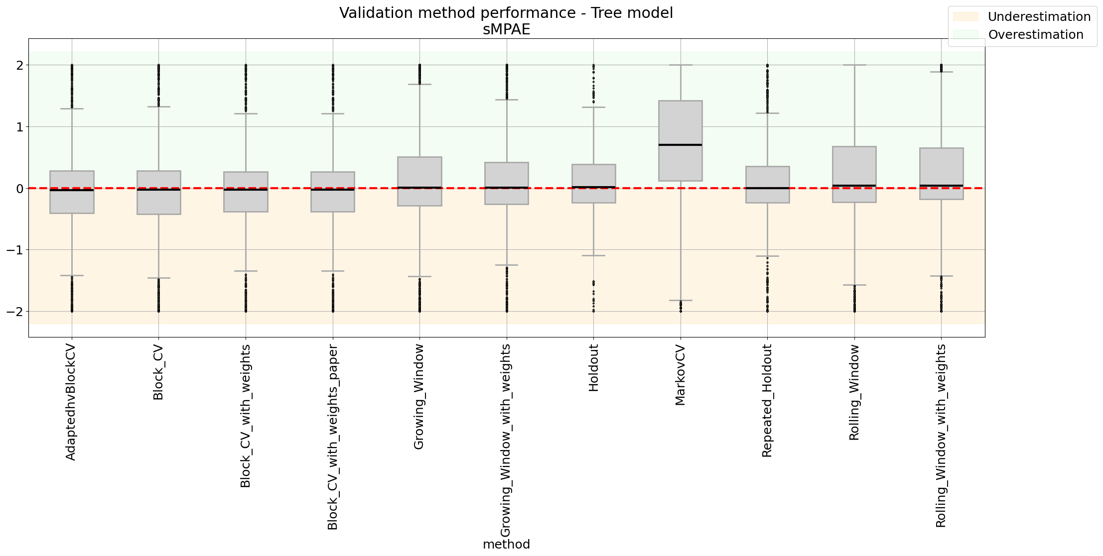
Overall Results – Decision Tree

Slide 10
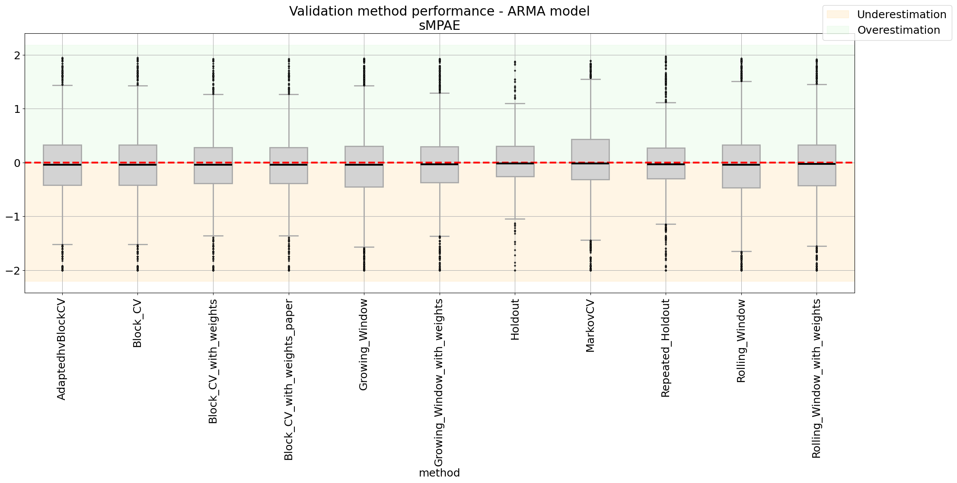
Overall Results - ARMA

Slide 11
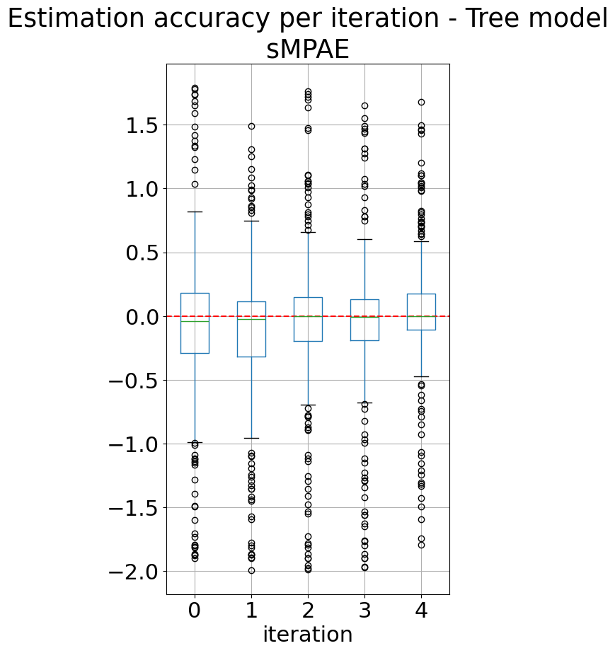
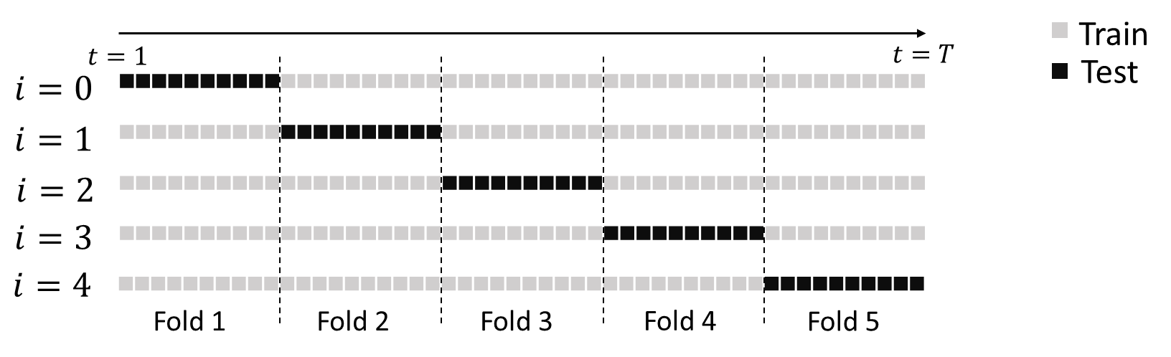
Should We Train In the Future?
Models that train in the future underestimate the error (sign of leakage!);
The most accurate models are the ones that use the past to train.

Slide 12
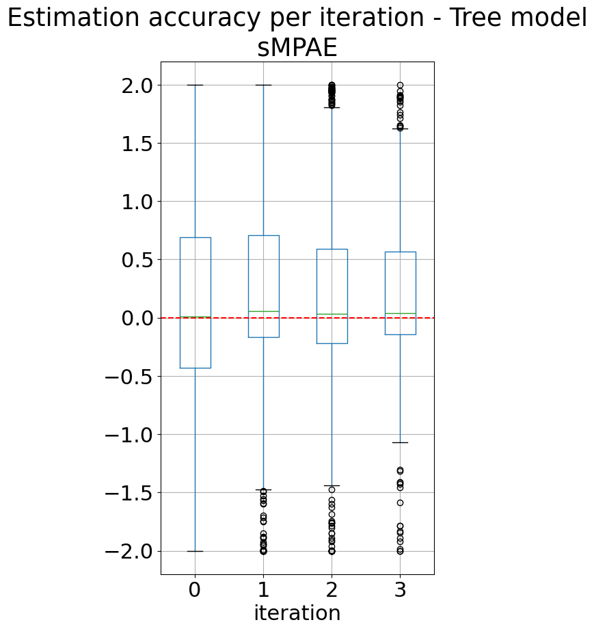
Should We Train In Older Data?
Models that train in the future underestimate the error (sign of leakage!);
The most accurate models are the ones that use the past to train.

