Slide 1
Reunião
14/04/2024

Slide 2
Metodologia de avaliação em Séries Temporais

Slide 3
Desde segunda-feira…
Avanços na escrita do “Related Work”
Novo artigo: Markov CV

Slide 4
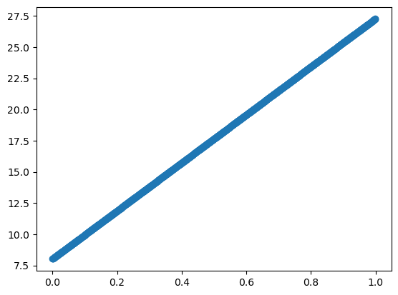
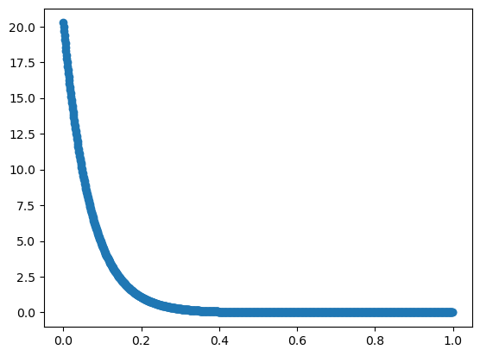
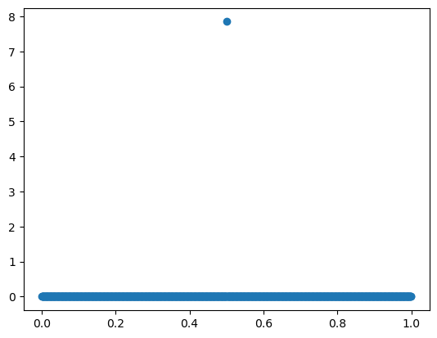
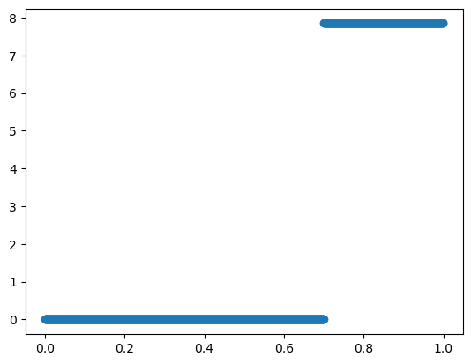
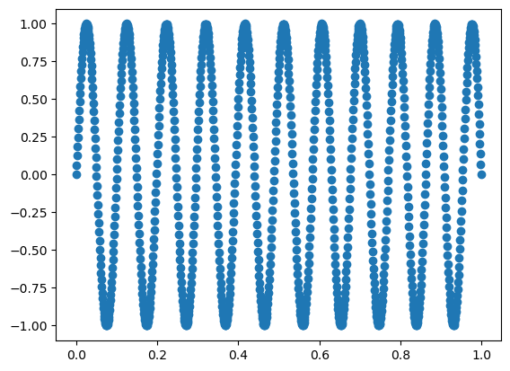
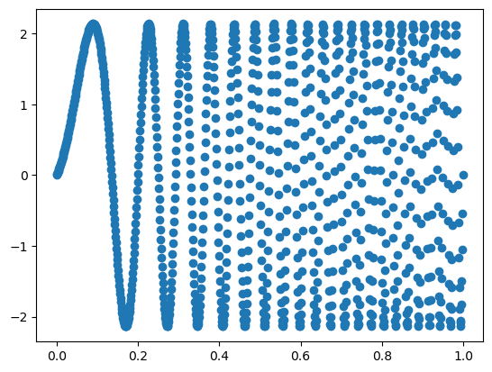
Synthetic Data - Blocks
linear
exponential
Delta Dirac
Indicator([a, +inf])
Sinusoidal
Frequency-varying Sinusoidal

Slide 5
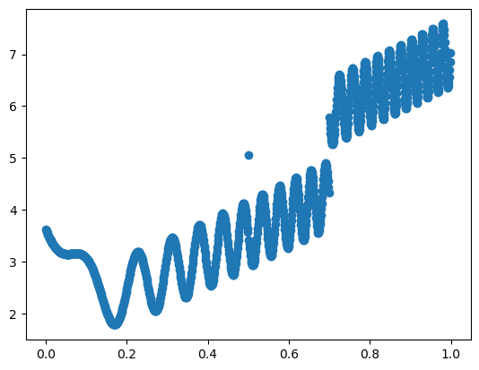
Synthetic Data – Combination of Blocks

Slide 6
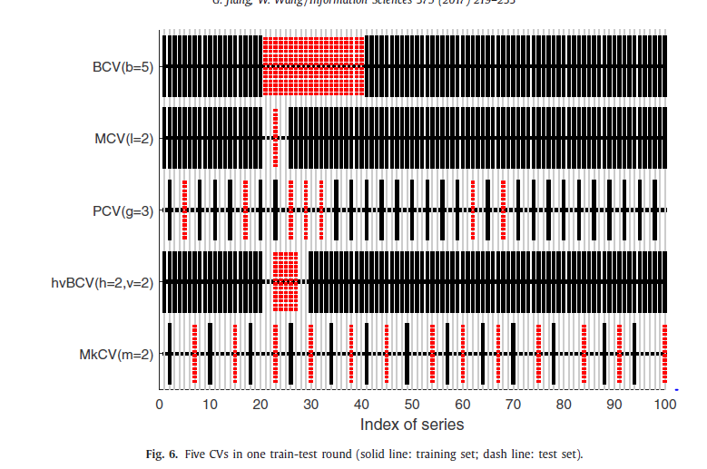
Markov CV (2016)
No other papers have experimented with this method;
Authors claim that it performs better than other time series CV techniques (block CV, modified CV, randomized CV and hv-Block CV)
Properties:
Each sample is trained and tested only once;
There is no overlap between training set and test set;
The distance between training set and test set is bigger than the autocorrelation order;
They claim to that this CV considers the periodicity, overlapping or correlation of series.
The number of partitions is dependent on the correlation order (which helps with parameter tuning, however it also makes it dependent on the accuracy of the estimation of autocorrelation order.

Slide 7
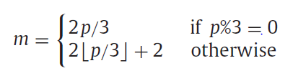



CV – Markov CV
time
Train
$$t=1$$
$$t=T$$
Test
$$i=0$$
2-fold CV
$$⋯$$
$$i=2m$$
2-fold CV

