Slide 1
Reunião
26/07/2024

Slide 2
Metodologias de avaliação em Séries Temporais

Slide 3
Esta semana
Website
Results (ARMA + Tree)

Slide 4
Results

Slide 5

Main Results
Weighted version of Block-CV is better than the original (less error and lower variance)
Weighted version of Growing Window is better than the original (less error and lower variance)
Weighted version of Rolling Window is worse than the original
These results are nowhere in the literature

Slide 6
Overall Results
Holdout method is one of the best models in almost all scenarios (similar to the results of other studies)
Weighted version of Block-CV is better than the original (less error and lower variance)
Weighted version of Growing Window is better than the original (less error and lower variance)
Weighted version of Rolling Window is worse than the original
Markov CV highly overestimates the error on the Decision Tree, but performs good on ARMA. Indicates that is highly sensitive to the model used.
Model that train in the future underestimate the error (sign of leakage!)
These results are nowhere in the literature

Slide 7
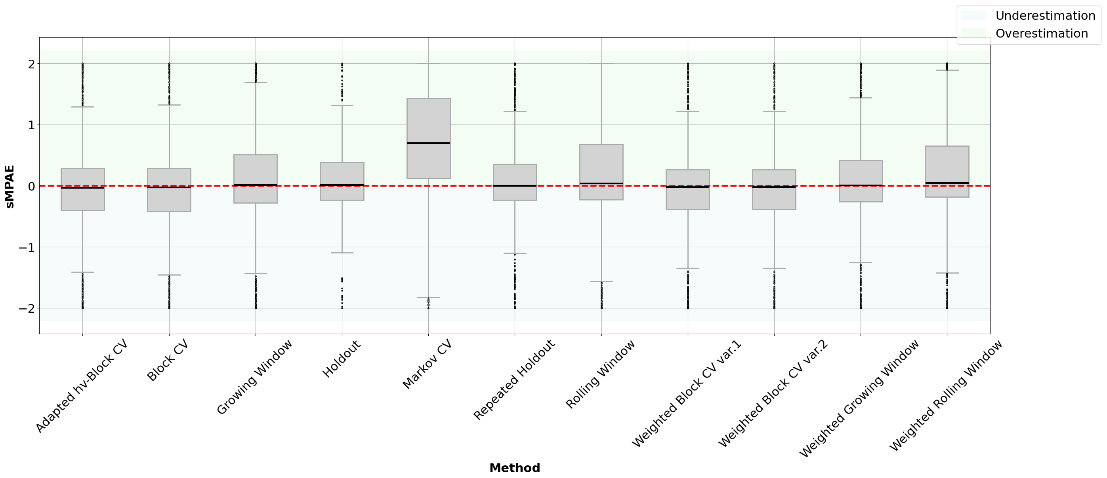
Decision Tree & Real Data
Weighted Growing Window is new (we did not find it anywhere!)
Best!

Slide 8
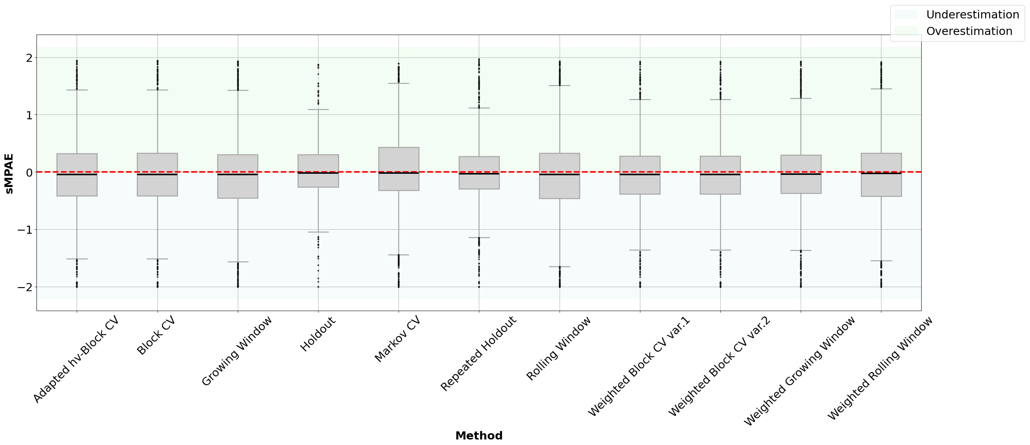
ARMA & Real Data
Best!

Slide 9
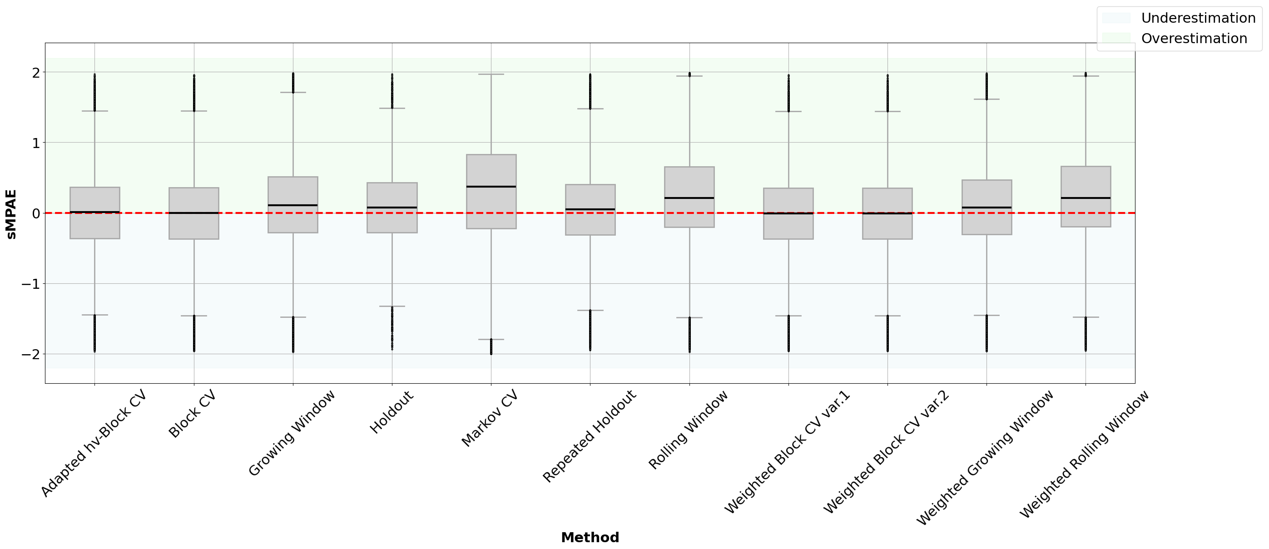
Decision Tree & Synthetic Data
This results are aligned with the remaining literature! (Block CV
is good for stationary data)
Best!

Slide 10
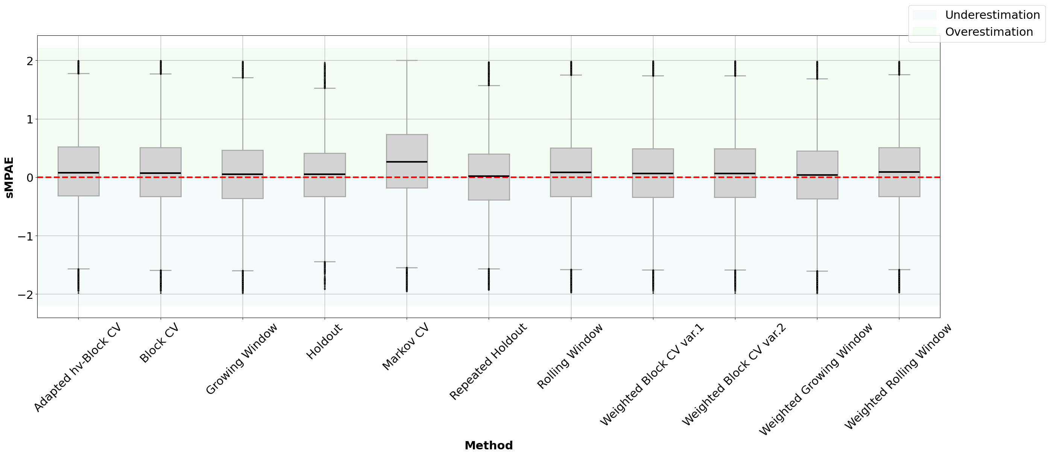
ARMA & Synthetic Data
Best!

Slide 11
ARMA & Synthetic Data
Best!

Slide 12
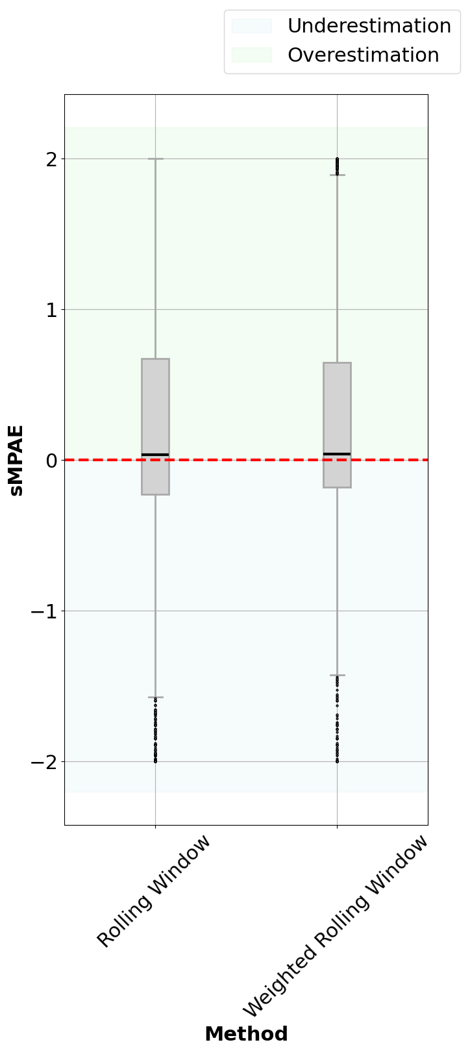
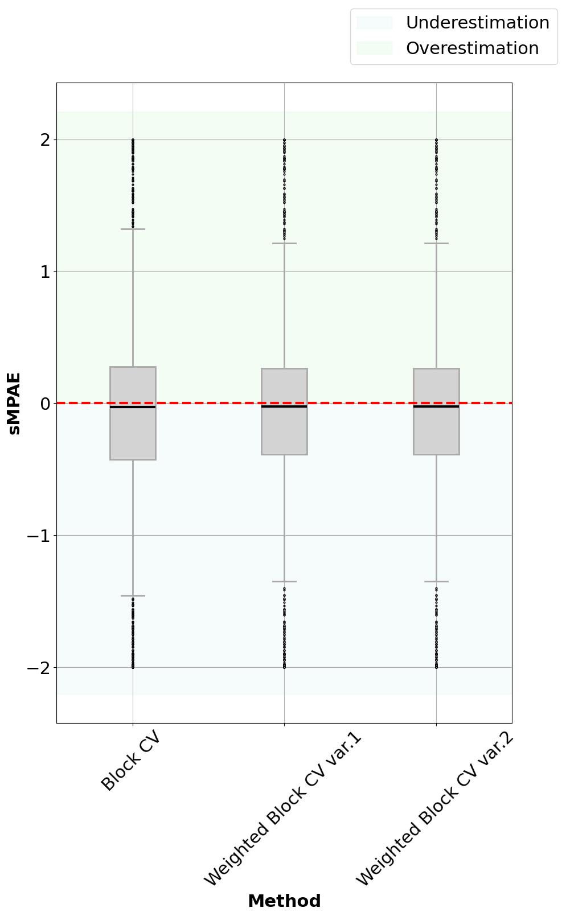

The effect of the Weights (Tree)

Slide 13
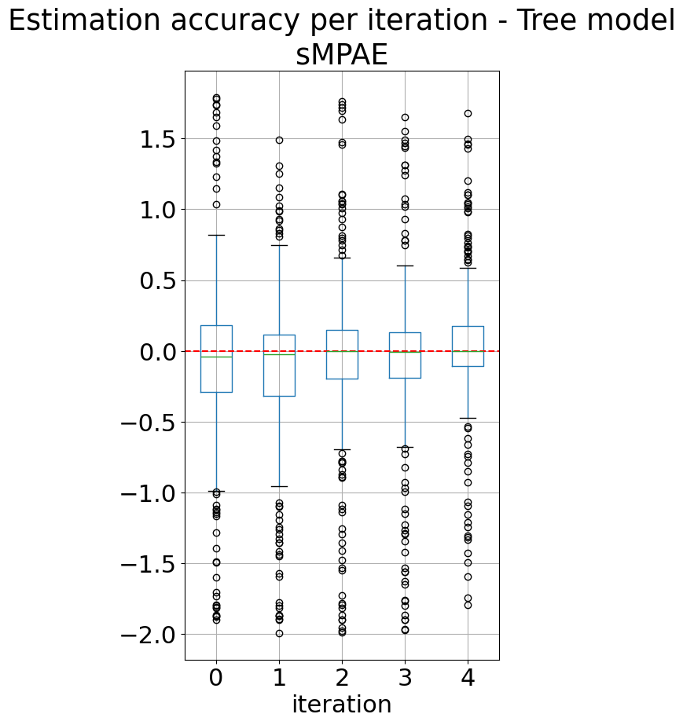
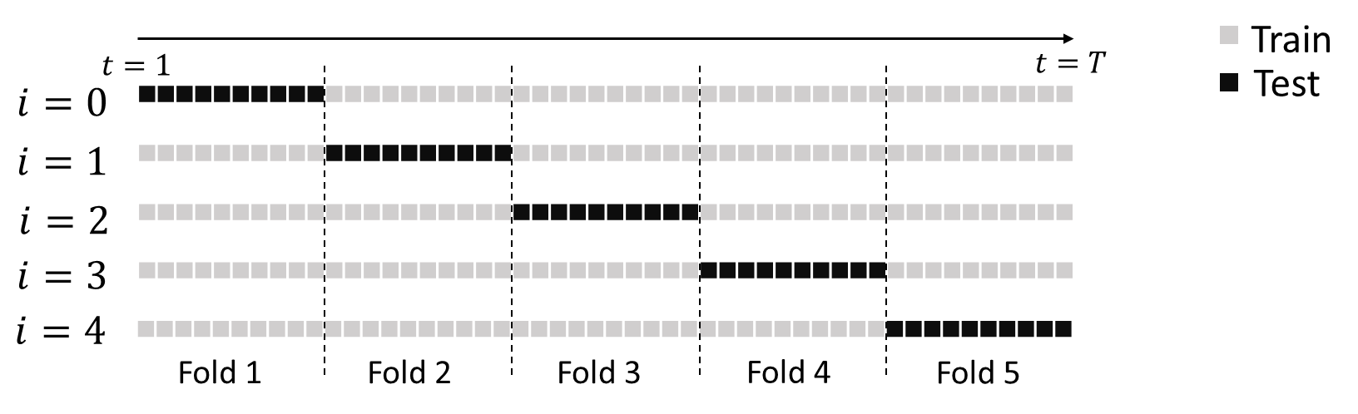
Should We Train In the Future?
Models that train in the future underestimate the error (sign of leakage!);
The most accurate models are the ones that use the past to train.

Slide 14
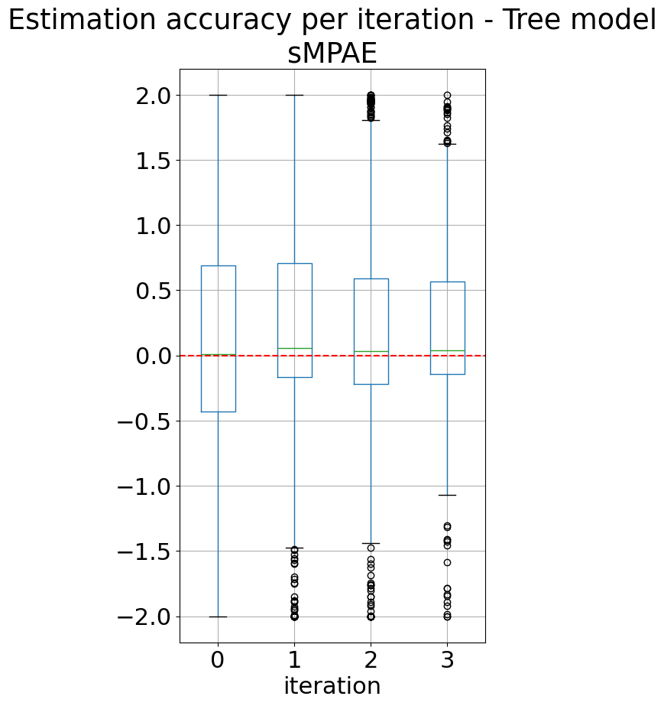
Should We Train In Older Data?
Models that train in the future underestimate the error (sign of leakage!);
The most accurate models are the ones that use the past to train.

