Slide 1
Métodos de validação para Modelos de Séries Temporais
Beatriz Pereira Lourenço
Miguel Santos Loureiro

Slide 2
Motivação e Enquadramento
Time series cv: previsão temporal de taxa de mortalidade:
Modelo ARIMA
Modelo LSTM
Principais problemas
Fraca descrição dos métodos
Métodos iguais com o mesmo nome; Métodos com o mesmo nome mas ligeiramente diferentes;
Pouca clareza relativamente ao melhor método
Resultados pouco claros de analisar
Dados temporais em formato tabular: “embedding layer”
Métodos que levam a data leakage

Slide 3
Cross-Validation em dados independentes

Slide 4
Atual Literatura e os seus problemas
Time series cv: previsão temporal de taxa de mortalidade
Principais problemas
Fraca descrição dos métodos
Métodos iguais com o mesmo nome; Métodos com o mesmo nome mas ligeiramente diferentes;
Pouca clareza relativamente ao melhor método
Resultados pouco claros de analisar
Métodos apenas pensados para modelos de machine learning: embedding layer
Métodos que levam a data leakage

Slide 5
Data Leakage
Data leakage refers to the inadvertent use of data from the test set, or more generally data not available during inference, while training a model. It is always a potential problem in any ML task. (Bergmeir 2023)
, leakage in data mining (henceforth, leakage) is the introduction of information about the target of a data mining problem that should not be legitimately available to mine from. (haufman 2012)

Slide 6
Two Types of Data Leakage
Leakage in data mining is the introduction of information about the target of a data mining problem that should not be legitimately available to mine from.¹
Feature Leakage
Leakage in Training Example
Bank Account Opening Prediction: An “account number” feature, for the problem of predicting whether a potential customer would open an account at a bank. Obviously, assignment of such an account number is only done after an account has been opened.
Forecast white noise: Suppose we are trying to predict the level of a white noise process yt for t ∈ {101, 102, . . . , 200}, clearly a hopeless task. Strictly speaking, the only feature used by this model, t , is legitimate. Hence the model has no leakage as defined by condition (2), however, it clearly has perfect prediction performance for the evaluation set in the example.
Example

Slide 7
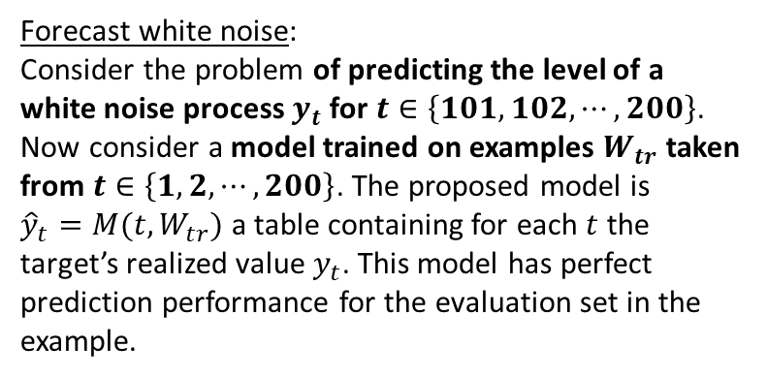
Data Leakage
Definition: Leakage in data mining is the introduction of information about the target of a data mining problem that should not be legitimately available to mine from.¹
Feature Leakage
Leakage in Training Example
Bank Account Opening Prediction:
Consider the “account number” feature for the problem of predicting whether a potential customer would open an account at a bank.
The assignment of such an account number is only done after an account has been opened.
Forecast white noise:
Consider the problem of predicting the level of a white noise process $y_{t}$ for $t∈\left\{101, 102, ⋯,200\right\}$. Now consider a model trained on examples $W_{tr}$ taken from $t∈\left\{1, 2, ⋯,200\right\}$. The proposed model is ${{\hat{y}}_{t}=M(t,W}_{tr})$ a table containing for each $t$ the target’s realized value $y_{t}$. This model has perfect prediction performance for the evaluation set in the example.
Example

Slide 8
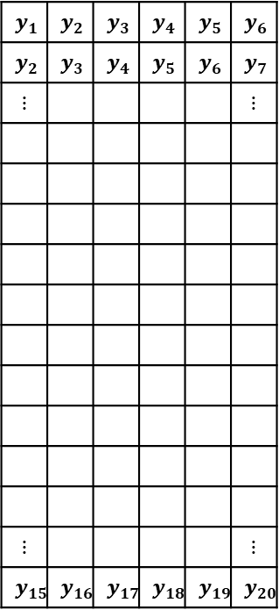


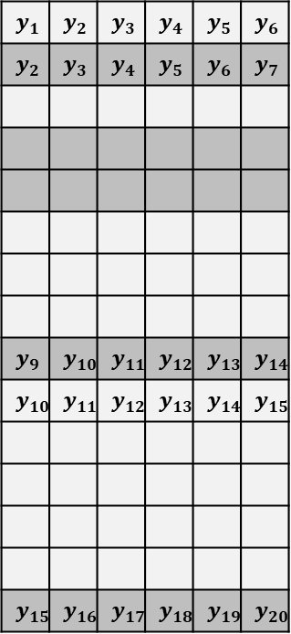
“Random k-fold Cross-Validation” em Séries Temporais
Treino
Test
Input
Output
Input
Output
$$y_{1}$$ | $$y_{2}$$ | $$y_{3}$$ | $$y_{4}$$ | $$y_{5}$$ | $$y_{6}$$
$$y_{2}$$ | $$y_{3}$$ | $$y_{4}$$ | $$y_{5}$$ | $$y_{6}$$ | $$y_{7}$$
$$⋮$$ |  |  |  |  | $$⋮$$
$$⋮$$ |  |  |  |  | $$⋮$$
$$y_{15}$$ | $$y_{16}$$ | $$y_{17}$$ | $$y_{18}$$ | $$y_{19}$$ | $$y_{20}$$
$$y_{1}$$ | $$y_{2}$$ | $$y_{3}$$ | $$y_{4}$$ | $$y_{5}$$ | $$y_{6}$$
$$y_{2}$$ | $$y_{3}$$ | $$y_{4}$$ | $$y_{5}$$ | $$y_{6}$$ | $$y_{7}$$
$$y_{9}$$ | $$y_{10}$$ | $$y_{11}$$ | $$y_{12}$$ | $$y_{13}$$ | $$y_{14}$$
$$y_{10}$$ | $$y_{11}$$ | $$y_{12}$$ | $$y_{13}$$ | $$y_{14}$$ | $$y_{15}$$
$$y_{15}$$ | $$y_{16}$$ | $$y_{17}$$ | $$y_{18}$$ | $$y_{19}$$ | $$y_{20}$$
$$y_{t}$$
“Temporal Embedding”
Partição aleatória
Teste
Treino
$$t$$
(Tabulação dos dados para utilização pelos modelos de ML)

Slide 9
Artigos que aplicam “Random k-fold Cross-Validation” em Séries Temporais
BERGMEIR, Christoph; BENÍTEZ, José M. On the use of cross-validation for time series predictor evaluation. Information Sciences, 2012, 191: 192-213.
BERGMEIR, Christoph; HYNDMAN, Rob J.; KOO, Bonsoo. A note on the validity of cross-validation for evaluating autoregressive time series prediction. Computational Statistics & Data Analysis, 2018, 120: 70-83.
CERQUEIRA, Vitor; TORGO, Luis; MOZETIČ, Igor. Evaluating time series forecasting models: An empirical study on performance estimation methods. Machine Learning, 2020, 109.11: 1997-2028.
SCHNAUBELT, Matthias. A comparison of machine learning model validation schemes for non-stationary time series data. FAU Discussion Papers in Economics, 2019.
JIANG, Gaoxia; WANG, Wenjian. Markov cross-validation for time series model evaluations. Information Sciences, 2017, 375: 219-233.
HEWAMALAGE, Hansika; ACKERMANN, Klaus; BERGMEIR, Christoph. Forecast evaluation for data scientists: common pitfalls and best practices. Data Mining and Knowledge Discovery, 2023, 37.2: 788-832.

Slide 10
Métodos de Validação

Slide 11
Métodos de Séries Temporais
Principais desvantagens:

Slide 12
O nosso estudo

Slide 13
Principais “Outputs”

Slide 14
Experiências

Slide 15
Objetivos

Slide 16
Ponto da Situação

