Slide 1
Reunião
14/04/2024

Slide 2
Metodologias de avaliação em Séries Temporais

Slide 3
Desde segunda-feira…
Avanços na escrita do “Related Work”
Novo artigo: Markov CV
Novos artigos (relevantes): Schnaubelt (estudo semelhante ao do Cerqueira, com bastante qualidade); Otto (review; dependência temporal e espacial); Schratz (dependência espacial)
Package: mais testes realizados para os métodos de geração de dados; implementação de mais um método (Markov CV); validação da biblioteca da Fraunhofer (Matlab); funções de interface com a biblioteca da Fraunhofer (dependência da nossa); funções auxiliares

Slide 4
Related Work…
Otto (Review de 2024):"In the case of spatially/temporally dependent data, standard random k-fold cross-validation procedures cannot be applied." (2): "Consequently, the evaluation of prediction performance tends to be overly optimistic because the training and test datasets become correlated, largely due to the neglected underlying correlation structure, whether across space or time"In the context of spatially dependent data:
Schratz (Spatial Dependency): "Crossvalidation and bootstrapping are two widely used performance estimation techniques (...). However, in the presence of spatial autocorrelation, estimates obtained using regular (non-spatial) random resampling maybe biased and overoptimistic."

Slide 5
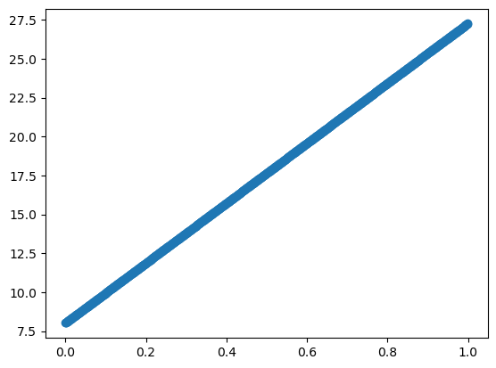
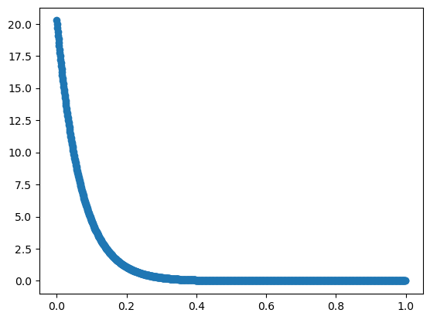
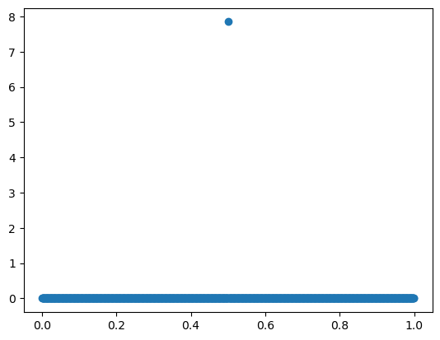
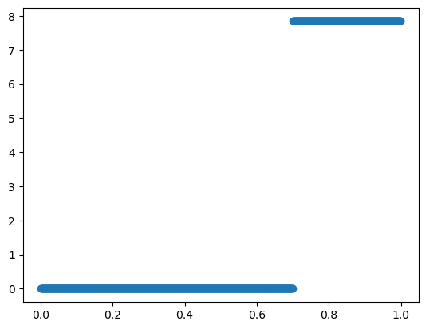
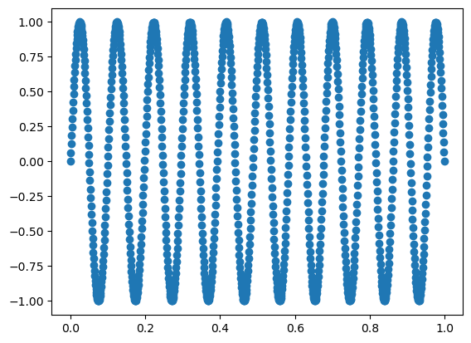
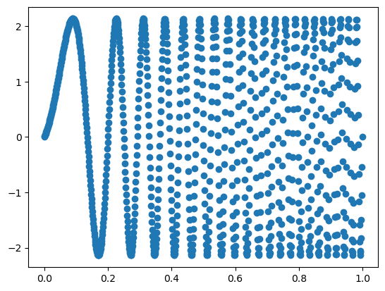
Synthetic Data – Building Blocks
linear
exponential
Dirac Delta
Indicator([a, +inf])
Sinusoidal
Frequency-varying Sinusoidal

Slide 6
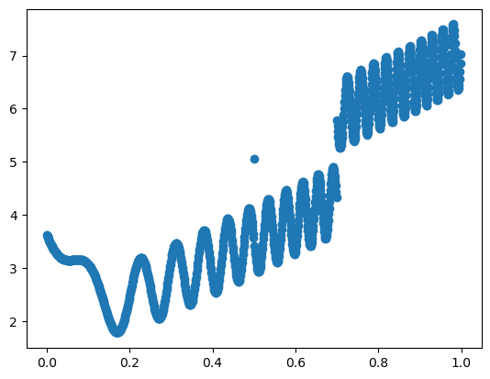
Synthetic Data – Combinations

Slide 7
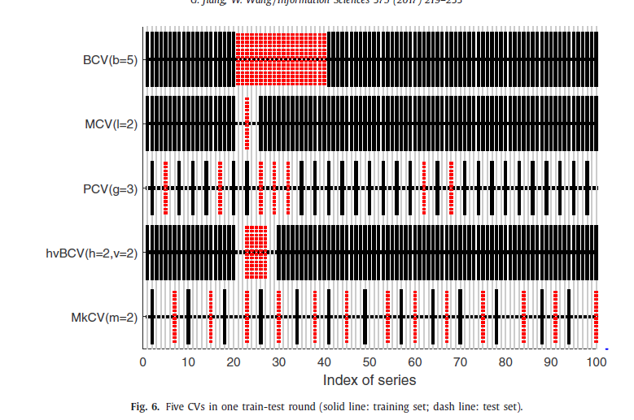
Markov CV (2016)
No other papers have experimented with this method;
Authors claim that it performs better than other time series CV techniques (block CV, modified CV, randomized CV and hv-Block CV)
Properties:
Each sample is trained and tested only once;
There is no overlap between training set and test set;
The distance between training set and test set is bigger than the autocorrelation order;
They claim to that this CV considers the periodicity, overlapping or correlation of series.
The number of partitions is dependent on the correlation order (which helps with parameter tuning, however it also makes it dependent on the accuracy of the estimation of autocorrelation order.

Slide 8
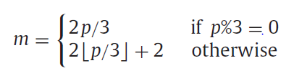



CV – Markov CV
time
Train
$$t=1$$
$$t=T$$
Test
$$i=0$$
2-fold CV
$$⋯$$
$$i=2m$$
2-fold CV

Slide 9
Próxima semana…
Revisão Bibliográfica em Data Streaming;
Terminar related work;
Escrever Introdução;
Restruturar código sobre geração dos dados e testar os dados;
Continuar implementação dos métodos;
Tratamento dos dados reais;

