Slide 1
Reunião
21/02/2024

Slide 2
Metodologia de avaliação em Séries Temporais

Slide 3
Timeline

Slide 4
Struture
Introduction
Literature review / Related work
Validation methods for time series modelling
Design of experiments
Results and Discussion
Conclusion and future work

Slide 5
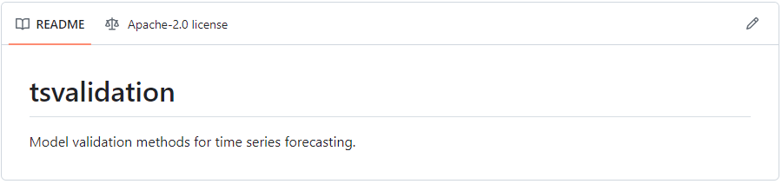
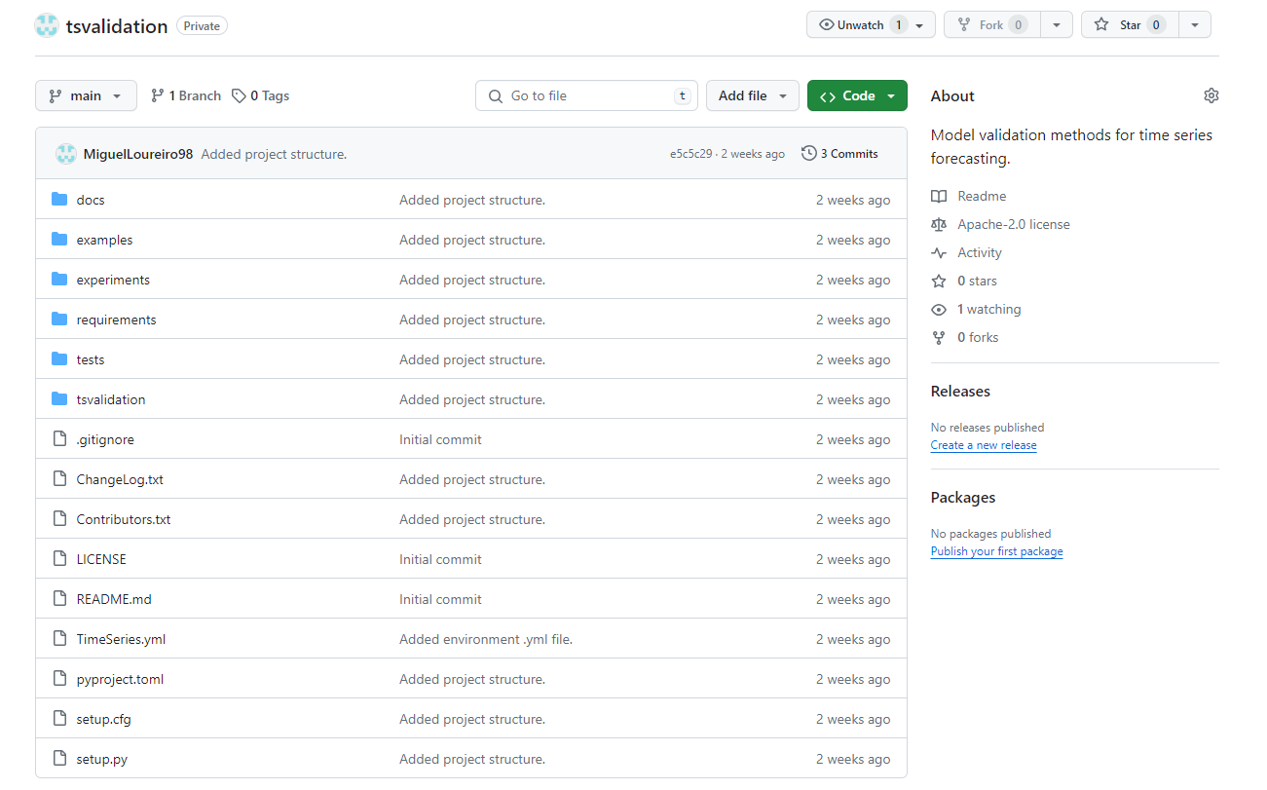
Python Package

Slide 6
Old Planning
Main goals
Comparison between validation methods;
Diverse data characteristics
RNN (LSTM)
ARIMA
Models
Repeated holdout method
Prequential methods (sliding window, growing window, gap-growing window)
Blocked CV, Modified CV & hv-Blocked CV
Other methods: classical approach
Other methods: ML approach
Real benchmark datasets in previous studys
Simulations from previous studys
Datasets
Validation Methods
Stationarity
Trends
Seasonality
Nonseasonal cycles
Frequency content
Shifts in level / System dynamics
Stationarity vs Non-stationarity
Relation between number of partitions/partition size and validation method performance
Relation between the impact of frequency characteristics in each partition and validation method performance
Relation between the number of shifts levels/change in dynamics in each partition and validation method performance
Data
Other Characteristics to explore
Tests

Slide 7


OOS – Fixed-origin/Holdout
time
Train
$$t=1$$
origin ($θ$)
$$t=T$$
Test
$$i=0$$

Slide 8





OOS – Rolling-origin-update
time
Train
$$t=1$$
origin ($θ$)
$$t=T$$
Test
$$i=0$$
$$θ+1$$
$$i=1$$
$$⋯$$
$$θ+h$$
$$i=h$$

Slide 9

OOS – Rolling-origin-recalibration
time
Train
$$t=1$$
origin ($θ$)
$$t=T$$
Test
$$i=0$$
$$θ+1$$
$$i=1$$
$$⋯$$
$$T−1$$
$$i=h$$

Slide 10

OOS – Rolling-origin-recalibration
time
Train
$$t=1$$
origin ($θ$)
$$t=T$$
Test
$$i=0$$
$$θ+1$$
$$i=1$$
$$⋯$$
$$T−1$$
$$i=T−θ−1$$

Slide 11



OOS – Fixed-size rolling window
time
Train
$$t=1$$
origin ($θ$)
$$t=T$$
Test
$$i=0$$
$$1$$
$$θ+1$$
$$i=1$$
$$⋯$$
$$T−θ−1$$
$$T−1$$
$$i=T−θ−1$$

Slide 12

Repeated Hold-out
time
Train
$$t=1$$
$$a_{0}$$
$$t=T$$
Test
$$i=0$$
$$a_{1}$$
$$i=1$$
$$⋯$$
$$a_{r}$$
$$i=r$$
Interval of random splits

Slide 13
Repeated Hold-out
New!
time
Train
$$t=1$$
$$a_{0}$$
$$t=T$$
Test
$$i=0$$
$$a_{1}$$
$$i=1$$
$$⋯$$
$$a_{r}$$
$$i=r$$
Interval of random splits

Slide 14




Prequential – Growing window
time
Train
$$t=1$$
$$t=T$$
Test
$$i=0$$
$$i=1$$
$$i=2$$
$$i=3$$
Fold 1
Fold 2
Fold 3
Fold 4
Fold 5

Slide 15
Prequential – Rolling window
time
Train
$$t=1$$
$$t=T$$
Test
$$i=0$$
$$i=1$$
$$i=2$$
$$i=3$$
Fold 1
Fold 2
Fold 3
Fold 4
Fold 5

Slide 16
Prequential – Gap Rolling window
time
Train
$$t=1$$
$$t=T$$
Test
$$i=0$$
$$i=1$$
$$i=2$$
Fold 1
Fold 2
Fold 3
Fold 4
Fold 5

Slide 17

CV – Blocked CV (K-fold)
time
Train
$$t=1$$
$$t=T$$
Test
$$i=0$$
$$i=1$$
$$i=2$$
$$i=3$$
$$i=4$$
Fold 1
Fold 2
Fold 3
Fold 4
Fold 5

Slide 18
CV – hv-Blocked CV
time
Train
$$t=1$$
$$t=T$$
Test
$$i=0$$
$$i=1$$
$$i=2$$
$$i=3$$
$$i=4$$
Fold 1
Fold 2
Fold 3
Fold 4
Fold 5

Slide 19
CV – Modified CV
time
Train
$$t=1$$
$$t=T$$
Test
$$i=0$$
$$i=1$$
$$i=2$$
$$i=3$$
$$i=4$$
Fold 1
Fold 2
Fold 3
Fold 4
Fold 5

Slide 20
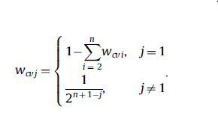
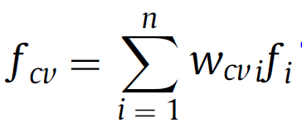
CV – “Weighted Blocked CV”
time
Train
$$t=1$$
$$t=T$$
Test
$$i=0$$
$$w_{1}$$
$$i=1$$
$$w_{2}$$
$$i=2$$
$$w_{3}$$
$$i=3$$
$$w_{4}$$
$$i=4$$
$$w_{5}$$
Fold 1
Fold 2
Fold 3
Fold 4
Fold 5
Ainda não incluído nas reviews que vimos

Slide 21
CV – “Weighted Growing window CV”
New!
time
Train
$$t=1$$
$$t=T$$
Test
$$i=0$$
$$i=1$$
$$i=2$$
$$i=3$$
Fold 1
Fold 2
Fold 3
Fold 4
Fold 5

Slide 22

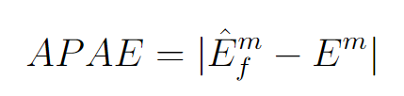
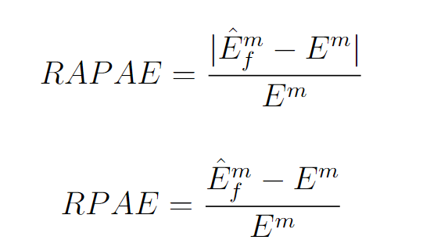



Metrics to use
1.
7.
Standard deviation between folds
2.
3.
New!
4.
New!
5.
6.
$$\frac{Nb. experiments with under \left(over\right) estimation}{Total nb. datasets}$$

Slide 23
Experiments & Data
Experiments
Data Characteristics to explore/
Metrics to Measure them
Stationarity
Frequency:
Peak frequency
Spectral centroid
Spectral Entropy
System Dynamics
Stability
Lumpiness
Max level shift
Maximum variance shift
Peak-to-peak amplitude
Trends
Linear trend: Fit linear regression and get slope
“Strength of trend”
Zero-crossing rate
What validation method is best and for what time series characteristics?
Other questions:
Impact of Stationarity vs Non-stationarity on the validation method performance
Impact of the number of partitions/partition size on the validation method performance
Impact of shifts levels/change in dynamics in each partition on the validation method performance
Impact of validating on older folds vs newer folds
Impact of training in the “future” and test in the “past”
Frequency:
Impact of Number of cycles in each fold
Impact of noise
System dynamics
Impact of stability and lumpiness between folds or/and between methods

Slide 24
Experiments & Data
Experiments
Number of partitions/partition size

Slide 25
Data Generation
1.
Functions to combine:
Sinusoid
Step functions
Linear trends
Impulse functions
Exponential trends
Time-varying sinusoid
White noise
2.
Data generation methods from Bergmeir and Cerqueira

