Slide 1
Deal Probability for Online Sellers
Helping sellers know what to expect from their listings.

Slide 2

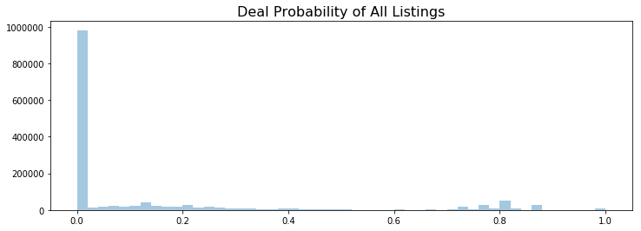
Importance of Online Sellers
Platforms that rely on used goods sales: Ebay, Craigslist, (Less)Amazon, Avito(Russia).
Online sellers are the lifeblood of these platforms. You must keep them happy.
Most online sellers have no idea what they’re doing, as shown by these 1.5M Listings on Avito.ru

Slide 3
Struggles of Online Sellers
Tiny details in a product listing can make a big difference in buyer’s interest.
Even with an optimized listing, demand for a product may simply not exist, frustrating sellers who may have over-invested in marketing.
Sellers online sometimes feel frustrated with both too little demand (indicating something is wrong with the product or the product listing) or too much demand (indicating a hot item with a good description was underpriced).

Slide 4
Solution: Deal Probability
Recommendations aimed at improving the experience of placing ads, and consequently prevent sellers from migrating to other platforms.
How to best optimize their listing.
Bot: “We noticed your ad description is too short. Ads with at least N number of words have higher chances of selling.”
Realistic expectation of buyer’s interest.
Bot: “Based on similar ads, yours has 99% chances of selling. Cash is coming your way!”

Slide 5
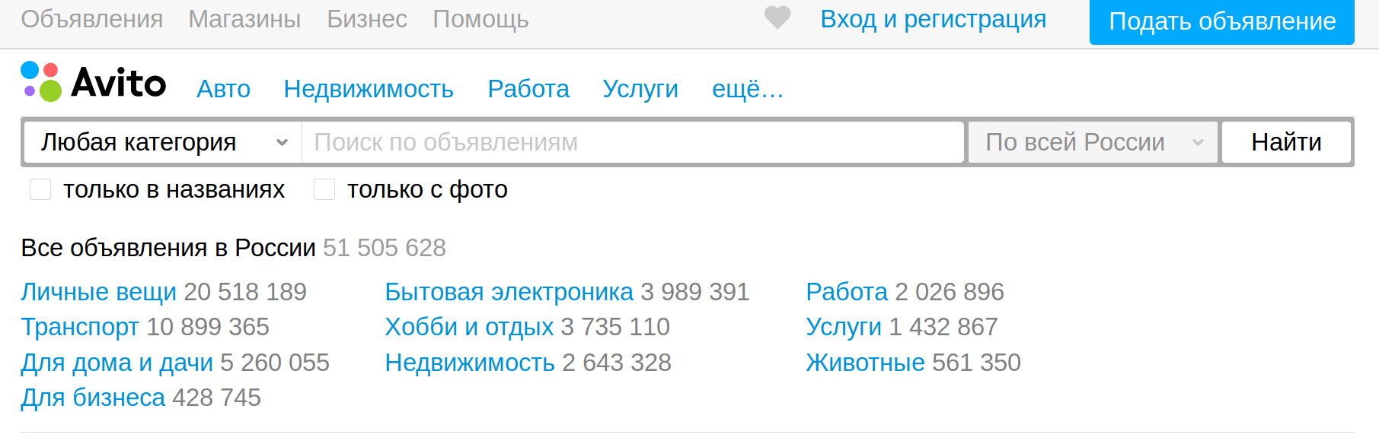
Avito’s Data

Slide 6

About Avito
Avito.ru is a Russian classified advertisements website with sections devoted to general goods for sale, jobs, real estate, personals, cars for sale, and services.
Avito.ru is the most popular classifieds site in Russia and is the second biggest classifieds site in the world after Craigslist.

Slide 7
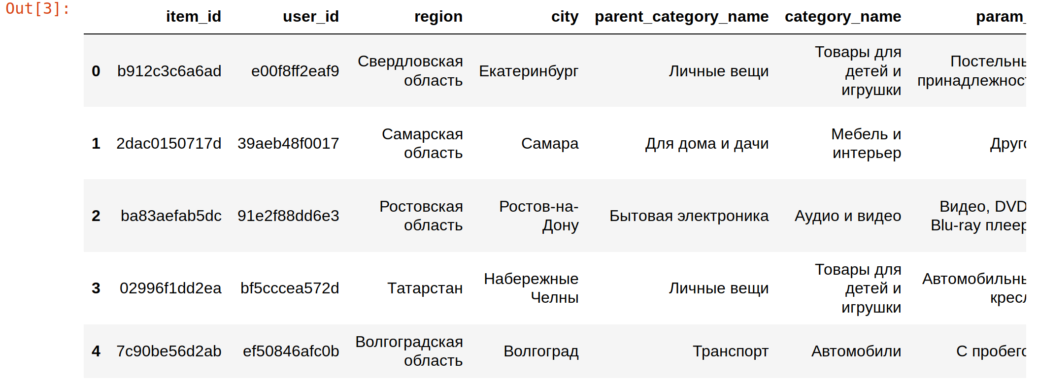
About the Dataset
It’s big. 1.5+Million ads.
It’s in Russian, with Cyrillic alphabet.
Titles and descriptions offer endless NLP opportunities.
Plenty of categorical data to binarize.

Slide 8
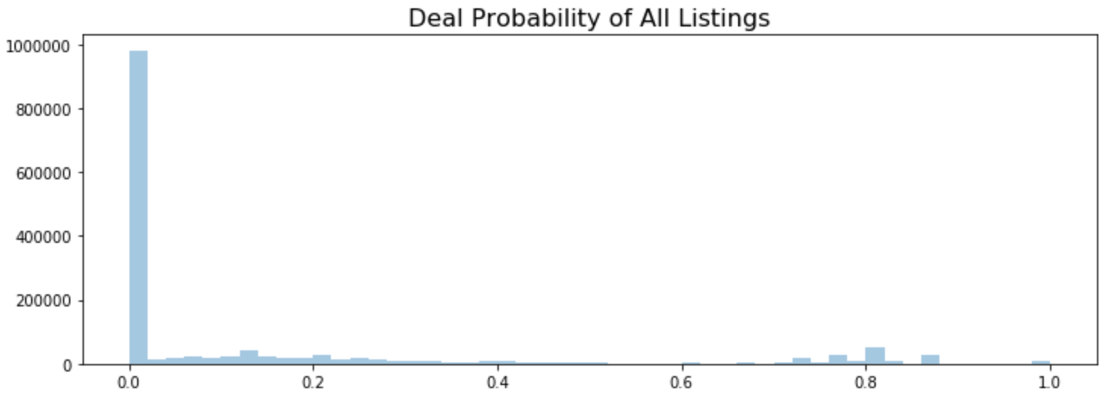
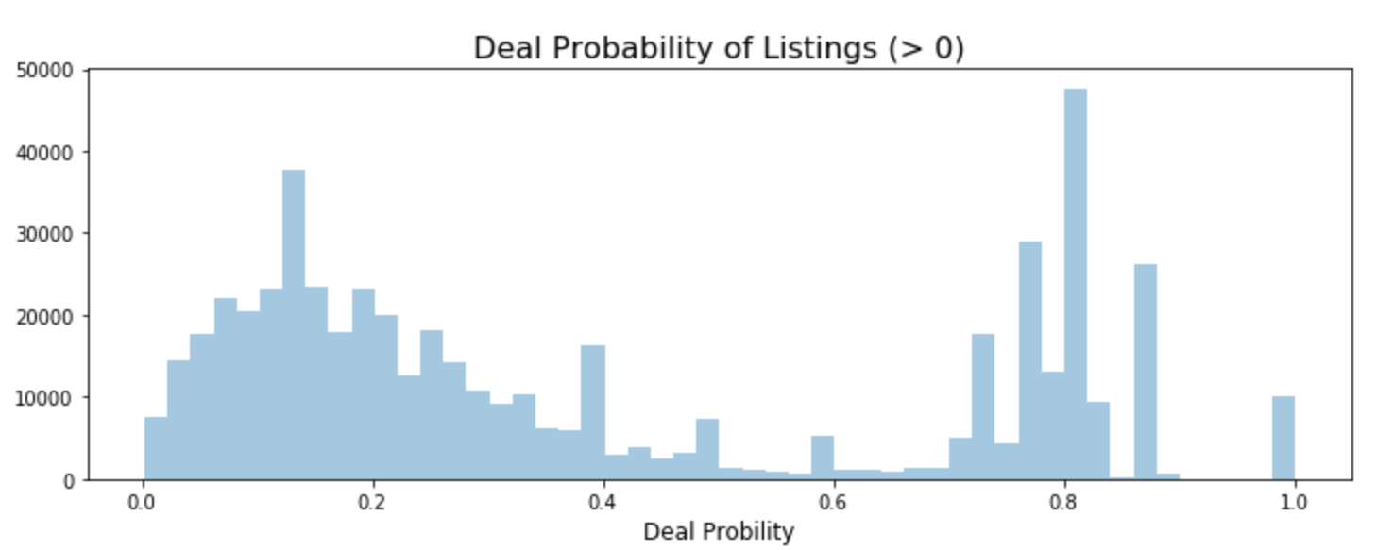
Outcome variable is very non-normal. There's three distinct groups. (Zero Range, Lower Range, Upper Range)

Slide 9
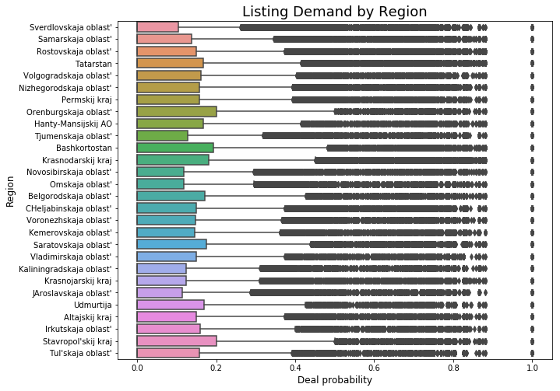
Demand Distribution by Region

Slide 10
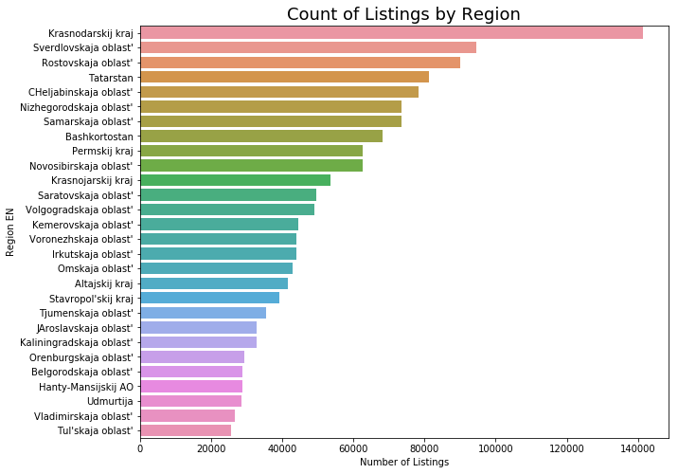
Listing Counts by Region

Slide 11
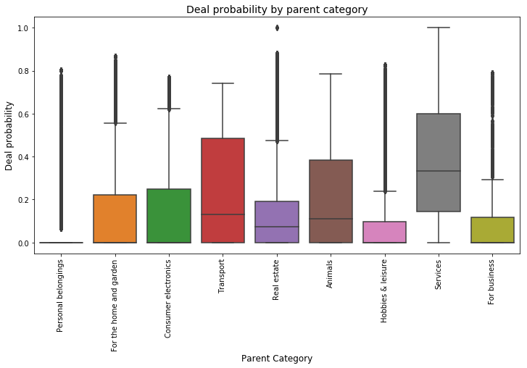
Deal Probability by Parent Category

Slide 12
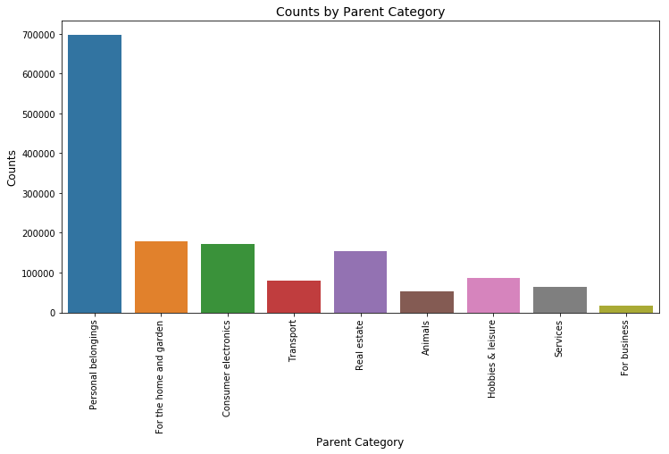
Ad Count by Parent Category

Slide 13
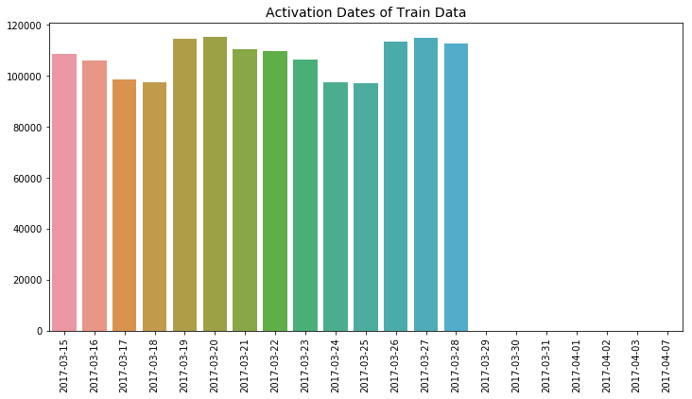
Count of Ad Activation Dates

Slide 14
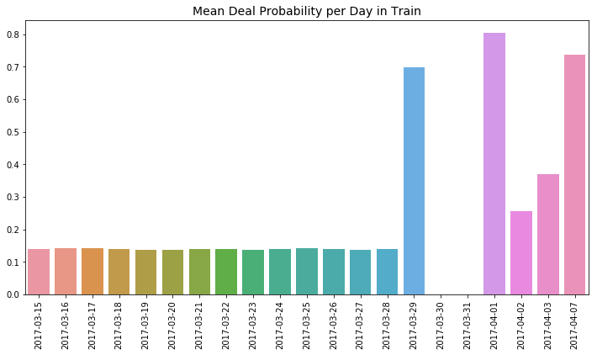
Daily Mean Deal Probability

Slide 15
Feature Engineering Pipeline
Generation of feature sets in detail...

Slide 16
VS
Natural Language Processing involves applying Singular Value Decomposition onto a Document-Frequency Matrix.
SVD is unsupervised (decomposition), PLSR is supervised (cross-decomposition).
PLSR is ideal for use when many features are correlated and/or the number of features exceeds the number of datapoints.
NLP for explanatory vs predictive purposes.

Slide 17
Cross-Decomposition of TF-IDF Vectors with BiGrams¶
This process consists of extracting term frequency vectors using the text in each ad as a document. Tokens for unigrams and bigrams will be included in this stage. Lastly, the resulting matrix will be reduced to the smallest number of components that retain all potential predictive power.
Perform onto both titles and descriptions and retain separate components for each.

Slide 18
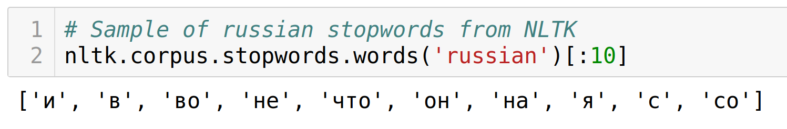
About this step
Russian stopwords from NLTK library.
Let vectorizer compute BiGrams along with single terms. TriGrams had very poor performance.
Vectorizer `lowercase=False` on titles and descriptions.
Filtering terms: set `min_df=0.00005`, which reduced 200k+ features down to 30k+.

Slide 19
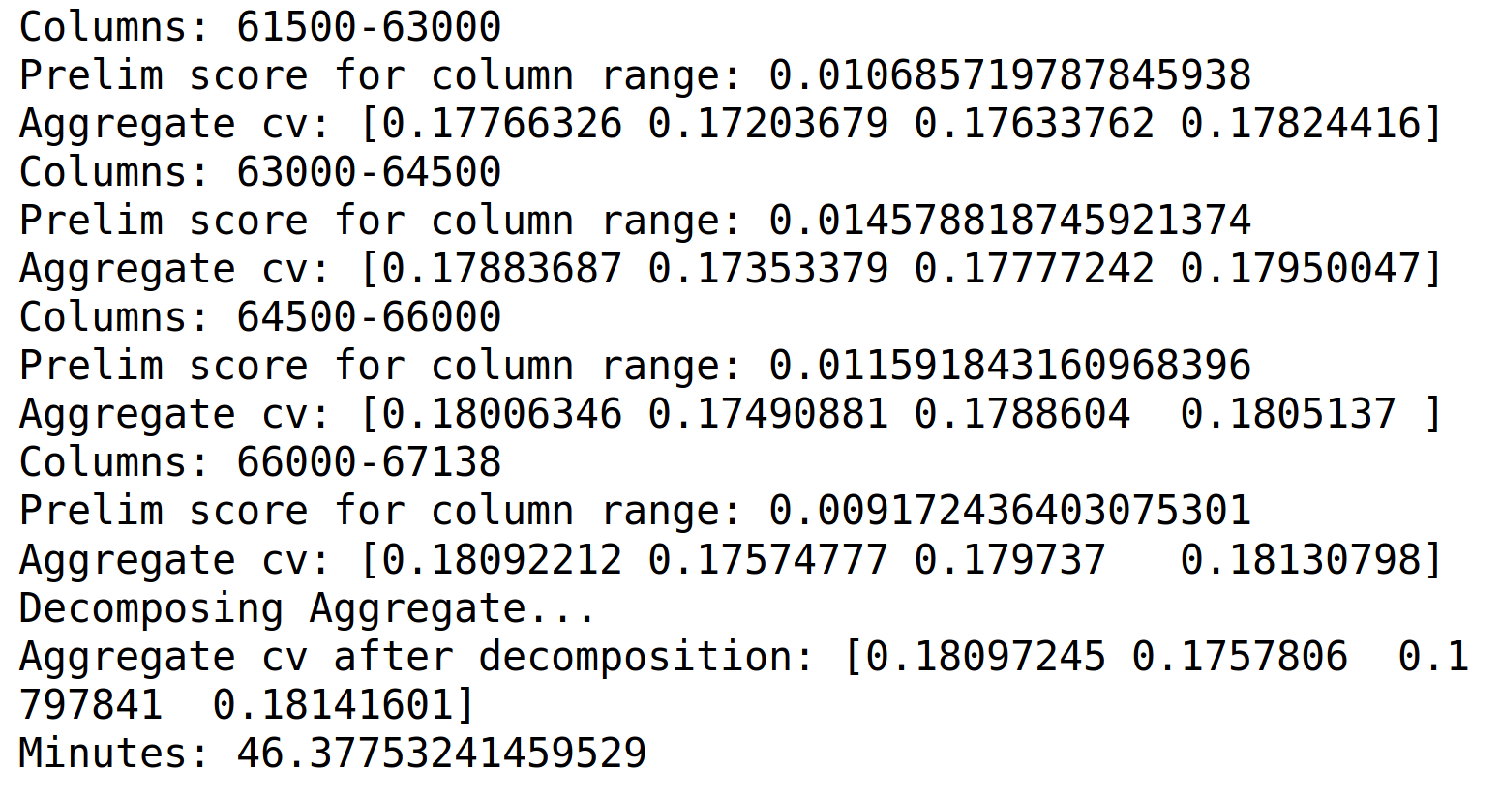
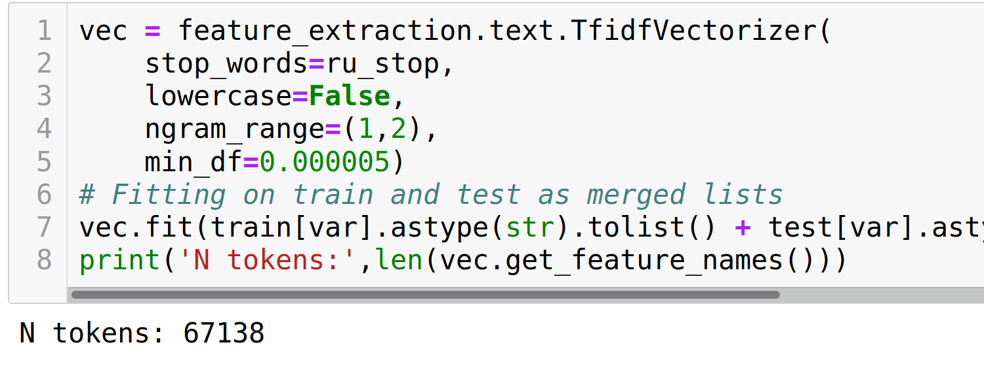
Challenges of PLSR Reduction
PLSR doesn’t handle CSR matrices. Only dense format data.
With 1.5Million rows on 30k columns, you WILL run out of memory.
Solution: Decompose column ranges at a time.
Iterative PLSR decomposes ranges of columns at a time, so process doesn’t run out of memory.

Slide 20
Discrete Vector Cross-Decomposition
This consists of splitting the dependent variable into discrete ranges and creating a vocabulary for each range.
Then vectorize and cross-decompose each vocabulary independently. Resulting components for each vocabulary will reflect the presence of terms common in a certain discrete range of target.

Slide 21
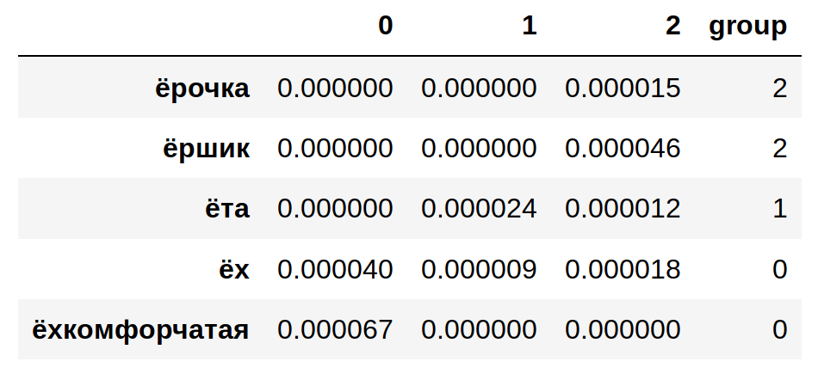
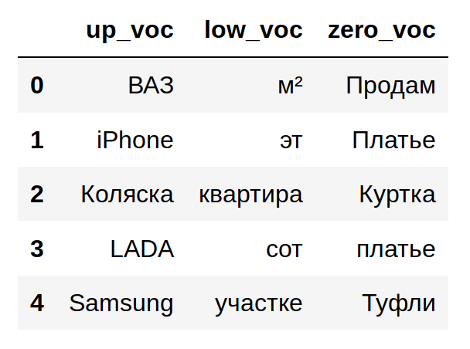
Make target groups: rows where deal probability is in either zero, lower or upper range.
Make strings: Join the titles of each group into 3 long corpuses to be used as documents.
Get TF-IDF matrix and transpose.
Indicator of which document has the highest frequency.
The index of each group are the terms most common in that range.

Slide 22
Discrete Vector Sums
Similar to previous procedure, vocabularies are created for discrete ranges of target.
Instead of decomposing the vectors of those vocabularies, you simply sum their frequencies along the row axis of the term frequency matrix. This results in a single variable for each vocabulary, which represents the aggregate frequency of a vocabulary's terms per ad.

Slide 23
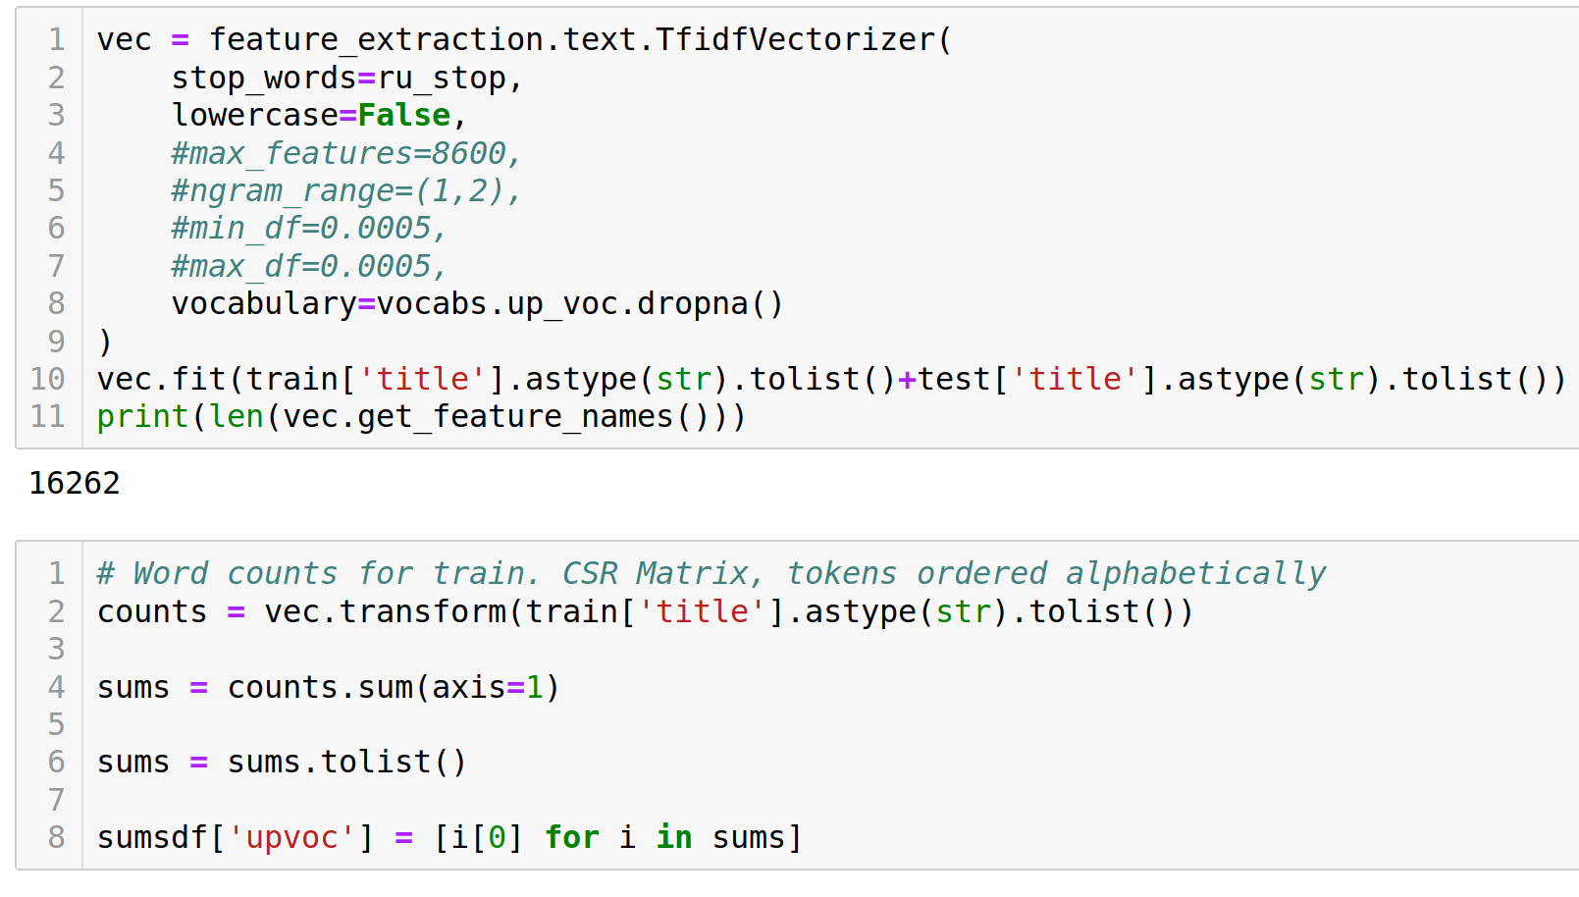

Slide 24
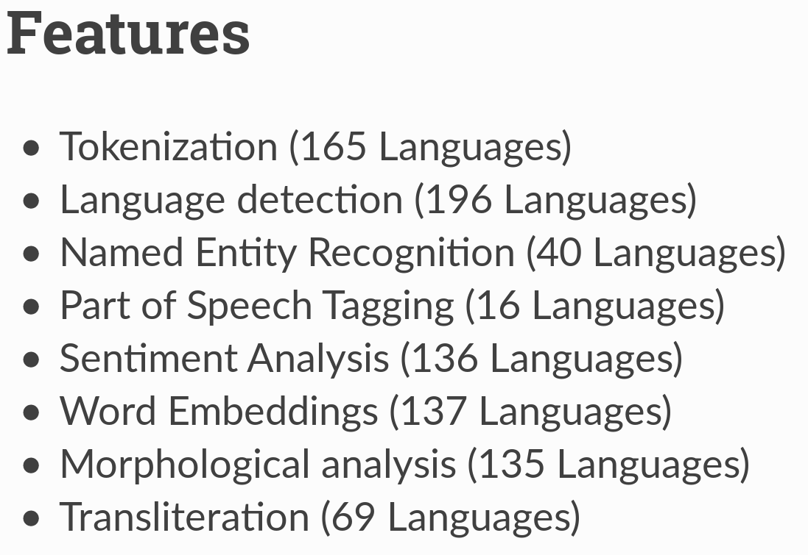
Sentiment Analysis
An NLP library called polyglot offers multi-language tools, such as Sentiment-Analysis and Named-Entity-Recognition in Russian.

Slide 25
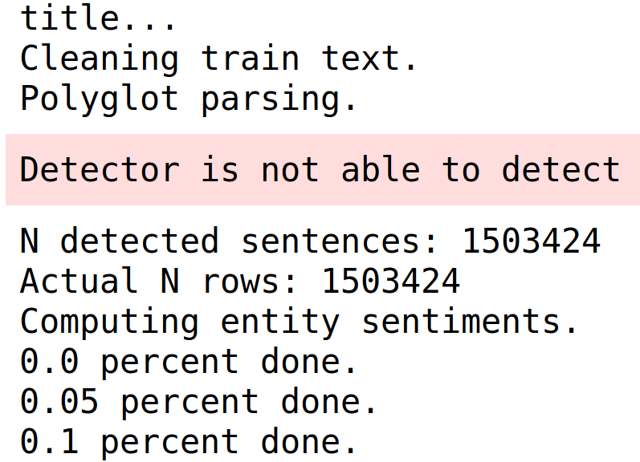
Weaknesses of Polyglot
Tokenization engine. Documents must be manually pre-processed to ensure the number of detected sentences matches the number of rows.
Bound to mismatches. Only worked on titles.

Slide 26
Binary CountVectorizer
Several categorical variables in this data have thousands of unique values which would increase the dimensional space unreasonably if binarizing in dense format.
A binary CountVectorizer does the heavy lifting of populating dummy counts in sparse format, and PLSR reduces the numerous columns to a few core components.

Slide 27
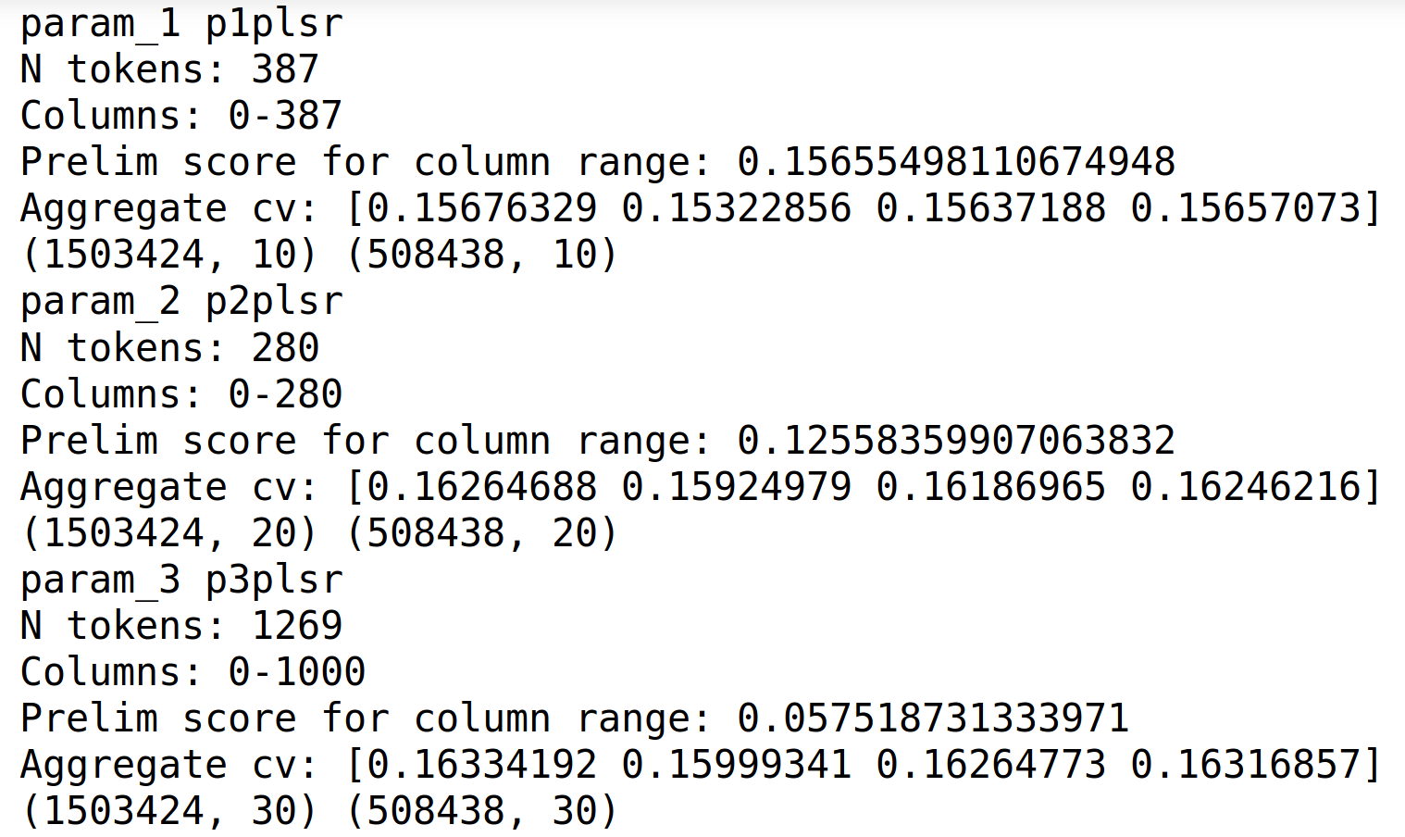
Binary CountVectorizer as Dummy

Slide 28
Target-Sorted Label Encodings
Normally, label encoding isn't recommended for machine learning because the algorithm will interpret the code numbers as meaningful information.
However, encodings can convey useful information if categorical values are sorted by their mean outcome value. This way, each label's code will represent an approximation of the target outcome.

Slide 29
Evaluations
Testing feature-sets and algorithms.

Slide 30
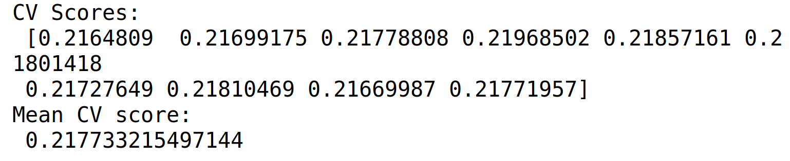
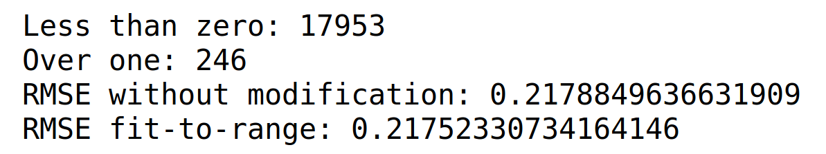
Baseline LinearRegression()
Scores are in RMSE.
CV is on X_dev and y_dev. Right figure is on X_val, y_val.
Output must be between 0 and 1.
Modification is limiting output to range.

Slide 31
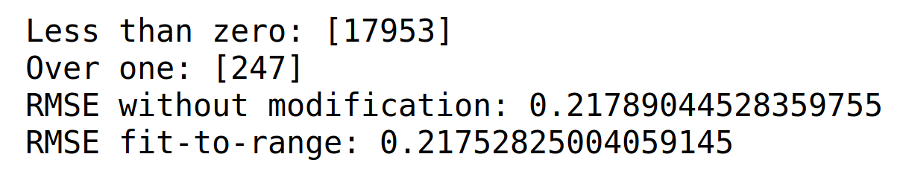
PLSR 50 Components
Took resulting 153 features engineered and reduced them to 50 components.
Scores remained the same on PLSR’s own prediction.

Slide 32
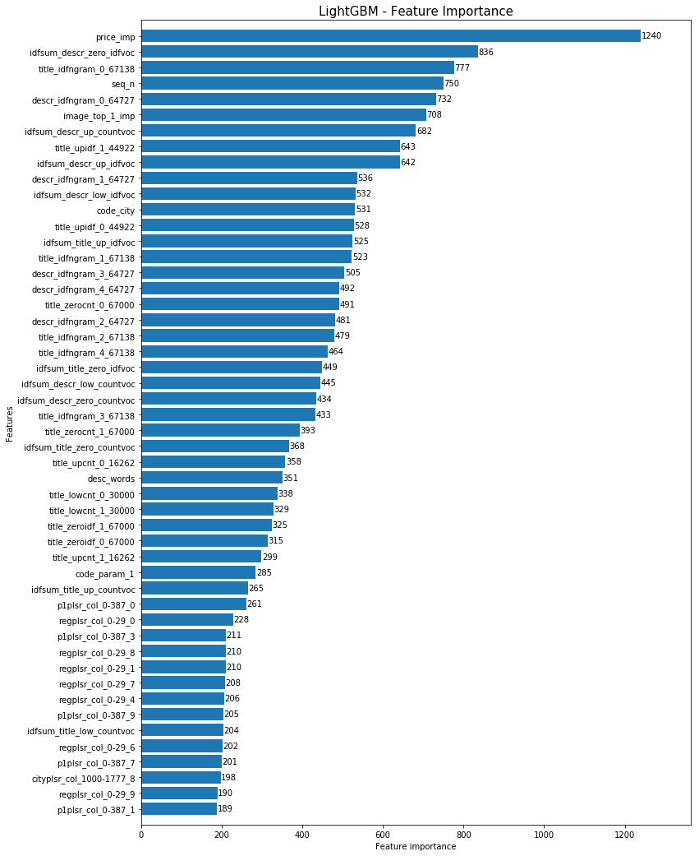
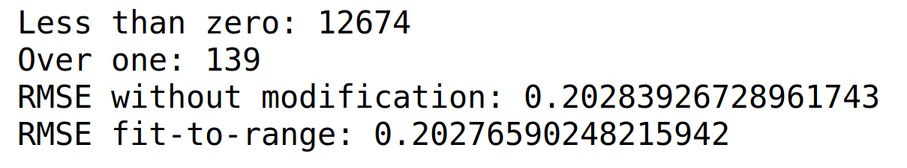
LightGBM is a gradient boosting framework that uses tree based learning algorithms. It is designed to be distributed and efficient.
Results below are using all 153 features.

Slide 33
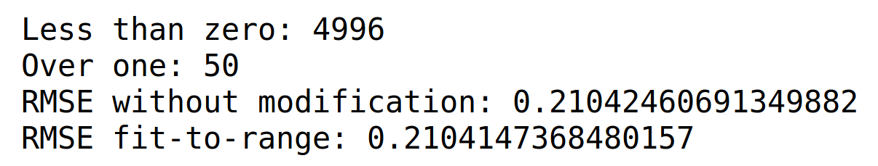
LGBM on PLSR 50 Components
Transformed all features with previous round of PLSR and fed them into LGBM. Scores are not better than LGBM on all features.

Slide 34
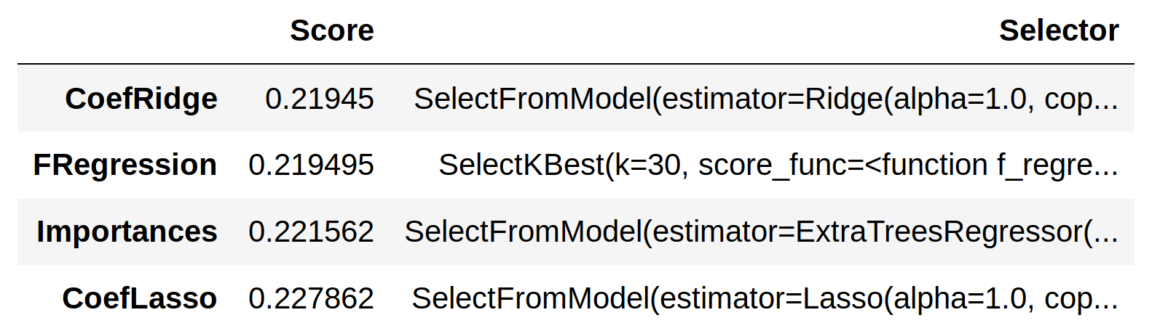
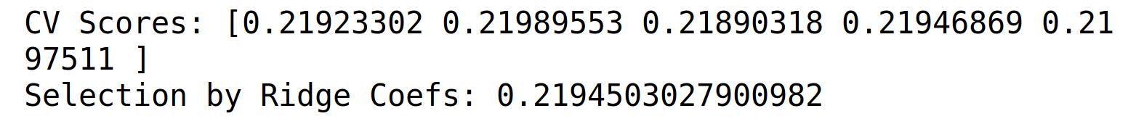
SelectFromModel(30 features)
Compared feature selection techniques:
Ridge gave the best scores.

Slide 35
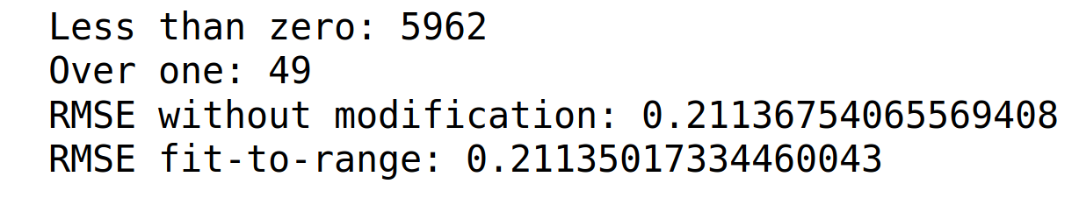
LGB with 30 Ridge-Sel Features
Took top 30 features based on SelectFromModel(Ridge), and did a train/test split for LGBM.

Slide 36
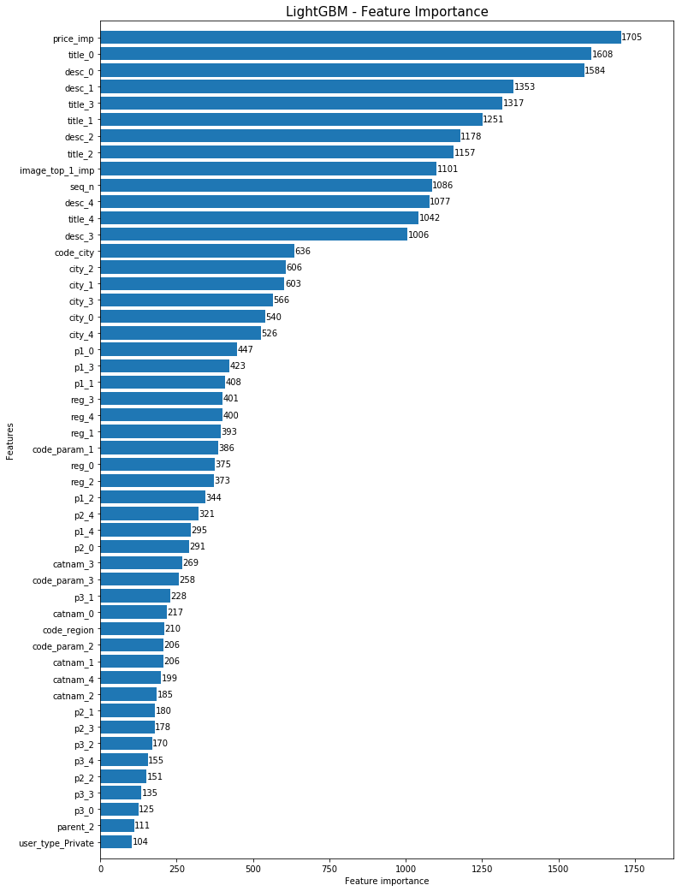
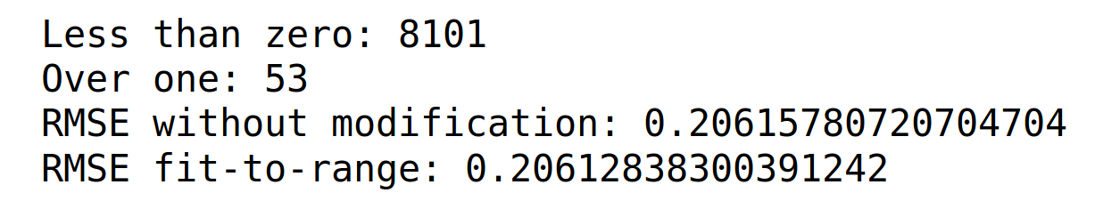
Took each original feature (title, descr, category, city) and did PLSR on all the features created from it.
LightGBM using PLSR 10 components for each original feature.

Slide 37
Results Table
Predictor | RMSE X_val
LinearRegression. All engineered features.(153) | 0.2175
PLSR 50 components. | 0.2175
LGB. All engineered features. | 0.2027
LGB on PLSR 50 Comp | 0.2104
SelectFromModel(Ridge, 30 features) | 0.2194
LGB with 30 Ridge Selected Features | 0.2113
LGB with PLSR by Original Features | 0.2061
Multi Layer Perceptron | 0.2603
Keras | 0.2110
RandomForestRegressor(100 trees) | 0.2106

Slide 38
Conclusions
About the final product.

Slide 39
Product Summary I
Based on several comparisons, the above-described feature-engineering pipeline followed by LightGBM is the best approach at predicting the deal probability of an online ad.
Why it Works.
It works due to the robustness and variety of feature-extraction and decomposition techniques. While feature extraction can generate a lot of data, this is only useful in a reduced dimensional space. Decomposing large CSR matrices produces predictively powerful components.

Slide 40
Product Summary II
What Problem it Solves
Online platforms for selling used goods rely on regular people selling their belongings online to achieve high-traffic. These sellers blindly sell their things with erroneous expectations and bad listing practices, thus becoming frustrated with online sales.
How it solves the problem.
Helping sellers understand the demand of their listings contributes in several ways: Informed sellers can optimize their listings for maximum deal probability and also optimize their choice of goods to sell, based on the deal probability of particular categories.

Slide 41
Product Summary III
How will it work in production?
In a production environment this model would learn from the sales information of a historic time window in order to predict the deal probability of new ads.
Necessary maintenance would involve adjusting some of the feature-engineering procedures to ensure they are capturing the most valuable information.

