Slide 1
Credit Card Fraud
1. INTRODUCTION TO DATASET
https://www.kaggle.com/mlg-ulb/creditcardfraud/home
The dataset contains transactions made by credit cards in September 2013 by european cardholders. This dataset presents transactions that occurred in two days, where we have 492 frauds out of 284,807 transactions. The dataset is highly unbalanced, the positive class (frauds) account for 0.172% of all transactions.

Slide 2
Credit Card Fraud
2. EXPLORATORY DATA ANALYSIS
PCA FEATURES- Features V1, V2, ... V28 are the principal components obtained with PCA. Unfortunately, due to confidentiality issues, we cannot provide the original features and more background information about the data.
TIME AND AMOUNT- They’re the only features which have not been transformed with PCA.
  'Time' contains the seconds elapsed between each transaction and the first transaction in the dataset.
  'Amount' is the transaction Amount.
CLASS- It’s the response variable and it takes value 1 in case of fraud and 0 otherwise.

Slide 3
Credit Card Fraud
3. MODEL OUTCOME OF INTEREST (Finally)
You should try several different approaches and really work to tune a variety of models before choosing what you consider to be the best performer.
Make sure to think about explanatory versus predictive power and experiment with both.

Slide 4
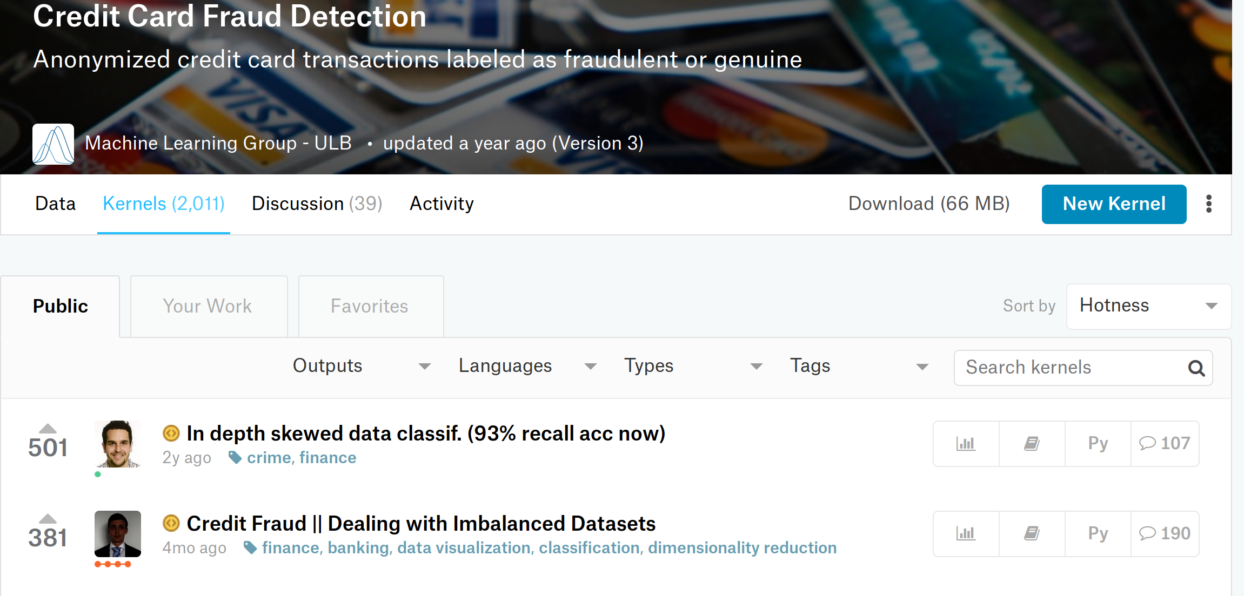
Credit Card Fraud
4- RESEARCH QUESTION
What is the best way to predict frauds? (show next)

Slide 5
Credit Card Fraud
Focus on reducing false negatives.
VS
Focus on reducing false positives.
VS
Focus on a custom balance?

Slide 6
Credit Card Fraud
5. HOW YOU CHOSE YOUR MODEL?
Custom scoring function.
  Recall vs Precision in a single score.
    Tested with all most commonly used SKLearn Classifiers.
  Optimum parameter combination.
    Performance varies with settings on classifier.
  Several iterations of model processing.
    Outlier handling greatly influenced prediction scores.
    Class-Balancing Techniques.

Slide 7
Credit Card Fraud
6. PRACTICAL USES FOR AUDIENCE OF INTEREST
Bank’s fraud-prevention mechanisms.
  (Annoying: Transactions canceled when traveling)
Data Science students.
  Addition to the pool of Kaggle’s forks on this Dataset.

Slide 8
Credit Card Fraud
7. WEAK POINTS OR SHORTCOMING?
Model Processing- Involves many steps. Steps depend immensely on the data. Doesn’t lend itself to quick iterations.
Need for Data Reduction- 270,000 non-frauds were undersampled to 5,000… Definitely affected precision. A supercomputer might handle complete set without the need for reduction.
  SVM and Kneighbors took the longest with larger model.

