Slide 1
IoT System for pH Monitoring in Manufacturing Facilities

Slide 2
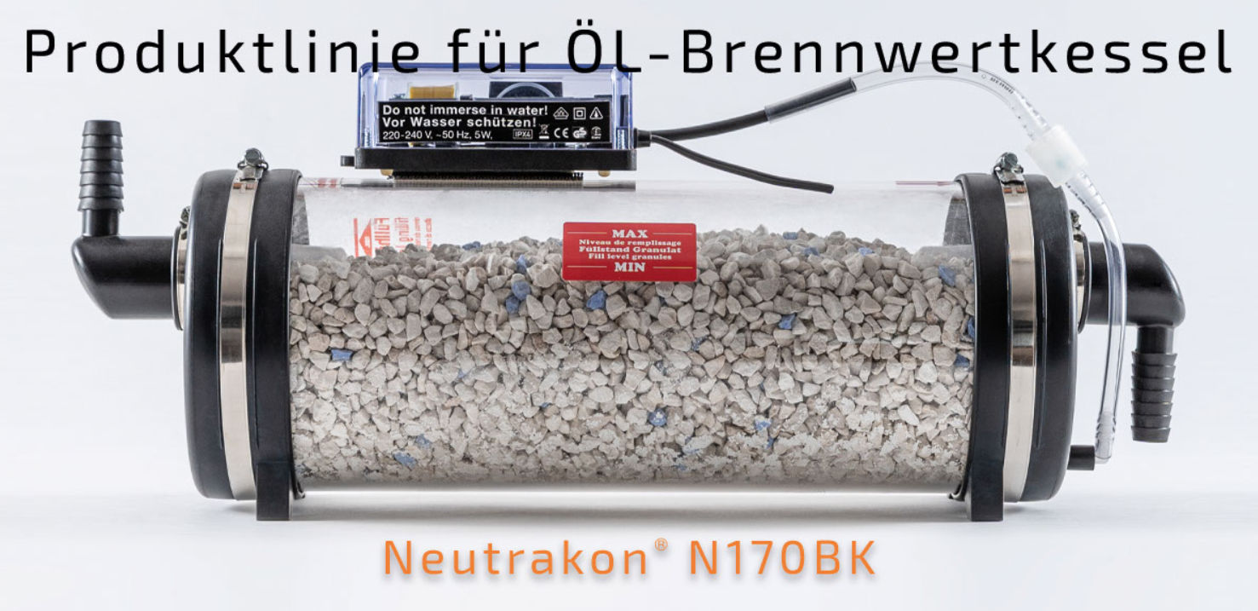
Equipment
Neutrakon® 05 /BGN Caldeira de condensação até 55 kW

Slide 3
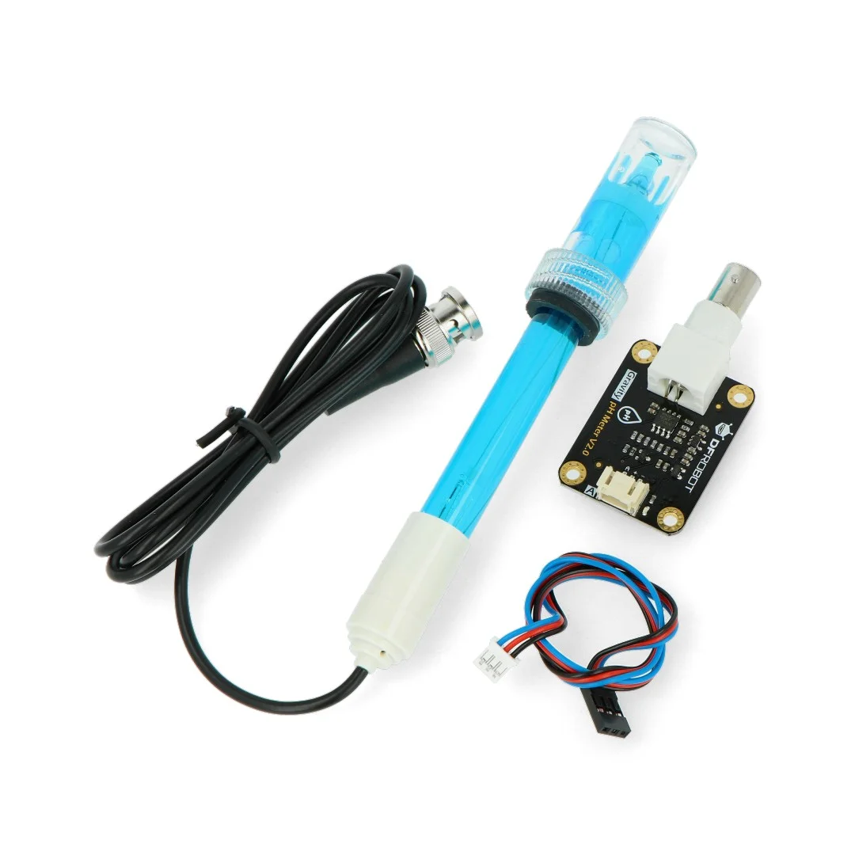
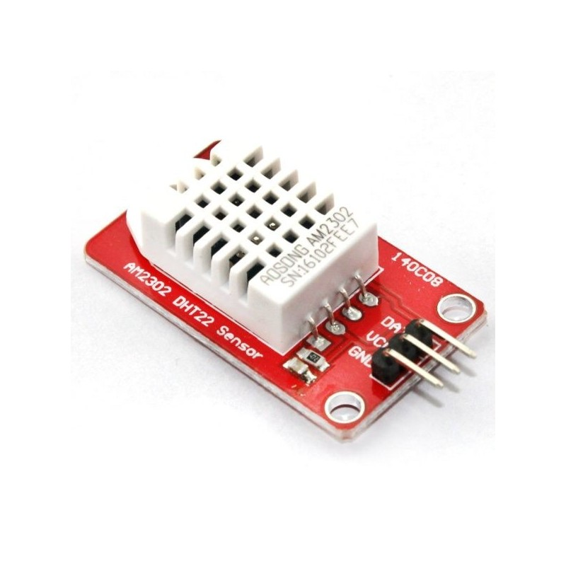
Sensors
Humidity and temperature ambient;
pH sensors (beggining and end of filter);
Inundation sensor;
Water flow;

Slide 4
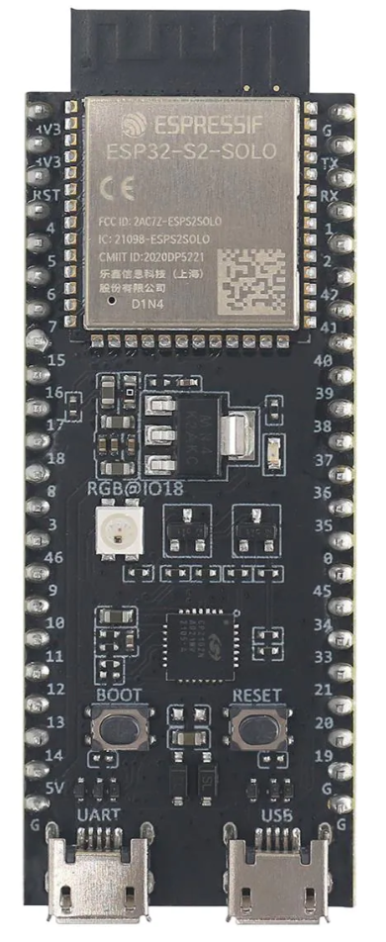
Board – ESP32-S2
Wi-Fi
Bluetooth
Low Power Mode
43 GPIO
Single Core 240 MHz
7.62€ (Mouser online store)

Slide 5
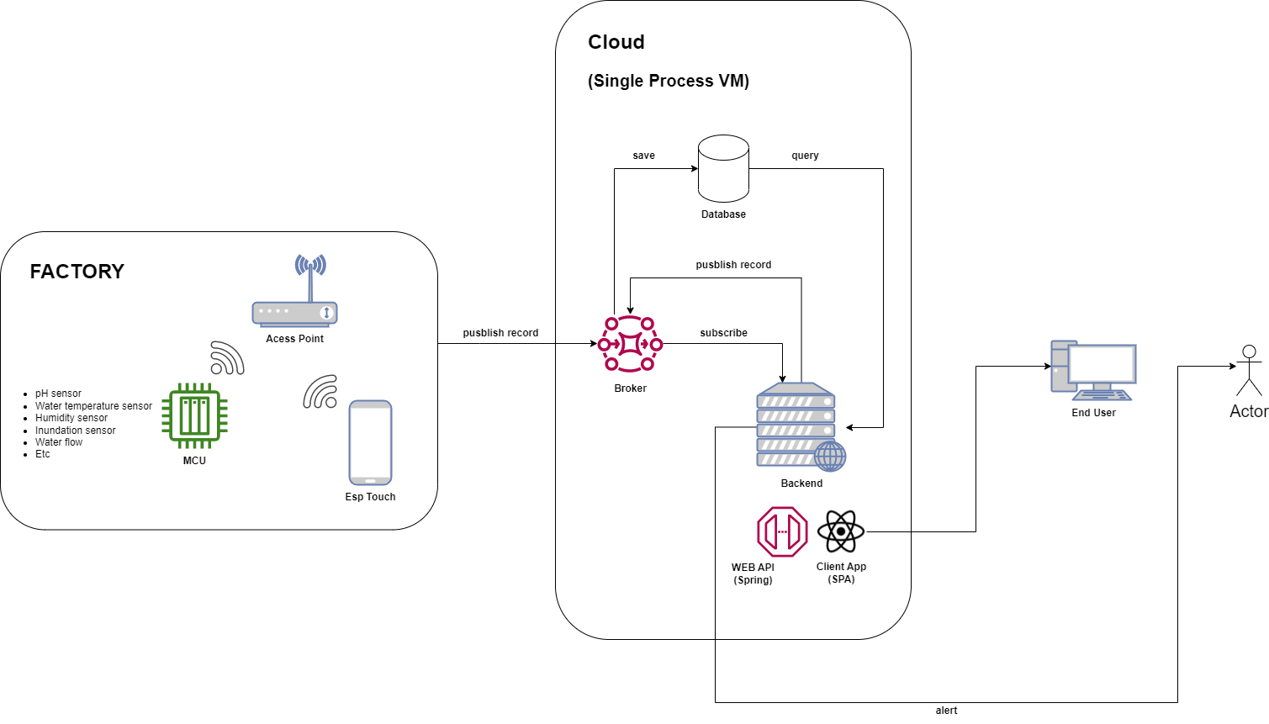
System Architecture
Hardware
ESP32-S2
Sensors
Access Point
IoT platform
Database
Backend - REST API
Broker
Frontend
Web App
Android App (optional)

