Slide 1
IoT System for pH Monitoring in Industrial Facilities
Pedro Silva nº47128 & Miguel Rocha nº47185 Supervised by: Professor Rui Duarte
Instituto Superior de Engenharia de Lisboa (ISEL)
Engenharia Informática e de computadores (LEIC)

Slide 2
01
Project overview
x
y
2

Slide 3
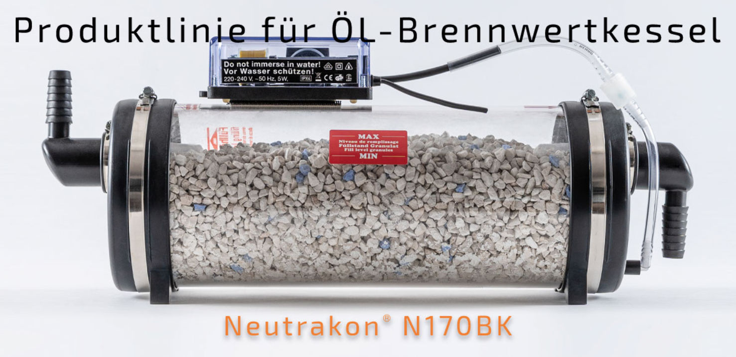
What’s the project Idea?
3
Solution that leverages the power of the Internet of Things (IoT) to monitor water filters performance and notifying the owner if pH or temperature values exceed a certain threshold.
3

Slide 4
Solution overview
An electronic system designed to be energy-efficient, equipped with sensors for collecting data, and capable of transmitting the data to the cloud.
A backend responsible for:
Gather the received sensor data;
Process collected data, and alert the user, if necessary.
Support multiple frontend devices;
Intuitive and secure website, to register devices and consult sensor data.
4

Slide 5
Previous work
SmartDoorLock-IoT
https://github.com/bernardocmarques/SmartDoorLock-IoT
5

Slide 6
02
Project Decisions and organization
201 CREATED
6

Slide 7
What we have done
List of things we’ve done:
Programming of the MCU to send synthetic data to the broker;
Broker setup;
Backend Server that receives data, analyses it and can notify a registered user via email;
API, running on the server, to access the collected data;
Website to manage and monitor registered devices.
Note: the Backend is running locally (personal laptop)
7

Slide 8
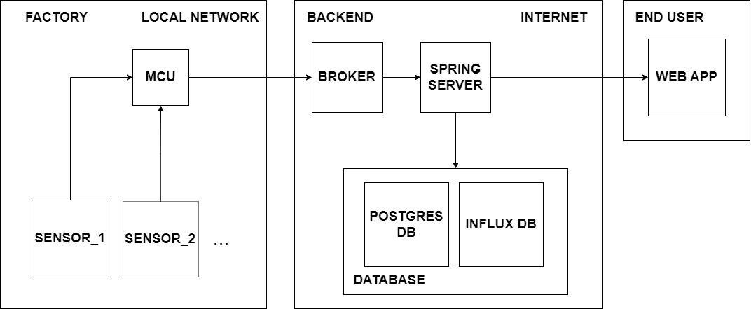
System Architecture
8

Slide 9

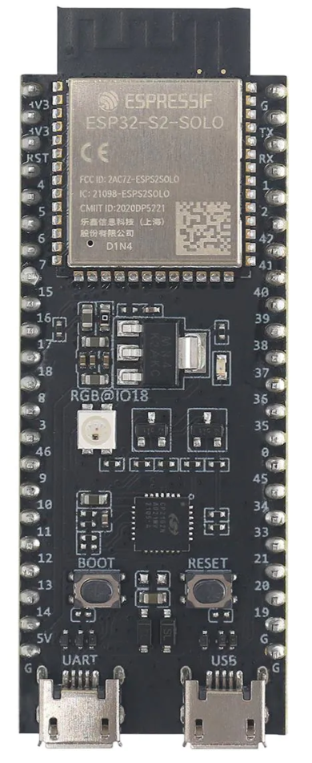
Board – ESP32-S2
Technologies Used:
ESP-IDF framework: official framework for ESP hardware devices; Official and 3rd party Support
Protocols Used:
MQTT
Security Measures:
MQTT messages are sent encrypted
Challanges:
Utilize the various power modes of the board intelligently to maximize battery life and conserve power.
Employ the complex ESP-IDF framework in the project implementation.
9

Slide 10
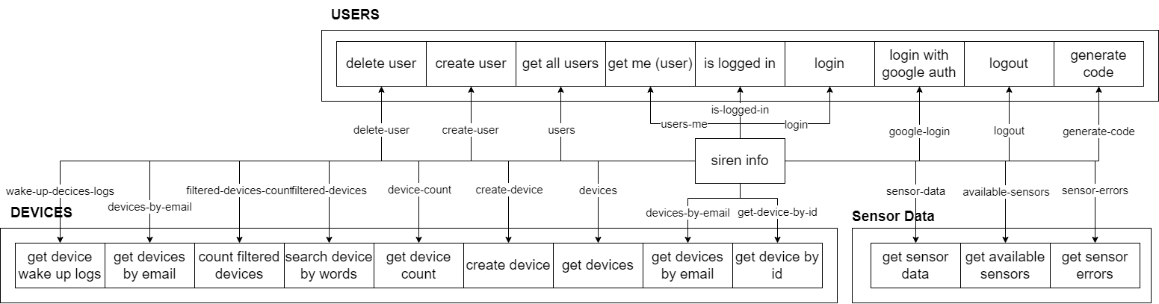
Siren Diagram
10

Slide 11





Backend
Technologies Used:
Postgres SQL: support for complex queries
InfluxDB: retrieve substantial amounts of data at a high speed.
Kotlin with Spring Boot framework for Backend Server: powerful framework to implement Rest APIs
HiveMQ CE for Backend Broker: open source and easy to deploy
Protocols Used:
HTTP: Rest API
MQTT: IoT - Broker - Server
OpenID Connect: Web application authentication
Security Measures:
Protected against SQL ejections: JDBI
Use of salted passwords
11

Slide 12
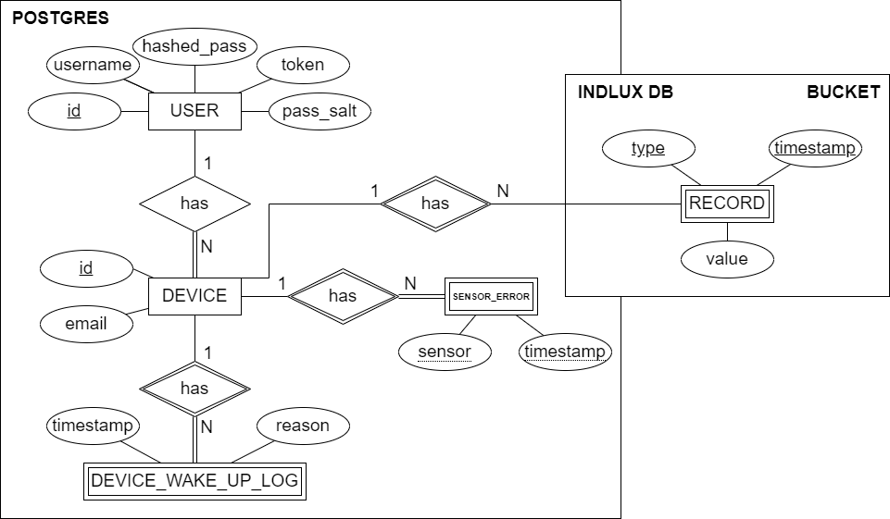
Data Models
PostgresSQL Database
Influx Database
12

Slide 13
Why do we use two different ways for data storage?
Time Series
Relational database
Provide optimized storage and querying capabilities
Fast querying: can quickly query and retrieve large volumes of data
Support for complex queries
Structured data
13

Slide 14


Frontend – Web aplication
Technologies Used:
React (Frontend): simple and powerful framework for frontend development
React-Bootstrap (Frontend): built in harmonious JavaScript elements
Typescript: type checking
Protocols Used:
OpenID Connect: Web application authentication
Security Measures:
Prevent CSRF attack using HTTP-only cookies
14

Slide 15
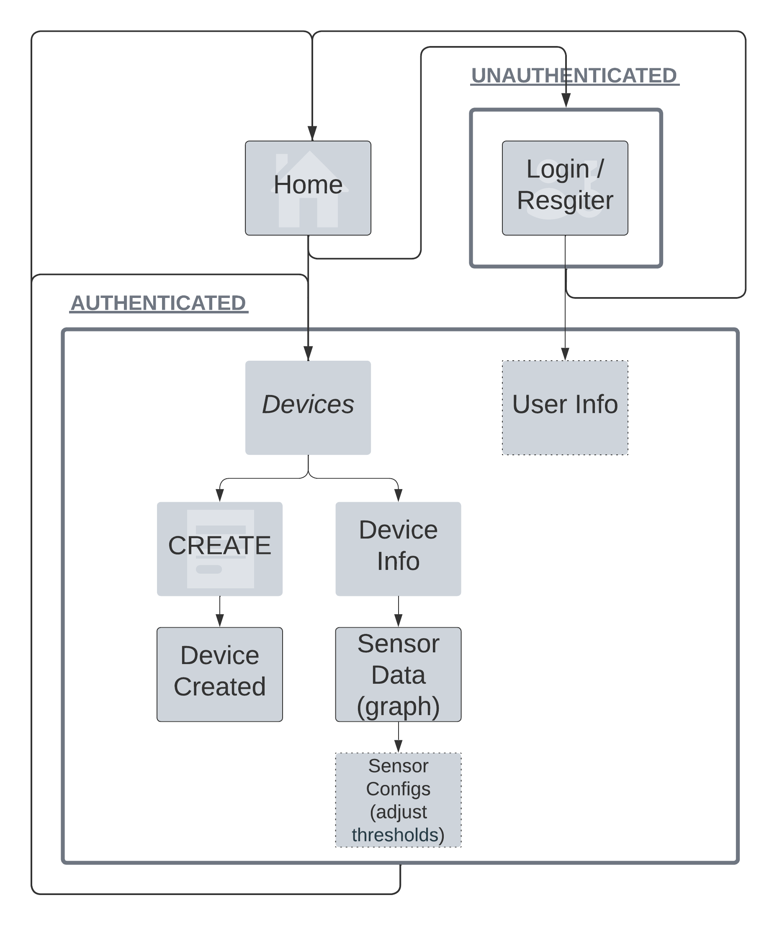
Website Navigation Diagram
15

Slide 16
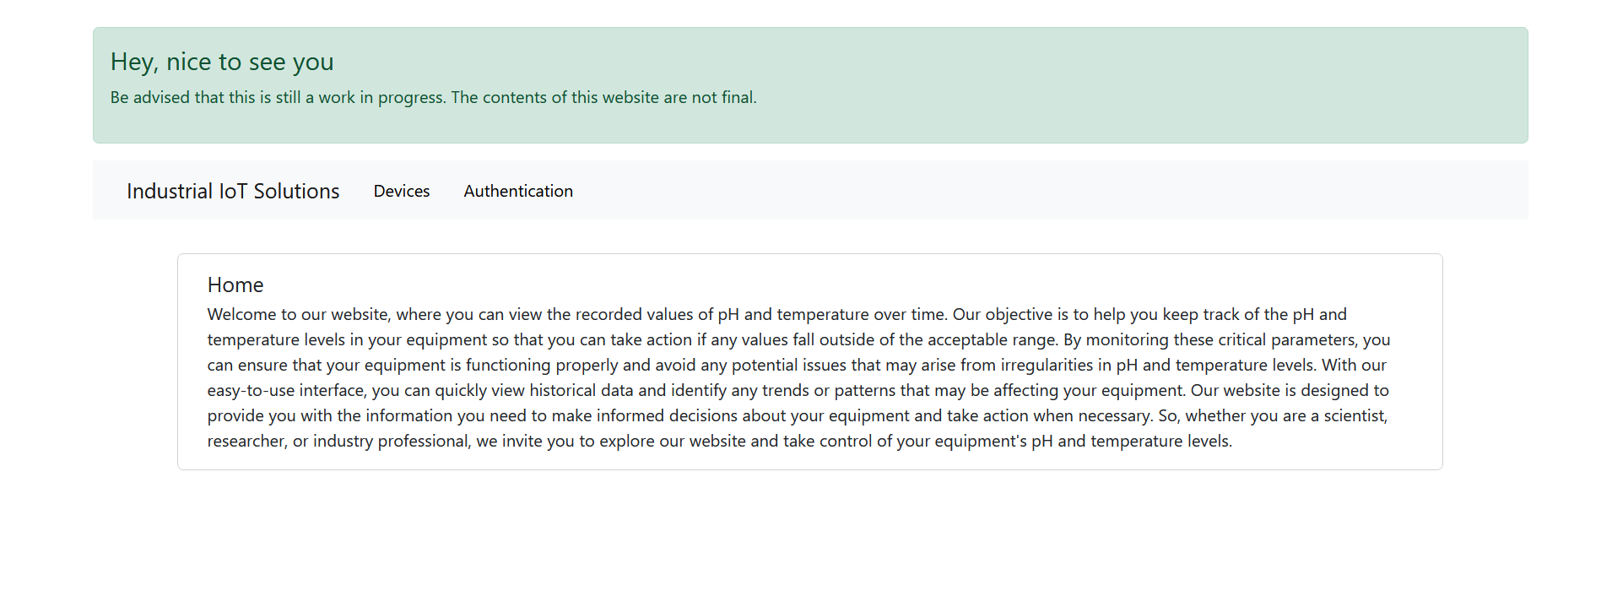
Website navigation demo - HOME
16

Slide 17
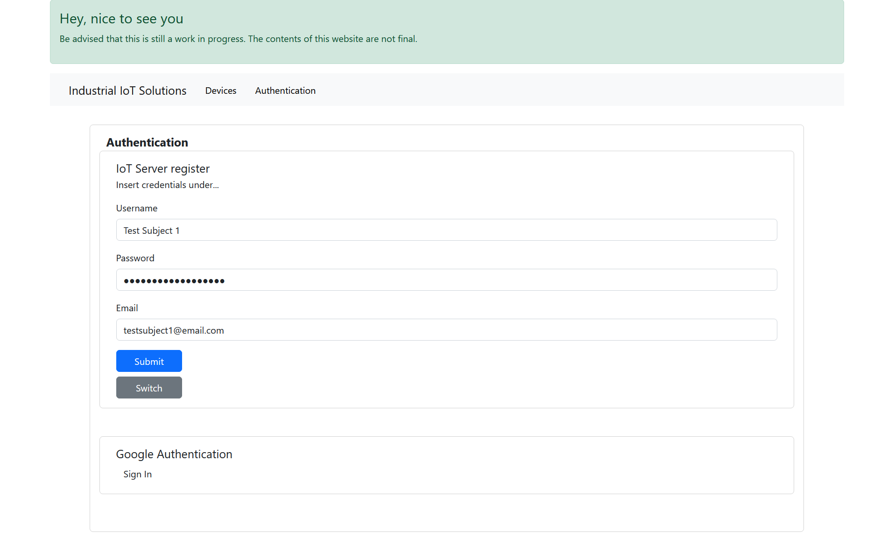
Website navigation demo – Sign Up
17

Slide 18
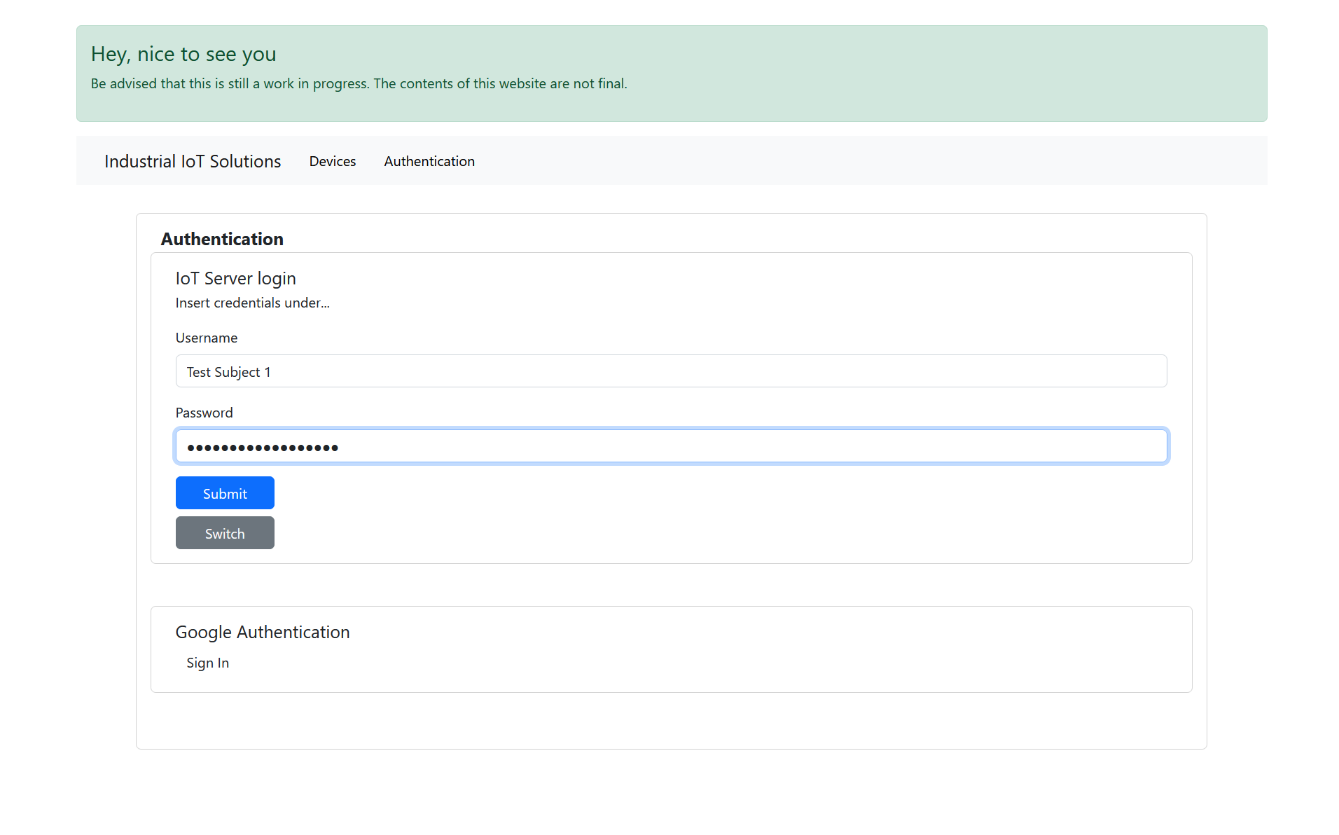
Website navigation demo – Sign In
18

Slide 19
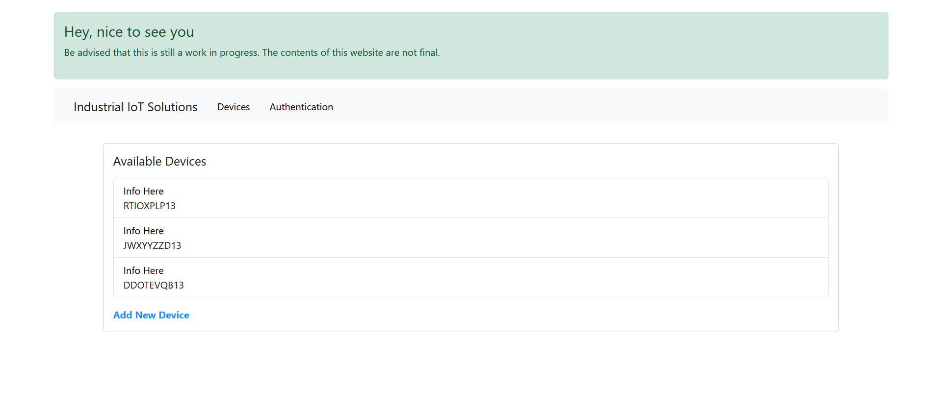
Website navigation demo – Devices
19

Slide 20
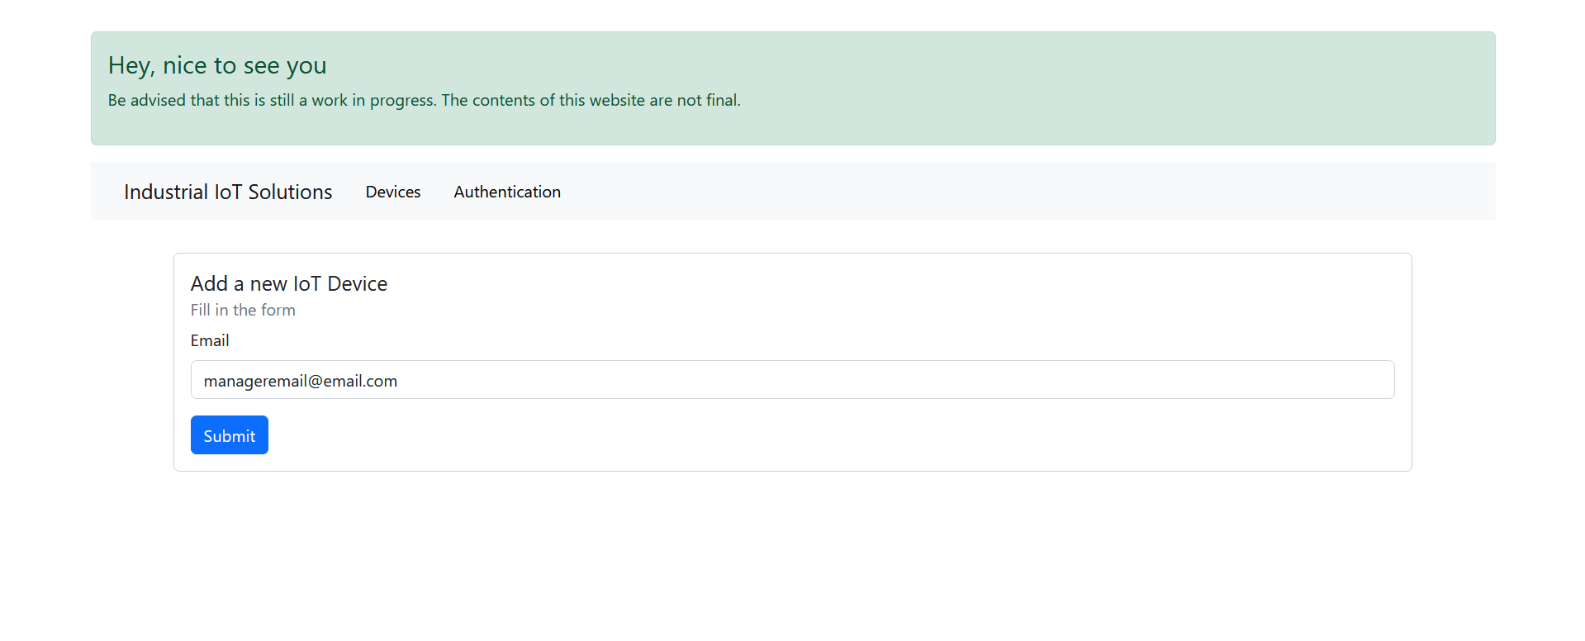
Website navigation demo – Add Device
20

Slide 21
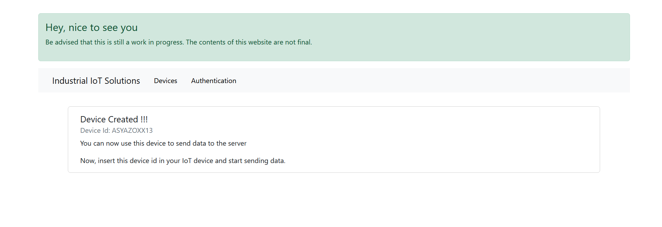
Website navigation demo – Add Device
21

Slide 22
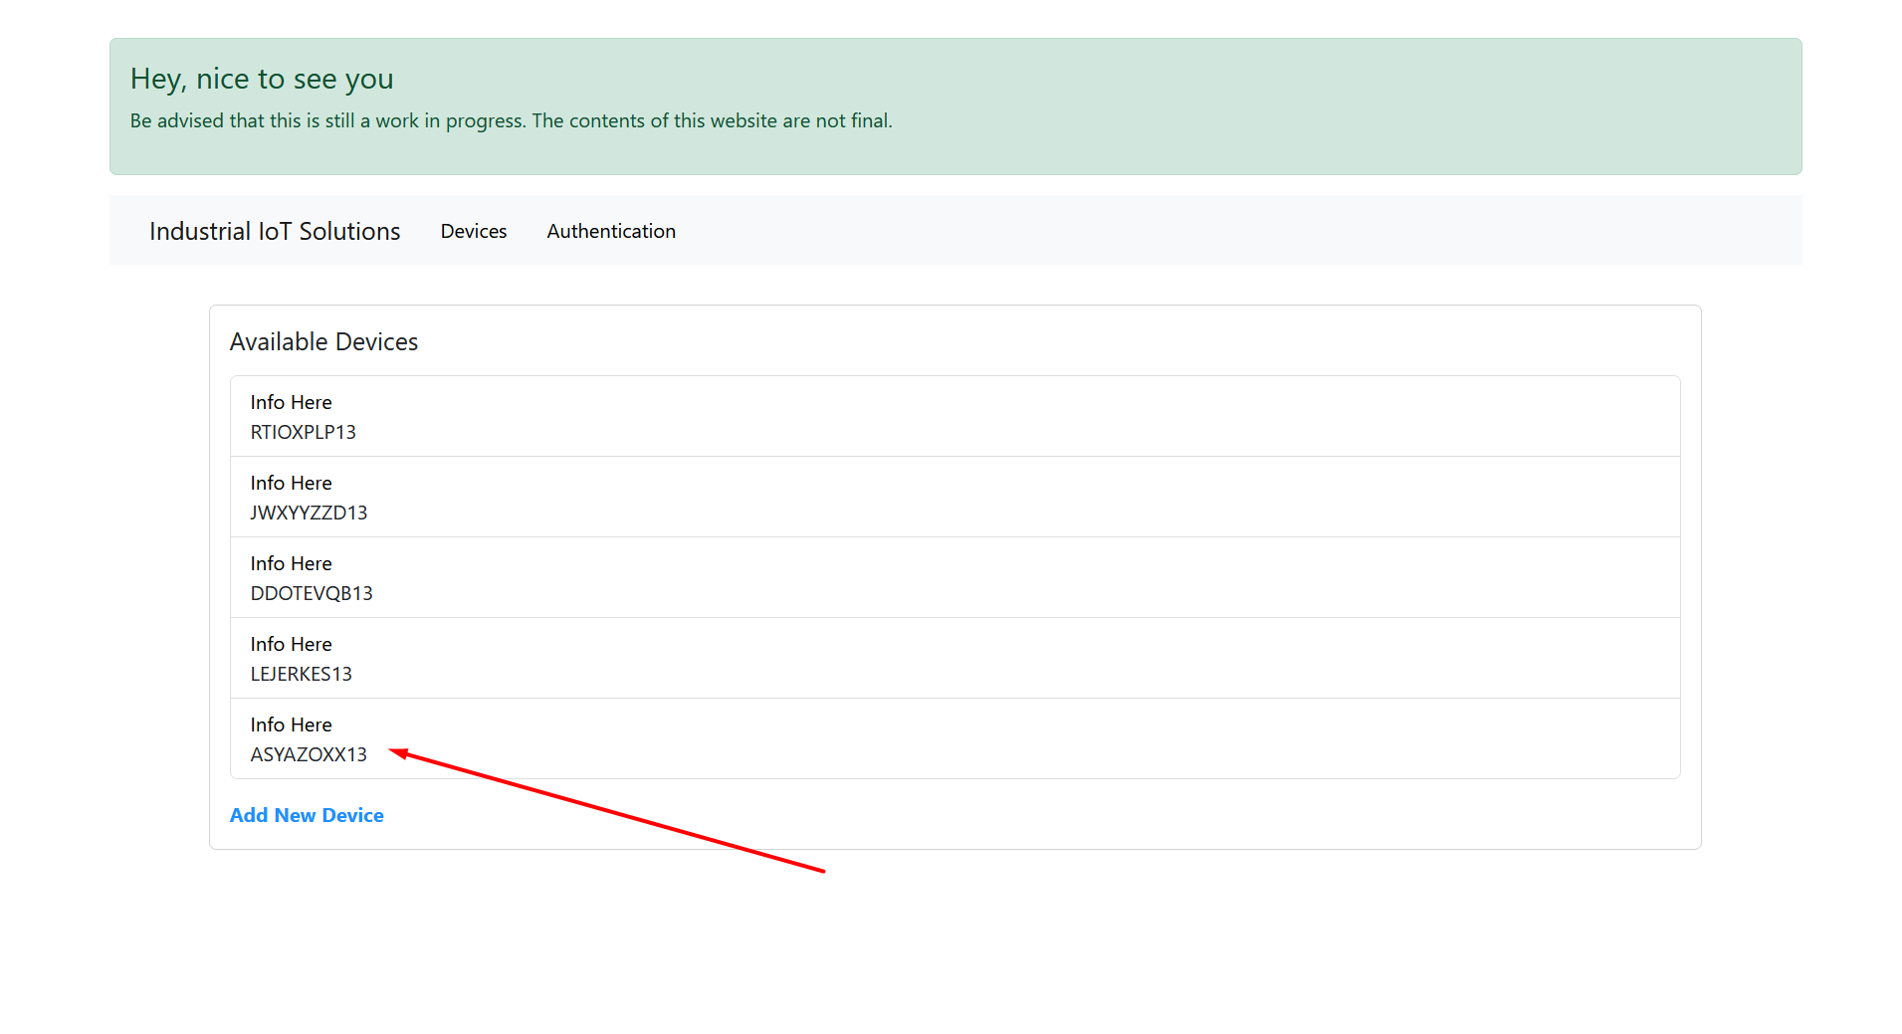
Website navigation demo – Add Device
22

Slide 23
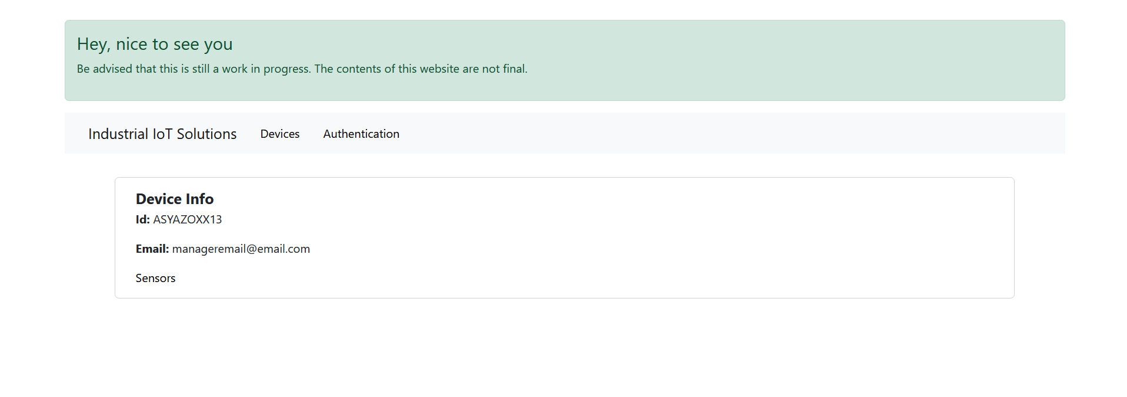
Website navigation demo –Device Info
23

Slide 24
Website navigation demo –Device Info
24

Slide 25
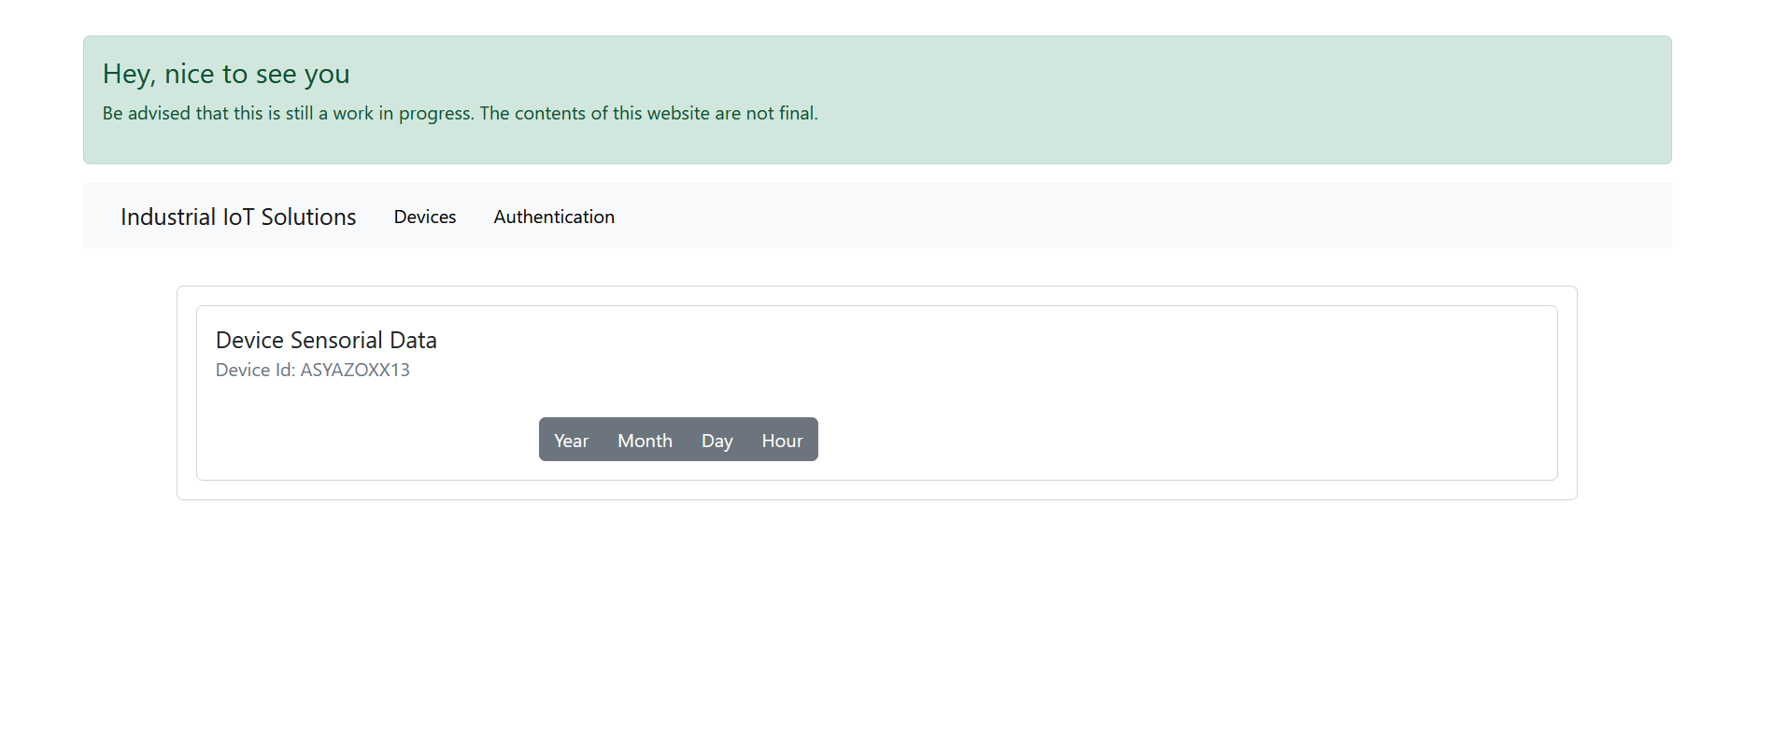
Website navigation demo –Device Info Filter Data
25

Slide 26
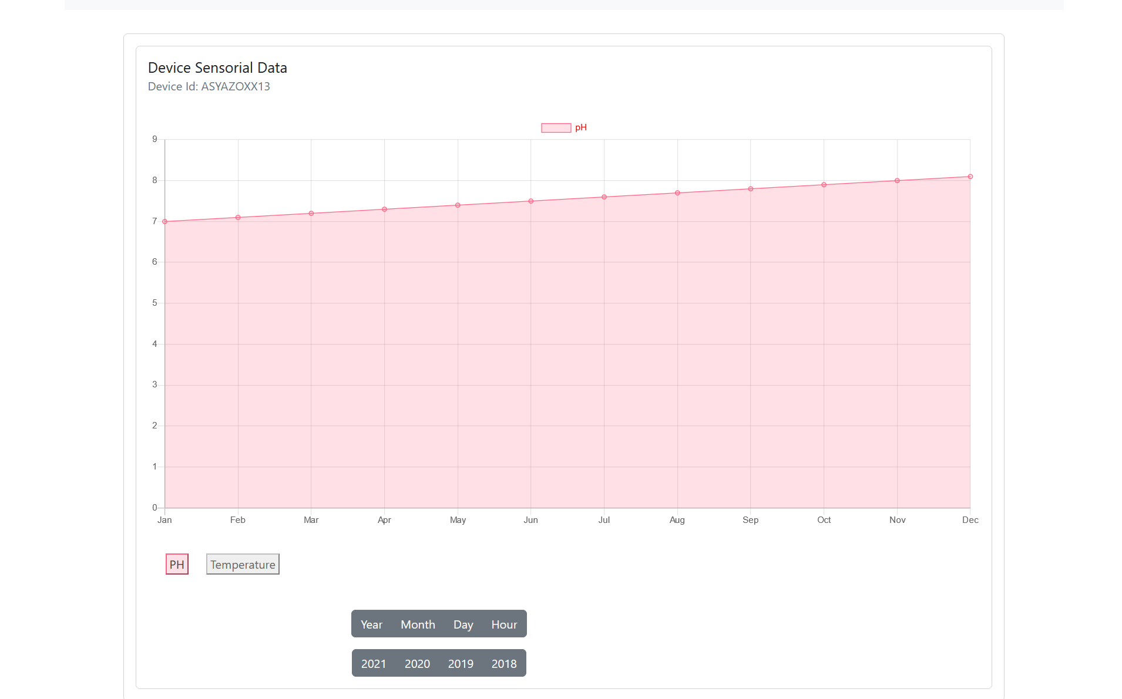
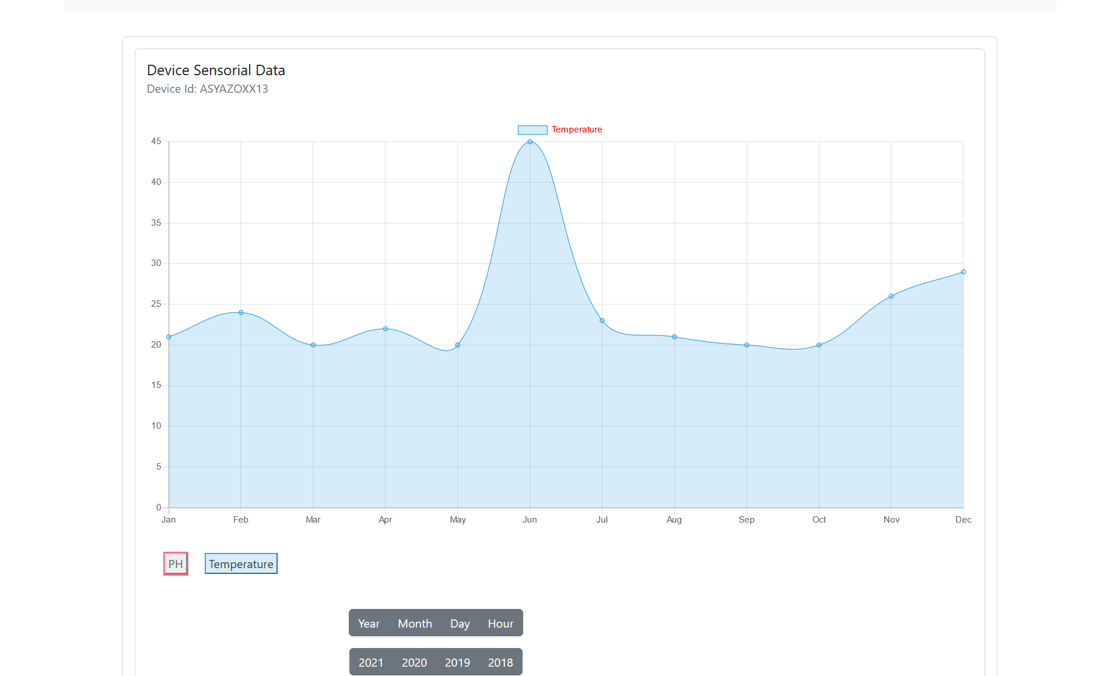
Website navigation demo –Get all the data 2019 ,PH,Temperature
26

Slide 27
03
What's next
Next steps...
27

Slide 28
Our Future Plans
MCU
Scalibility
Implement modules that read from real sensors
Use load balancer
Responsive Website
Work with real data
Works on different screens and devices
Use information provided by sensors
Security
Deployment
In AWS?
Use MQTTS instead of MQTT and
improve website security
28

Slide 29
END
Questions ?
29

