Slide 1
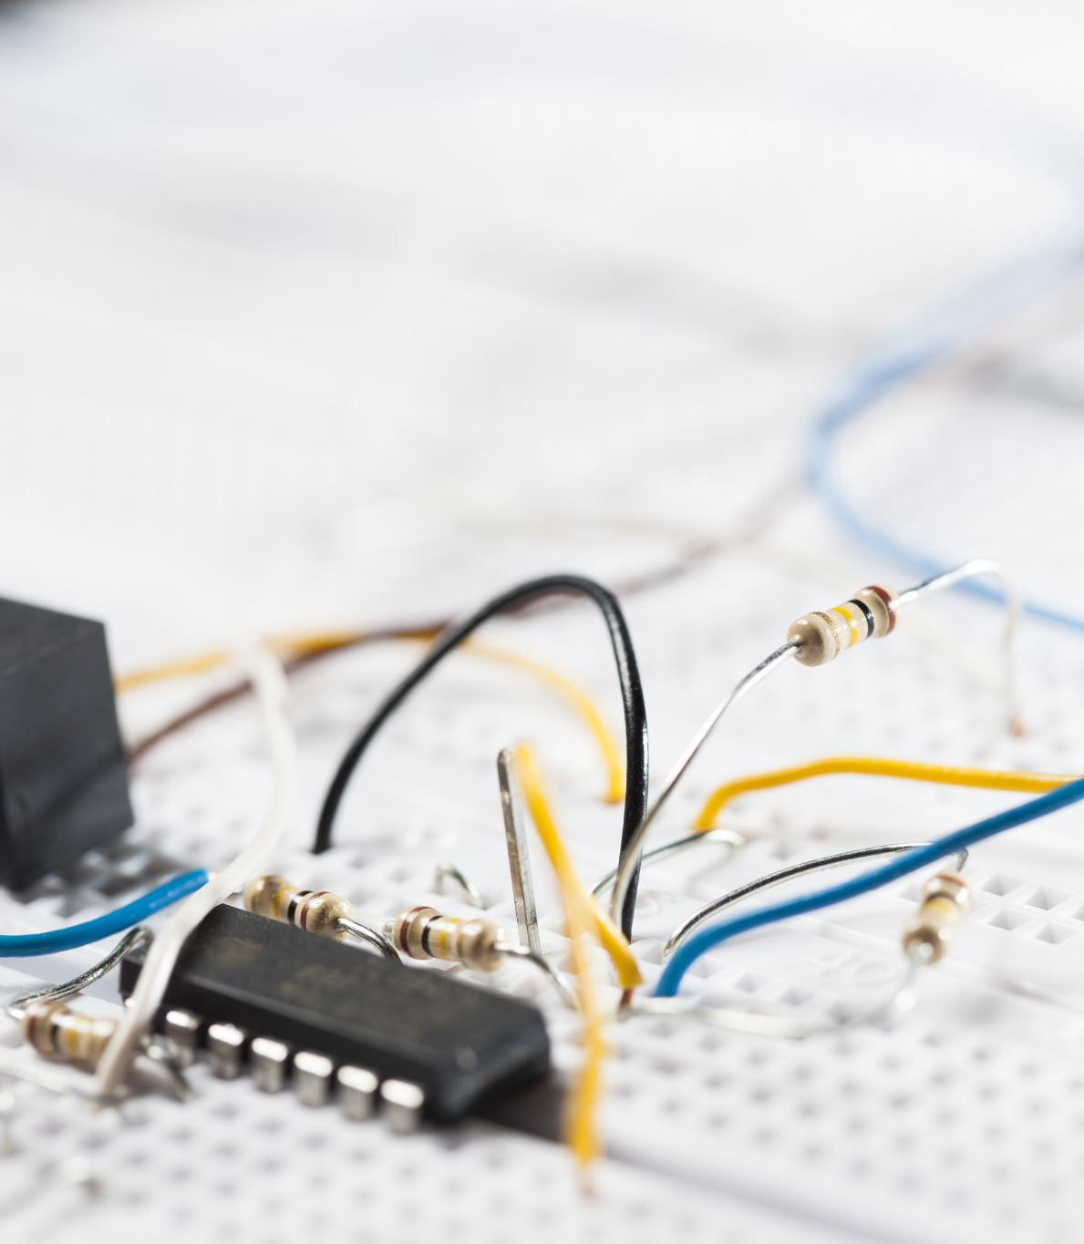
IoT System for pH Monitoring in Manufacturing Facilities
Instituto Superior de Engenharia de Lisboa (ISEL)
Engenharia Informática e Computadores (LEIC)

Slide 2
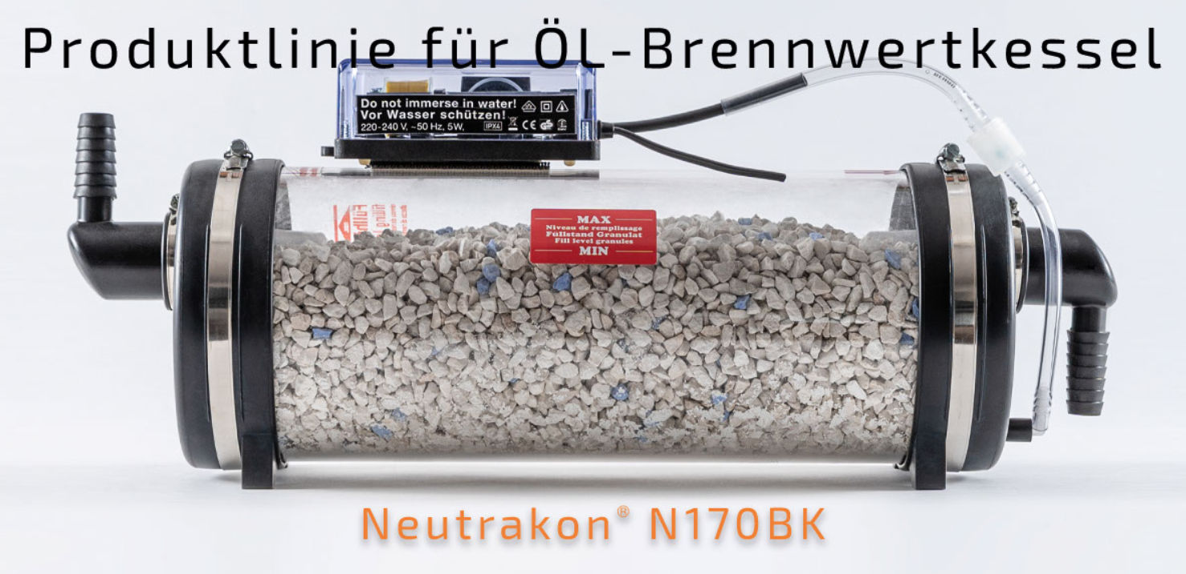
Water Filter
Neutrakon® 05 /BGN Caldeira de condensação até 55 kW

Slide 3
Requirements
Economic Hardware
High battery life device
Low false alarm frequency
Visual alarm
Hardware documentation

Slide 4
Main Objectives
Programming the MCU to collect and send data
Setting the message broker
Implementing the back-end service to manage system logic (data analysis and alert system)
Implementing a user-friendly interface to interact with the system (visualize data, adding devices, etc)
Implementing the database to store system data

Slide 5
Optional Objectives
Android App to visualize collected data (and other convenient actions)
Additional sensors, to collect more data, from the system
AI algorithm to improve data collection

Slide 6
Justification
Better understanding of the IoT world
Increase in hardware programming skill
Use of alternative network protocols
Further our understanding of various topics covered during our academic course:
Web programming
Database design and implementation
Android programming (optional)
Architectural design of a medium scale project (software + hardware)

Slide 7
Scope
Associate/remove IoT devices to/from the IoT platform
Having the ability to visualize collected data, in a graph form
Notification systems to alert the admin/manager of a possible filtration system filter malfunction
System thresholds configuration (PH or/and water temperature critical level)

Slide 8
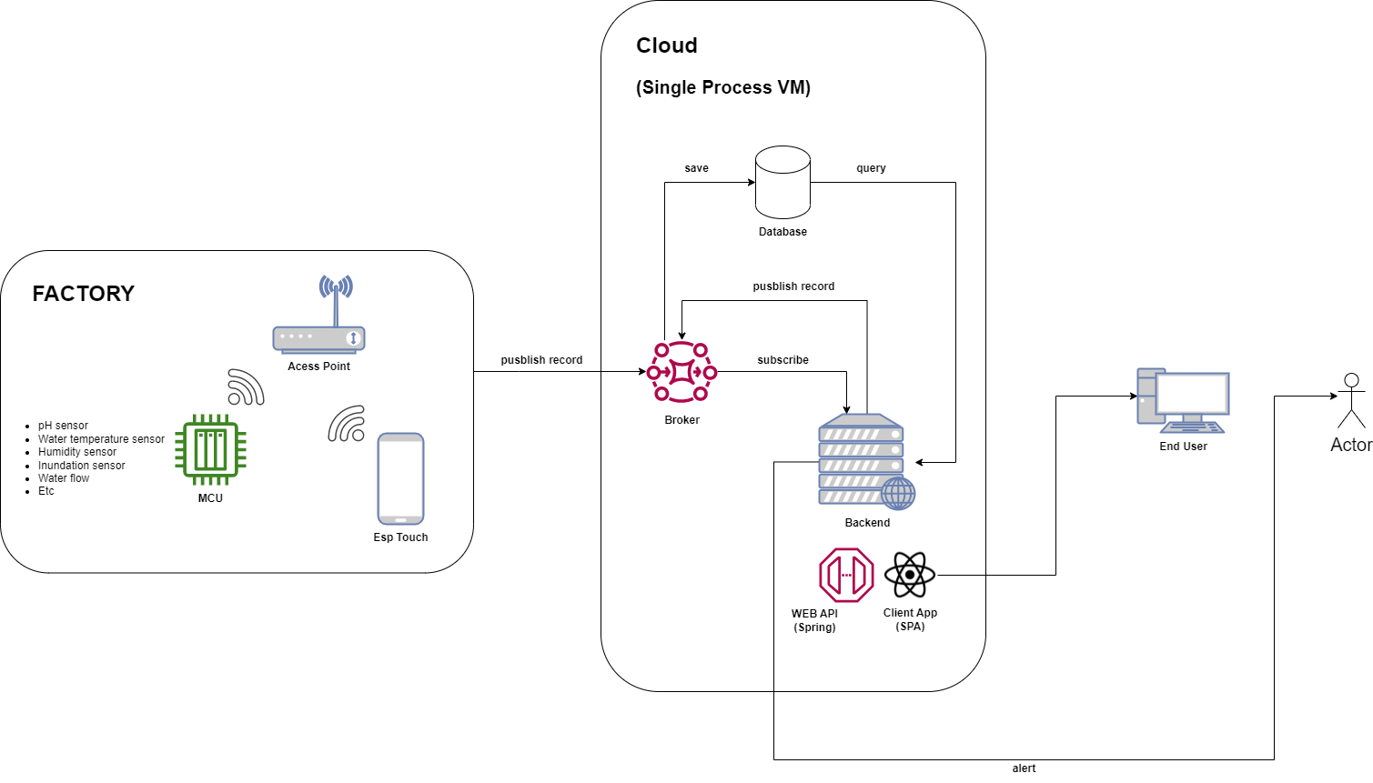
System Architecture
Hardware
ESP32-S2
Sensors
Access Point
IoT platform
Database
Backend - REST API
Broker
Frontend
Web App
Android App (optional)

Slide 9
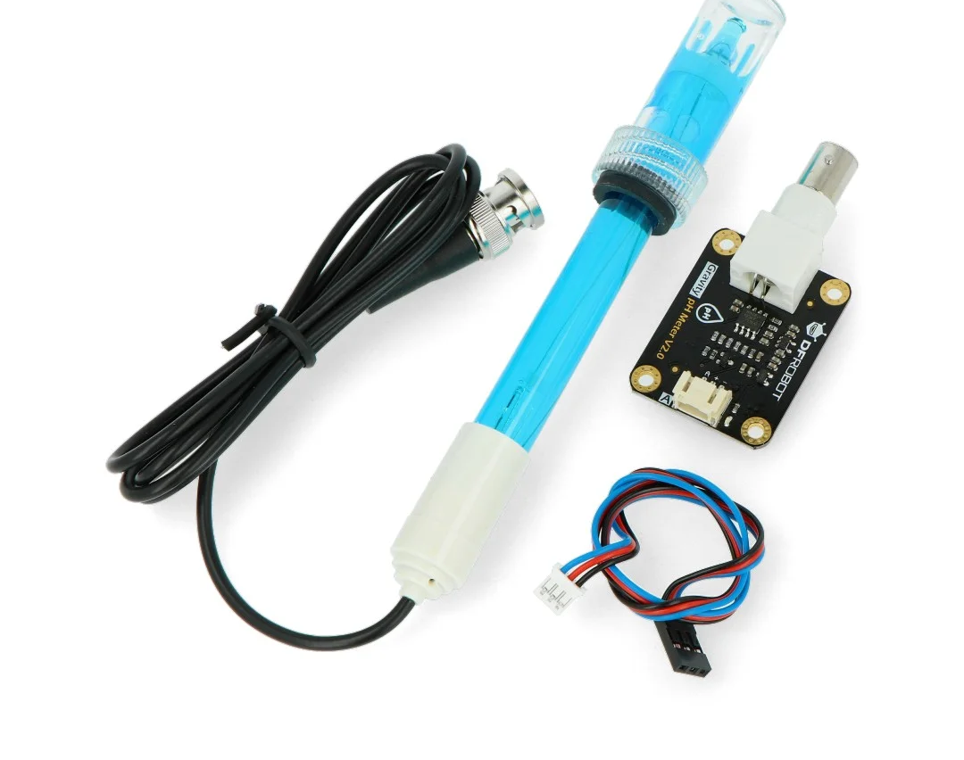
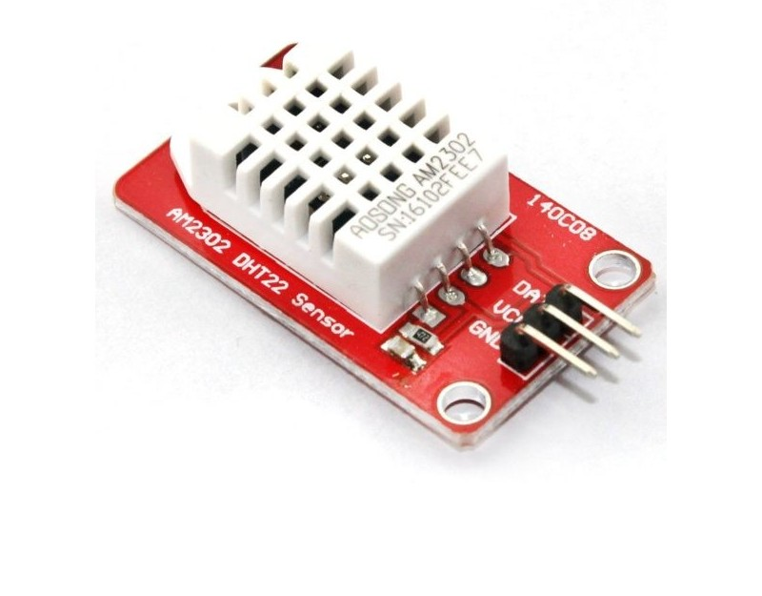
Sensors
Humidity and temperature ambient
pH sensors (beggining and end of filter)
Inundation sensor
Water flow

Slide 10
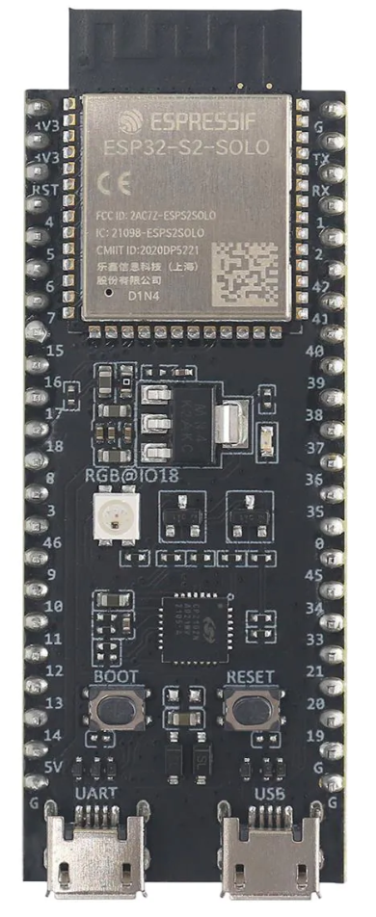

Board – ESP32-S2
Wi-Fi
Bluetooth
Low Power Mode
43 GPIO
Single Core 240 MHz
7.62€ (Mouser online store)
Coded with ESP-IDF framework

Slide 11




IoT Platform
Postgres SQL -> Database
Kotlin -> Backend
Spring Boot framework -> Backend
HiveMQ CE -> Broker

Slide 12



Frontend
React -> Web App
React Bootstrap -> Web App
Android (optional) -> Android App

Slide 13
Constraints and assumptions
Limited hardware programming experience
Low experience programming MCUs
New to IoT technology and platforms
New to alternative network protocols (other than HTTP)
Hardware has to be possible to acquire in timely manner

Slide 14



Project Organization
Team:
Pedro Silva
Miguel Rocha
Guide professor:
Rui Duarte
Company:
Mommertz (located in Germany)
Plattform management:
Basecamp
Git Hub

Slide 15
Major Milestones
20 Mar. 2023
Project Proposal
24 Apr. 2023
Progress presentation
5 June 2023
Beta version (report, poster, and organization)
10 July 2023
Final version (Academic Calendar 2022/2023)

Slide 16
Bibliography
https://mommertz.de/neutralisation-oel-bwk.html
https://botland.store/gravity-temperature-sensors/15094-gravity-ph-analog-sensormeter-v2-dfrobot-sen0161-v2-5904422342920.html
https://www.electrofun.pt/sensores-arduino/sensor-humidade-temperatura-dht22-am2302-modulo?utm_campaign=efshopping&utm_source=google&utm_medium=cpc&utm_source=google&utm_medium=shopping&utm_campaign=roas&gclid=CjwKCAjw5dqgBhBNEiwA7PryaNJvTICP7r6IVvm_VTUBhN60vsUV195PoVzG8gtCwhgmIQjtwREtyhoCotUQAvD_BwE

Slide 17
Bibliography
https://pt.mouser.com/ProductDetail/Espressif-Systems/ESP32-S2-DevKitC-1U?qs=pBJMDPsKWf0y5luJFio6Ng%3D%3D
https://www.google.com/search?q=espressif+idf&rlz=1C1FCXM_pt-PTPT1045PT1045&sxsrf=AJOqlzWG8QtYywWcD9jUsnxLutr3o13HVw:1679256691016&source=lnms&tbm=isch&sa=X&ved=2ahUKEwji47fU5uj9AhVicKQEHRf5D9cQ_AUoAXoECAEQAw&biw=1536&bih=714&dpr=1.25#imgrc=iaGd5y6o3iDlzM&imgdii=FyR0RU9LwaPsiM

Slide 18
Bibliography
https://docs.espressif.com/projects/esp-idf/en/latest/esp32/about.html
https://www.interviewbit.com/blog/spring-vs-spring-boot/
https://www.pngwing.com/en/free-png-nlelb
https://www.hivemq.com/developers/community/
https://www.pngwing.com/en/free-png-aglpc
https://react-bootstrap.github.io/

Slide 19
Bibliography
https://pt.wikipedia.org/wiki/Ficheiro:Android_logo_2019_%28stacked%29.svg
https://pt.m.wikipedia.org/wiki/Ficheiro:Kotlin_logo.svg
https://mommertz.de/
https://salesdorado.com/pt-br/automacao/ferramentas-gerenciamento-projetos/avis-basecamp/
https://1000logos.net/github-logo/

