Slide 1
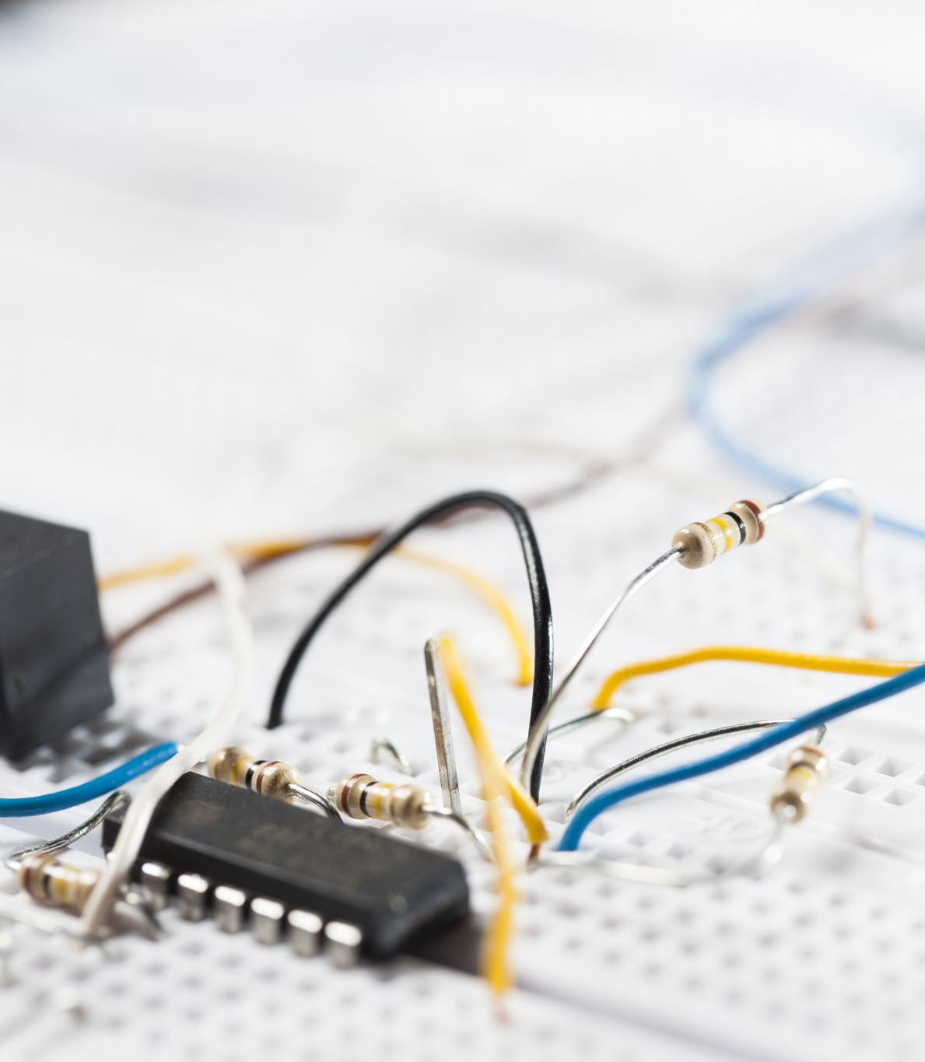
IoT System for pH Monitoring in Industrial Facilities
Instituto Superior de Engenharia de Lisboa (ISEL)
Engenharia Informática e Computadores (LEIC)

Slide 2
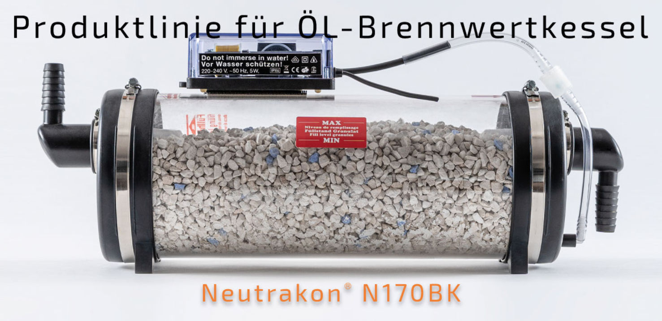
Water Filter
Neutrakon® 05 /BGN Caldeira de condensação até 55 kW

Slide 3
Disadvantages of the company's strategy
Expensive for the client
Less data collected
More error-prone

Slide 4
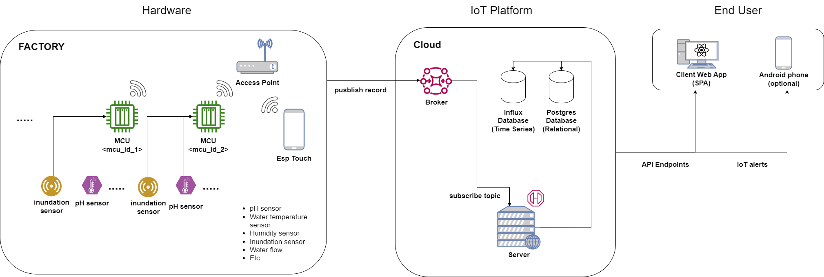
System Architecture

Slide 5
Advantages of our strategy
Less Expensive
More data collected
Less error-prone

