Slide 1
IoT System for pH Monitoring in Industrial Facilities
Pedro Silva nº47128 & Miguel Rocha nº47185 Supervised by: Professor Rui Duarte
Instituto Superior de Engenharia de Lisboa (ISEL)
Engenharia Informática e de computadores (LEIC)

Slide 2
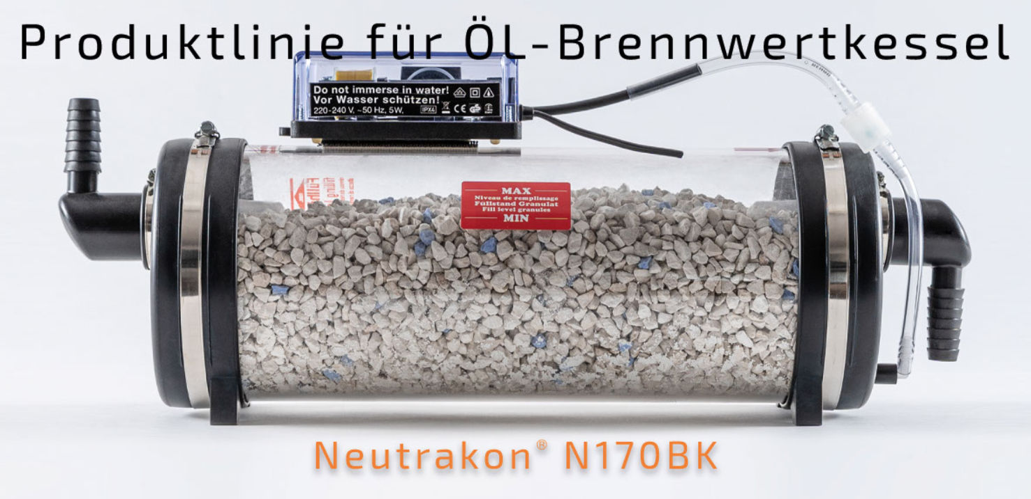
Motivation
3
Current strategy:
The company carries out device inspections every 6 months to check the health of the devices
Our solution:
Solution that leverages the power of the Internet of Things (IoT) to monitor pH levels of water in a neutralisation mechanism, allowing users to be informed when the device is in need for maintenance.
3

Slide 3
Objectives
An electronic system designed to be energy-efficient, equipped with sensors for collecting data, and capable of transmitting the data to the cloud.
Create a Backend for:
Gather the received sensor data;
Process collected data, and alert the user, if necessary;
Expose a Web API, allowing other applications to interact with the system
Intuitive and secure website, to register devices and consult sensor data.
4

