Slide 1

Data-driven epidemiologic approach to conducting site feasibility for a global phase III tuberculosis vaccine clinical trial
Wai-Ling MuiI, Falgunee K. Parekh, Ashley S. Tseng, Joy Toro, Taylor Craig, Maggwa Ndugga , Alexander C. Schmidt, Alemnew F. Dagnew, Craig Penz, Ghiorghis Belai

Slide 2
TB vaccine efficacy trials pending
Efficacious TB vaccines and administration protocols required to achieve WHO TB goals (Uplekar, 2015)
Several vaccines in pipeline (Hatherill, 2020) with two having shown efficacy in phase IIb efficacy trials (Nemes, 2018; Tait, 2019)
Phase III trials required to establish efficacy

Slide 3
Many TB vaccine trial sites required
Phase III trials of TB vaccines may require 10k participants per arm (Frick, 2020)
This will require many TB vaccine sites, each of which must have:
High local TB incidence
Sufficient capacity

Slide 4
Typical new site identification limited
Time and financial costs limit assessment quality:
Bias:
Tend to refer to sites already used and investigators well known when considering sites
Poor evaluation:
Assessment questionnaires not necessarily sufficiently customized
Unsystematic evaluation

Slide 5
Data-driven approach for site evaluation developed and implemented
Overall approach:
Identified 221 sites in high-burden countries
Based on pre-existing knowledge, expertise in TB vaccine trials and WHO TB data
Gathered data on each
Via a SmartSheet questionnairse sent to each site
Scored each site according to relevant factors
Incident, site capacity, regulatory landscape, experience and accessibility
Use expert-determined weights to yield per-site score
30 for incidence, 25 for site capacity and 15 each for the rest
Results
14 sites > 85%, 54 75-84% and 45 65-74%

Slide 6
Study envisioned
Trial phase:
III
Population:
Healthy 15-34-year-olds
High risk of TB infection

Slide 7
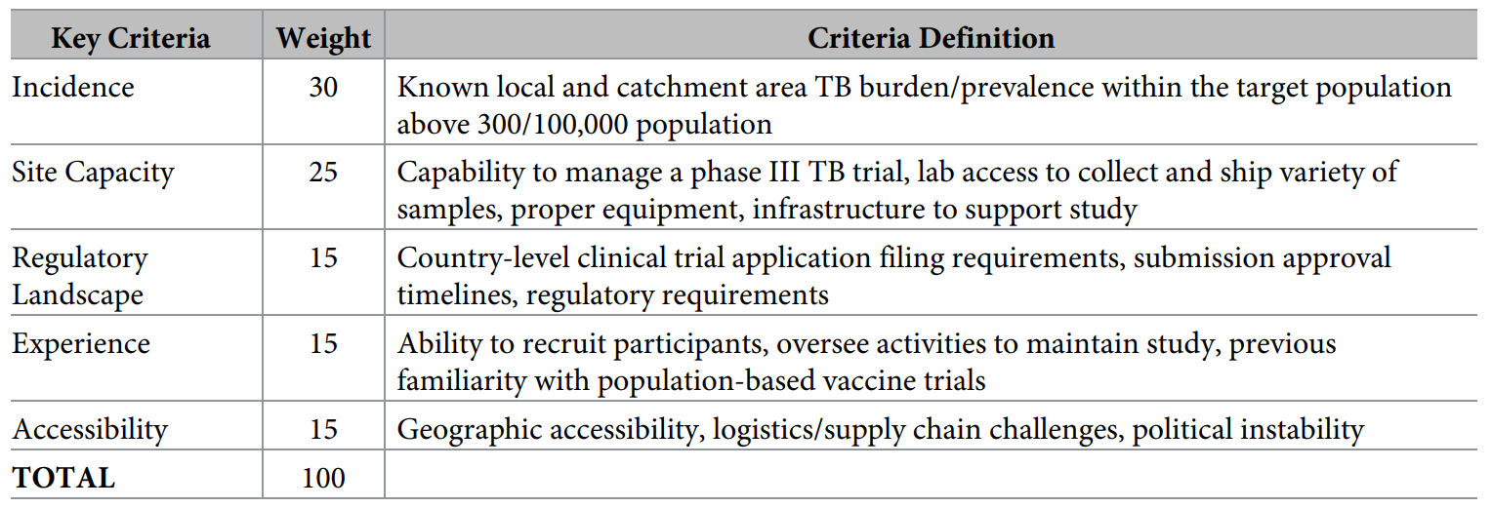
Key criteria in site feasibility

Slide 8
Key criteria in site feasibility
Note: in this paper, only incidence and site capacity are evaluated. Other criteria are evaluated in a later phase of this study. Site capacity will also be more deeply analysed.

Slide 9
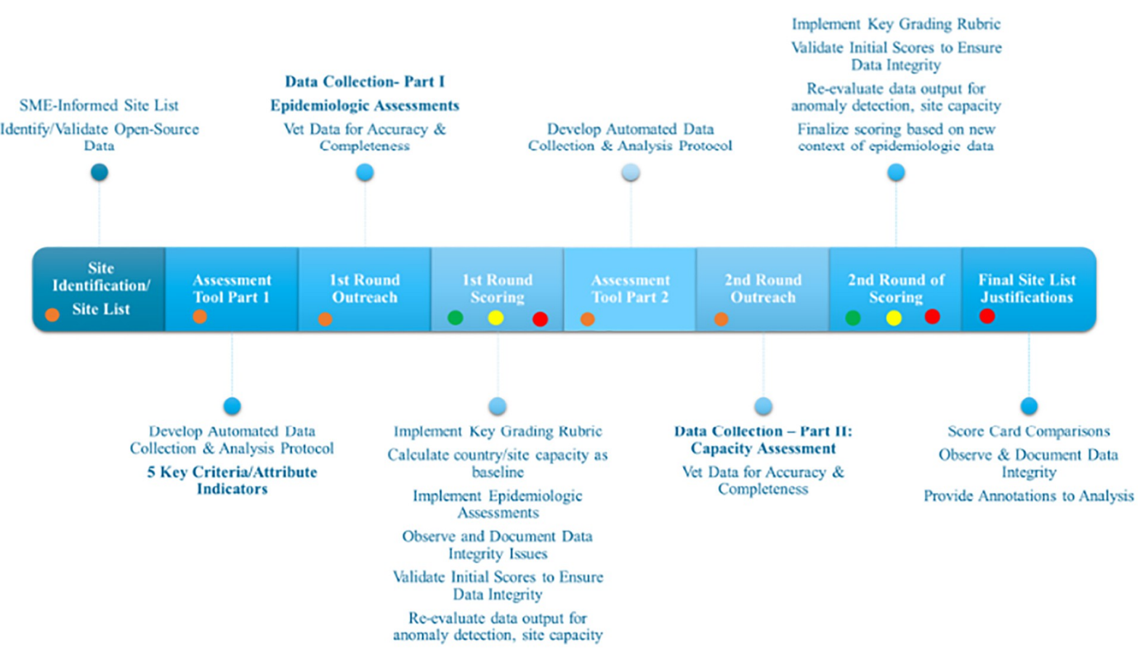

Slide 18
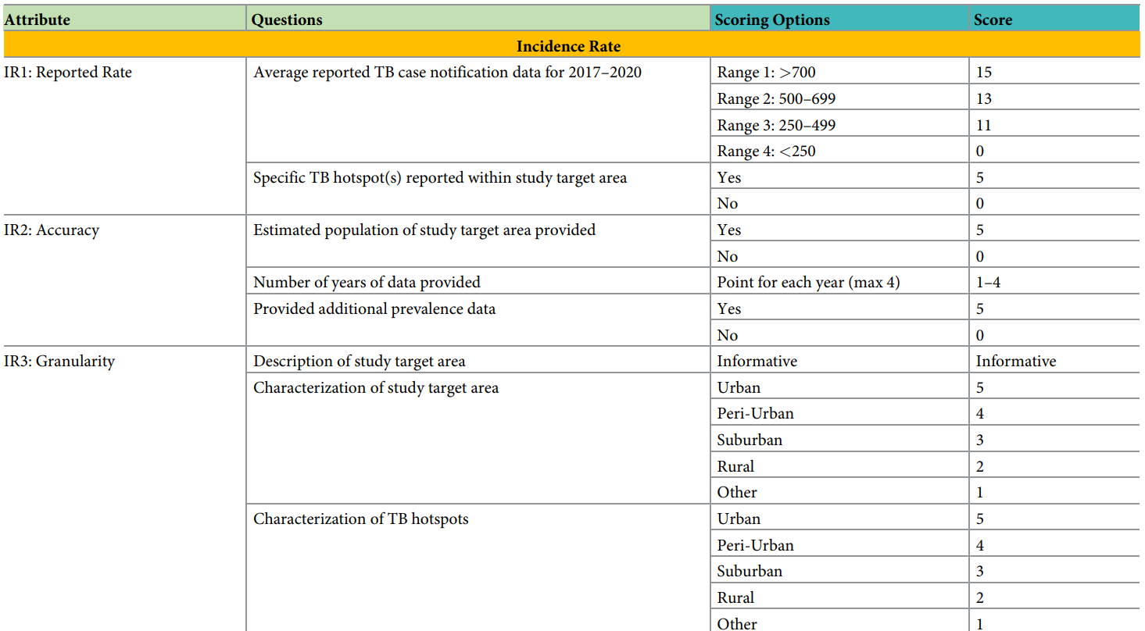
Incidence indicator breakdown

Slide 19
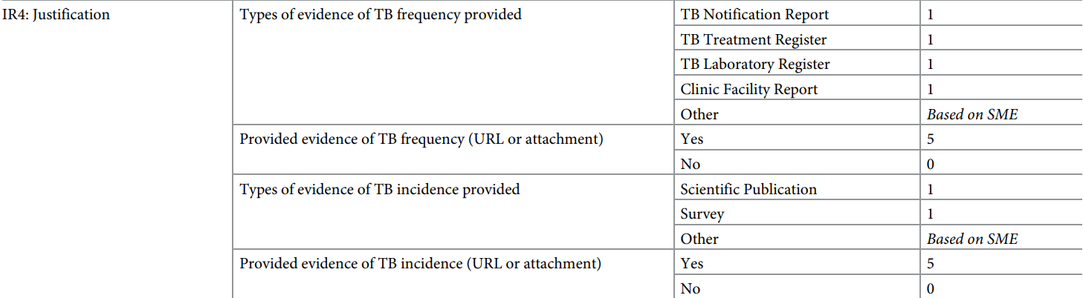
Incidence indicator breakdown

Slide 20
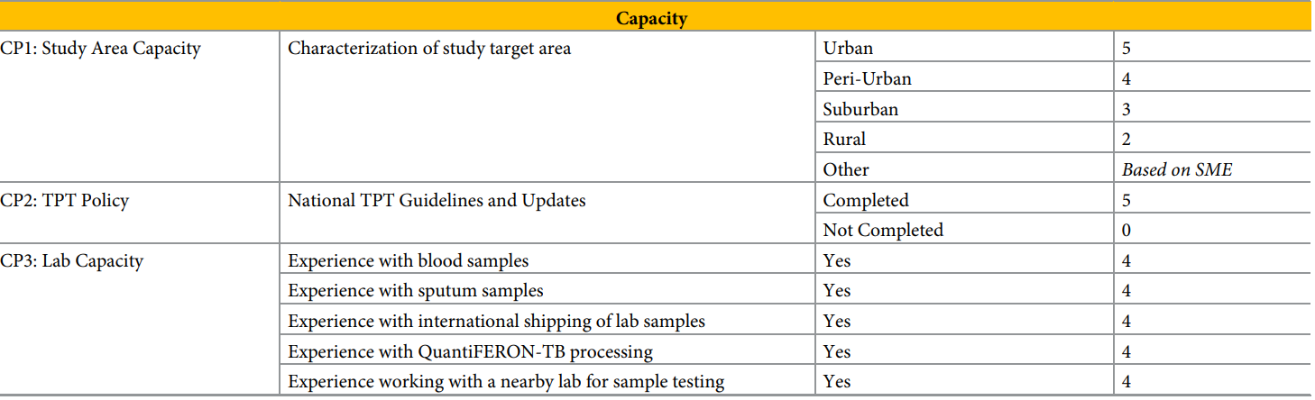
Incidence indicator breakdown

Slide 21
Incidence indicator breakdown

Slide 22
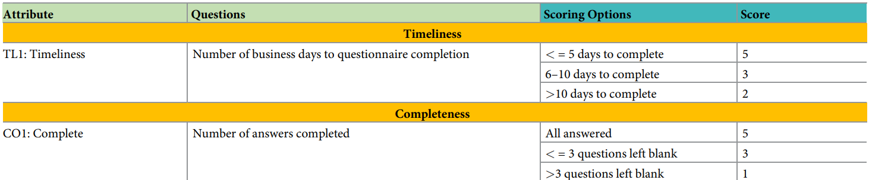
Timeliness and completeness indicator breakdowns

Slide 23
Feasibility assessment tool (FAT)
Purpose: collect, vet and evaluate site-specific data
Tool: SmartSheet (a collaboration and work management tool)
Advantage: questionnaire responses go directly into spreadsheets
Indicators thus far assessed:
All incidence attributes
Only key aspects of site capacity
Initial collection
Responses from sites
Additional metadata: dates sent and received, locations, points of contact
Responses reviewed for each site by a single team member, with follow-up for incorrect, incomplete or unclear answers

Slide 24
Epidemiological analysis
Accurate incidence rate determination critical
Problem:
Accurate indicate rate really requires long-term follow-up of large populations, and is not normally done
Alternative: case notifications as proxy
Some sites provided an estimate that incorporates missing notification factor

Slide 25
Incidence rate calculation
From each site for 15-34-year-olds, get # of TB cases (new and relapse) and total # of such individuals in area
If population size not provided, then calculated using UN 15-34-year-old population proportion
Repeated for 4 years of data (2017-2020)
Weight estimates evenly across years
Outliers identified and IR possibly adjusted by experts

Slide 26
Indicator and attribute scoring
Performed initially upon receipt of data
Assessed for plausibility by experts
Anomalies flagged and sites contacted for resolution
Score re-calculated if new data received

Slide 27
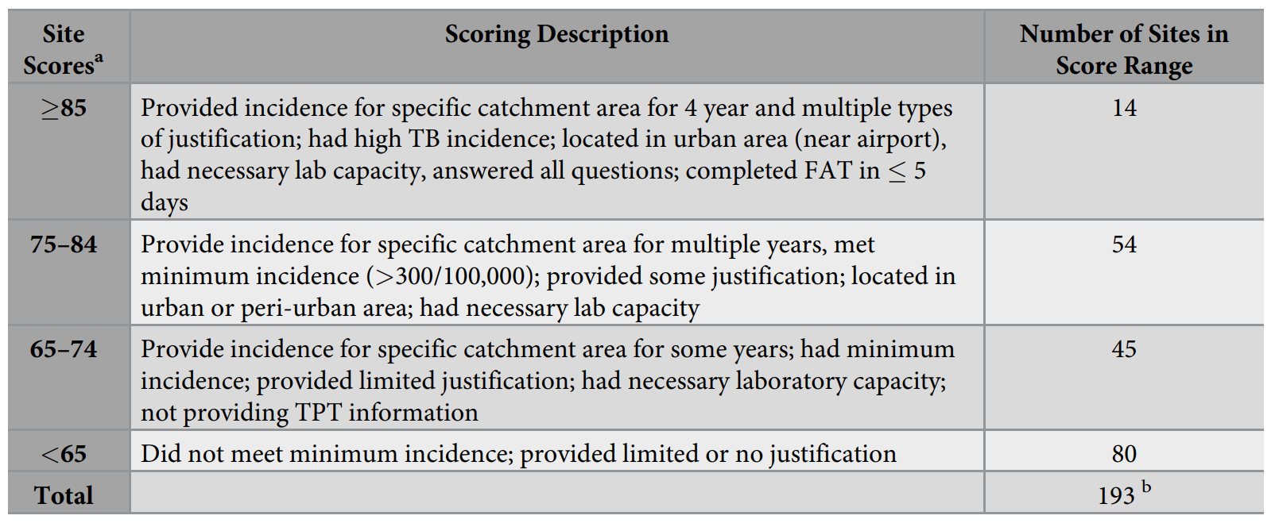
Results

Slide 28
Sites for follow up
Sites with scores greater than 65 followed up for detailed assessment
This was 92 sites
This total excludes all 27 South African and 8 Philippine sites
Selected by default due to experience for further follow-up

Slide 29
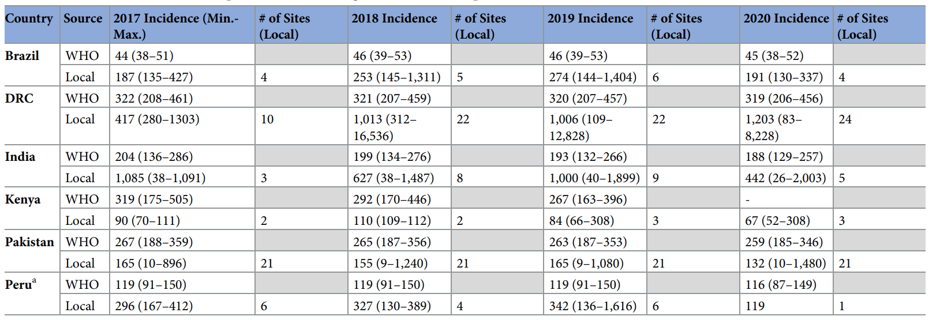
Identification of TB catchment areas

Slide 30
Further comments
Time for data collection:
10 weeks (not bad for 191 sites across 25 countries)
Within-country comparisons:
Very informative, as similar factors would likely influence scores (especially incidence, e.g. things affecting TB case notification and so on)
Notable examples of new information:
DRC: several high-incidence sites with sufficient capacity
Kenya: lower incidence than expected
Even-handed assessment of sites:
Lesser-known sites given an opportunity to be noticed
Conducting clinical trials there would:
Improve their capacity
Reduce underrepresentation of their populations

Slide 31
Quality of results
Rigorous:
Required interdisciplinary team of epidemiological and clinical trial experts with experience in infectious diseases, as well as data analysts and public health experts
Standardised:
Reduced resource demands
Objective
Enabled expanding pool of sites evaluated

Slide 32
Conclusion
Developed a rigorous, relatively low-cost procedure that yields standardized results that facilitate comparison between sites in an objective manner
Identified sites with significant incidence and sufficient capacity for further consideration

