Slide 1
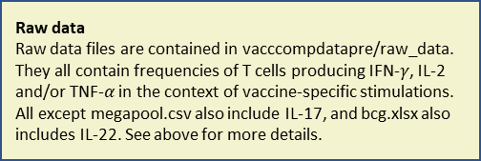
Raw data
Raw data files are contained in vacccompdatapre/raw_data. They all contain frequencies of T cells producing IFN-$γ$, IL-2 and/or TNF-$α$ in the context of vaccine-specific stimulations. All except megapool.csv also include IL-17, and bcg.xlsx also includes IL-22. See above for more details.
aeras.402.xlsx
bgc.xlsx
h1.xlsx
h1-group_info.xlsx
h56.xlsx
id93.xlsx
main.xlsx
megapool.csv
Process raw data
Raw data files are processed into dataframes for further analysis in R. Column names are standardised, background stimulation frequencies are subtracted (where this hasn’t already been done) and different stimulations are summed over. IL-22 is summed over from bcg.xlsx.
All .R files not mentioned below.
aeras(I)Tbl
l4(I)Tbl & l8(I)Tbl
h1(I)Tbl
h56(I)Tbl
id93(I)Tbl
lOrigMain(I)Tbl
meg(I)Tbl
Join processed tables
All R dataframes except meg(I)Tbl are joined together. Each subject is given a new patient identifier.
Data_Join.R
join17Inc(I)Tbl
Extract and remove IL-17
IL17 is summed over to produce join17Exc(I)Tbl. Data from “megapool.csv” is included with the other datasets in join17Exc(I)Tbl. IL17 is also extracted to give single IL17 frequencies in single17(I)Tbl.
IL-17-Calc_And_Removal.R
join17Exc(I)Tbl
single17Exc(I)Tbl
Subtract day zero
For each subject for each cytokine combination, that subject’s response at baseline is day zero from the all responses from that subject for that cytokine combination. Where an individual lacked a day zero response, the median response at day zero for that cytokine combination for that individual’s vaccine and infection status combination was subtracted.
Sub_Baseline.R
join17Exc(I)Tbl
single17Exc(I)Tbl
Extract day zero and memory responses
The responses for each individual on the last timepoint for that individual’s trial for each of the above datasets are put into datasets starting with “tmax”, with the remainder of the name what the dataset was already named, e.g. “tmaxJoin17IncTbl” for “join17IncTbl”. Responses at day zero are also extracted into individual tables, with the prefix “bl”.
Summ_Stat_Calc.R
tmax*
bl*
Legend
In a data table name, an “I” in brackets, e.g. in join17Inc(I)Tbl, means that the data has been processed in two ways, and is available in two tables – one included the “I”, and one note. The one including the “I”, e.g. join17IncITbl, has frequencies per stimulation condition. The one excluding the “I”, e.g. join17IncTbl, has frequencies summed over stimulation condition, where multiple stimulations were performed for a single individual at a single timepoint.

