Slide 1
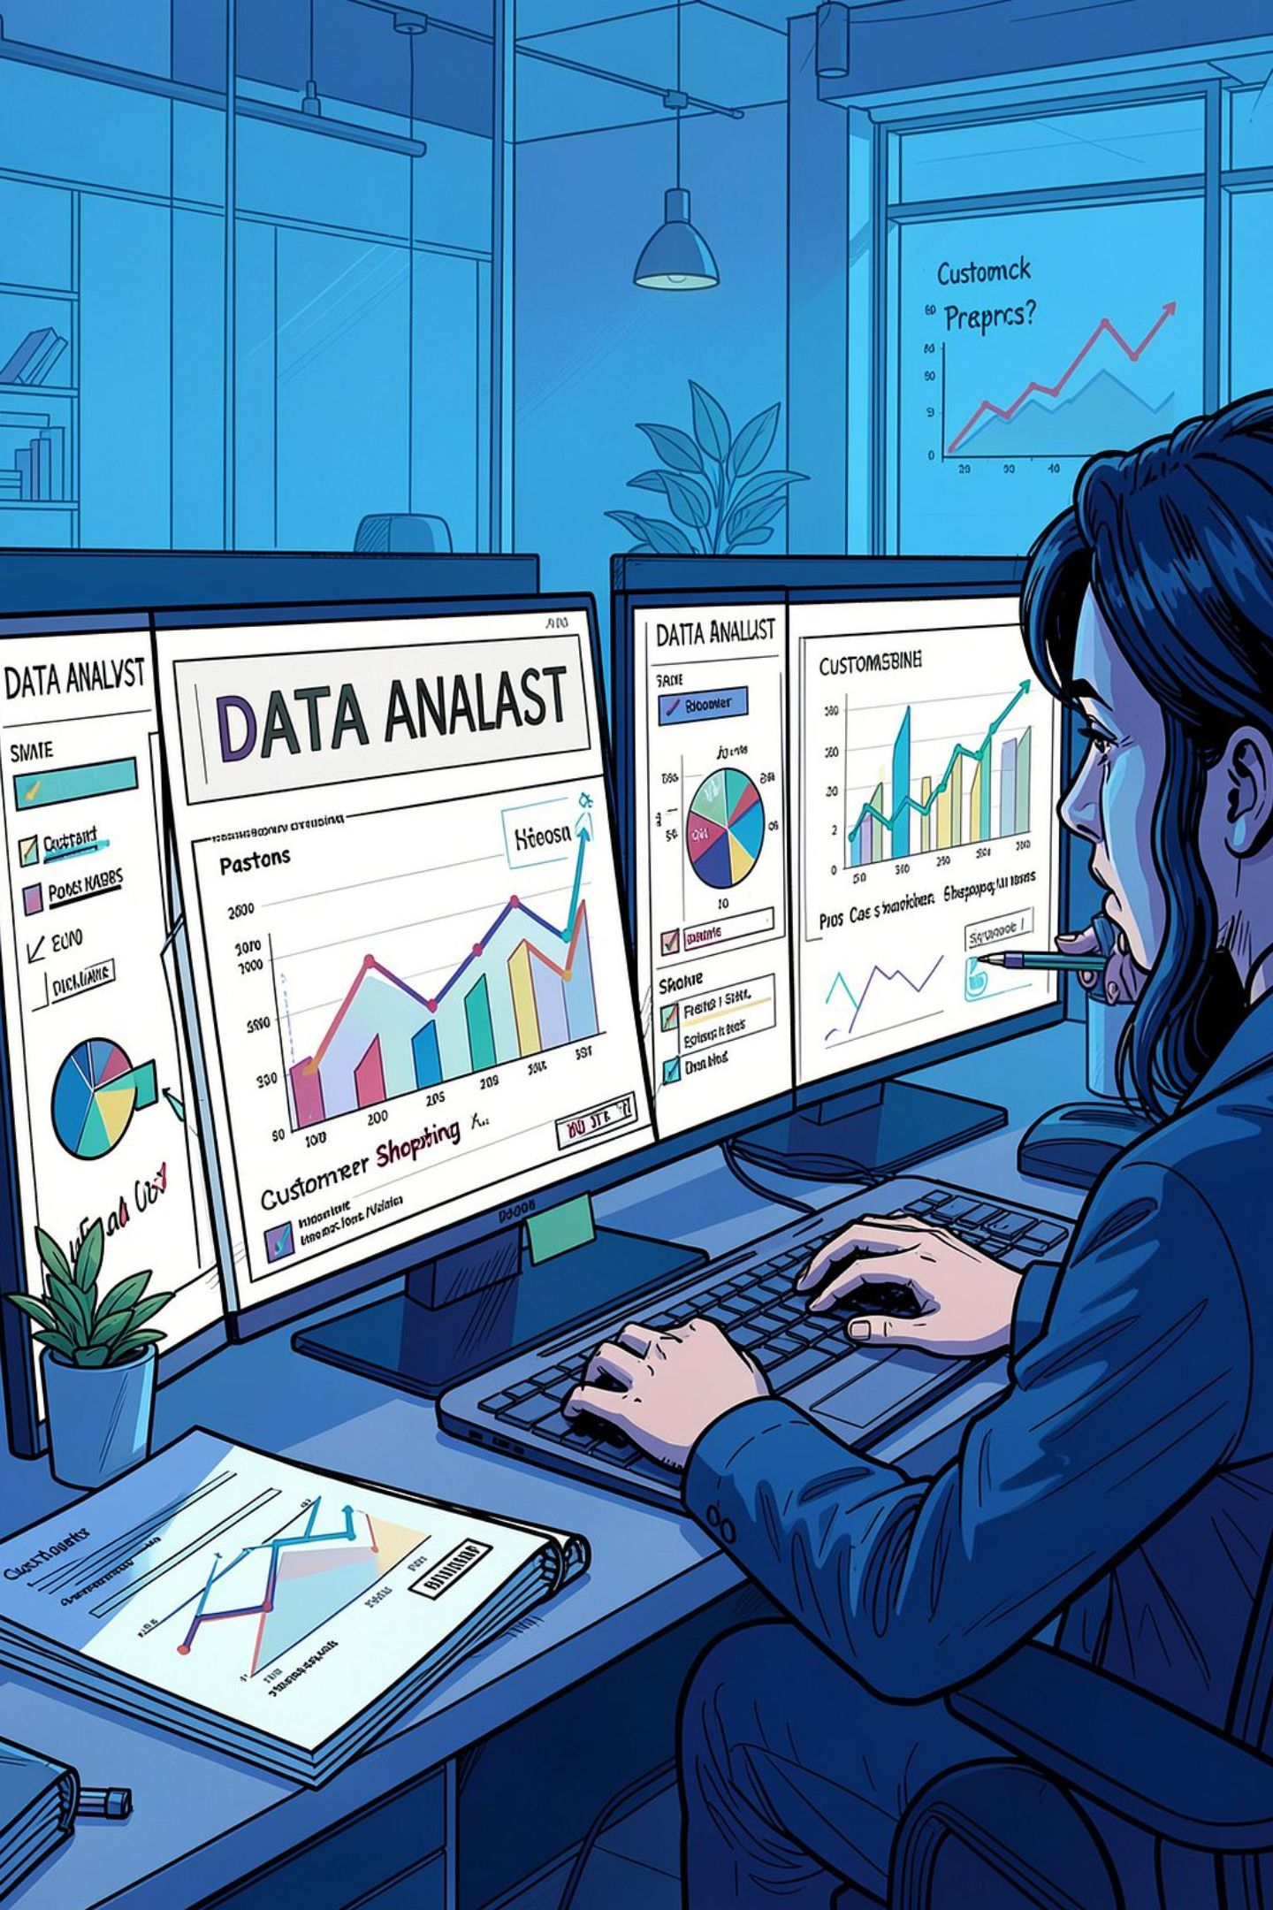
Customer Shopping Behavior Analysis
Insights from 3,900 transactions across product categories - spending patterns, segments, and subscription behavior.

Slide 2
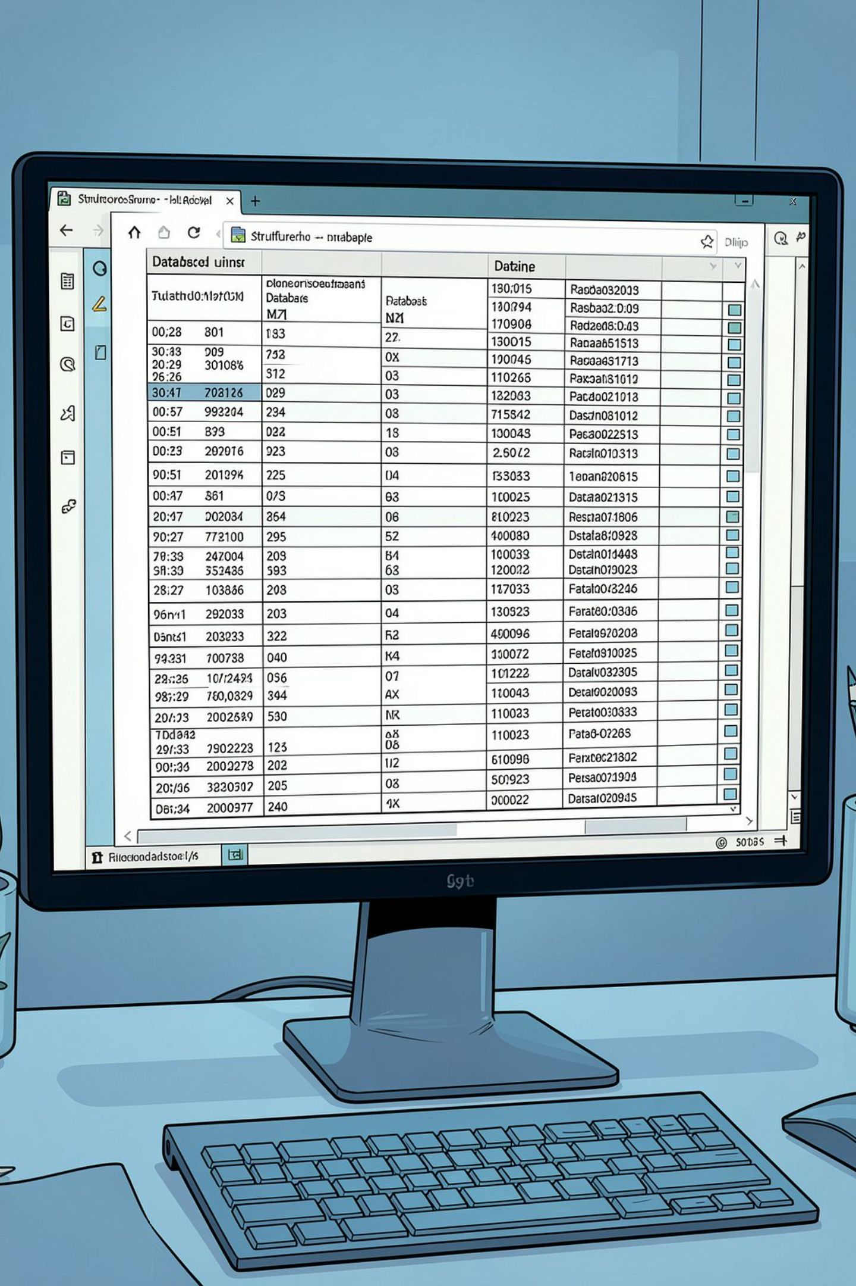
Dataset at a Glance
3,900
Purchases
18
Features
37
Missing Values
Review Rating column
$59.76
Avg. Purchase

Slide 3

Data Preparation in Python
Load & Explore
Engineer Features
Clean
Columns standardized to snake_case; redundant promo_code_used dropped.

Slide 4
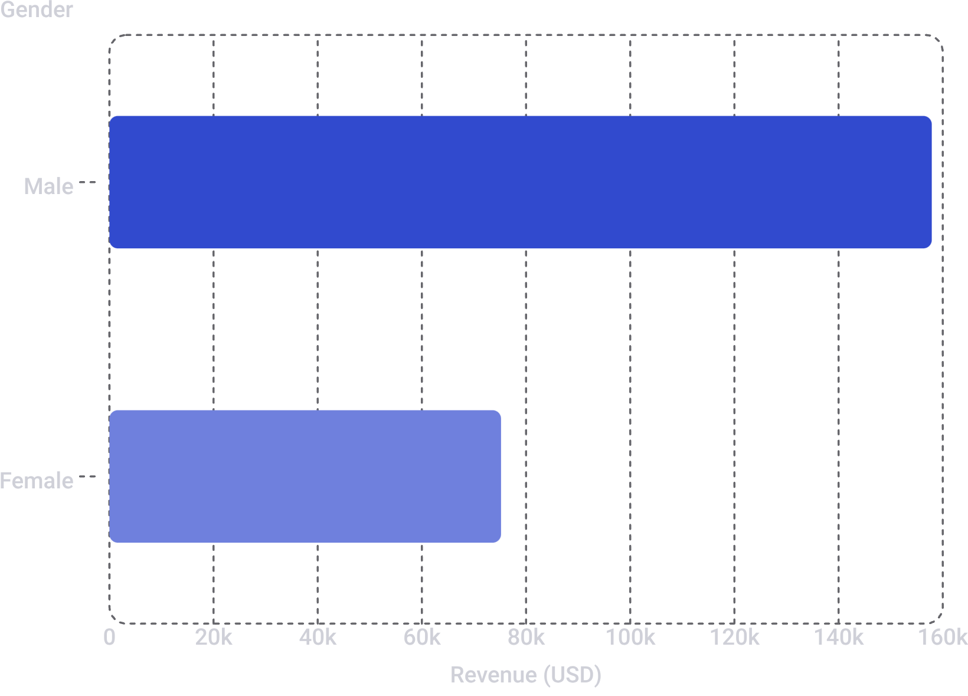
Revenue by Gender
Male customers drive 2× more revenue
Male: $157,890 vs. Female: $75,191

Slide 5
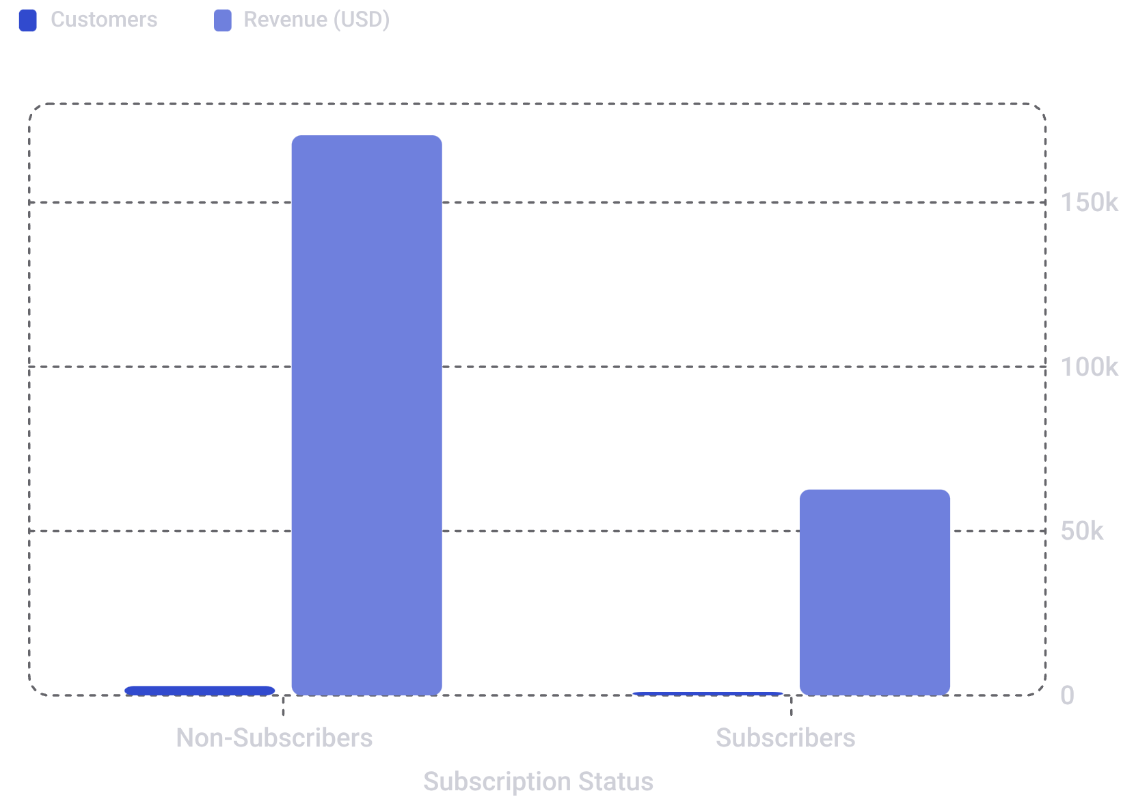
Subscribers vs. Non-Subscribers
73% of customers are non-subscribers
Non-subscribers generate $170K in revenue vs. $63K from subscribers — a major growth opportunity.

Slide 6
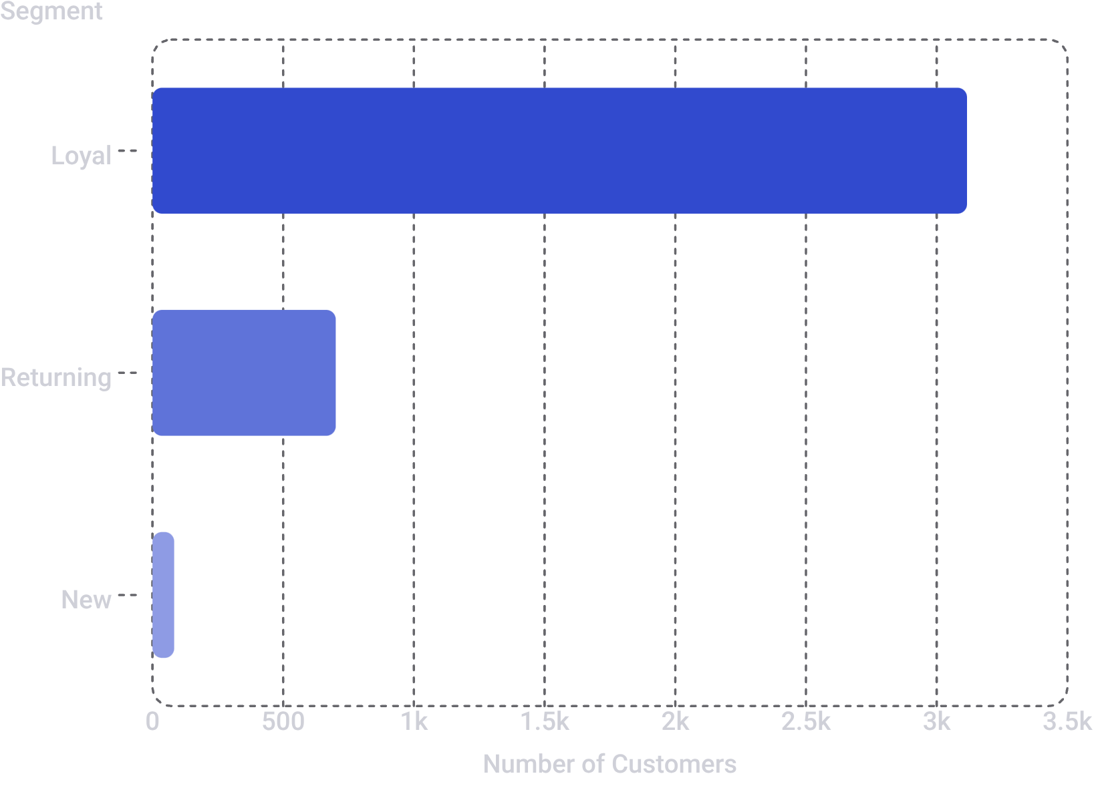

Customer Segmentation
80% Loyal customers
Only 83 New customers - focus on acquisition and converting Returning (701) to Loyal.
958 repeat buyers (>5 purchases) are subscribed vs. 2,518 who are not.

Slide 7
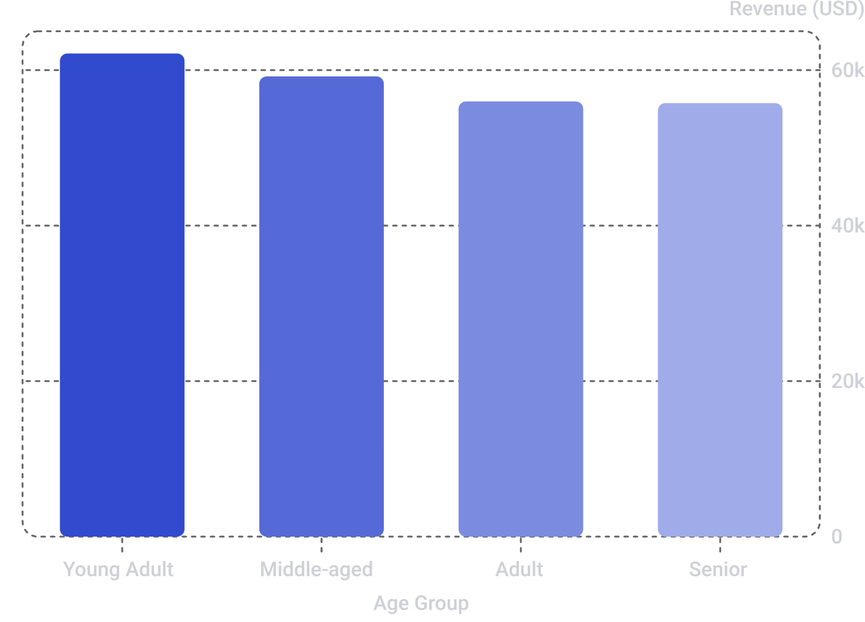
Revenue by Age Group
Young Adults lead revenue
Young Adult: $62K - highest contributor. Revenue declines slightly with age, but all groups are relatively close.

Slide 8
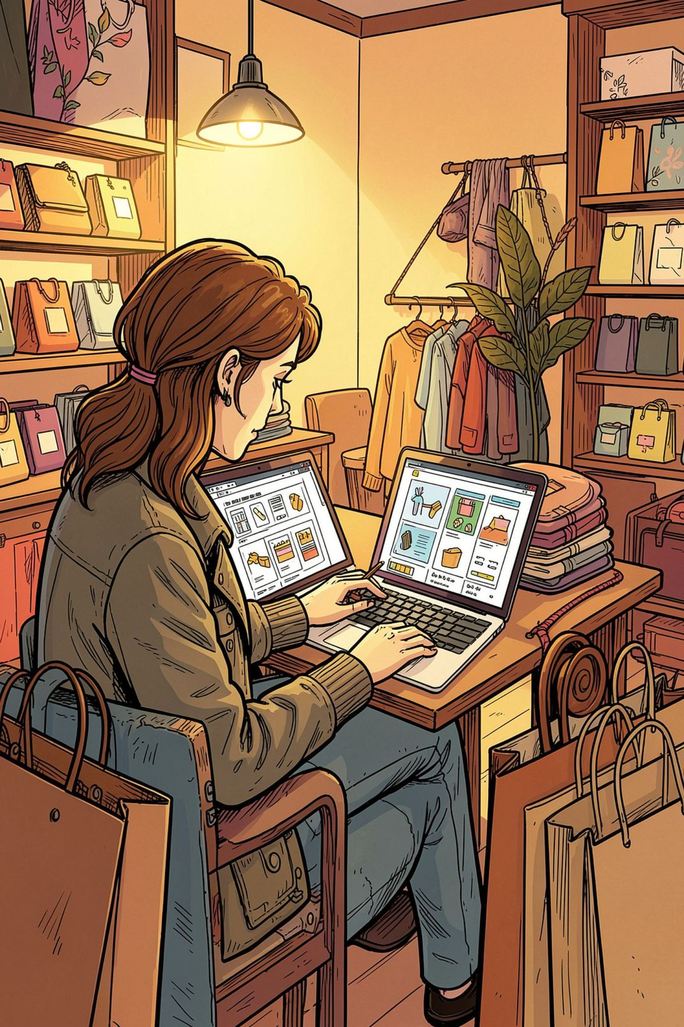
Top Products & Discount Insights
Top Rated
Most Discounted
Gloves (3.86), Sandals (3.84), Boots (3.82)
Hat (50%), Sneakers (49.7%), Coat (49.1%)
High-Spend Discount Users
839 customers spent above the average purchase amount with discounts

Slide 9
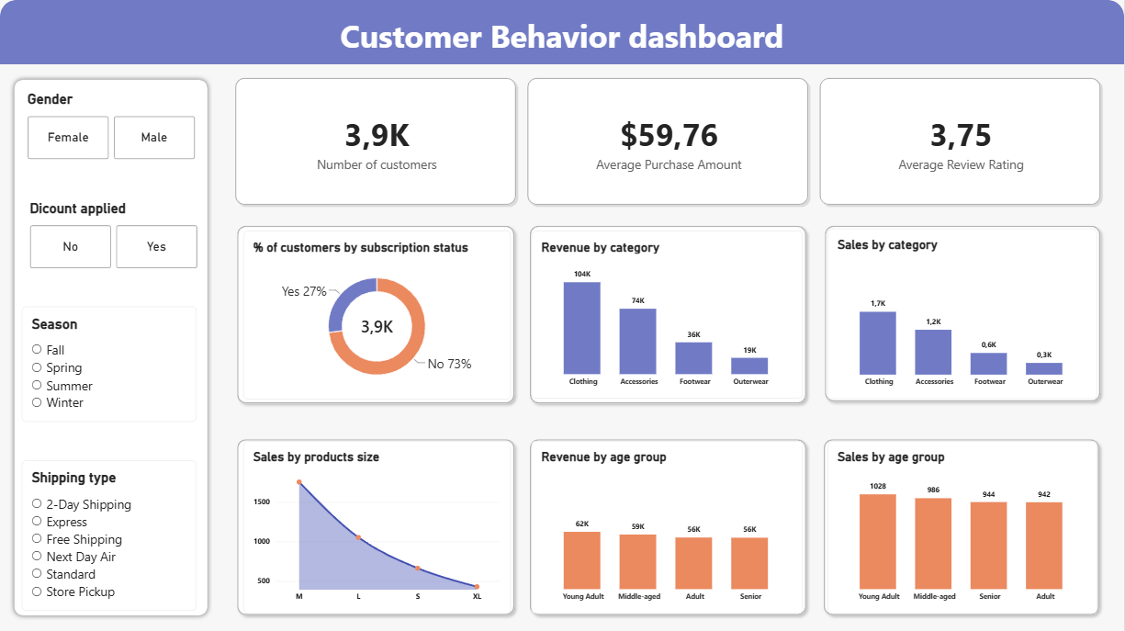
Power BI Dashboard
Interactive Filters & Key Views
Filters : Gender, Discount applied, Season, Shipping type
KPIs : 3.9K customers, $59.76 avg revenue, 3.75 avg review rating
Revenue and sales by category : Clothing leads ($100K)
Revenue and sales by category : Similar values across age groups
Product size sales : M size leads

Slide 10

Business Recommendations
Boost Subscriptions
Promote exclusive subscriber benefits
Loyalty Programs
Reward repeat buyers → Loyal segment
Review Discounts
Balance sales lift with margin control
Targeted Marketing
Focus on high-revenue age groups & express shipping users

