Slide 1
Good VS Bad UI
João Ventura 77387
Lab Class P1

Slide 2
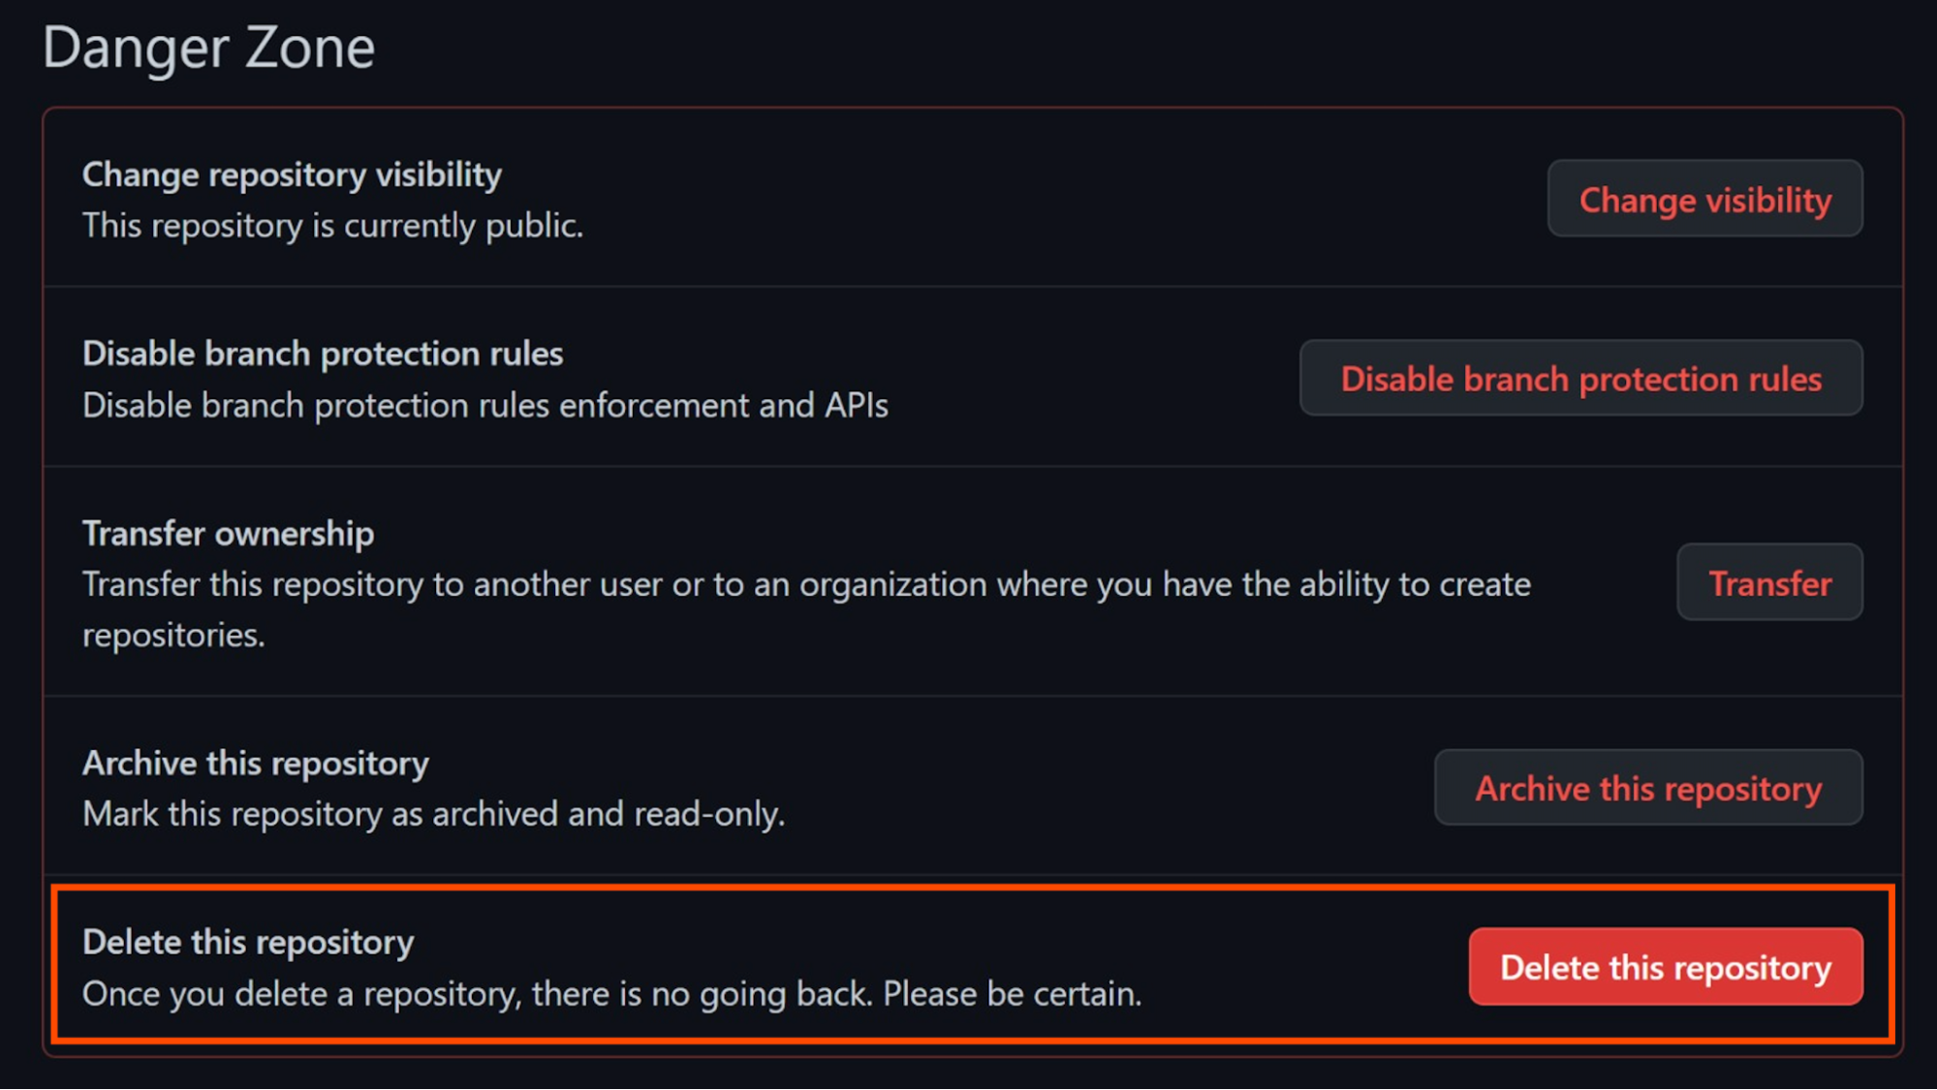
Good Design
Github “Danger Zone” Model
Objective

Slide 3
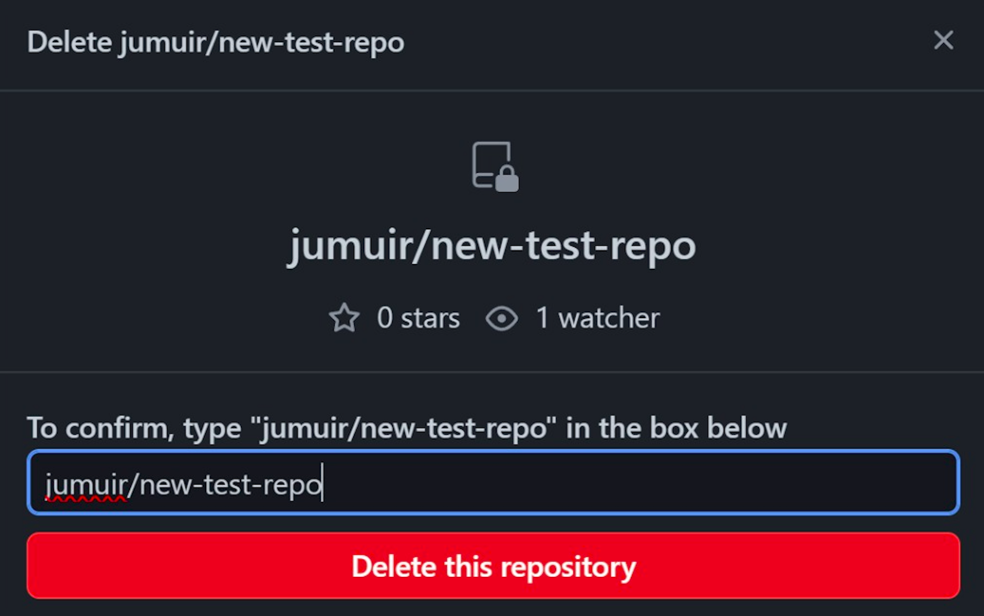
Good Aspects

Slide 4
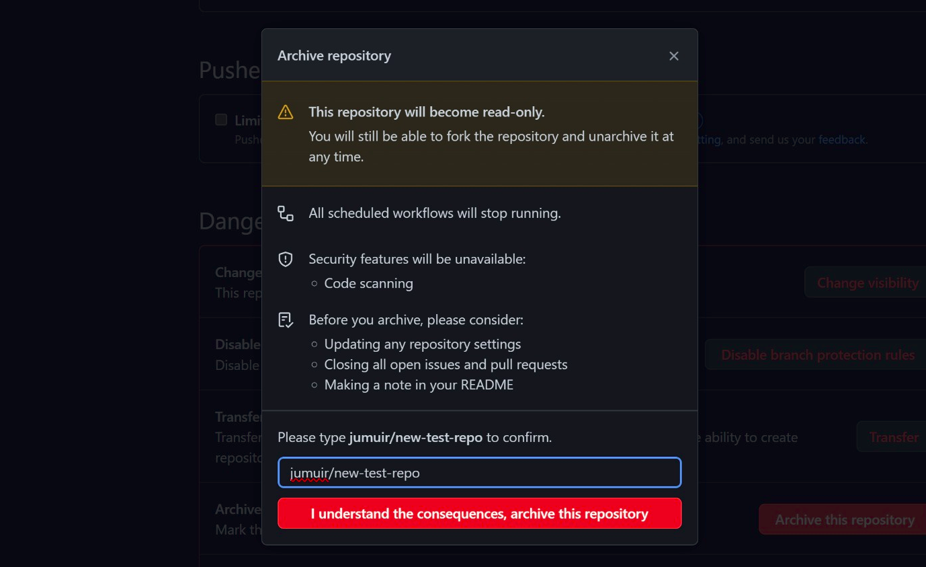
Why it works

Slide 5
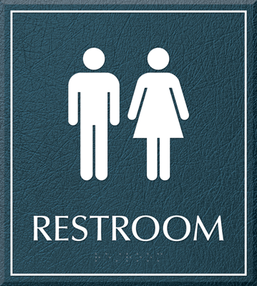
Bad Design Bathroom Signs
Objective

Slide 6
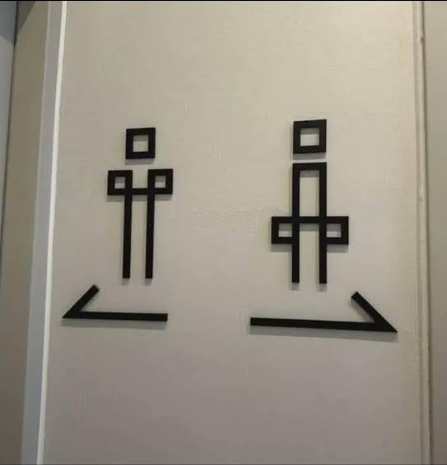
Bad aspects

Slide 7
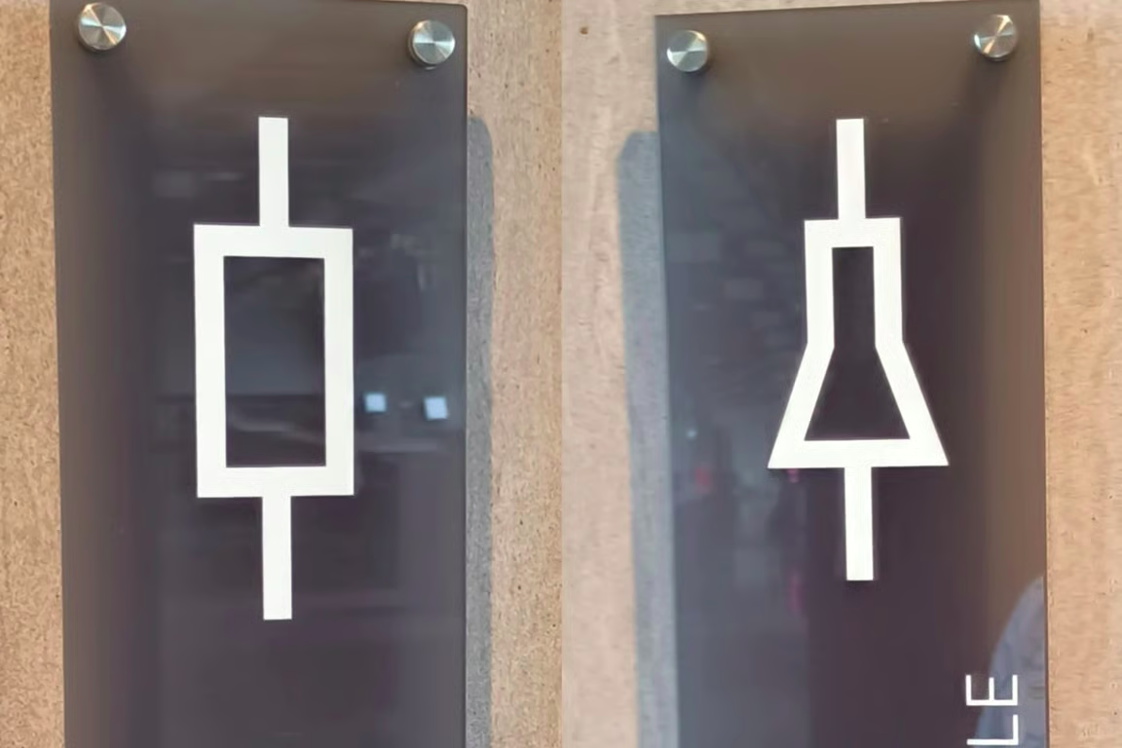
Why

Slide 8
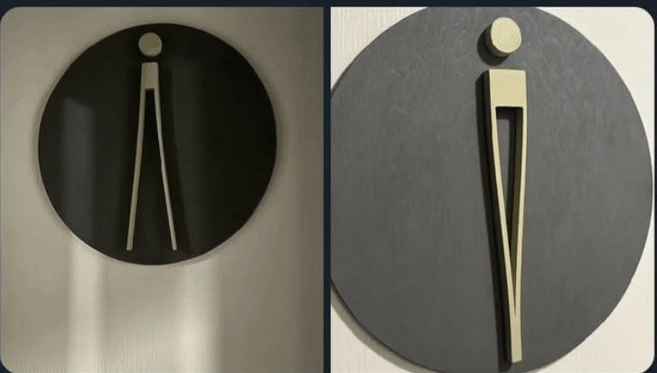
Choice of Design

Slide 9
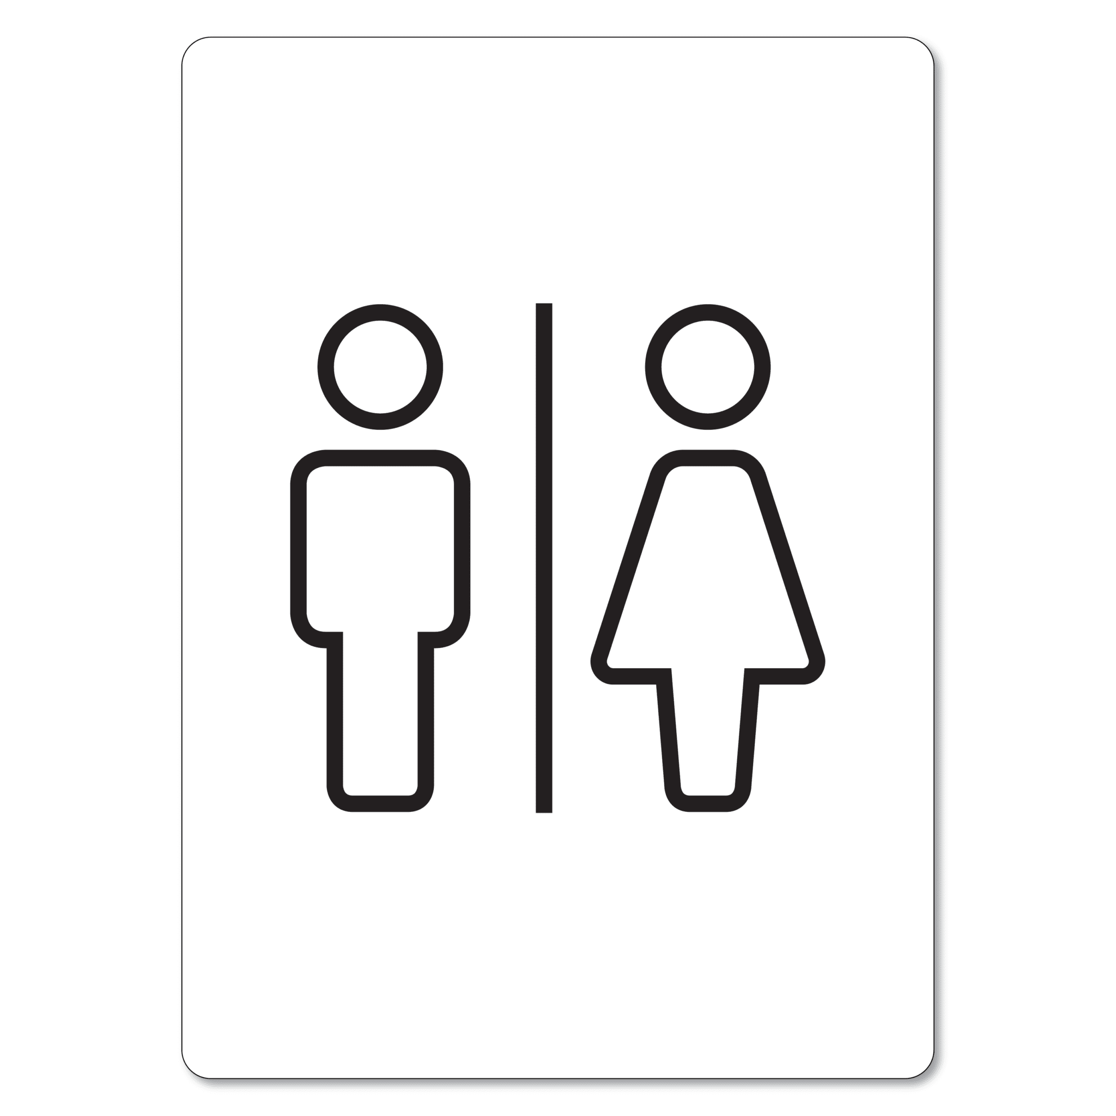
Just make it simple

