Slide 1

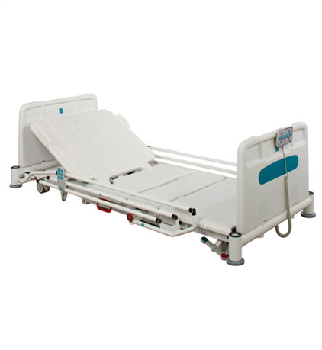

How to Hire a Low Bed
Key Features:
Low height range – 22.5cm to 71cm
Max patient weight - 30 stones (190kg)
Max safe working load – 40 stone (255Kg)
Easy to clean and decontaminate
Battery backup
12cm clearance under bed for hoist
Auto-cardio chair position
Central locking braking system, dual side
Extendable mattress platform for taller patients
Removable head/foot ends
Pricing:
7 day hire at £8.25 per day
(without mattress)
Delivery charge £80
Pick up charge £80
Acute Site:
Office Hours: Check availability of low bed with the equipment library Ext:4446
If no bed available, Equipment library will contact Falls Avoidance Nurse - who will check what beds are currently in use.
Out of Hours: Contact Portering Service Ext:4646
If no bed can be made available, you might wish to consider hiring a bed, if you do, inform Falls Avoidance Nurse EXT:5875
so that usage can be audited.
Community Sites:
If you have no low bed of your own, or are unable to change an existing patient onto another bed frame, then you can consider hiring a bed.
Inform the Falls Nurse of any hire so that usage can be audited. Contact:07876740016
1st Call Mobility - Contact Details:
Tele: 01279 425648
Fax: 01279 425653
Email: sales@1stcallmobility.co.uk
Please inform your ward manager each time you hire a low bed and document in patient care records.

