Slide 1

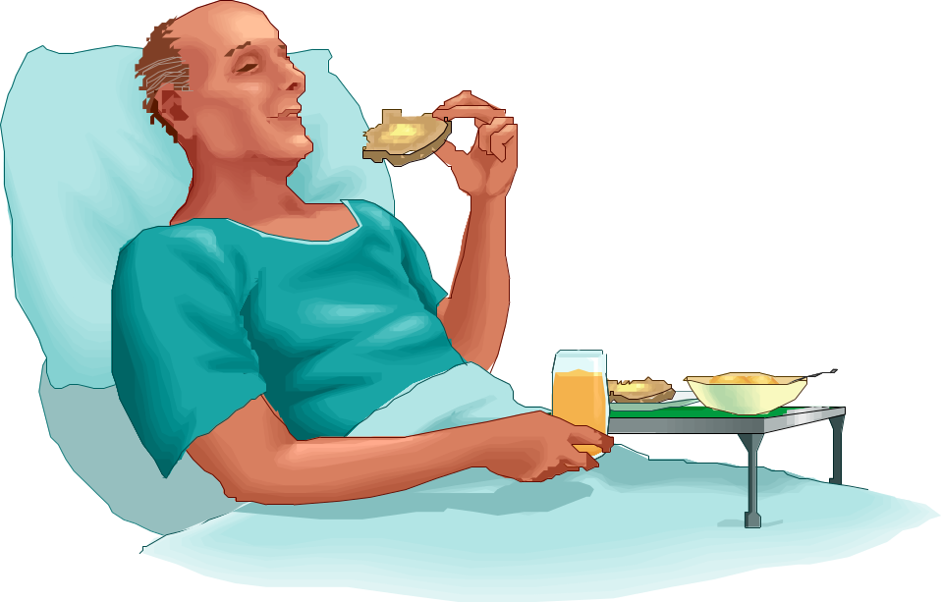
SPEECH AND LANGUAGE THERAPY DEPARTMENT
DYSPHAGIA STUDY SESSION
WORKBOOK
Speech and Language Therapy Ex: 5101
©

Slide 2

  Screening Inpatients for Dysphagia
Pre-Course Workbook 2017
This self-directed workbook is designed to help you identify and investigate
some of the issues associated with Dysphagia prior to attending the practical
session. Once completed it can form part of the evidence you require to support your claim of competence with recommendations for an update of knowledge and skills.
To aid a blended learning experience, we expect you to read the information in this workbook thoroughly and complete as much as possible prior to attending the study day. The answers to the questions posed in this workbook will be given on that day. You will be tested on your knowledge at the end of the workbook and a pass mark of 100% will be required to achieve competency. There will be time during the day to ask any questions and participate with discussion.
Steps required to achieve competence to carry out dysphagia screening:
  Read and complete workbook
  Pass questionnaire on Training Tracker
  Print workbook and bring to practical session
  Attend practical session
  Carry out supervised screening assessment with a competent colleague
  Sign off Competency with Ward Manager

Slide 3
Aims of Training
  Increase dysphagia knowledge and
  skills of nurses
  Adhere to clinical competency guidelines
  (local Trust policy and National Inter- Professional Dysphagia Framework)
  Improve efficiency of SLT dysphagia service
  by accepting referrals at the optimum time for the patient
  Reduce time patient NBM
  Ensure nutrition, hydration and medication are provided early and in appropriate form, to optimise recovery and potential for rehabilitation
  .

Slide 4
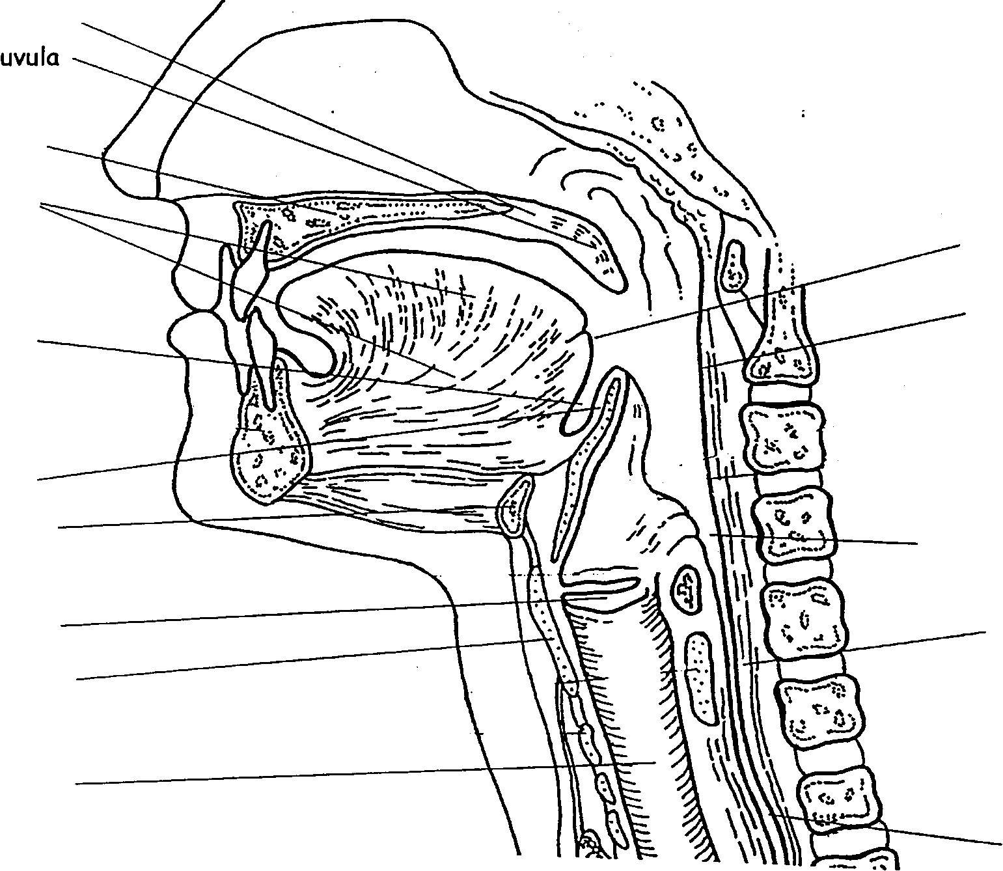
ANATOMY
soft palate
hard palate
tongue
Base of tongue
vallecula
posterior pharyngeal wall
epiglottis
hyoid bone
pyriform sinus
vocal cords
cricopharyngeal sphincter
thyroid cartilage
trachea
oesophagus

Slide 5
The Normal Swallow
Swallowing has 4 main stages:
Stage 1 – Oral Preparatory Stage
1) Food / liquid is placed in the mouth.
2) The lips are closed
3) The food is chewed and mixed with saliva (salivation is necessary for swallowing – stimulated by sight smell and palatability of food)
4) The food / liquid is formed into a bolus by the muscles of the tongue, palate and cheeks
5) The palate and the tongue separate the oral cavity from the nasal cavity.
The airway is open and nasal breathing may continue until Stage 2.
Stage 2 – Oral Stage (voluntary swallow -1 sec)
1) The tongue propels the food / liquid to the back of the throat.
2) This results in triggering of the swallowing reflex
This stage takes one second(s) to complete.
Stage 3 – Pharyngeal Stage (automatic <1 sec)
1) The food / liquid is forced over the base of tongue
2) The airway is sealed off by the larynx moving up and forward, lowering of the epiglottis and closure of the vocal cords.
The food moves through the pharynx via peristalsis and the cricopharyngeal sphincter relaxes, allowing food to enter the oesophagus.
Stage 4 – Oesophageal Stage (8-20 secs)
The food moves to the stomach by peristalsis
You cannot swallow unless there in something in your mouth –
food, liquid, saliva

Slide 6
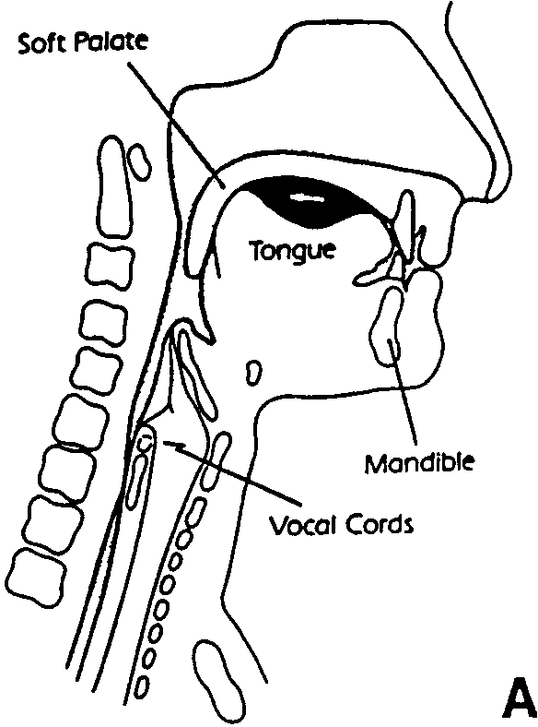
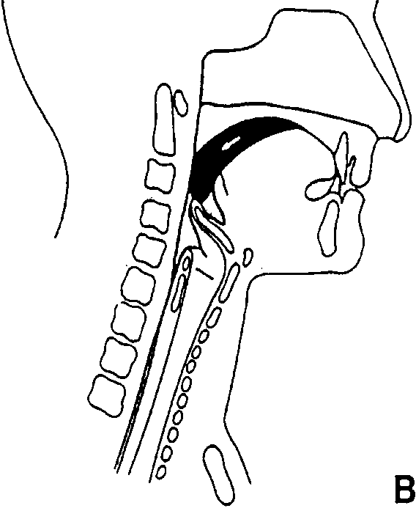
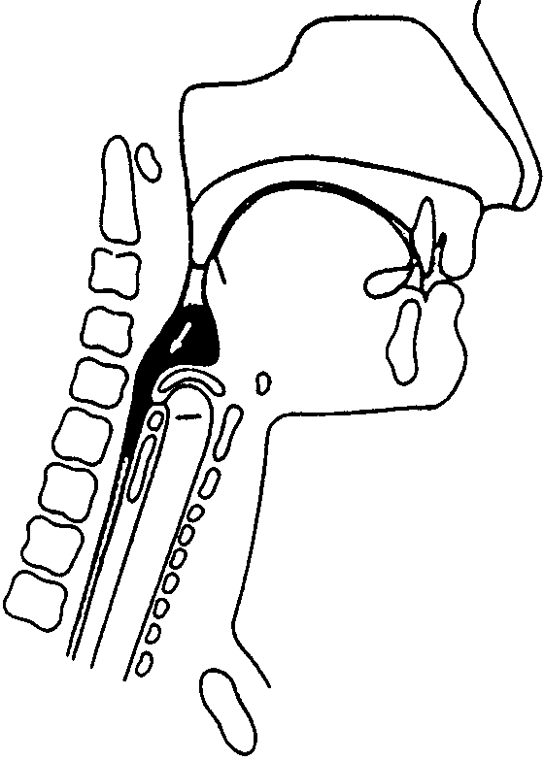
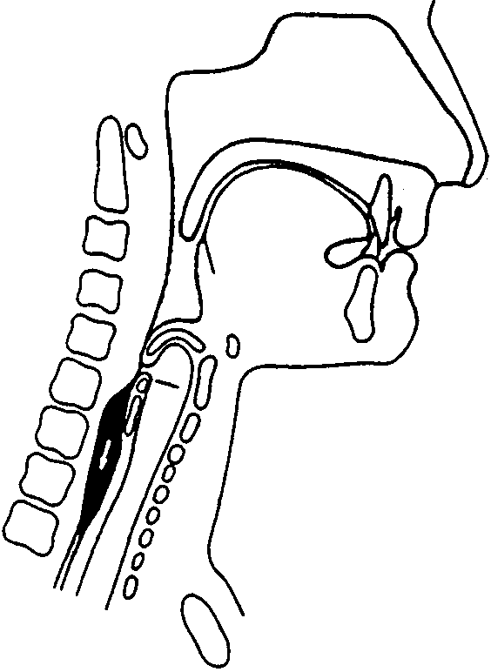
BOLUS PROPULSION DURING THE SWALLOW
Oral Preparatory Phase Oral Transit
Pharyngeal Phase Oesophageal Phase

Slide 7
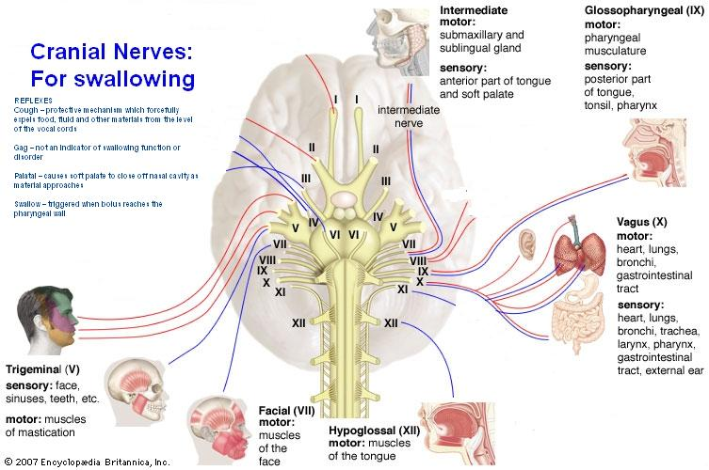
CRANIAL NERVES

Slide 8
DAMAGE TO CRANIAL NERVES
V – Trigeminal
  Reduced strength of muscles of mastication
  Problems biting and chewing
VII – Facial
  Weakness of facial muscles (may be one side only)
  Drooling / losing food from mouth
  Pocketing food between teeth and cheek
  Slurred speech (dysarthria)
IX – Glossopharyngeal
Pain or discomfort on talking and swallowing
  Decreased gag reflex
  Decreased swallow reflex
X – Vagus
  May result in absent / disturbed reflexes
- gag
- cough
- palatal
- swallow
  Incomplete closure of the vocal cords during speech leading to breathy
or gurgly voice
XII – Hypoglossal
  Reduced tongue strength and mobility
  Slurred speech
  Problems chewing and controlling food and drink in mouth
REFLEXES
  Cough – protective mechanism which forcefully expels food, fluid and
other materials from the level of the vocal cords
  Gag – not an indicator of swallowing function or disorder
  Palatal – causes soft palate to close off nasal cavity as material approaches
  Swallow – triggered when bolus reaches the pharyngeal wall

Slide 9
CONDITIONS AFFECTING SWALLOWING
Neurological | Mechanical
CVA | Poor dentition
Head Injury | Mucosal Inflammation
Dementia | Impaired Salivation
Anoxia | Webs/ Strictures
Motor Neurone Disease | Head and Neck Cancer
Parkinsons | Trauma and surgery
Multiple Sclerosis | Tracheostomy
Huntingtons | Pulmonary Conditions
Cerebral Tumour/ disease
Myasthenia Gravis
Guillain-Barre Syndrome

Slide 10
CHANGES IN THE ELDERLY
SWALLOWING MECHANISM
Poor dentition - increased chewing required
Ossification in the thyroid and cricoid cartilages
Increase of cervical arthritis – decreasing pharyngeal contraction
Reduced speed of reflexes
Oesophageal function deteriorates
Dry mouth from drugs and mouth breathing causing difficulty swallowing.

Slide 11
DYSPHAGIA IS...
“a swallowing disorder which may occur in the oral and/or pharyngeal stages and arise from a wide range of neurological, structural and psychological conditions”
(Royal College of Speech & Language Therapists 2006)
  Dysphagia can lead to aspiration of food or liquid and is a factor in the development of pneumonia.
Incidence of dysphagia:
    33% patients in acute care
    66% patients requiring long term care
    50% of stroke patients
  Dependence for feeding and oral care were found to be highly significantly related to pneumonia
  As per National stroke guidelines, all stroke patients should be screened within 24 hours for dysphagia before being given food or drink
  Dysphagia is associated with excess morbidity and increased mortality rates (SIGN 2004)
.

Slide 12
DYSPHAGIA – Some facts and figures
In a recent survey carried out across Europe, Dysphagia sufferers in the UK showed the highest incidence of negative responses for effects on eating patterns, impact on behaviour at mealtimes, and enjoyment of eating and life in general.
The majority of UK sufferers had been asked by their doctor or nurse about their swallowing problems and over half had been diagnosed, but few thought their problem was treatable. Following are some of the survey results:
44% had lost weight during the previous 12 months due to
swallowing problems
62% were unable to eat certain foods and 60% ate less than
normal
59% still felt hungry or thirsty after meals
49% felt that eating was not an enjoyable part of their day, in most
cases because of swallowing problems, and 73% said that these
problems had made life in general less enjoyable
of the 79% who were bothered by swallowing problems at
mealtimes, 68% felt embarrassed and 47% experienced
anxiety or panic attacks during meals
55% had been diagnosed with a swallowing problem, but only
around a third of sufferers get professional treatment. 70% do
not know whether, or do not think, their problem is treatable.

Slide 13
D A N G E R S I G N A L S
· Weight loss
· Chest infections / pneumonia
· Coughing / choking - before / during / after food and drink
· Dehydration - urine infections
· Voice quality - wet/gurgly - during/after meals
· Residue of food - in cheeks, under tongue, stuck to hard palate
· Drooling
· Pain on swallowing - needs investigation
· Vomiting on/after swallowing
· Breathing difficulties after eating/drinking
· Spiked temperature
· History of swallowing problems
· Slurred speech
· Anxiety/reluctance to eat/drink
· Marked changes in eating/drinking/swallowing ability

Slide 14
Speech and Language Therapy Services
INPATIENT DYSPHAGIA CARE PATHWAY
Dysphagia Screening Test
for Nurses
Medical assessment
MDT observations
Normal eating and drinking
Dysphagia identified?
NO
YES
Referral to Speech and Language
Therapy for Swallow Assessment
Referral to Dietitian for Nutrition
Assessment & Management
(Eg: Non-oral feeding)
Bedside Assessment of Swallowing
(within 2 working days of receipt
of referral)
Referral to O.T. for advice re.
independent feeding
More detailed
Assessment required?
Eg: Videofluoroscopy
Referral to Physio for advice re:
Positioning / chest status
YES
Obtain x-ray from doctor
Intervention
- diet modification
- strategies / techniques
- therapy exercises
YES
Review
Still requires input?
Share information with patient,
carers and MDT
NO
Discharge

Slide 15

THE MULTIDISCIPLINARY TEAM
SPEECH AND LANGUAGE THERAPIST - to offer expert assessment and advice on the management of dysphagia, using her advanced knowledge of the anatomy and physiology of the oral tract and of the processes involved in normal and abnormal deglutition:
a) training nursing/care staff according to the dysphagia policy
b) providing advice and support to dysphagia-trained nurses
c) initial/follow up assessment of those patients identified by the referral criteria
d) planning treatment - in conjunction with dysphagia-trained nurse/other disciplines
e) monitoring change
f) monitoring service standards
DYSPHAGIA-TRAINED NURSE - to ensure that all patients with swallowing problems receive adequate nutrition in as safe and pleasant a way as possible. In order to do this they are required to attend training sessions and ensure that following this, their level of clinical competence is adequate.
They should be aware of the extent and limits of their own skills and be able to identify when referral to other professions is necessary.
They are responsible for:
a) initial screening assessment
b) identification of difficulties/needs on the management plan
c) referral to other disciplines
d) ensuring that the management plan is carried out
e) monitoring change
f) monitoring service standards.
Ward managers should ensure that at least one qualified nurse per shift is trained and that skills are maintained through attending follow-up sessions.
OTHER NURSING STAFF - to identify difficulties with feeding and initiate a request for a screening assessment. They are involved in carrying out dysphagia management plans and recording daily progress.
NURSING AUXILIARIES - may be involved in carrying out dysphagia management plans as directed by the dysphagia-trained nurse.
DIETITIAN - to offer expert advice on nutritional management.
a) Training nursing and care staff on identification of ‘at risk’ patients
b) Assessment of the patients’ nutritional intake and comparison to calculated physiological requirements.
c) To make recommendations based on these needs taking into account the various social and emotional factors as well as physical ability.
d) Monitoring, and if necessary, re-evaluating change in conjunction with nursing staff.
DIET KITCHEN - to ensure that dysphagic patients receive meals of an appropriate consistency.
MEDICAL STAFF - the consultants have ultimate responsibility for the patients’ hospital care. Initial assessment by the dysphagia-trained nurse and all referrals to the speech and language therapist are assumed authorised by the consultants’ agreement to the policy.
PHYSIOTHERAPIST - the expert in positioning and may be called upon to give advice. Patients with suspected swallowing problems need careful monitoring for signs of chest aspiration.
OCCUPATIONAL THERAPIST - to assess the patient’s ability to self feed and is available to offer advice on the provision of suitable aids and equipment.

Slide 16
Role of the Speech and Language Therapist
Assessment of Cranial Nerve function (aid diagnosis)
Assess type of Dysphagia (i.e. oral vs pharyngeal)
Assess suitability of various consistencies
Liaise with other professionals in management of Dysphagia (i.e. videofluoroscopy, NG, PEG)
On-going management from acute to community
Rehabilitation techniques when appropriate

Slide 17
Role of the Nurse
Please write down some ideas regarding dysphagia
which are relevant to you on your ward:

Slide 18
ANATOMY
Please label the diagram:

Slide 19
THE NORMAL SWALLOW
Please fill in the gaps (it may help to eat something!)
Stage 1 – Oral Preparatory Stage
Food / liquid is placed in the mouth.
The lips are ……………………..
The food is chewed and mixed with ………………………..
The food / liquid is formed into a bolus by the muscles of the
………………….., ……………………… and …………………
The …………………….. and the ……………………….
separate the oral cavity from the nasal cavity.
The airway is …………………….. and nasal breathing may
continue until Stage 2.
Stage 2 – Oral Stage
The ……………………… propels the food / liquid to the back
of the throat.
This results in triggering of the …………………...
……………………
This stage takes ………………….. second(s) to complete.
Stage 3 – Pharyngeal Stage
The food / liquid is forced over the ………………….. of
…………………..
The airway is ……………………………. by the larynx moving
………………… and ……………………….., lowering of the
epiglottis and ……………………….of the vocal cords.
The food moves through the pharynx via peristalsis and the
cricopharyngeal sphincter ……………………………,
allowing food to enter the ……………………..……
Stage 4 – Oesophageal Stage
The food moves to the stomach by ………………………

Slide 20

COMMON TYPES OF DYSPHAGIA
Please refer to the page about cranial nerves and complete the ‘Symptoms’ and ‘Consequences’:
Breakdown of: | Cranial nerve: | Symptoms | Consequences
Lips | VII Facial | Loss of food/drink through lips, drooling, hard to swallow | Weight loss, aspiration
Cheeks | VII Facial
Jaw | V Trigeminal
Teeth | N/A
Soft palate | IX Glossopharyngeal
Tongue tip | XII Hypoglossal
Back of tongue | XII Hypoglossal
Weak pharynx | All of the above possible
Weak vocal cords | X Vagus
Poor co-ordination | All of the above possible
Delayed reflexes | All of the above possible

Slide 21
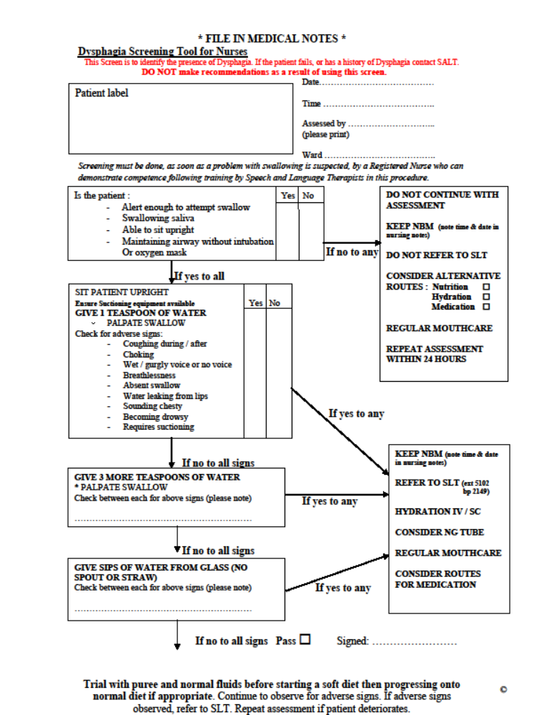

Slide 22
SUPERVISED EATING / DRINKING
Check beforehand:
Oral hygiene
Sitting position
Use of dentures
Alertness
Check during:
Steady pace
Clear mouth between mouthfuls
Mouthful size
Face to Face
Encourage patient to swallow twice per mouthful
Surroundings
Check afterwards:
Keep upright for 30 minutes
Food Charts
Clear mouth
Mouth care

Slide 23
Diet and Fluid Modifications
Fluids
Normal (Thin fluids)
Thickened Fluids (Double cream/
½ Scoop to 200mls fluids tomato soup consistency)
Thickened Fluids (Thicker than
1 scoop to 200mls fluids Syrup, but still
pourable)
Thickened Fluids (Pudding
2 scoops to 200mls fluids consistency)
Diet
Normal (no restrictions)
Soft (Texture E) (Easy to chew foods –includes bread)
Puree (Texture C) (Blended, no lumps)
Starter (Smooth puddings/ semi solid)

Slide 24
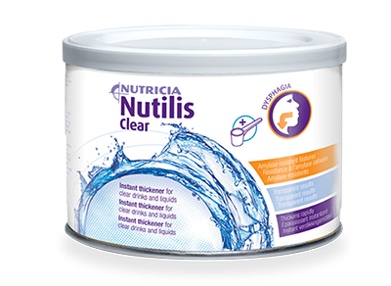
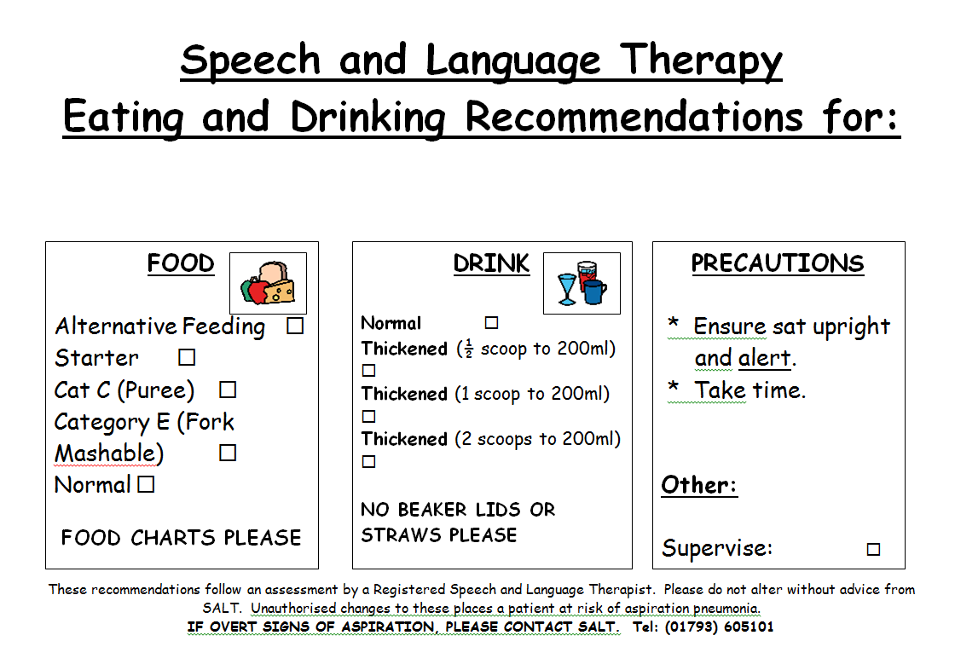
Thickening

Slide 25
