Slide 1




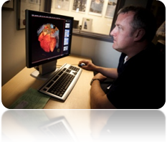



Nasogastric Feeding Tube Placement and Management Workbook 2014

Slide 2
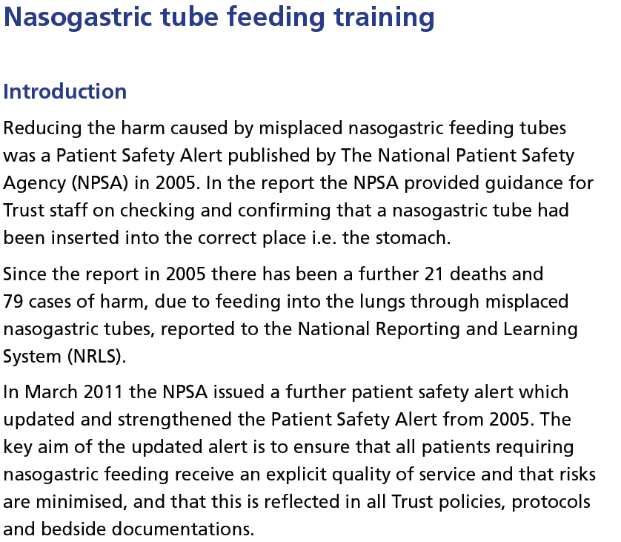
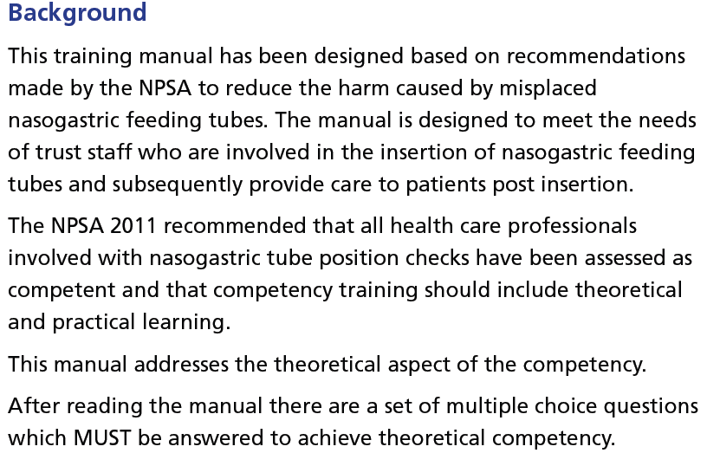

Slide 3
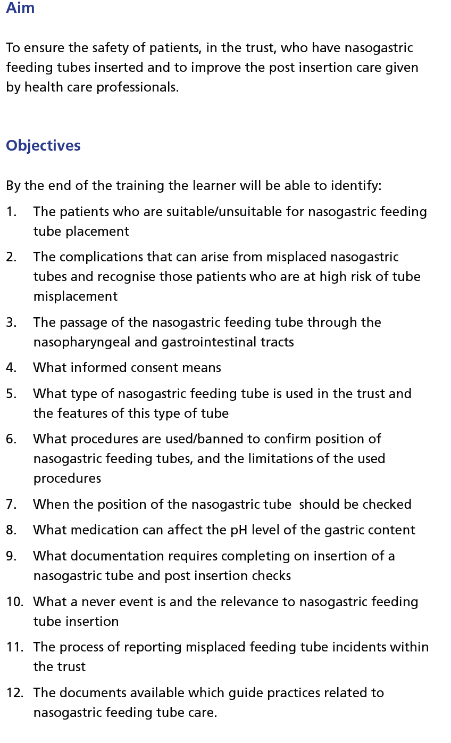

Slide 4
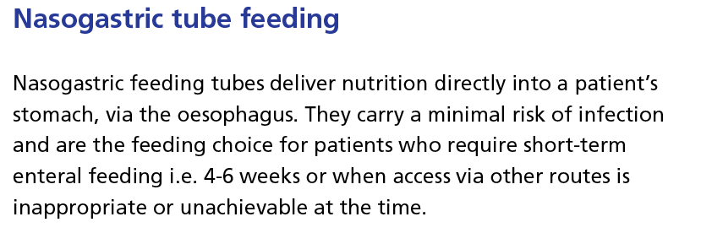
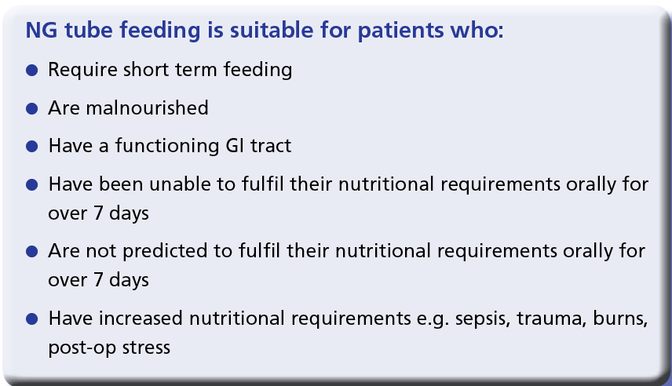

Slide 5
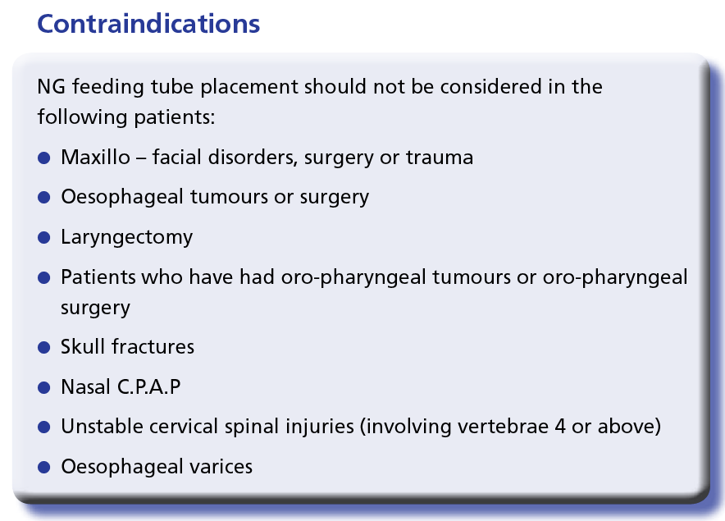
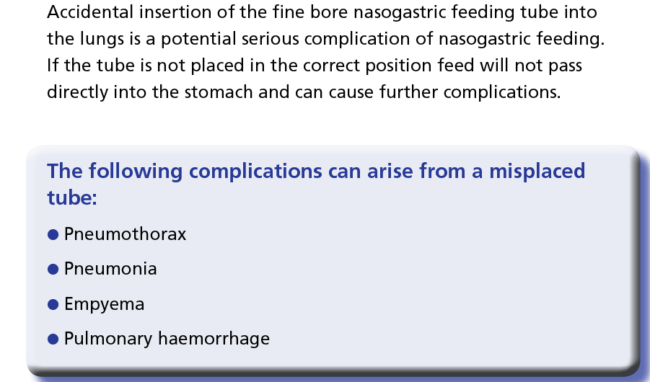

Slide 6
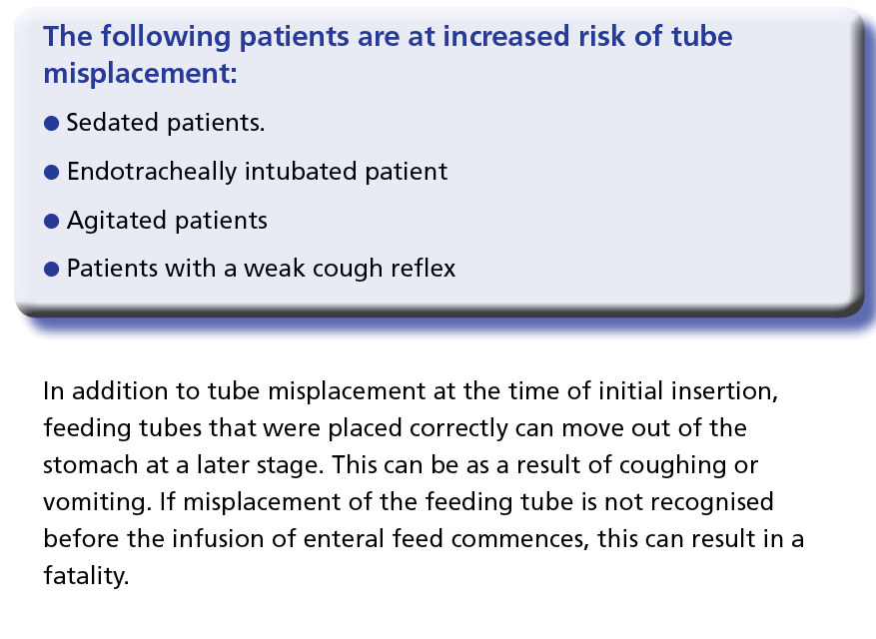
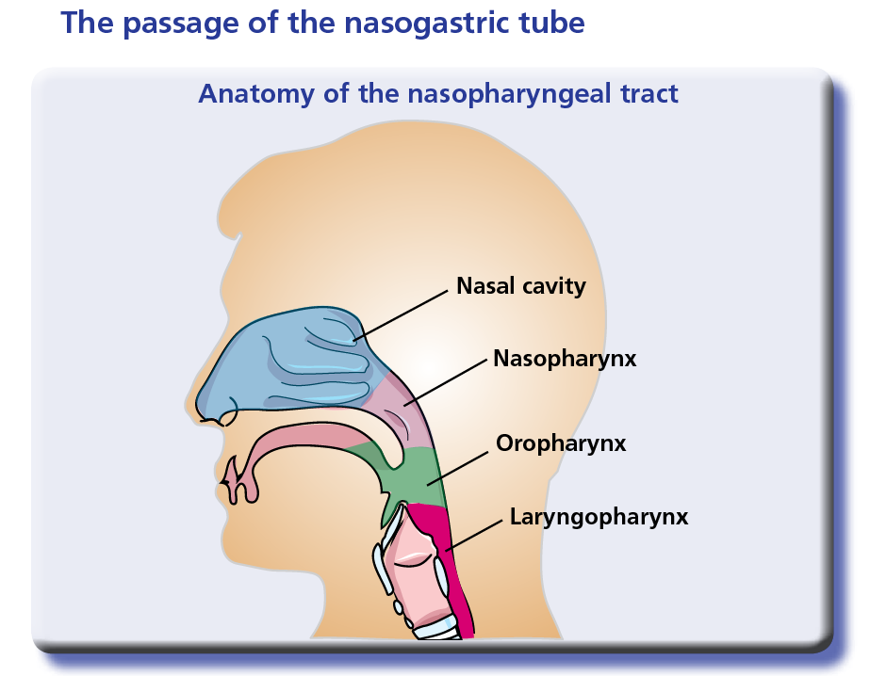

Slide 7
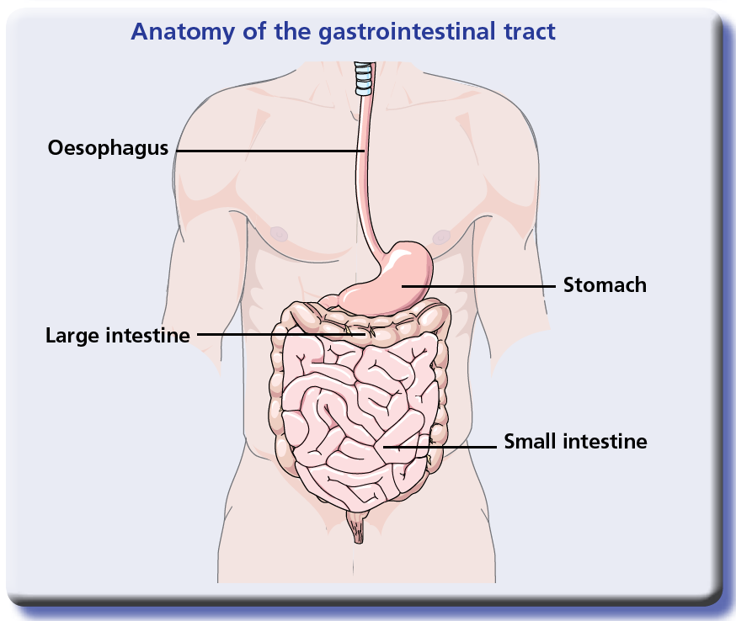
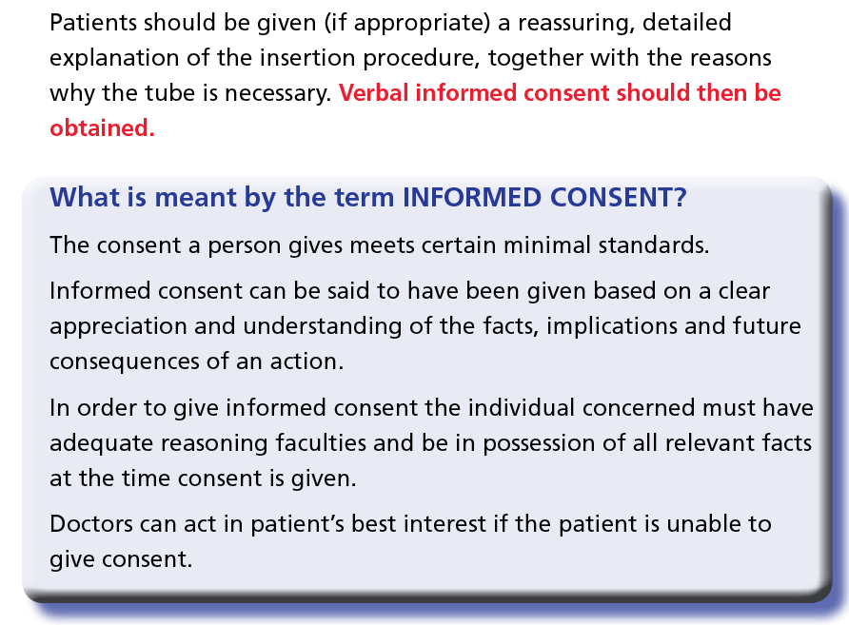

Slide 8
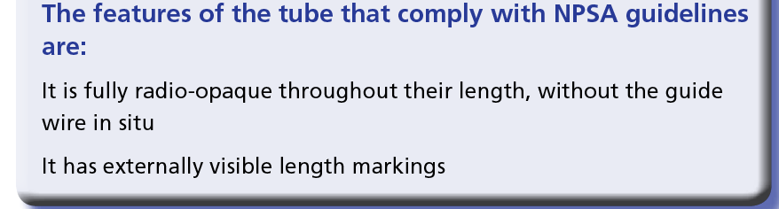
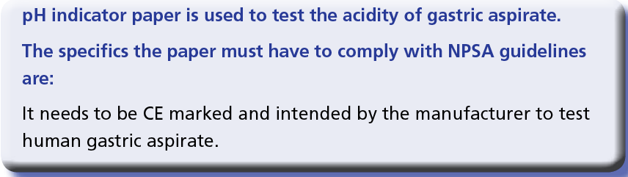
The tubes that are used throughout GWH Trust.
The nasogastric tubes that are used in the Trust
are Freka™ made by Fresenius Kabi Ltd.
They are made of polyurethane and are 8fg in diameter (possibly 10fr in ICU)
1 fg (french gauge) or CH (charriere) is ⅓mm so an 8fg tube has an external diameter of 2.67mm.
The tube is 120cm in length and has a standard luer lok™ connection on its end.
A Ryles tube is not recommended for feeding but may be used if it has been in place for aspiration purposes abut the patient now has a functioning GI tract and can tolerate feeding.

Slide 9
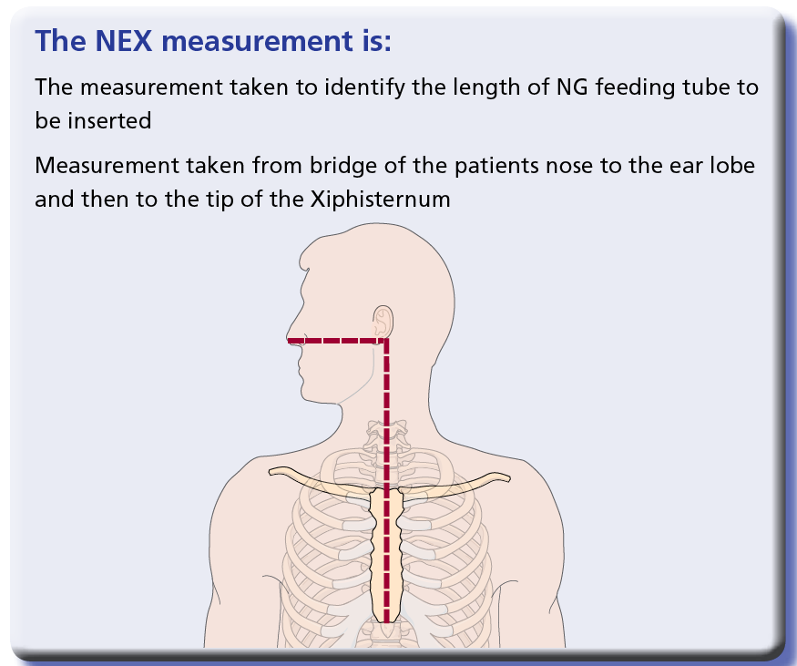

Slide 10
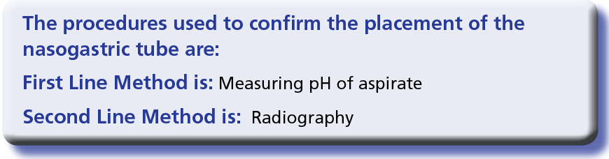
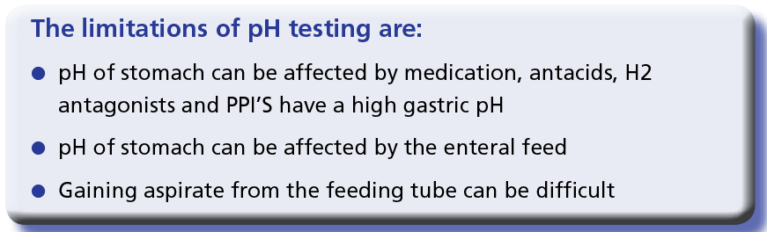
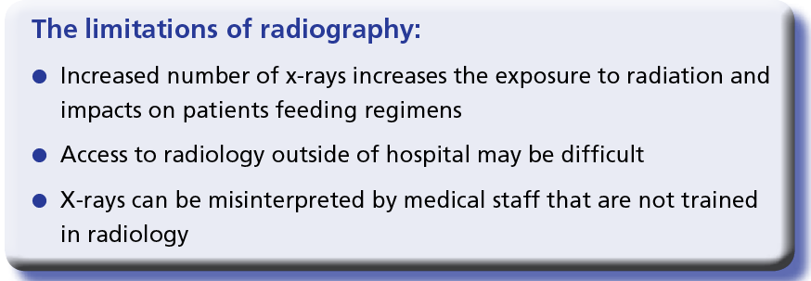
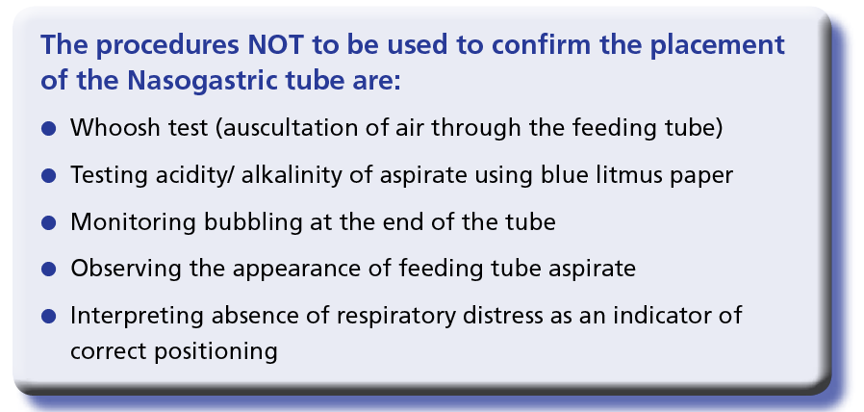

Slide 11
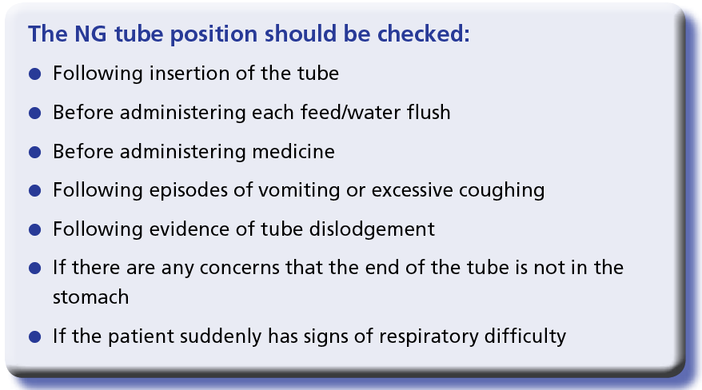
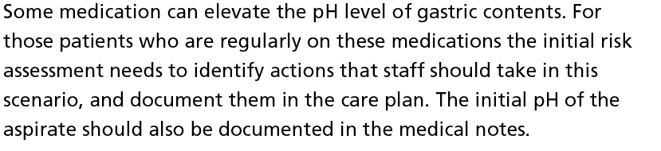
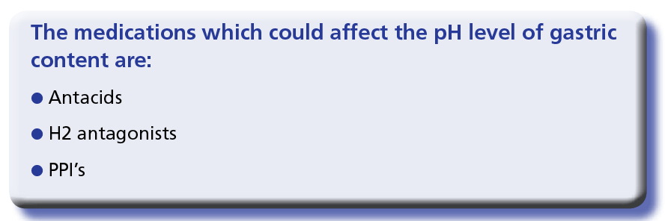

Slide 12
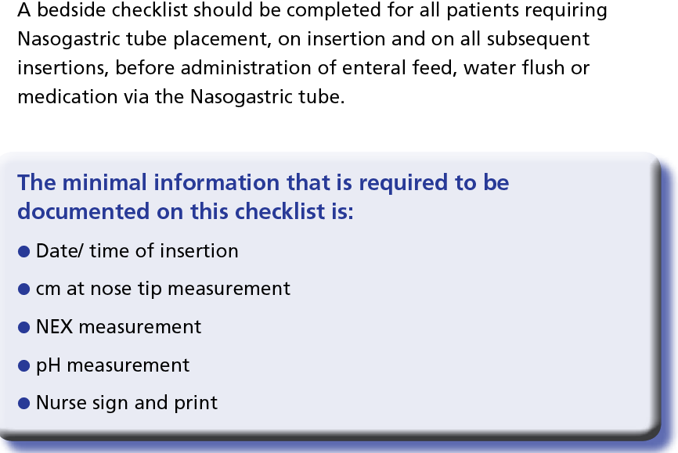
The trust uses a pink Nutrition record sheet which is available on the intranet.
This must be used for any patient receiving enteral feeding and is a centralised record of all the parameters for prescribed treatment and safe monitoring.

Slide 13
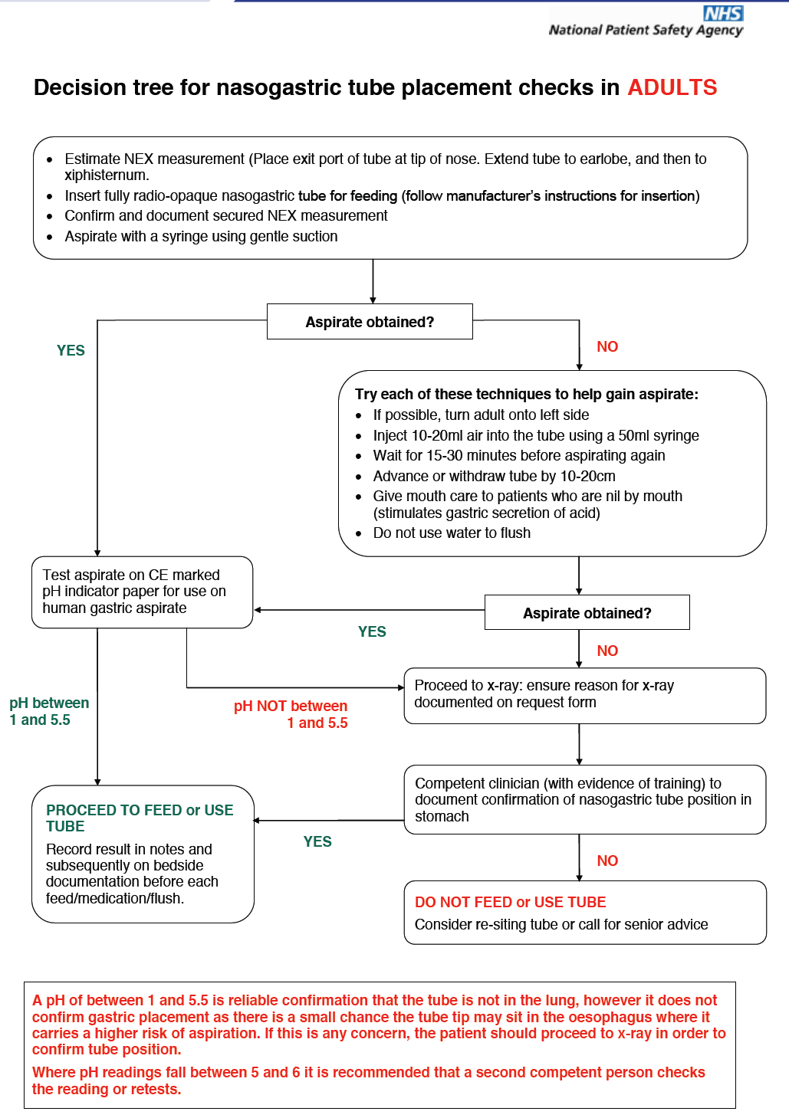

Slide 14
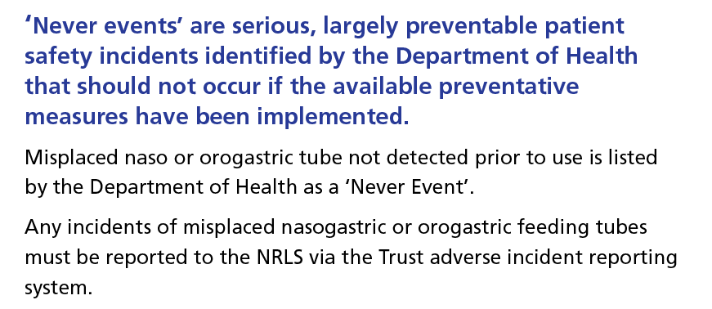
The trust incident reporting system is to complete an IR1 form on-line.
There are available via the Trust intranet under the useful links section on the left then incident form / risk register
You are now required to complete some questions on line via Training Tracker.
Please log onto Training Tracker and look for the module entitled
“Insertion of a Nasogastric tube”.
If you do not have a Training Tracker password, please contact
Kat Saunders on Ext 5329 or e-mail: kat.saunders@gwh.nhs.uk

