Slide 1
HIV Post Exposure Prophylaxis – Sexual and Non-Sexual Exposures.
Jessica Daniel and Denise Reeves
Great Western Hospital Foundation Trust
Severn Deanery ED Training Day.
14th March 2012

Slide 2
Outline of talk
What is PEP?
What is the evidence for PEP?
How do you assess a patients risk and need for PEP?
The drugs, side effects and complications.
Follow up
Hepatitis B vaccination
Cases

Slide 3
What is PEP?
PEP is a combination of 3 antiretroviral medications that prevent the acquisition of HIV infection following potential exposure to HIV either through sex, occupational exposure and sometimes non-occupational-non-sexual exposure.

Slide 4
How does PEP work?
Pathogenesis studies suggest there is a window of opportunity to abort HIV infection after exposure to the virus by inhibiting viral replication with antiretroviral medication.
It takes 48-72hours for HIV to be detected in the regional lymph nodes once it has crossed the mucosal membranes (e.g. genital tract, rectal mucosa, conjunctiva, skin penetration)
It takes up to 5 days for HIV to be detected in the blood.

Slide 5
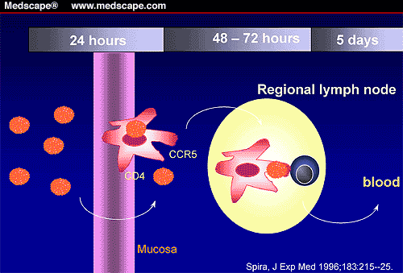
Dynamics following exposure to HIV
Notes:
This picture shows the dynamics of infection following crossing mucosal barrier
It takes between 48 and 72 hours before HIV can be detected in regional lymph nodes and up to 5 days before HIV becomes disseminated and detected in blood.
This may therefore reflect a window of opportunity after an exposure by which an infection can be prevented using PEP

Slide 6
Does PEP work?
Animal studies
Human studies
Vertical Transmission
Pre-exposure prophylaxis (PrEP)
Notes:
RCT not ethical

Slide 7
What is the evidence that PEP works?
Animal Studies
Macaques and SIV
1) Using tenofovir showed that 100% of infections prevented following IV innoculation of SIV when TDF was given within 24 hours after exposure and continued for 28 days.
As time to initiation of PEP increased and duration of PEP decreased the number of macaques protected reduced. ¹
2) PEP with tenofovir following intra-vaginal inoculation showed 100% protection against SIV-2 when administered with 36 hours. ²
1) Tsai et J Virol 1998;72:4265-73
2) Otten et al J Virol 2000;74:9771-5

Slide 8
Time to initiation and duration of PEP
Tsai CC et al. J Virol 98; 72: 4265-4273
Notes:
There are numerous animal studies, they however are not standardised and only some show protection
Models mimicing percutaneous and sexual exposure suggest that PEP may be protective. But there are case reports of individuals acquiring HIV despite PEP both following occupational or sexual exposure, not 100% effective
Although this animal model using tenofovir for PEP in macaques involves only small numbers (iv)
it shows
In the first 3 rows that as time to initiation increases the number of animals protected reduces
In the lower 3 rows as the duration of PEP increases the number of animals protected increases
Also as duration of pep increases to 28 days number of animals protected similarly increases
It is unclear whether this can be applied to humans

Slide 9
Human studies
Occupational Exposure
Retrospective case control study of health care workers occupational exposed to HIV showed a 28 day course of AZT (zidovudine) was protective. ¹
Cardo et al N Engl J Med 1997; 337:1485
Notes:
Not ethical to perform prospective randomised controlled trial

Slide 10
Human Studies cont
Sexual Transmission
Post Exposure prophylaxsis
2 Brazilian studies
MSM given PEPSE supplies to commence after sexual exposure. 0.6% vs 4.2%¹
Victims of sexual assault given PEPSE. 0% vs 2.7%. ²
Significant less seroconversions in those who
utilised PEP compared to those who did not.
Praca Once Study Team. J Accquir Immune Defic Syndr 2004;35:519:25
Schecter. 6th International Conference on Drug Therapy. Glasgow, UK (abstract PL 6.1)
Notes:
Lots of failed microbicide studies

Slide 11
Vertical Transmission
Rate of HIV mother to child transmission has reduced from 20% to <1% with the introduction of triple therapy or AZT plus planned c-section in UK.
Many African studies showing benefits of AZT, single dose nevirapine and triple therapy in reducing HIV transmission.
1. Sperling RS et al. Maternal viral load, zidovudine treatment and the risk of HIV-1 transmission from mother to infant. NEJM. 1996;335:1621-9
2. Wade et al. Abbreiviated regimens of zidovudine prophylaxis and perinatal transmission of HIV-1 virus. NEJM. 1998;339:1409-14
Notes:
BAN
Mma mma

Slide 12
Pre exposure prophylaxis
Pre-exposure prophylaxis
PrEP recent RCT African study approx 1000 patients
39% reduction in new HIV diagnosis in patients who used intravaginal Tenofovir gel 12 hrs prior to sexual intercourse¹
Karin QA et al. Effectiveness of 1% tenofovir vaginal microbicide gel in S. African women:results of the CAPRISA 004 trial. Oral abstract TUSS0502.18th IAC July 2010.

Slide 13
Risk Assessment

Slide 14
The risk of HIV transmission
Type of exposure
X
Risk source is HIV+
Notes:
In general the risk of transmission of HIV following an exposure is small and is dependant upon the exposure itself and where HIV status of the source is unknown the likelihood they are HIV positive
Unprotected receptive anal sex with unknown MSM =
3% x 15% = 0.45 or 1/122
Unprotected receptive anal sex with a known HIV + MSM
3% x 1 = 3% or 1/33

Slide 15
Risk of the exposure Assuming source is HIV positive
Type of exposure | Risk of HIV Transmission per exposure (%)
Blood Transfusion | 90-100
Receptive anal sex | 3
Receptive vaginal sex | 0.2
Insertive vaginal sex | 0.09
Insertive anal sex | 0.06
Receptive oral (fellatio) | 0.4
Needle-stick injury | 0.3
Sharing injecting equipment | 0.67
Mucous membrane exposure | 0.09

Slide 16
Risk of sexual exposure
Presence of other STI’s
Sexual assault
Bleeding
Viral load of the source patient
Notes:
Compartmentalistion of HIV

Slide 17
Risk of occupational exposure
Practical HIV exposure risk assessment
Type of Injury
Type of Fluid
Volume of Fluid
Source Person
Cardo DM, Culver DH, Ciesielski CA, et al. N Engl J Med 1997;337:1485–90.

Slide 18
Type of Injury
Deep injury
Broken skin (abrasions, cuts, eczema etc)
Mucous membranes especially the eye.

Slide 19
High Risk Body Fluids
Amniotic Fluid
Blood
Cerebrospinal Fluid
Human Breast Milk
Serous fluids (pleural, synovial, burns, pericardial, amniotic, peritoneal)
Saliva in association with dentistry
Semen/ vaginal secretions
Unfixed Tissues or Organs

Slide 20
Low Risk Body Fluids
Faeces
Saliva
Urine
Vomit
(unless blood stained)

Slide 21
Volume of Fluid
Visible blood on device
Needle placed in source patient’s artery or vein
Wide bore needle

Slide 22
Source Person
Known HIV positive
Risk is further increased if the patient
has a high plasma HIV viral load
is seroconverting
has advanced AIDS
Concominant STI
Bleeding (menses, traumatic SI, assault)
undetectable HIV viral load not necessarily protective
Known source but unknown HIV status with risk factors (IVDU / IVDU partner, male / bisexual partner, exchanged money for sex, endemic risk, piercings, tattoos medical Rx abroad)
Sexual contact of the above
Unknown Source?

Slide 23
Risk source is HIV positive
Community group |  | HIV seroprevalence (%)
MSM | London | 20.30
 | Scotland | 3.2
 | Elsewhere | 3.6
Heterosexuals | Sub Saharan Africa | 5.2
 | Caribbean | 2
 | Eastern Europe , Central Asia | 0.7 (Ukraine 1.6)
 | Latin America | 0.6 (Belize, Guyana, Suriname 2.3)
 | North America | 0.6
 | South East Asia | 0.3 (higher in Thai sex workers)
 | Western and Central Europe | 0.3
 | UK | 0.2
 | Oceania | 0.3 (except Papa New Guinea 1.5)
 | North Africa and Middle East | 0.2 (except Sudan 1.4)
 | East Asia | 0.1
IVDU’s | London and non-UK | 4.7
 | Elsewhere in UK | 0.5

Slide 24
Does the exposed person need PEP
Has it been less than 72 hours since time of exposure?
Exposed person is HIV negative?
Type of exposure has place them at high risk of HIV?
Source contact is HIV positive or high risk of being positive?

Slide 25
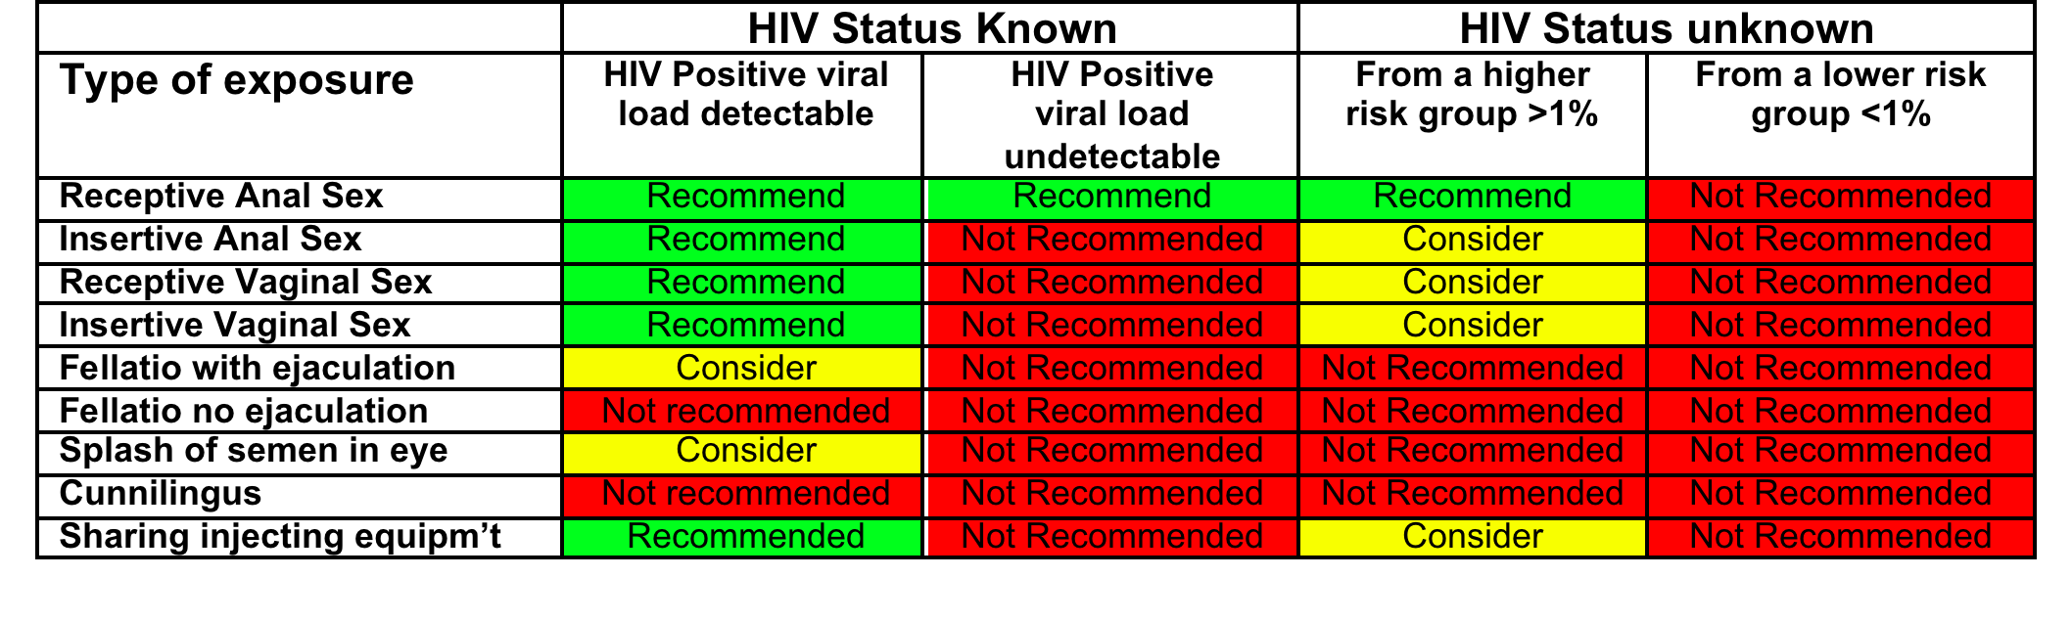
National and Local Guidelines

Slide 26
General guidance
Take each case on it’s individual basis.
Should discuss the pros and cons of PEP with all patients.
Have a lower threshold for administering PEP in cases of sexual assault.
If in any doubt start PEP ASAP whilst gathering more information about the risk.
Test source patient if possible (but do not wait for results until starting PEP)
Notes:
Duty to give the patient information to make an informed choice.
Often more unknowns in SA especially stranger SA.

Slide 27
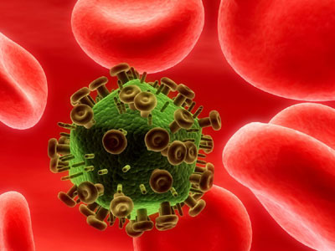
Post Exposure Prophylaxis: The Drugs
Denise Reeves
HIV Pharmacist

Slide 28
Antiretroviral Medication
5 classes of antiretrovirals available:
- Nucleoside reverse transcriptase inhibitors (NRTIs)
- Non-nucleoside reverse transcriptase inhibitors (NNRTIs)
- Protease Inhibitors (PIs)
- Integrase inhibitors
- Fusion inhibitors Entry Inhibitors
- CCR5 inhibitor
Notes:
HIV invades and takes over CD4 cells and replicates. Replication occurs in distinct stages creating a lifecycle for HIV. 5 different classes of ARVs have been designed to interrupt this lifecycle by controlling the virus at various stages of the replication process.

Slide 29
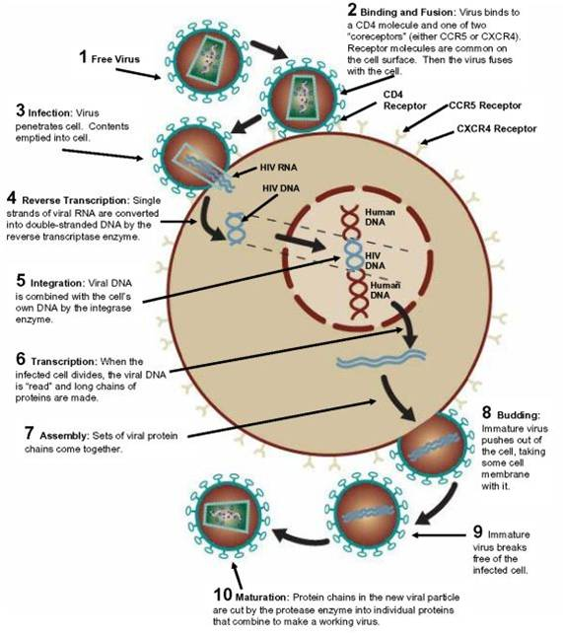
NRTIs
NNRTIs
Fusion Inhibitors
CCR5 Inhibitors
Integrase Inhibitors
Protease Inhibitors
Notes:
Entry of HIV into cell
The external proteins on the HIV viron play an important role in attachment and fusion onto the target cell.
Viral glycopeptide gp120 binds tightly onto CD4 receptor on the surface of the host cell. A conformational change in the gp20 protein allows it to bind to a second protein known as the chemokine co-receptor – ENTRY INHIBITORS
Fusion
The viral surface protein glycopeptide (gp41) interacts with the target cell to complete the fusion process and allow subsequent entry of the viral RNA and enzymes into the cell. FUSION INHIBITORS
Reverse transcription
RT converts RNA into viral DNA. This process is error prone and contributes to the development of mutations and different strains of virus. – NRTIs and NNRTIs n.b. NRTIs require intracellular phosphorylation and therefore not appropriate for TDM
Integration
Newly made HIV DNA moves to the cell nucleus, where it is spliced into the host cell DNA using an enzyme called integrase. – INTEGRASE INHIBITORS
Transcription and translation
mRNA is produced and transported to cytoplasm. The virus then causes the cells protein making machinery to use mRNA template to make long chains of viral proteins and enzymes
Assembly and budding
HIV proteins and genomic RNA gather inside the cell. The precursor proteins that make up the immature viral core are now cut into smaller functional proteins by protease. A viral particle forms and budds off from the cell i.e. infectious particle released into blood. – PROTEASE INHIBITORS

Slide 30
BASHH Recommended PEP
Triple therapy
2 x NRTIs
- Truvada: Tenofovir and emtricitabine
ONE tablet ONCE a day for one month
1 x boosted PI
- Kaletra: Lopinavir (boosted with ritonavir)
TWO tablets TWICE a day for one month

Slide 31
Side Effects
Truvada
Diarrhoea
Nausea
Vomiting
Headache
Kaletra
Diarrhoea
Nausea
Vomiting
More serious / less common side effects:
Allergic reactions (incl rash)
Renal problems
Hepatic problems
Notes:
NRTIs and PIs: patients with hep b or c are at increased risk of hepatic side effects

Slide 32
Management of Side Effects
Diarrhoea:
Loperamide
Nausea and Vomiting:
Domperidone
Headache:
Paracetamol

Slide 33
The PEP Pack
Initial PEP pack contains a three day supply:
- 3 x Truvada tablets
- 12 x Kaletra tablets
- 10 x domperidone
- 12 x loperamide
Attached to each PEP pack is:
- Patient Information Leaflet
- Pre-printed prescription (to be completed fully and sent to pharmacy in the pre-printed envelope)

Slide 34
Common Drug Interactions
Hormonal contraceptives
Some antibiotics
Certain statins (particularly simvastatin)
Fluticasone (Flixotide®, Seretide®)
Methadone
St John’s Wort
Garlic capsules
Notes:
Abx: kaletra may increase conc (CYP3A inhibiton) of clarithromycin (which prolongs QT interval) and may therefore increase risk of cardiac associated adverse events
SJW and garlic: Induce CYP450, thus decrease Pis (lopinavir completely metabolised by CYP3A)
OCP: PIs decrease levels (although ritonavir is a potent inhibitor, shows inducing properties with OCP)
Statins: CYP3a Inhibition thus increased risk of myopathy with Simvastatin / lovastatin, pravastatin not affected
Futicasone: Metabolised by CYP3A (thus don’t give with CYP inhibitors), consider switch to beclomethasone
Methadone: metabolised by CYP3A

Slide 35
Monitoring and Investigations
Baseline
HIV
Hep B / C serology
Syphilis serology
FBC
U & E’s, LFT’s, Ca, Phos, glucose, lipids, TG
UPCR
Offer baseline STI screen
Offer Hep B vax if indicated

Slide 36
Follow up
Safety bloods whilst taking PEP:
FBC
U & E’s, LFT’s, Ca, Phos, glucose, lipids, TG
UPCR
STI screen at 2 weeks post exposure if prophylactic antibiotics not given or if symptomatic.
2nd and 3rd Hep B vax
1 month after finishing PEP: HIV
Hep C
Ensure Hep B vax completed and check Hep Bs ab titres
3 months after finishing PEP:
HIV
Hep C
Syphilis serology
Hep B booster if required / Hep B s ab titres

Slide 37
Hepatitis B vaccination
Offer to all not immune patients or those whose immunity is uncertain.
Perform baseline serology
No harm done if vax given and Hep B cab positive or immune post vaccination.
Ultra- rapid schedule 0,7,14 days booster at 1 year.
Effective up to 6 weeks after exposure.
But best to commence vaccination at first visit.
Notes:
Side effects

Slide 38
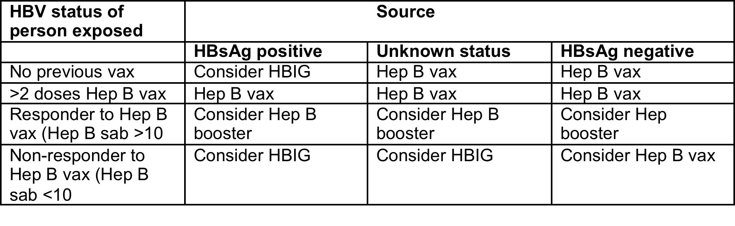
Hep B vaccination guideline.

Slide 39
Emergency contraception
Offer to all female patients not using effective contraception.
Within 72 hours:
Levonelle 1500mg PO stat72 -120 hours
Offer emergency IUD
Ella One 30mg P0 stat
(NB pill precautions if already using hormonal contraception)

Slide 40
Case 1
42 year old married lady
Bitten by HIV positive sister. Also ? Hep B or Hep C positive
Sister
Chaotic alcoholic.
Does not attend for HIV care
Not registered with GP
Sister does not know her CD4 or VL
Sister not taking ARV’s
What else would you like to know
Would you start PEP?
Would you recommend Hep B immunoglobulin?

Slide 41
The injury
Deep penetrating bite to right hand (thenar eminence)
Sister had bleeding ulcers in mouth from chewing her gums.
No possibility of determining sisters HIV viral load.
Therefore HIV PEP was started

Slide 42
Human bites
In general PEP not recommended for human bites.
Unless source is known HIV positive.
2 case reports of HIV transmission through human bites
1996 – 47 y o MSM. Terminal AIDS patient with CNS lymphoma accidentally bit neighbour during a grand mal seizure. Neighbour took AZT but seroconverted 30 days later.¹
1999 – 31 y o HIV positive patient with toxoplasmosis accidentally bit his mother during a seizure.²
1988 – 30/198 health care workers who were biten or scrathed by one violent HIV positive patient. Not on treatment. No transmissions. ³
1. Vidmar L et al. A Human bite: possible mode of HIV-1 transmission. Int. Conf AIDS 1996 Jul 7-12; 11 362 (abstarctno. Tu.C.2563).
2. Andreo S at al. HIV 1 Transmission by Human bite. AIDS Research and Human Retroviruses. Vol 20. No. 4 2004, pp.349-350.
3. Lack of Transmission of HIV through human bites and scratches. JAIDS. 1988.
Notes:
Violent HIV patient frequently bit or scratched others, his mouth had blood and saliva. His fingernails were often soiled with semen, faeces or urine.

Slide 43
Case 2
L.B
17yr old Caucasian girl
Presented to Youth Clinic Carfax Street
Distressed and unsure what to do
Reported she was sexually assaulted about 60 hours ago.
Described assailant as a Black man in his late 20’s, early 30’s, possibly African

Slide 44
Sexual History:
Only ever had female partners
PMHx: nil
Meds: nil
NKDA
Symptoms:
c/o yellow PV discharge
How would you manage this patient?

Slide 45
1) Risk assessment for PEP
1. Assess patients risk of HIV infection:
HIV positive partner
Partner from high risk country
IVDU / IVDU partner
Blood transfusion
Medical treatment, piercing, tatoo abroad
Patient’s last HIV test
2 .Assess risk of infection in source patient

Slide 46
National and Local Guidelines

Slide 47
Further Management
Emergency Contraception
Hep B vax
Discussion regarding reporting to the Police and forensic examination.
Swabs and prophylaxtic antibiotics

Slide 48
Case 3
32 yr old anaesthetics' registrar
Needle stick from a spinal needle – pt undergoing a LA.
Source patient female from Thailand
Source never tested for HIV
What else do you need to know?

Slide 49
Type of injury
Type of fluid
Risk source is positive
Volume of fluid

Slide 50
Outcome
PEP started within 2 hours
Team looking after patient approached her to perform complete risk assessment and an HIV test.
Source had no other risk factors for HIV infection and was happy to do an urgent HIV HIV test – negative (note window period)
PEP stopped.

Slide 51
Case 3
28 year old male MSM
Sexually assaulted – unprotected receptive anal intercourse with unknown male partner.
Met on the internet
Would you recommend PEP?

Slide 52
HIV risk assessment
Victim frequent visitor to saunas
Sexual Hx, PMHx, DH
Recently treated for primary syphilis
HIV POCT test

Slide 53
National and Local Guidelines

Slide 54
Case 4
24 year old Nigerian lady
Sexually assaulted by KMP
Known HIV positive
What do you do next?

Slide 55
Test victim with consent: negative
Get more info re: assailant
Viral load and CD4 count
Drug regimen
Previous resistance test
Adherence

Slide 56
National and Local Guidelines

Slide 57
Case 4 cont
VL <40
CD4 420
Current regime Atripla
Resistance test Wild type
Adherence 100%

Slide 58
Case 5
S.B.
39 yr old married Caucasian lady
Attending GUM for follow up
Sexually assaulted about 52 hours ago by stranger whilst out jogging in Westbury.
Reported to the Police and assessed at the SARC. Forensic examination performed.
Given prophylactic antibiotics
Possibly had Hep B vax for travelling
No contraception - given EC (husband vasectomy)
Now requesting PEP
How would you manage her?

Slide 59
PEP risk assessment
Risk patient is HIV positive
4 children youngest 18 months old HIV test in pregnancy negative
Risk assailant is HIV positive
Caucasian male possibly from UK

Slide 60
National and Local Guidelines

Slide 61
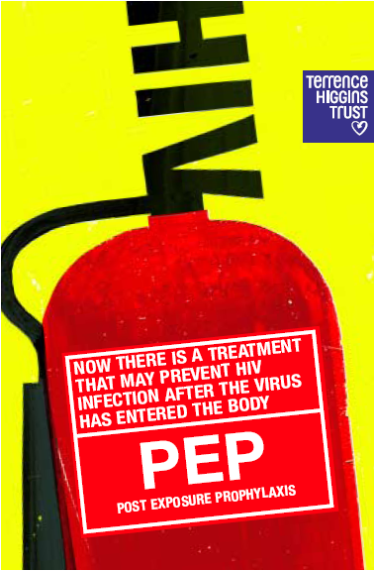
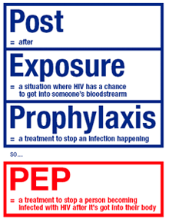
Image: Terence Higgins Trust
Image: Terence Higgins Trust

Slide 62
Any Questions?

