Slide 1

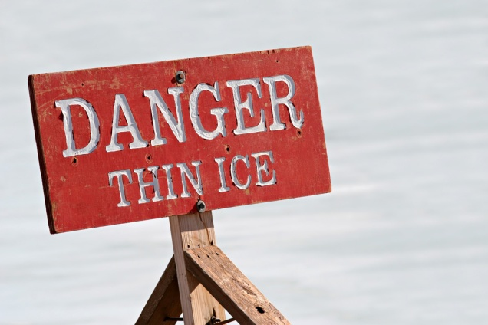

Risk Management at Great Western Hospitals NHS Foundation Trust

Slide 2
Introductions
Lesley Palmer – Legal and Inquest Manager
Hayley Aplin – Risk and Governance Facilitator

Slide 3
Aims of this session
Overview of risk management framework
What is a risk
How to register a risk, including scoring, planned action and review
What is an incident
How to use the electronic risk system

Slide 4
Risk Management Regulatory Framework
Annual Governance Statement (Parliament)
CQC Standards
Governance Risk Rating (Monitor)
NHSLA Risk Management Standards
CNST Risk Management Standards

Slide 5
Risk Management within the Trust
Risk Management Strategy – framework / structure
How to Assess Risk Procedure – scoring risk
Board Assurance Framework (BAF) - top down risks
Risk Register – bottom up risks
Executive Committee – scrutinises & challenges risks (15+ monthly, BAF quarterly and directorates risk registers on rotational basis)
Audit Risk & Assurance Committee – overview of process (bi-monthly BAF and 15+ / occasional directorate risk registers)
Trust Board – accountable / assured by committees
Important framework which is audited every year

Slide 6
Risk Management Process Flow Chart
Staff identify a
“risk”
Reported to line manager
Identified as a “risk”
Risk assessed in accordance with “How to Assess Risk” procedure
Risk is captured onto the directorate/specific area risk register by the General Manager
Risk Register managed by the directorate/specific area meeting
Risks scoring above 15 added to the 15+ Risk register by Legal Services Manager

Slide 7
TRUST BOARD
Takes assurance / overall responsibility
Executive Committee
Scrutinises and challenges
15+ Risk Register (10 times a year)
Directorate Risk Registers (rotational)
Board Assurance Framework (3 times a year)
Audit Risk and Assurance Committee
Overviews process and systems
15+ Risk Register (three times a year)
Directorate Risk Registers (occasionally)
Board Assurance Framework (twice a year)
Diagnostics and Outpatients Directorate Board Meeting
Overview of the management of risks on the directorate risk register (monthly)
(July Ex Co)
Unscheduled Care Directorate Board Meeting
Overview of the management of risks on the directorate risk register (monthly)
(October Ex Co)
Planned Care Directorate Board Meeting
Overview of the management of risks on the directorate risk register (monthly)
(September Ex Co)
Womens and Childrens Directorate Board Meeting
Overview of the management of risks on the directorate risk register (monthly)
(June Ex Co)
Integrated Community Health Board Meetings
Overview of the management of risks on the directorate risk register (monthly)
(February Ex Co)
Other Area Risk Registers
Corporate Services
(November Ex Co)
Workforce
(November Ex Co)
Finance
(May Ex Co)
Mental Health
(January Ex Co)
Local Risk Management and Review by individual managers
Management of risks – sets action / implements action/ reviews progress / reviews score / updates register

Slide 8
What is a Risk?
Hazard – situations with the potential to cause harm
Risk – the probability that a specific adverse event / consequence will occur in a specific time period or as a result of a specific situation (hazard)
Risk = Consequence x likelihood
(outcome or adverse event) x (probability)

Slide 9
Consequence (e.g. nature of risk)
 | Consequence score (severity levels) and examples of descriptors
 | 1 | 2 | 3 | 4 | 5
Domains | Negligible | Minor | Moderate | Major | Catastrophic
Impact on the safety of patients, staff or public (physical/psychological harm) | Minimal injury requiring no/minimal intervention or treatment. No time off work | Minor injury or illness, requiring minor intervention Requiring time off work for >3 days Increase in length of hospital stay by 1-3 days | Moderate injury requiring professional intervention Requiring time off work for 4-14 days Increase in length of hospital stay by 4-15 days RIDDOR/agency reportable incident An event which impacts on a small number of patients | Major injury leading to long-term incapacity/disability Requiring time off work for >14 days Increase in length of hospital stay by >15 days Mismanagement of patient care with long-term effects | Incident leading to death Multiple permanent injuries or irreversible health effects An event which impacts on a large number of patients
Likelihood
Likelihood score | 1 | 2 | 3 | 4 | 5
Descriptor | Rare | Unlikely | Possible | Likely | Almost certain
Frequency How often might it/does it happen | This will probably never happen/recur | Do not expect it to happen/recur but it is possible it may do so | Might happen or recur occasionally | Will probably happen/recur but it is not a persisting issue | Will undoubtedly happen/recur,possibly frequently
Notes:
Consequence is 1/8 domains of risk (Safety, Quality, Workforce, Statutory, Reputational, Business, Finance, Environmental)

Slide 10
Nature of Risk
Listing risks into categories aids overview and management of risks
Safety
Caring
Well Led
Effectiveness
Finance
Responsiveness

Slide 11
Notes:
Input of all risks onto the risk register is encouraged
All risks scoring >8 MUST be added to the Risk register
Lower risks are managed in relevant areas.

Slide 12
Risk Example – Non-Clinical
Hazard / cause = SNOW
Risk = People unable to attend the hospital / more falls and fractures / staff shortage / block up in A&E (consequence / effect) x likelihood (e.g. almost certain as it is winter)
What might happen because of the hazard?

Slide 13
Risk Example – Non- Clinical
Hazard / cause = Regulatory compliance
Risk = multiple breaches of statutory requirements / reputational damage / increased litigation / Monitor (consequence / effect) x likelihood (e.g. possible)
What might happen because of the hazard?

Slide 14
Risk Example – Clinical
Hazard / cause = Medicine with similar look alike packaging
Risk = Administration of the wrong medicine to the patient resulting in harm / death (consequence / effect) x likelihood (e.g. possible)
What might happen because of the hazard?

Slide 15

What is an Incident?
Any incident which could have or did lead to harm.
Example – one medicine error might be an incident which could lead to a risk being added to the risk register if a trend is identified in medicine management – e.g. swab left in patient after surgery

Slide 16
How to register a risk ?
Via Safeguard Risk Management Module available on the intranet
Advice and support from Hayley Aplin, Risk and Governance Facilitator (ext 5426) Nasira Meah, Legal Services Administrator (ext 4173)

Slide 17
How to Use the Electronic System
Intranet
Incident Form / Risk Register
Automatic Sign in
Enter Risk
Manage Risk
How the Executive Committee and Board perceive risks

Slide 18
Some ground rules........
Avoid amending risk descriptions;
Add a new version when risk score amended;
All risks should have an action plan;
Risks should be reviewed periodically; review risks of 15+ monthly;
Use ‘How to Assess Risk’ procedure;
Ask for help if unsure.
Notes:
Users should properly describe risks, e.g. ‘finance’ is not a risk, but ‘failure to breakeven at year end if we do not control expenditure on theatre stock’ is a risk, once a risk has been described users should not amend the risk description, it is much better to close the risk and open a new one if the circumstances have materially changed;
You must create a new version of the risk, every time you change the risk score;
Think carefully about who you list as the manager/owner or action lead or person accountable, if you put a name down that person will receive chasing emails every 10 days when deadlines have passed (one user recently put Alf Troughton’s name down – Alf was none too pleased!);
If you score a risk as a 15 or above you must discuss this with your senior team immediately. 15+ risks are unacceptable according to the risk management strategy, so it will be important for you to get the score verified with senior colleagues and if it is agreed that the risk is 15 or above, that you have robust action plans in place to mitigate the risk;

