Slide 1
Cultural Sensitivity in Safeguarding
9th October 2015
Rosemary Campbell-Stephens

Slide 2
cultural ‘sensitivity’
Understanding the role of culture in human relationships
Coming to terms with historical clashes between cultures
Being unafraid to confront the cultural genocide that has contributed to the world as it is today
Learning about and confronting the cultural assumptions of the past that under pin policies today
Acknowledging where you and those you serve may sit in the picture
Act – to protect those we serve
Doing the right things in the right way for the right reason

Slide 3
working definition
Cultural competency, or cultural awareness and sensitivity, is defined as, "the knowledge and interpersonal skills that allow providers to understand, appreciate, and work with individuals from cultures other than their own.

Slide 4
starting points
However, being culturally conscious starts with understanding self, before understanding others

Slide 5
preventing harm
Safeguarding and helping prevent children and young people from all communities and cultures being subject to harm or abuse.

Slide 6
dilemmas
Research shows that Black children and those of mixed heritage are more likely to be subject to child protection plans and/or end up in the care system than white children. The reasons behind this are still unclear, but we do know there are certain issues that impact on the safeguarding and wellbeing of BME children.

Slide 7
no excuse
`Culture’ is no excuse for harming a child. All children have a right to be protected from harm and we need to be clear about the difference between culturally specific practice that is not harmful, and incidents of abuse that may be linked to aspects of religious belief.

Slide 8
all children have a right to be protected from
harm regardless of their background
No
with due regard to who they are

Slide 9
harm …. state sanctioned ?
Children from minority ethnic backgrounds suffer other types of abuse such as racial harassment, Islamophobia and bullying which can harm them physically and emotionally.

Slide 10
liberal language
Even the language we use can serve to minoritise people, as well as those issues pertaining to them
But within the liberal language we retain the balance of power and the hierarchy of cultures

Slide 11
theoretical perspectives
Historically the weight of theoretical perspectives has been informed by inherently racist assumptions
Sociological, economic, political, biological, anthropological, psychological etc. theories often originated from historically flawed perspectives (euro-centric)
Take psychology for example: Freud, Jung, Erickson all held particular views about the impact of ‘race’:
“ The causes for the American energetic sexual repression can be found in the specific American complex, namely to living together with ‘lower races, especially with Negroes”
Carl Jung 1950
Adult & children’s services perspectives have all been influenced by the above
Notes:
Carl Jung was in his day star student of Freud!

Slide 12

re-imagining ?

Slide 13
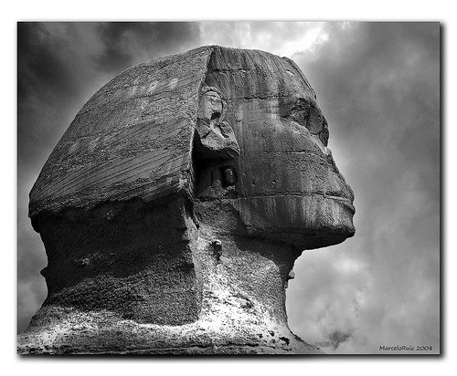

Slide 14
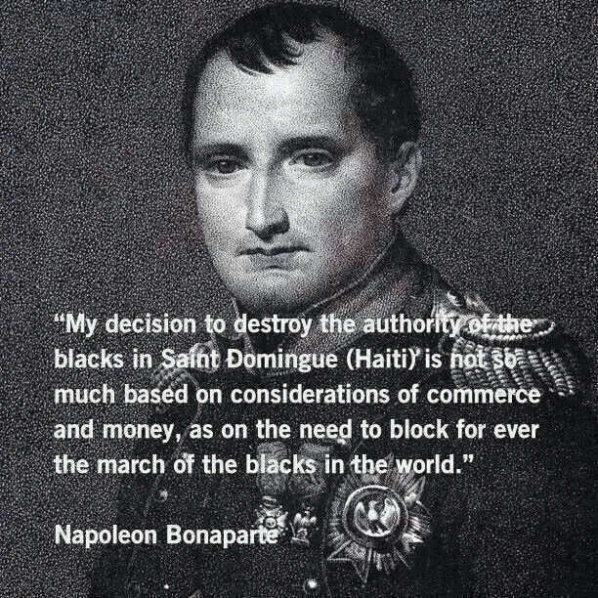
ideology

Slide 15
culture and racism
Images of Black people became common in British art and culture from the early days of the slave trade.
In the 16th century, masks of Black faces were worn in court society at fashionable functions and pageants,
By the 18th century, images of Black people were being used to denote prosperity and high fashion.
Black children were bought and treated like pampered 'pets' by wealthy White families.
But by the time of Elizabeth I and the advent of the slave trade, some writers were portraying 'blackness' as satanic and sinful, while 'whiteness' was purity and virginity, as (supposedly) embodied by the queen

Slide 16
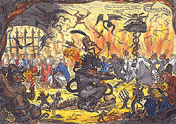
what has this got to do with anything ?

Slide 17
…….. when trade in goods such as ivory, pepper and hides was replaced by the trade in enslaved Africans, Europeans needed to justify their un-Christian behaviour. So they declared the Africans not to be human beings of equal worth to themselves but instead primitive savages. Africans would benefit from enslavement, Europeans argued, as it freed them from their savage state.

Slide 18
vulnerability
Part of what ensures that adults and children from certain groups remain vulnerable to harm, is ignoring the cultural genocide, that enabled Britain to build its empire, while continuing the daily micro attacks, essentially acts of violence on what is left of African and other indigenous cultures, eroding people’s sense of who they are, their value, their agency and their contribution.

Slide 19
reconciliation
At a time when Britain is birthing a new conversation about what it is to be British, there is often ambivalence or denial about our nations past.
Culturally competent approaches to service delivery can set us all free, and elevate us all to a level of humanity eroded by our past

Slide 20
predisposition
Diversity approach – valuing the contributions of everyone in society, embracing & valuing differences
Cultural awareness & Cultural sensitivity – understanding other cultures and ethnic groups, using that knowledge to respect difference and provide services in a way that demonstrates that awareness
Cultural literacy – builds on the knowledge of other cultures and conveys the sense of an individual’s ability to engage with their wider environment/community.

Slide 21
Culturally mature organisation
A set of congruent behaviours, attitudes, and policies that come together in a system, agency, or among professionals that enables effective work in cross-cultural situations
Cross, T., Bazron, B., Dennis, K., Isaacs, M. 1989

Slide 22
cultural understanding in practice
Essential elements at every level of an organisation: policy making, administration & practice. Also reflected in attitudes, structures, policies & services:
Valuing diversity
Having the capacity for cultural self-assessment
Being conscious of the dynamics inherent when cultures interact
Having institutionalized cultural knowledge
Having developed adaptations of service delivery reflecting an understanding of cultural diversity

Slide 23
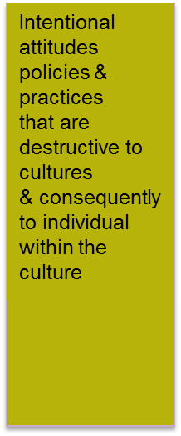
Cultural Competence Continuum
Cultural Destructiveness
Cultural Incapacity
Cultural Blindness
Cultural Pre- competence
Cultural Competence
Cultural Proficiency
Towards Cultural Competence
OR
G
A
N
I
S
A
T
I
O
N
Lack of capacity to support minority ethnic clients/staff due to extremely biased beliefs and paternal attitude toward those not of a mainstream culture
Belief that service/helping approaches traditionally used by the dominant culture are universally applicable regardless of ‘race’ or culture Encourages Assimilation
Desire to deliver quality services & a commitment to diversity by hiring minority staff, initiating training & recruiting Black leaders but lacking information on how to maximise these capabilities Can be Tokenism
Acceptance & respect for difference, continual self assessment, careful attention to dynamics of difference, expanding knowledge/resources & adaptation = continuous improvement
Holding culture in high esteem, seeking to add to the knowledge of culturally competent practice, OD through research, influence, relationships, promoting self determination
Adapted from Terry L. Cross 1998 & Juli Coffin 2007
Notes:
Cultural Destructiveness
The most negative end of the continuum is represented by attitude, policies and practices which are destructive to cultures and consequently to the individuals within the culture. The most extreme example of this orientation are programs which actively participate in cultural genocide-the purposeful destruction of a culture.
Cultural Incapacity
The next position on the continuum is one at which the system or agencies do not intentionally seek to be culturally destructive but rather lack the capacity to help minority clients or communities. The system remains extremely biased, believes in the racial superiority of the subdominant group and assumes a paternal posture toward “lesser” races. These agencies may disproportionately apply resources, discriminate against people of colour on the basis of whether they “know their place” and believe in the supremacy of dominant culture helpers. Such agencies may support segregation as a desirable policy. They may act as agents of oppression by enforcing racist policies and maintaining stereotypes. Such agencies are often characterized by ignorance and an unrealistic fear of people of colour. The characteristics of cultural incapacity include: discriminatory hiring practices, subtle messages to people of colour that they are not valued or welcome, and generally lower expectations of minority clients.
Cultural Blindness
At the midpoint on the continuum the system and its agencies provide services with the express philosophy of being unbiased. They function with the belief that colour or culture make no difference and that we are all the same. Culturally blind agencies are characterized by the belief that helping approaches traditionally used by the dominant culture are universally applicable; if the system worked as it should, all people—regardless of race or culture—would be serviced with equal effectiveness. This view reflects a well intended liberal policy; however, the consequences of such a belief are to make services so ethnocentric as to render them virtually useless to all but the most assimilated people of colour.
Such services ignore cultural strengths, encourage assimilation and blame the victims for their problems. Members of minority communities are viewed from the cultural deprivation model which asserts that problems are the result of inadequate cultural resources. Outcome is usually measured by how closely the client approximates a middle-class non-minority existence. Institutional racism restricts minority access to professional training, staff positions and services.
Eligibility for services is often ethnocentric. For example, foster care licensing standards in many states restrict licensure of extended family systems occupying one home. These agencies may participate in special projects with minority populations when monies are specifically available or with the intent of “rescuing” people of colour. Unfortunately, such minority projects are often conducted without community guidance and are the first casualties when funds run short. Culturally blind agencies suffer from a deficit of information and often lack the avenues through which they can obtain needed information. While these agencies often view themselves as unbiased and responsive to minority needs, their ethnocentrism is reflected in attitude, policy and practice.
Cultural Pre-Competence
Culturally competent agencies are characterized by acceptance and respect for difference, continuing self-assessment regarding culture, careful attention to the dynamics of difference, continuous self-assessment regarding culture, careful attention to the dynamics of difference, continuous expansion of cultural knowledge and resources, and a variety of adaptations to service models in order to better meet the needs of minority populations. The culturally competent agency works to hire unbiased employees, seeks advice and consultation from the minority community and actively decides what it is and is not capable of providing to minority clients.
Cultural Proficiency (Coffin) or Advanced Cultural Competence (Cross)
The most positive end of the scale is advanced cultural competence or proficiency. This point on the continuum is characterized by holding culture in high esteem. The culturally proficient agency seeks to add to the knowledge base of culturally competent practice by conducting research, developing new therapeutic approaches based on culture and publishing and disseminating the results of demonstration projects. The culturally proficient agency hires staff who are specialists in culturally competent practice. Such an agency advocates for cultural competence throughout the system and improved relations between cultures throughout society.
In conclusion, the degree of cultural competence an agency achieves is not dependent on any one factor. Attitudes, policies, and practice are three major arenas where development can and must occur if an agency is to move toward cultural competence. Attitudes change to become less ethnocentric and biased. Policies change to become flexible and culturally impartial. Practices become more congruent with the culture of the client from initial contact through termination. Positive movement along the continuum results from an aggregate of factors at various levels of an agency’s structure. Every level of the agency (board members, policy makers, administrators, practitioners and consumers), can and must participate in the process. At each level the principles of valuing difference, self-assessment, understanding dynamics, building cultural knowledge and adapting practice can be applied. As each level makes progress in implementing the principles, and as attitudes, policies and practices change the agency becomes more culturally competent.
Descriptions from Terry L. Cross 1998 (reprinted 2008), Diagram adapted from Juli Coffin 2007 (from Australian Human Rights Organisation)

Slide 24
solution
An ethic of conviction focusing on the type of society we wish to build
An ethic of responsibility that challenges the instrumental logic of today’s society
Permanent collective questioning
Leadership focussed on the greater good at every level
Moral leadership focussed on equity

Slide 25
service providers
Reconcile with Britain’s past
Acknowledge the truth about how diverse people have shaped Britain
Embrace diversity as an asset
Invest in and develop staff with a global mindset
Be more ambitious for our most vulnerable
Turn the lens inwards on the service and the system
Move away from polarised positions
Challenge prevailing wisdom
Pick the politics out of the policy direction

Slide 26
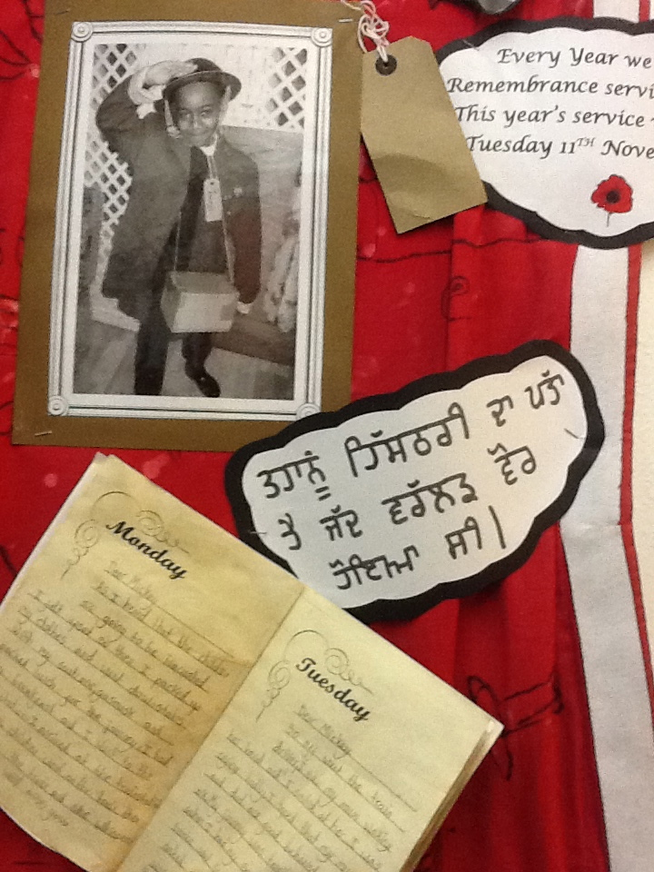
the fabric of society

Slide 27
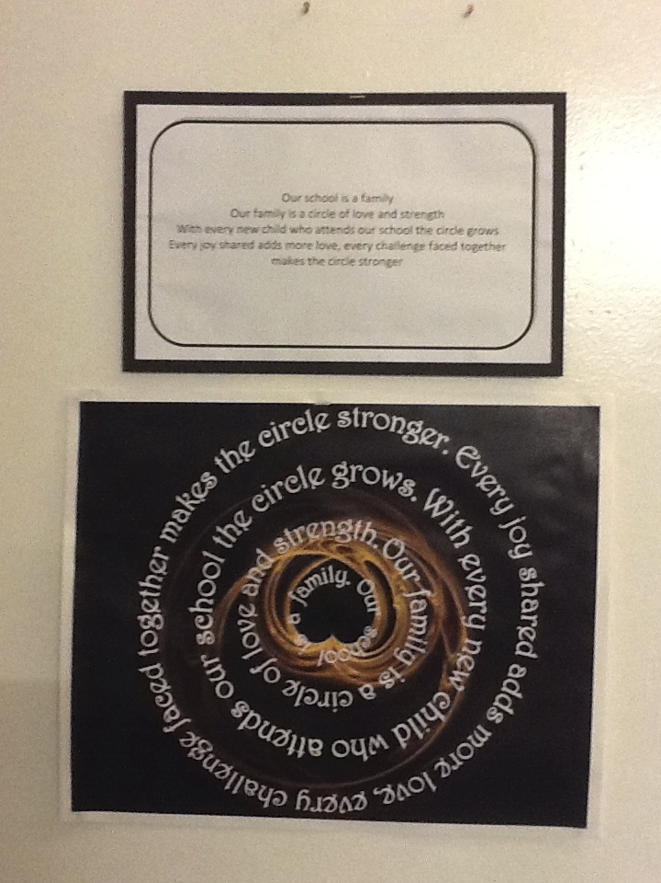

Slide 28
challenging assumptions
Truth and reconciliation
Redefine purpose
Act from a position of love and abundance
Speak truth to power
Challenge stereotypes - personal or structural that lead to inequity
Liberating thinking & reimagining
Creating alternative, radical and compelling narratives (different language)
Pick the politics out of the policy direction
Understanding and coming to terms with self

Slide 29
outcomes for the adults and children
Well-being
Morality
Connectedness & sense of belonging
To see themselves (& their potential) reflected through the schooling process
Agency & responsibility
A heightened self consciousness
Courage & resilience
A love of life and learning

Slide 30
References & Further Reading
Terry Cross Cultural Competency (Cross, T., Bazron, B., Dennis, K., and Isaacs, M. 1989)
Terry Cross Cultural Competence Continuum 2008
Julie Coffin, model of Cultural Security (Australian Human Rights Report 2011)
Larry Purnell developed model ‘Purnell Model of Cultural Competence’ outlining 12 domains of cultural competence translates well at both an individual and organisational level.
Preparing and Supporting Culturally Competent Leaders (US Institute for Education)
Organisation Development (Mee-Yan Cheung-Judge, Linda Holbeche 2011).

Slide 31

perspective
Notes:
Perspective is everything, at different stages of our lives, things can look very different
RMC Consultants

Slide 32
a work in progress
Rosemary Campbell-Stephens MBE
Freelance Consultant
Visiting Fellow : Institute of Education, London
Email : rosemary@2ndprinciple.com

