Slide 1

Identifying and Protecting Potential Victims of Human Trafficking and Modern Day Slavery
Presented by
Roger McVicker

Slide 2
What is Human Trafficking?
Human Trafficking & Modern Day Slavery is an international organised crime, with the exploitation of human beings for profit at its core.
It is an abuse of basic rights, with organised criminals preying on vulnerable people to make money. Victims are often brought to the UK from abroad. However, we know that trafficking also occurs within the UK and that children in particular are increasingly vulnerable to falling victim to exploitation.
Human Trafficking is a process, starting with the recruitment and ending with the exploitation of the victim
There are various forms of exploitation, most common in UK:
- Sexual exploitation - Labour exploitation
- Domestic servitude - Forced begging/ stealing
- Benefit fraud

Slide 3
It happens here, UK figures
In 2013, 2744 victims of trafficking were recorded in the UK
The most common countries of origin (source countries):
In the UK adults are most commonly trafficked/ enslaved for sexual and labour exploitation
Children are most commonly trafficked for sexual
exploitation and criminal exploitation.
Adults | Children
Poland | UK
Romania | Vietnam
Albania | Slovakia
Hungary | Romania
Nigeria | Nigeria
Notes:
STOP – How many of these people are here illegally?

Slide 4
Indicators of human trafficking
ACT | Means | Purpose
Recruitment | Threat of force | For the purpose of exploitation
Transportation | Use of force | Prostitution of others
Transfer | Other forms of coercion | Other forms of sexual exploitation
Harbouring | Abduction | Domestic Servitude
Receipt of persons | Fraud | Forced labour or services
 | Deception | Slavery or practices similar to slavery
 | Abuse of ones power | Removal of organs
 | Abuse of another’s position of vulnerability | Criminality
 | Giving or receiving of payments or benefits to achieve ‘consent’

Slide 5
Side Note: Consent
b) The consent of a victim of trafficking … to the intended exploitation … shall be irrelevant where any of the means have been used.
c) The recruitment, transportation, transfer, harbouring or receipt of a child for the purpose of exploitation shall be considered ‘trafficking in persons’ even if this does not involve any of the means

Slide 6
Modern Slavery
An umbrella term used to describe:
Offences of human trafficking, slavery, forced labour and domestic servitude.
Slavery-like practices such as debt bondage, sale or exploitation of children and forced or servile marriage.
While varied in nature, all involve one person depriving another person of their liberty, in order to exploit them for personal or commercial gain.

Slide 7
Group interaction
Please ‘call out’ factors you think contribute towards the practice and growth of human trafficking?
Consider:
- Supply and demand
- PUSH FACTORS
- PULL FACTORS

Slide 8
What is the difference between People Smuggling and Human Trafficking?
Simply put, the main technical differences between human trafficking and people smuggling are:
Consent - people smuggling, while often undertaken in dangerous or degrading conditions, involves consent. Trafficking victims, on the other hand, have either never consented or if they initially consented, that consent has been rendered meaningless by the coercive, deceptive or abusive action of the traffickers.
Exploitation - people smuggling ends with the migrants' arrival at their destination, whereas trafficking involves the ongoing exploitation of the victim.
Internal Trafficking - smuggling is always transnational, whereas trafficking may not be. Trafficking can occur regardless of whether victims are taken to another country or moved internally

Slide 9
Decision making Authorities
Known as ‘Competent Authorities’.
In the UK there are 2 Competent Authorities (CA):
- UK Human Trafficking Centre (UKHTC)
- UK Home Office Immigration and Visas (UKV&I)
Both CAs operate on a 2 tiered approach:
Stage 1: Reasonable Grounds
Reasonable grounds that the person may be a victim of trafficking
“One can reasonably believe the individual is a victim of trafficking”
Stage 2: Conclusive Decision
Conclusive decision that the person is a victim of trafficking
“One can conclude the individual is a victim of trafficking”

Slide 10
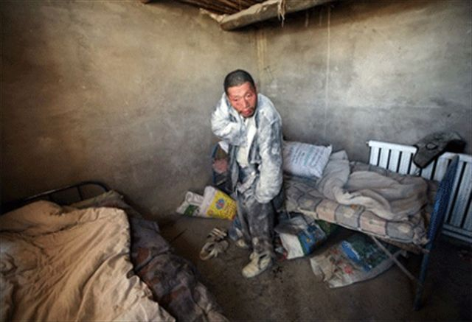
Human Trafficking in the Workplace

Slide 11
The International Labour Organisation (ILO) uses six indicators to help identify forced labour.
Threats of actual physical or sexual violence
Restriction of movement and confinement
Debt bondage
Withholding of wages or excessive wage reductions
Retention of passport and identity documents
Threat of denunciation to the authorities

Slide 12
Why wouldn’t a PVoT self-identify?
Victims of trafficking rarely identify themselves as victims. . . Why?
Group work: Discuss and note your reasons.

Slide 13
To report a potential victim of human trafficking:
Police Emergency 999
Police Non-emergency 101
Crime Stoppers 0800 555 111
G.L.A Help Line 0845 602 5020
National Trafficking Helpline 0800 0121 700
Migrant Help – Advice on Trafficking 24/7 07766 668 781

Slide 14
Specialist Support Services provided by
Migrant Help
As a minimum we provide:
Physical, psychological and emotional support
Spiritual support when appropriate
Legal representation
Financial support
Education

Slide 15
How Migrant Help assist beneficiaries
Safe and secure accommodation
Food
An allowance
Access to health care, dentistry, opticians, counselling & mental health services
Assistance to gain benefits, training and employment
Interpretation and translation
Legal advice – in order to make an informed decision

Slide 16
How we help cont.
Referral to specialists such as sexual health, substance misuse services
Help with relevant ID documentation/replacement Papers – Embassy appointments
An environment conducive to encouraging cooperation with law enforcement agencies
Contact with family & friends
OISC Level 1 advice

Slide 17
How we help cont..
Assistance to return home
Advocacy & navigation through the NRM
Support while attending court
A shoulder to cry on!

Slide 18
Support Services Provision
Sign Posting
Compensation
First Responder - NGO
Liaison with Police and Competent Authority
Net working and Partnership
Integration
Repatriation

