Slide 1

Section Title
Mental Health
Dr Kumaran Gohula Thevan
Consultant Child & Adolescent Psychiatrist
Named Doctor for Safeguarding

Slide 2

Mental Health
All of us have mental health and, like our bodies, our minds can become unwell.
1 in 10 young people will experience a mental health problem.
These include depression, anxiety disorder, eating disorders, psychosis or bipolar disorder.
A mental health problem can feel just as bad, or worse, as any other physical illness – only you cannot see it.
It’s important to talk about mental health and get help early if things don’t feel right, just like we would for our physical health.

Slide 3
Definition of mental health
"The capacity to live a full, productive life as well as the flexibility to deal with its ups and downs. In children and young people it is especially about the capacity to learn, enjoy friendships, to meet challenges, to develop talents and capabilities.”
Source: Young Minds 1999

Slide 4

Characteristics of good mental health
Feels good about themselves
Feels comfortable with other people
Able to meet the demands of life
Expresses emotions in healthy ways
Is optimistic (positive)
Uses health skills
Stress management
Decision making
Conflict resolution
Uses “I messages”
Copes/adapts with change
Assertive
Active listener
Can be part of a team/group
Notes:
Share feelings with others

Slide 5

Characteristics of poor mental health
Does NOT share feelings
Emotions control behaviors
Is pessimistic (negative)
Ignores/denies problems
Can not accept change
Lets stress control life
“You” messages (blame and escalate)
Aggressive and passive
Depressed
Runs from conflict
Close minded
Needs to “run” the group

Slide 6
The mental health continuum
Good wellbeing
Mental Wellbeing
I have a mental health diagnosis but I am coping well and enjoying my life
I have no diagnosis.
I am well and enjoying my life
I have a mental health diagnosis but
I am not coping and I am not happy
I have no diagnosis, but I am not coping and I am not happy
Poor wellbeing
Notes:
Take the group through the continuum one stage at a time.
Highlight this example at stage 2:
Someone may be become quite stressed in the run up to their exams. This may negatively affect their sleep or appetite and they may develop a heightened level of anxiety during that period. In other words, their mental health or wellbeing is negatively affected. They do not have a diagnosis of a mental health problem and things may improve for them with some support and strategies or just when the exams finish. Alternatively, things may continue to get harder for them and may become a diagnosable mental health problem such as anxiety disorder.
Highlight this example at stage 4:
-Someone may have experienced an episode of psychosis whilst they were at university (this can involve stress and anxiety, disrupted sleep, hallucinations and delusions). This episode passes with treatment and they do not experience any further symptoms of psychosis. They feel good again and enjoy university.
Explain the main point of this is to show that whether we have a diagnosed mental health problem or not, we still experience good or bad days. The same goes for people with a diagnosed mental health problem. People often assume that if you have a diagnosis that means you are never happy and things are always tough for you. This simply isn’t true. With the right support, a person can learn to manage or fully recover from a mental health problem and experience very good mental wellbeing.

Slide 7

8 Ways to Wellbeing
Section Title
Talking being open with people I trust about how I’m feeling.
Exercising looking after my body, playing sport, eating healthy.
Calming trying meditation, good sleep habits like turning my phone off early.
Learning a new skill, a great way to gain confidence.
Relating spending time with the people I care about.
Contributing helping others or contributing to causes I believe in.
Creating expressing myself creatively e.g. music, art, drama, writing.
Congratulating being kind to myself, or listing the qualities I value in myself.
Notes:
Discuss with the person next to you, which do you think is the one thing that young people do most often or feel comfortable with, and which is the one that they do least often?
Why do you think that is?
What are the barriers for young people towards doing some of these things?
What could be done to remove some of those barriers?
Then present back as a group.
Then ask the group to look at the slide again on their own and take 5 minutes of thinking time to themselves to identify which is the one they are most comfortable with and which is the one they are least comfortable with / do least frequently and to think about what their personal barriers are. They can write some thoughts on this in their notebooks.
Then ask them to identify one which they want to try more often.

Slide 8

Time to Change
Time to Change is a nationwide movement to get people talking about mental health.
No one should feel ashamed about having a mental health problem, they wouldn’t if they had a broken leg.
Today we’re going to learn a bit more about mental health and challenge some of the common myths

Slide 9
Cultural perspectives on mental health problems
Different cultures have different approaches to mental health and mental illness.
Most Western countries agree on a similar set of clinical diagnoses and treatments for mental health problems. However, cultures in which there are other traditions or beliefs may not use these terms.
Depending on the culture you grew up in, you might be more familiar with terms related to mental illness. And in many cultures, mental health is closely associated with religious or spiritual life.
How you understand your own mental health, and any problems you experience, will be personal to you.
Notes:
Ask the group to put their hands up if they answer yes to any of the questions
Put your hands up if..
You have physical health
You have mental health
You have felt angry in the past week
You have felt sad in the past week
You have felt happy in the past week
You have felt stressed in the past week
That is your mental health! Your mental health is your emotions. It is normal to feel a whole range of emotions, including negative ones. We all have mental health just as we all have physical health.
When negative emotions persist for a long period and get in the way of us functioning in our daily lives as we ordinarily might, that means our mental health is not in a good place and we may have a mental health problem.

Slide 10
Experiencing Mental Illness
Experiencing a mental health problem is often upsetting and frightening, particularly at first.
Being unwell may feel that it's a sign of weakness, or that you are 'losing your mind', and that it's only going to get worse. You may be scared of being seen as 'mad' by other people in your life. You may also be afraid of being locked up in an institution.
These fears are often reinforced by the negative portrayals.
Evidence shows this stops young people from talking about problems, or seeking help.
.

Slide 11
Negative Portrayals of Mental Illness
The majority of violent crimes and homicides are committed by people who do not have mental health problems.
People with mental health problems are more dangerous to themselves than they are to others: 90% of people who die through suicide in the UK are experiencing mental distress.
It is estimated that more than 7 million people will have a mental illness.
50–70 cases of homicide a year involving people known to have a mental health problem
Contrary to popular belief, the incidence of homicide committed by people diagnosed with mental health problems has stayed at a fairly constant level since the 1990s
Substance abuse appears to play a role: The prevalence of violence is higher among people who have symptoms of substance abuse (including discharged psychiatric patients and non-patients).

Slide 12
Types of Mental Illness
There are many different mental health problems, and many symptoms are common to more than one diagnosis..
Common Symptoms include:
Low mood
Self-harm
Anxiety and Panic
Aggression
Inability to function
Poor concentration
Poor sleep
Poor appetite
Paranoia

Slide 13
Major Mental Illnesses
Schizophrenia
Bipolar Disorder
Major Depression
Obsessive-Compulsive Disorder
Anxiety/Panic Disorder

Slide 14
Neurodevelopmental Disorders
Learning Disability
ADHD
ASD
Dyslexia
Dyspraxia
OCD
Tourettes
Epilepsy

Slide 15
Classification and Diagnosis of Childhood Disorders
Externalizing disorders
Characterized by outward-directed behaviors
Noncompliance, aggressiveness, overactivity, impulsiveness
Includes attention-deficit/hyperactivity disorder, conduct disorder, and oppositional defiant disorder.
More common in boys
Internalizing disorders
Characterized by inward-focused behaviors
Depression, anxiety, social withdrawal
Includes childhood anxiety and mood disorders
More common in girls

Slide 16
Attention Deficit/Hyperactivity Disorder
Excessive levels of activity
Fidgeting, squirming, running around when inappropriate, incessant talking
Distractibility and difficulty concentrating
Makes careless mistakes, cannot follow instructions, forgetful

Slide 17

Attention Deficit/Hyperactivity Disorder
Three subcategories in DSM-IV-TR
Predominantly inattentive type
Predominantly hyperactive-impulsive type
Combined type
Differential diagnosis
ADHD or Conduct Disorder?
ADHD
More off-task behavior, cognitive and achievement deficits
Conduct Disorder
More aggressive, act out in most settings, antisocial parents, family hostility

Slide 18
Girls with Attention Deficit/Hyperactivity Disorder
Hinshaw et al. (2006) large, ethnically diverse study of girls
Combined type had:
More disruptive behaviors than inattentive type
More comorbid diagnoses of conduct disorder or oppositional defiant disorder than girls without ADHD
Viewed more negatively by peers than inattentive type or girls without ADHD
Inattentive type
Viewed more negatively by peers than girls without ADHD
Girls with ADHD more likely to:
Be anxious and depressed
Exhibit neurological deficits (e.g., poor planning, problem-solving)
Have symptoms of eating disorder and substance abuse by adolescence

Slide 19
Conduct Disorder (CD)
Pattern of engaging in behaviors that violate social norms, the rights of others, and are often illegal
Aggression
Cruelty towards other people or animals
Damaging property
Lying
Stealing
Vandalism
Often accompanied by viciousness, callousness, and lack of remorse

Slide 20
Oppositional Defiant Disorder (ODD)
ODD behaviors do not meet criteria for CD (especially extreme physical aggressiveness) but child displays pattern of defiant behavior
Argumentative
Loses temper
Lack of compliance
Deliberately aggravates others
Hostile, vindictive, spiteful, or touchy
Blames others for their problems
Comorbid with ADHD, learning and communication disorders
Disruptive behavior of ODD more deliberate than ADHD
Most often diagnosed in boys but may be as prevalent in girls

Slide 21
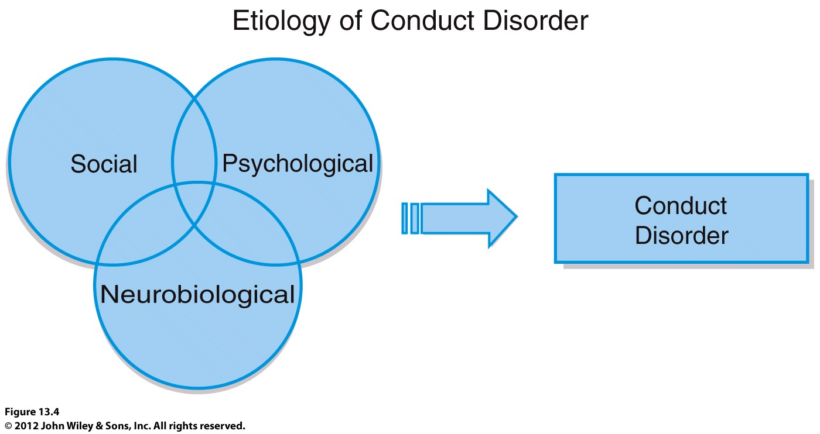
Aetiology of Conduct Disorder

Slide 22
Depression and Anxiety in Children and Adolescents
Commonly co-occur with ADHD and CD
Also co-occur with each other
Early research suggested that depression and anxiety could be distinguished from each other in the same way they are in adults:
Depression – high negative affect, low positive affect
Anxiety – high negative affect but not low levels of positive affect
More recent research calls this finding into question

Slide 23
Depression in Children and Adolescents
Symptoms common to children, adolescents, and adults
Depressed mood
Inability to experience pleasure
Fatigue
Problems concentrating
Suicidal ideation
Symptoms specific to children and adolescents
Higher rates of suicide attempts and guilt
Lower rates of
Early morning awakening
Early morning depression
Loss of appetite
Weight loss
Prevalence
1% of preschoolers
2 – 3% of school-age children
6% of girls and 4% of boys during adolescence

Slide 24
Aetiology of Depression in Children and Adolescents
Genetic factors
Early adversity and negative life events
Family and relationship factors
A parent who is depressed
Parental rejection only modestly associated with depression
Children with depression and their parents interact in negative ways
Less warmth
More hostility
Cognitive distortions and negative attributional style
Stable attributional style
Develops by early adolescence
By middle school, attributional style serves as a cognitive diathesis for depression

Slide 25
Anxiety in Children and Adolescents
Fears and worries common in childhood
Anxiety disorder
More severe and persistent worry
Must interfere with functioning
Most childhood fears disappear but adults with anxiety disorders report feeling anxious as children
“I’ve always been this way”
Prevalence
3-5% of children and adolescents are diagnosed with anxiety disorder

Slide 26
Anxiety Disorders in Children
Separation Anxiety Disorder
Worry about parental or personal safety when away from parents
Typically first observed when child begins school
Social Anxiety Disorder
Extremely shy and quiet
May exhibit selective mutism
Refusal to speak in unfamiliar social setting
Prevalence
1% of children and adolescents
Etiology
Overestimation of threat
Underestimation of coping ability
Poor social skills

Slide 27
PTSD
Exposure to trauma
Chronic physical or sexual abuse
Community violence
Natural disasters
Symptom categories
Flashbacks, nightmares, intrusive thoughts
Avoidance
Negative cognitions and moods
Hyperarousal and vigilance
Some symptoms may differ from adults
May exhibit agitation instead of fear or hopelessness

Slide 28
OCD
Prevalence 1 to 4%
Symptoms similar to those in adults
Most common obsessions:
Contamination from dirt and germs
Aggression
Thoughts about sex and religion more common in adolescence
OCD more common in boys than girls

Slide 29
Learning Disability
Evidence of inadequate development in a specific area of academic, language, speech or motor skills
e.g., arithmetic or reading
Not due to mental retardation, autism, physical disorder, or lack of educational opportunity
Individual usually of average or above average intelligence

Slide 30
Learning Disability
DSM has 3 categories:
Learning disorders
Communication disorders
Motor skills disorder
Often identified and treated in school
Reading disorders more common in boys
DSM-5 Criteria for Learning Disorder:
Difficulties in learning basic academic skills (reading, mathematics, or writing) inconsistent with person’s age, schooling, and intelligence
Significant interference with academic achievement or activities of daily living

Slide 31
Intellectual Developmental Disorder
Formerly known as Mental Retardation in DSM-IV-TR
Not preferred due to stigma
Followed the guidelines of the American Association on Intellectual and Developmental Disabilities (AAIDD)
The AAIDD Definition of Intellectual Disability:
Intellectual disability is characterized by significant limitations both in intellectual functioning and in adaptive behavior as expressed in conceptual, social, and practical adaptive skills
This disability begins before age 18
Five Assumptions Essential to the Application of the Definition
Limitations in present functioning must be considered within the context of community environments typical of the individual’s age, peers, and culture
Valid assessment considers cultural and linguistic diversity as well as differences in communication, sensory, motor, and behavioral factors
Within an individual, limitations often coexist with strengths
An important purpose of describing limitations is to develop profile of needed supports
With appropriate personalized supports over a sustained period, the life functioning of the person with intellectual disability generally will improve

Slide 32
Autism Spectrum Disorder
DSM-5 combined multiple diagnoses into one: Autism Spectrum Disorder
Autistic disorder, Asperger’s disorder, pervasive developmental disorder not otherwise specified, and childhood disintegrative disorder
Research did not support distinctive categories
Share similar clinical features; vary only in severity
DSM-5 includes different clinical specifiers relating to severity and the extent of language impairment

Slide 33
Autism Spectrum Disorder
Profound problems with the social world
Rarely approach others, may look through people
Problems in joint attention
Pay attention to different parts of faces than do people without autism; focus on mouth, neglect eye region
This neglect likely contributes to difficulties in perceiving emotion in other people
Theory of mind
Understanding that other people have different desires, beliefs, intentions, and emotions
Crucial for understanding and successfully engaging in social interactions
Typically develops between 2½ and 5 years of age
Children with ASD seem not to achieve this developmental milestone

Slide 34
Autism Spectrum Disorder
Communication deficits
Children with ASD evidence early language disturbances
Echolalia: immediate or delayed repeating of what was heard
Pronoun reversal: refer to themselves as “he” or “she”
Literal use of words
Repetitive and ritualistic acts
Become extremely upset when routine is altered
Engage in obsessional play
Engage in ritualistic body movements
Become attached to inanimate objects (e.g., keys, rocks)

Slide 35
Autism Spectrum Disorder
Comorbidity
IQ < 70 is common
Children with intellectual developmental disorder score poorly on all parts of an IQ test; children with ASD score poorly on those subtests related to language, such as tasks requiring abstract thought, symbolism, or sequential logic
Prevalence
1 out of 110 children
Found in all SES, ethnic, and racial groups
Diagnosis of ASD is remarkably stable
Prognosis
Children with higher IQs who learn to speak before age six have the best outcomes

Slide 36
Causes
Bio-Psycho-Social Perspective
assumes that biological, sociocultural, and psychological factors combine and interact to produce mental illness

Slide 37
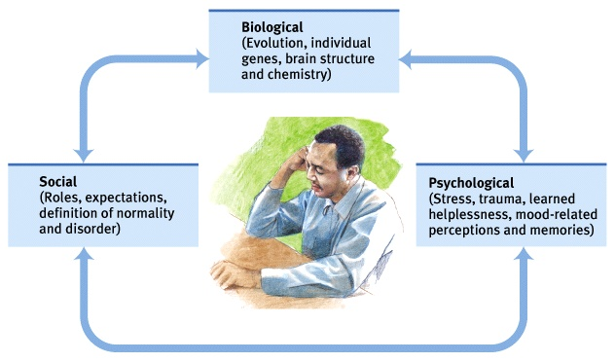
Bio-Psycho-Social Approach

Slide 38
Bio-Psycho-Social Approach
These factors change over time.
“Normal” behavior changes over cultures, sub-cultures and time.
E.g., is gang behavior or violence “abnormal”?
It’s more important to understand behavior (and symptoms)

Slide 39
Schizophrenia
Positive Symptoms:
Confusion about what is real or imaginary
Preoccupation with normal beliefs
Paranoia
Hallucinations
Heightened or dulled perceptions
Odd thinking and speaking processes
Racing thoughts or slowed down thoughts

Slide 40
Negative symptoms of schizophrenia
Lack of friends
Passivity
Interacting in a mechanical way
Flat emotions
Decrease in facial expressions
Monotone speech
Lack of spontaneity
Difficulty in abstract thinking

Slide 41
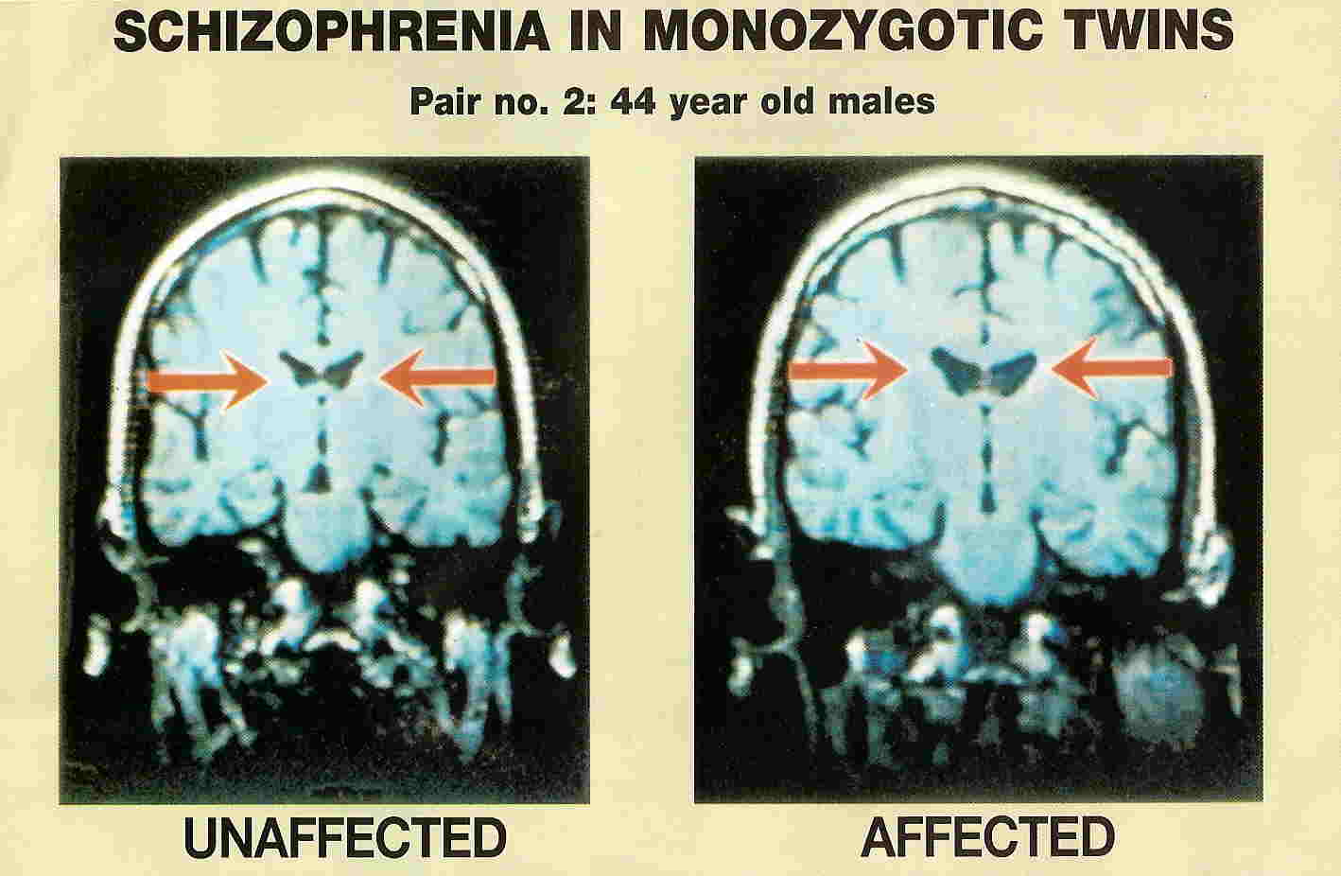
Schizophrenia in identical twins
MRI shows enlarged ventricles in twin with schizophrenia.
Source: Daniel Weinberger, MD, NIMH Brain Disorders Branch

Slide 42
Bipolar Disorder:
Manic phase
Increased energy
Decreased need for sleep
Increased risk taking
Unrealistic belief in abilities
Increased talking and physical, social and sexual activity
Aggressive response to frustration
Racing, disconnected thoughts
The depressed phase is similar to major depression

Slide 43
Major Depression
Persistent sad, anxious or empty mood
Decreased energy, fatigue
Loss of interest in usual activities, including work and sex
Sleep disturbances (insomnia or oversleeping)
Appetite and weight changes
Hopelessness, pessimism
Guilt, helplessness, thoughts of death, suicide
Suicide attempts
Difficulty concentrating, making decisions
Hypochondria

Slide 44
ANOSOGNOSIA
32.1% are unaware they have an illness
25.3% are modestly unaware
40.7% are aware
Poor insight is a manifestation of the illness
Listen
Empathize
Practice reflective listening

Slide 45
Interacting in crisis situations Dos and Don’ts
DO
Remember that a person with mental illness has the same rights to fair treatment and legal protection as anyone else.
Continually assess the situation.
Be calm

Slide 46
Do, continued
Be helpful. Ask “What would make you feel safer/calmer, etc?”
Give firm, clear directions. The subject may already be confused and may have trouble making the simplest decision. Only one person should talk to the subject.

Slide 47
Do, continued
Respond to apparent feelings, rather than content (“You look/sound scared.”)
Respond to delusions and hallucinations by talking about the person’s feelings, not what he or she is saying (“That sounds frightening.” “I can see why you are angry.”)

Slide 48
DON’T
Join into behavior related to the person’s mental illness (e.g., agreeing/disagreeing with delusions/hallucinations).
Stare at the subject. This may be interpreted as a threat.

Slide 49
Don’t, continued
Confuse the subject. One person should interact with the subject. If a direction or command is given, follow through.
Touch the subject unless safe. Although touching can be helpful to some people who are upset, for disturbed people with mental illnesses it may cause more fear and can lead to violence.

Slide 50
Don’t, continued
Give multiple choices. Giving multiple choices increases the subject’s confusion.
Whisper, joke or laugh. This increases the subject’s suspiciousness and the potential for aggression.
Deceive the subject. This increases fear and suspicion; the subject will likely discover the dishonesty and remember it.

Slide 51
Important questions to ask:
Do you take any medications?
Have you taken your medication?
Do you want to hurt yourself?
Do you want to hurt someone?

Slide 52
Determine whether person has a family member, guardian, or mental health clinician. Contact that person.
Contact the local mental health duty person or police if a person with mental illness is extremely agitated, uncommunicative, or displaying inappropriate emotional responses. He or she may be experiencing a psychiatric crisis.

Slide 53
Continually assess a person’s emotional state for any indications that they may be a danger to themselves or others.
Be honest. Getting caught in your well-intentioned deception will only increase their fear and suspicion of you.

Slide 54
Avoid the following conduct with people with mental illness:
Circling, surrounding, closing in on, or standing too close.
Sudden movements or rapid instructions and questioning.
Whispering, joking or laughing in their presence.

Slide 55
The Fine Line between Social Welfare Crises and Mental Illness Crises
Chicken and Egg scenario with fractured services
Understanding that social problems can cause symptoms of mental illness
Understand that without ameliorating causal trigger, difficult to treat mental illness.
Evidence suggests hospitalisation does not improve outcome
Self-harm and suicidality does not directly indicate mental illness

Slide 56
Section Title
Thank You

