Slide 1
The Impact of mental illness on individuals and families
Thomas Jordan
SANE
Oxford Mental Health Support Network

Slide 2
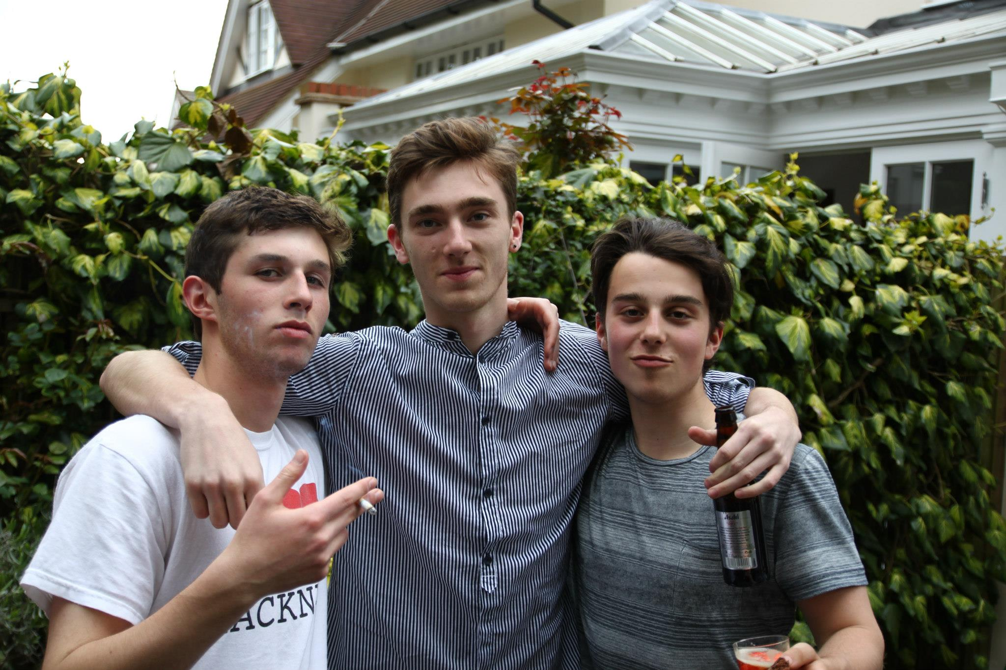

Slide 3
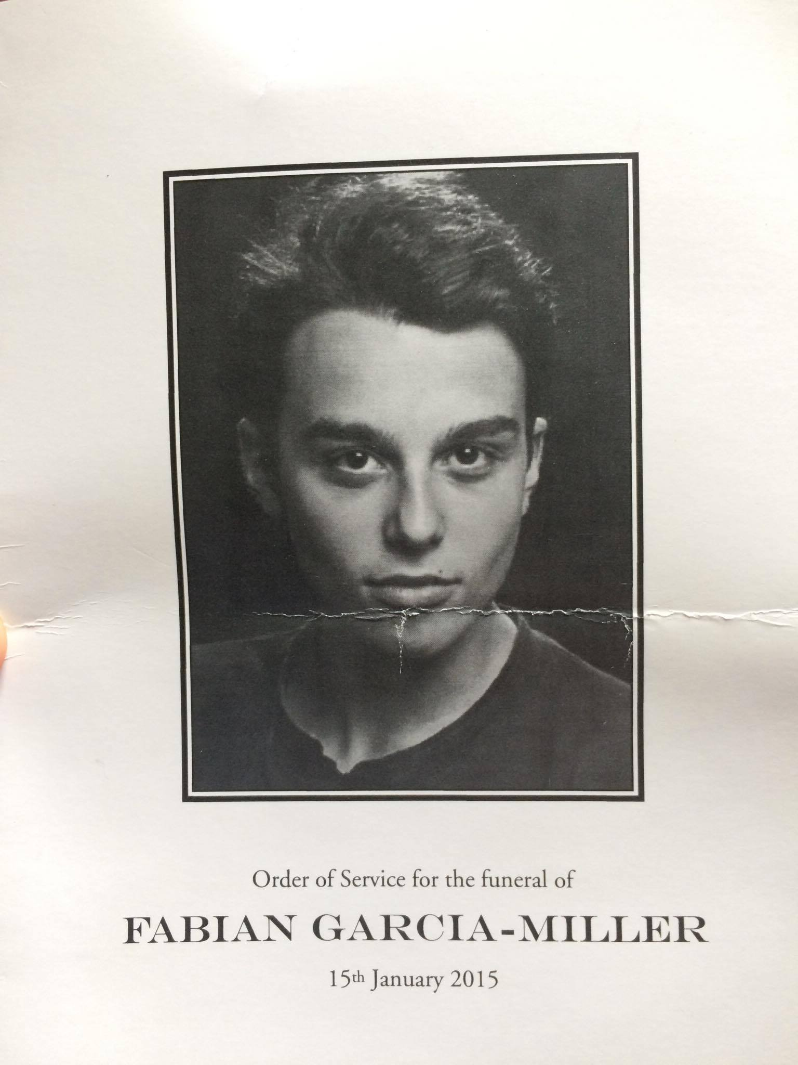

Slide 4
6,188
Source: Samaritans

Slide 5
“Self-inflicted”

Slide 6
“This sad, boring, lazy, sleepy, stranger isn’t what I’m really like.”

Slide 7
Biological
chemical
environmental
Genetics
Physical illness
Dopamine
Serotonine
Brain chemistry
Societal pressures
Traumatic incidences
Upbringing

Slide 8
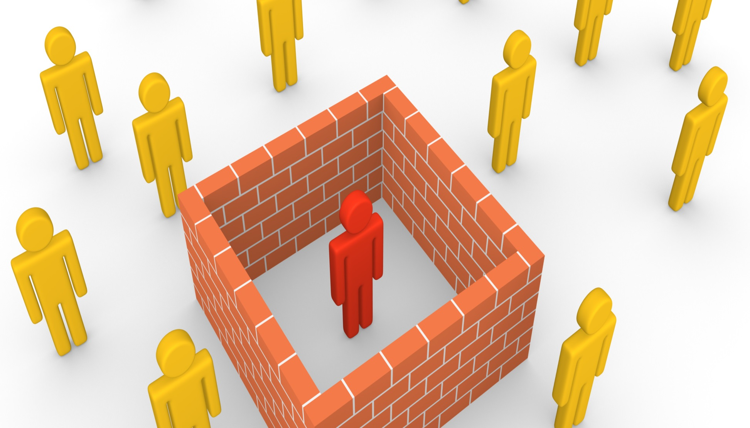

Slide 9
£124,000,000,000
Source: UK’s Faculty of Public Health

Slide 10
