Slide 1
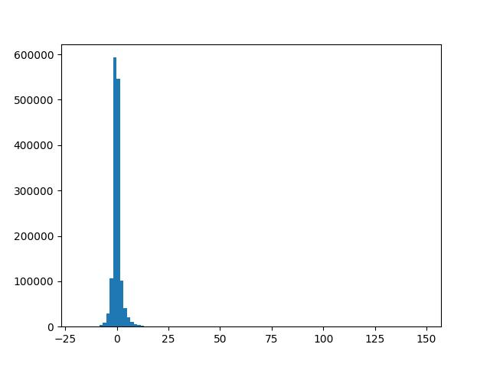
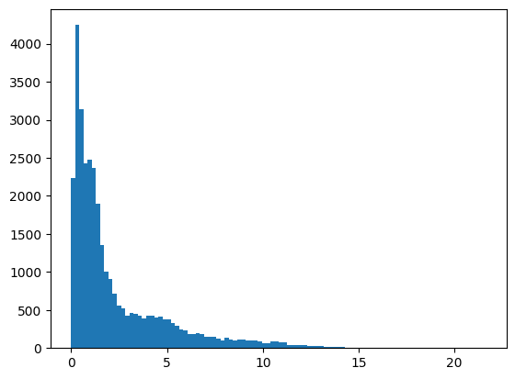
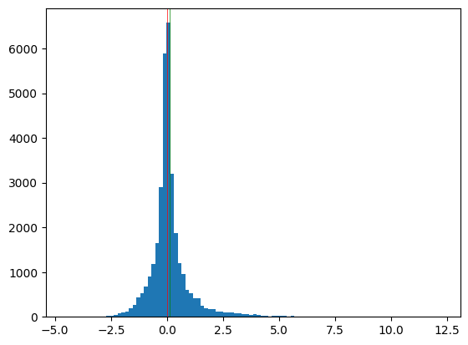
inm_tp
inm_tp_anom
inm_tp_anom_17_weeks
"inm_tp_17weeks": {
"n": 2004912000,
"mean": 0.00259094423382796,
"std": 2.2429165864378766,
"mad_std": 0.9001498579770326,
"q001": -8.457143783569336,
"q01": -5.042857646942139,
"q25": -0.7857145667076111,
"q50": -0.18571411073207855,
"q75": 0.4214286804199219,
"q99": 7.864285945892334,
"q999": 17.688865859986123
},
count 32760.000000
mean 0.117832
std 0.928408
min -4.566667
1% -1.833183
25% -0.234167
50% -0.000833
75% 0.292500
99% 3.810342
99.9% 6.129880
max 12.249166
dtype: float64

Slide 2
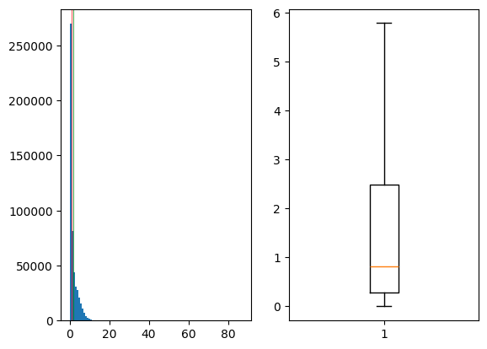
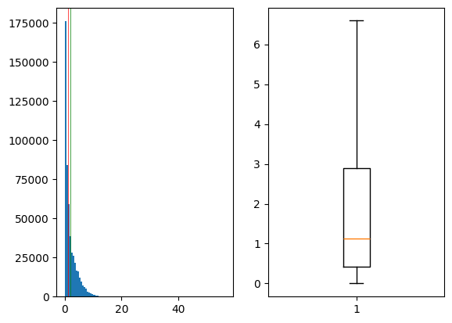
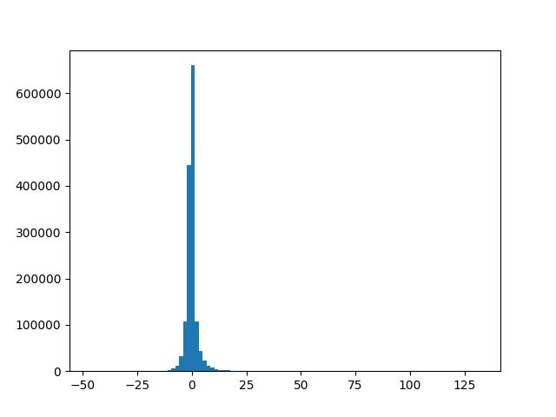
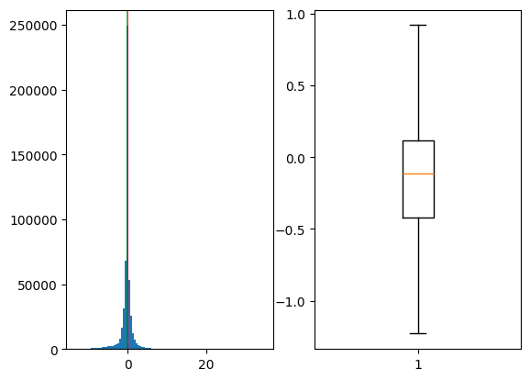
tp
tp_clim
count 519840.000000
mean 1.786427
std 2.325117
min 0.000000
1% 0.000833
25% 0.285833
50% 0.813333
75% 2.485834
99% 9.556666
99.9% 19.155403
max 87.251663
zeros 0.632695
dtype: float64
count 519840.000000
mean 1.981716
std 2.184212
min 0.000000
1% 0.003333
25% 0.416667
50% 1.124167
75% 2.886666
99% 9.506668
99.9% 12.436666
max 56.298332
zeros 0.376654
dtype: float64
tp_anom_6_weeks
tp_anom
count 519840.000000
mean -0.195300
std 1.814926
min -13.285834
1% -6.839167
25% -0.423333
50% -0.111667
75% 0.113333
99% 4.977500
99.9% 16.415482
max 34.759167
zeros 0.001924
dtype: float64
"era_tp_6weeks": {
"n": 1122854400,
"mean": 0.0019905816939461587,
"std": 2.913295983169404,
"mad_std": 1.027230137604475,
"q001": -11.049999124526977,
"q01": -6.442856788635254,
"q25": -0.9714285731315613,
"q50": -0.19999995827674866,
"q75": 0.40714284777641296,
"q99": 10.992856979370117,
"q999": 25.87857139778137
},

Slide 3
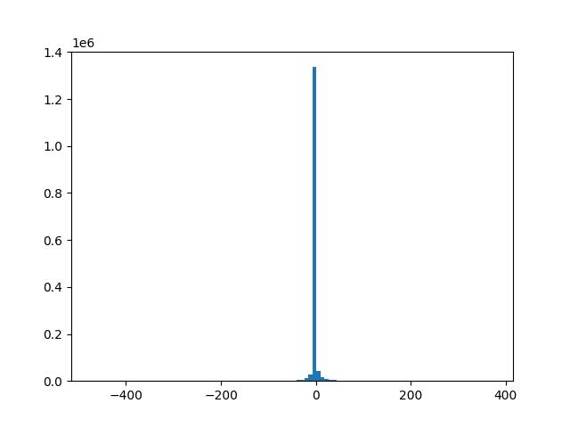
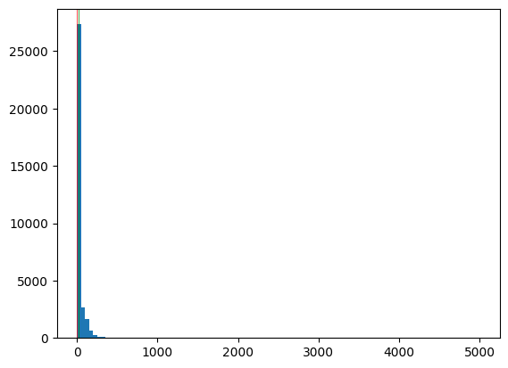
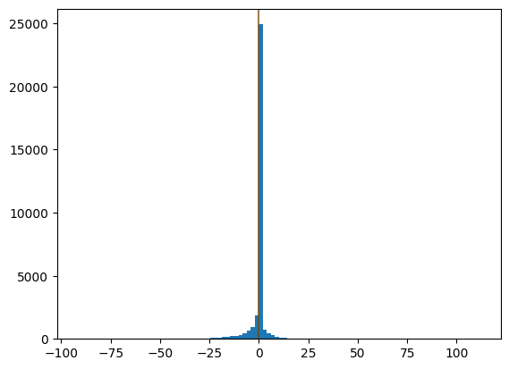
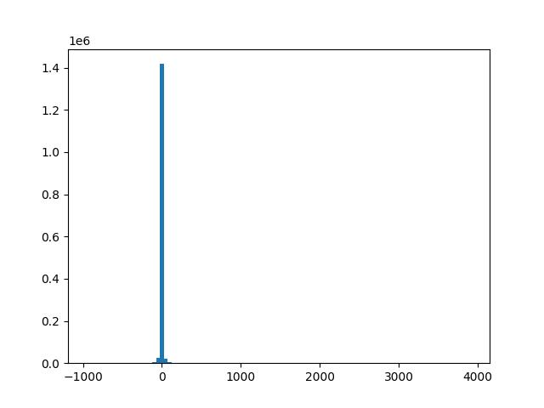
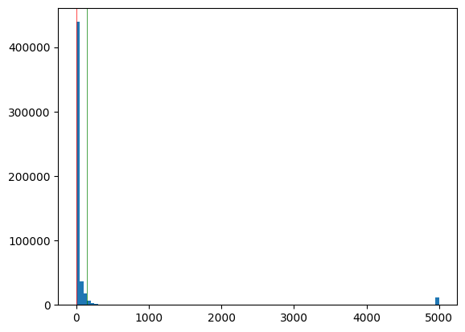
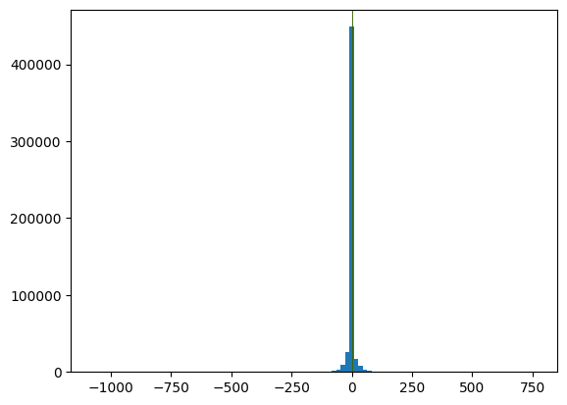
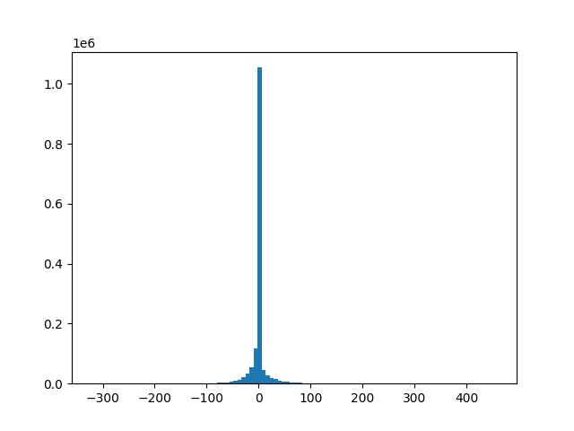
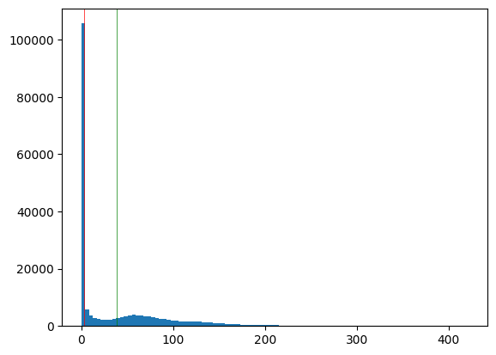
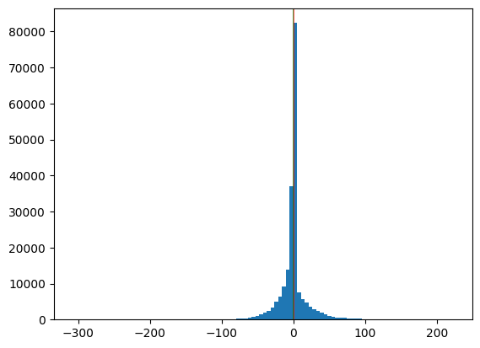
inm_swe
inm_swe_anom
inm_swe_17weeks
count 3.276000e+04
mean 2.269461e+01
std 7.593759e+01
min -3.666433e-02
1% -2.374748e-06
25% -3.973643e-09
50% 0.000000e+00
75% 1.780418e+00
99% 2.307910e+02
99.9% 5.678498e+02
max 5.000000e+03
dtype: float64
count 3.276000e+04
mean 2.269461e+01
std 7.593759e+01
min -3.666433e-02
1% -2.374748e-06
25% -3.973643e-09
50% 0.000000e+00
75% 1.780418e+00
99% 2.307910e+02
99.9% 5.678498e+02
max 5.000000e+03
dtype: float64
"inm_swe_17weeks": {
"n": 2004912000,
"mean": 0.001107086576495924,
"std": 8.67267377644246,
"mad_std": 1.467570647449179e-07,
"q001": -73.64116658020019,
"q01": -24.82857322692871,
"q50": 0.0,
"q99": 28.27142906188965,
"q999": 85.74747204590307
},
era_sd
era_sd_anom
era_sd_6weeks
"era_sd_6weeks": {
"n": 1122854400,
"mean": 0.004733848040847398,
"std": 15.465398788846425,
"mad_std": 0.0,
"q001": -103.4348720703125,
"q01": -37.52857208251953,
"q50": 0.0,
"q99": 43.342857360839844,
"q999": 123.03487390899812
},
count 519840.000000
mean 144.151245
std 777.536255
min -0.039998
1% -0.000003
25% 0.000000
50% 0.000000
75% 0.691666
99% 5000.000000
99.9% 5000.000000
max 5000.025391
dtype: float64
count 5.198400e+05
mean -2.772884e-01
std 1.412465e+01
min -1.073543e+03
1% -4.540769e+01
25% -1.894931e-07
50% 0.000000e+00
75% 0.000000e+00
99% 4.901204e+01
99.9% 1.095486e+02
max 7.621317e+02
dtype: float64
"era_sd_6months": {
"n": 438510240,
"mean": 0.04876991902864316,
"std": 17.998739685414666,
"mad_std": 0.009884137626830488,
"q001": -116.4988197479248,
"q01": -54.97667087554932,
"q25": -0.20333345234394073,
"q50": 0.0,
"q75": 1.1920929132713809e-08,
"q99": 67.29469879150363,
"q999": 144.70958836366043
},
count 203014.000000
mean 38.502316
std 56.846348
min -0.039998
1% -0.001667
25% 0.000000
50% 2.446667
75% 65.683340
99% 245.223127
99.9% 317.206974
max 421.528320
dtype: float64
count 2.030140e+05
mean -5.157353e-01
std 2.085798e+01
min -3.077184e+02
1% -6.001697e+01
25% -4.541667e+00
50% -2.235174e-09
75% 6.439785e-07
99% 7.070472e+01
99.9% 1.355263e+02
max 2.227833e+02
dtype: float64

Slide 4
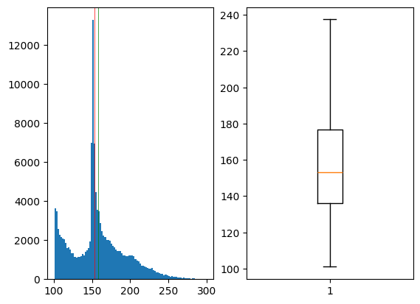
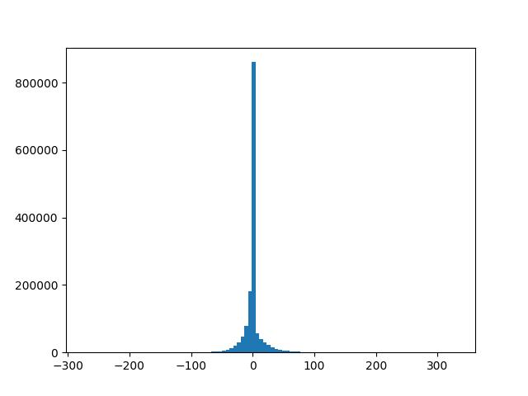
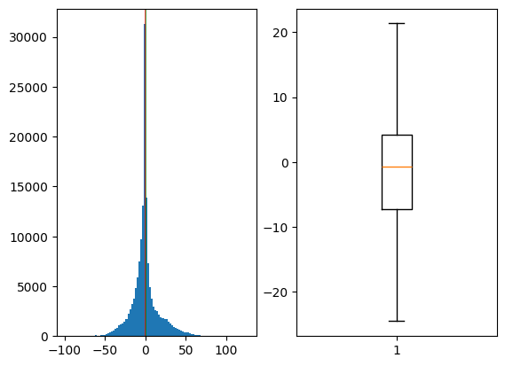
sden
count 131780.000000
mean 157.783875
std 34.696880
min 101.001663
1% 101.706323
25% 136.079990
50% 153.286674
75% 176.624191
99% 251.768400
99.9% 280.302410
max 298.723328
dtype: float64
sden_6weeks
"era_sden_6weeks": {
"n": 438510240,
"mean": 0.004989204904061375,
"std": 18.872284545060612,
"mad_std": 0.6142210238277912,
"q001": -125.93318586730958,
"q01": -53.14285659790039,
"q25": -1.7857145071029663,
"q50": 0.0,
"q75": 9.04713388649725e-08,
"q99": 64.55714416503906,
"q999": 160.69200645446932
},
sden_anom
count 152954.000000
mean -0.091227
std 17.041697
min -98.670006
1% -42.504018
25% -7.314583
50% -0.670000
75% 4.147916
99% 53.721664
99.9% 80.956159
max 126.005005
dtype: float64

Slide 5
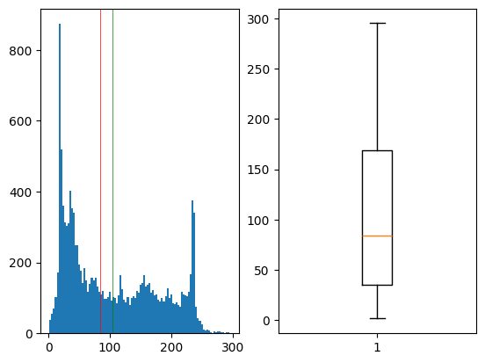
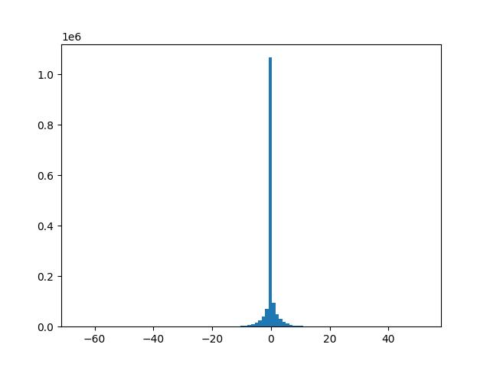
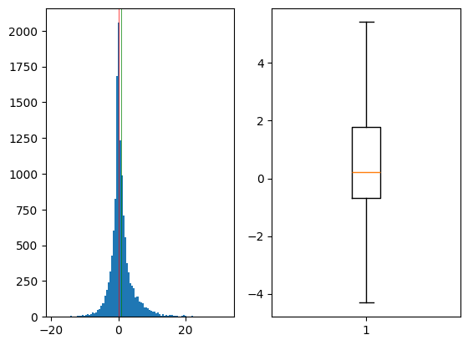
Inm_ww
count 13090.000000
mean 104.590508
std 76.053558
min 1.599999
1% 9.348198
25% 34.987498
50% 84.222473
75% 168.715866
99% 245.274052
99.9% 278.174383
max 295.118378
dtype: float64
"inm_ww_17weeks": {
"n": 2004912000,
"mean": 0.0007227607905220335,
"std": 2.2181530921778125,
"mad_std": 3.582134662281078e-07,
"q001": -14.749157769203187,
"q01": -7.514286041259766,
"q25": -2.575772271029564e-07,
"q50": 0.0,
"q75": 2.3096799850463867e-07,
"q99": 7.5714287757873535,
"q999": 14.928571701049805
},
Inm_ww_anom
count 13023.000000
mean 0.820355
std 3.760852
min -19.091667
1% -8.242300
25% -0.665833
50% 0.208333
75% 1.768333
99% 14.736400
99.9% 26.016905
max 32.108334
zeros 0.000000
dtype: float64

Slide 6
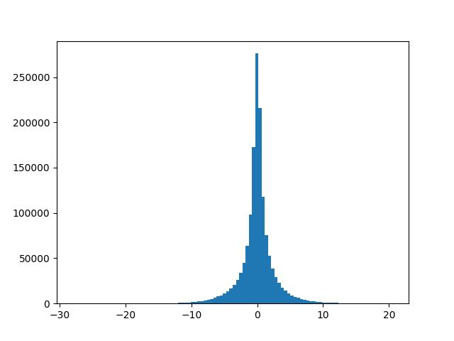
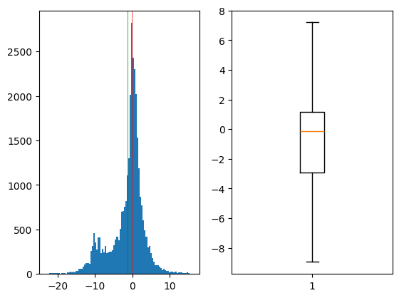
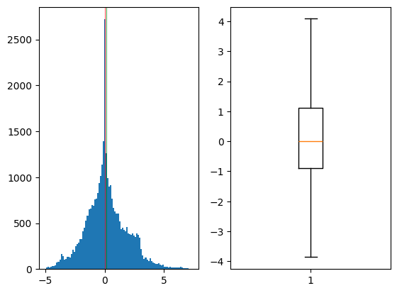
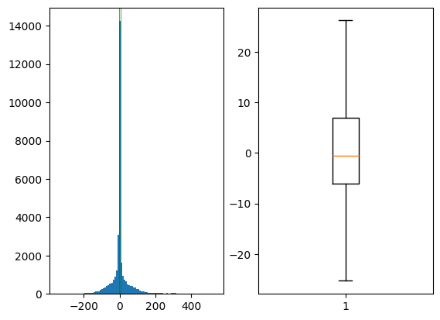
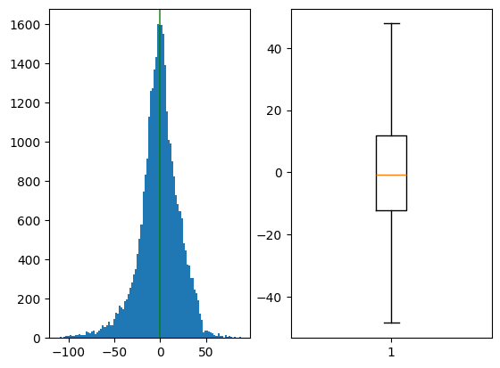
Inm_t2m_17weeks
Inm_t2m
count 32760.000000
mean -1.302181
std 4.616503
min -22.950001
1% -14.350000
25% -2.900000
50% -0.150000
75% 1.150000
99% 9.000000
99.9% 14.462050
max 16.050001
dtype: float64
Inm_u850
count 3.276000e+04
mean 1.548703e-01
std 1.753851e+00
min -4.945000e+00
1% -3.873675e+00
25% -8.833335e-01
50% 1.142422e-07
75% 1.103333e+00
99% 4.941217e+00
99.9% 6.784278e+00
max 7.305000e+00
dtype: float64
"inm_t2m_17weeks": {
"n": 2004912000,
"mean": 4.7690803297998655e-05,
"std": 2.596282436551929,
"mad_std": 1.2813895860227755,
"q001": -12.924579285621643,
"q01": -8.021429061889648,
"q25": -0.850000262260437,
"q50": 0.007142867427319288,
"q75": 0.8714284896850586,
"q99": 8.007143020629883,
"q999": 13.0
},
inm_hlt
inm_olr
count 32760.000000
mean -1.245256
std 22.150177
min -111.400002
1% -70.040999
25% -12.299998
50% -0.600000
75% 11.800000
99% 46.000000
99.9% 73.548201
max 88.400002
dtype: float64
count 32760.000000
mean 6.027833
std 67.349846
min -349.000000
1% -160.882002
25% -5.999999
50% -0.500000
75% 6.900004
99% 300.041003
99.9% 450.264018
max 537.700012
dtype: float64

Slide 7
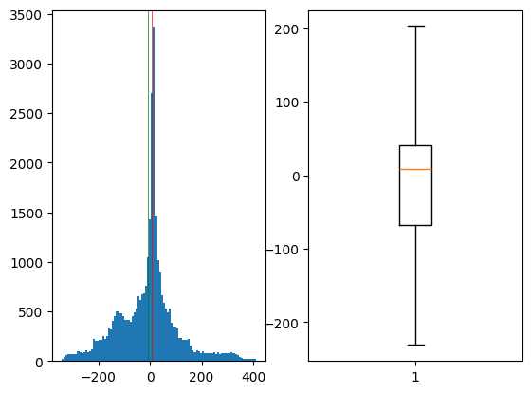
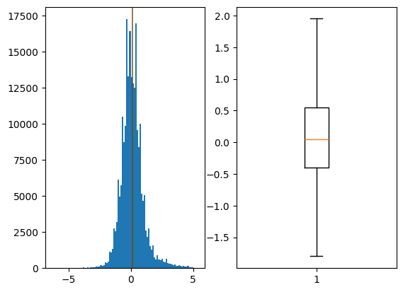
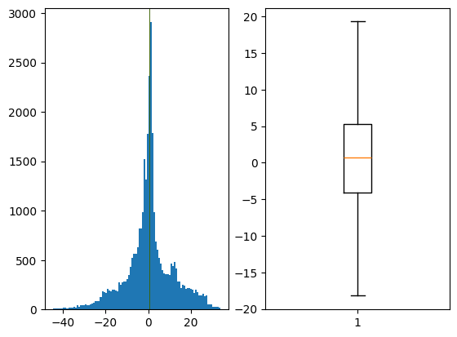
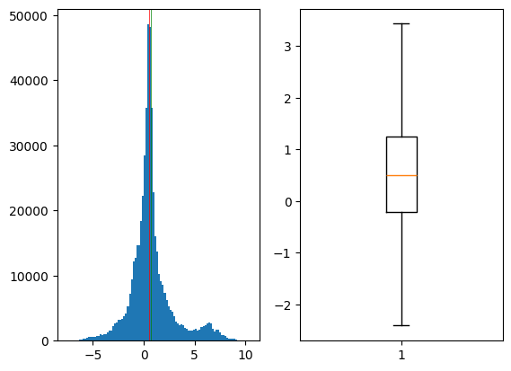
inm_h500
count 32760.000000
mean -5.697595
std 116.794853
min -341.100006
1% -295.899994
25% -68.399996
50% 8.500001
75% 40.099998
99% 329.041003
99.9% 397.572297
max 411.200012
dtype: float64
Sst (masked)
count 227065.000000
mean 0.112589
std 0.930929
min -6.300000
1% -1.900000
25% -0.400000
50% 0.050000
75% 0.550000
99% 3.250000
99.9% 4.700000
max 5.350000
dtype: float64
inm_mslp
count 32760.000000
mean 0.595086
std 11.225744
min -44.700001
1% -31.299999
25% -4.100000
50% 0.700000
75% 5.300000
99% 27.300001
99.9% 32.799999
max 34.000000
dtype: float64
t2m
count 519840.000000
mean 0.745771
std 2.131961
min -7.605834
1% -4.418333
25% -0.220833
50% 0.505000
75% 1.240833
99% 7.490001
99.9% 8.928333
max 10.485001
dtype: float64

Slide 8
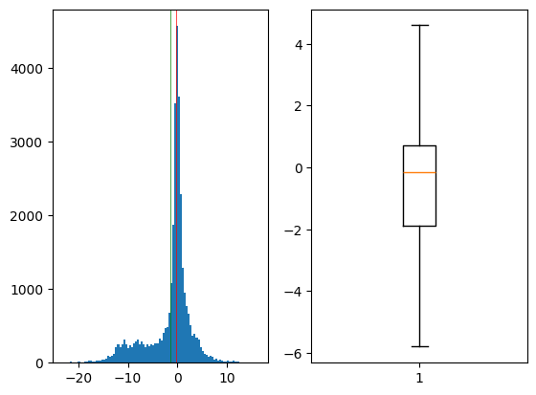
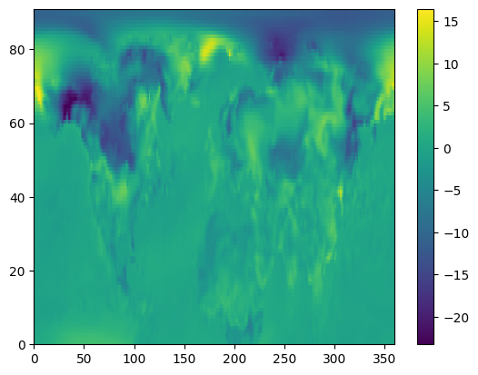
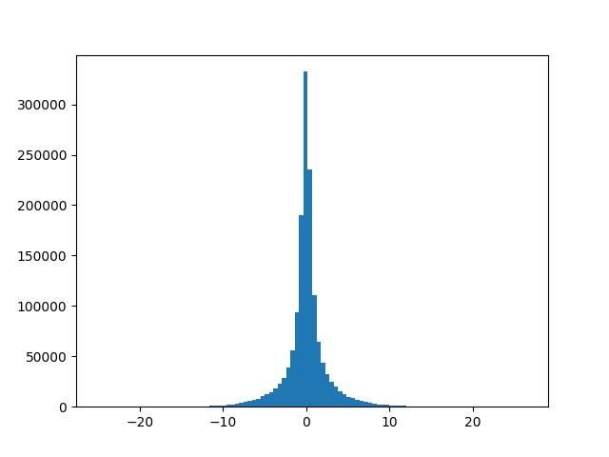
count 32760.000000
mean -1.313420
std 4.506778
min -23.250000
1% -14.970500
25% -1.900000
50% -0.150000
75% 0.700000
99% 8.100001
99.9% 13.512050
max 16.450001
dtype: float64
inm_ts
"inm_ts_17weeks": {
"n": 2004912000,
"mean": 6.790659782816032e-05,
"std": 2.574086067606036,
"mad_std": 1.0907700896322727,
"q001": -13.228571891784668,
"q01": -8.178572654724121,
"q25": -0.7285712957382202,
"q50": 0.014285773038864136,
"q75": 0.7499998807907104,
"q99": 8.064285278320312,
"q999": 13.107142448425293
},
inm_ts_17weeks

