Slide 1
Continuous Behavioral Biometrics for Zero-Trust Network Access: An Event-Driven Microservices Architecture
Student: Mihai Țălu
Supervisor: Lect. Dr. Alina-Delia Călin

Slide 2
Agenda
1
Problem Domain & Motivation
5
Empirical Results & Evaluation
2
State-of-the-Art Analysis
6
Live System Demonstration
3
Proposed Microservice Architecture
7
Conclusions & Future Horizons
4
Deep Metric Learning Implementation

Slide 3
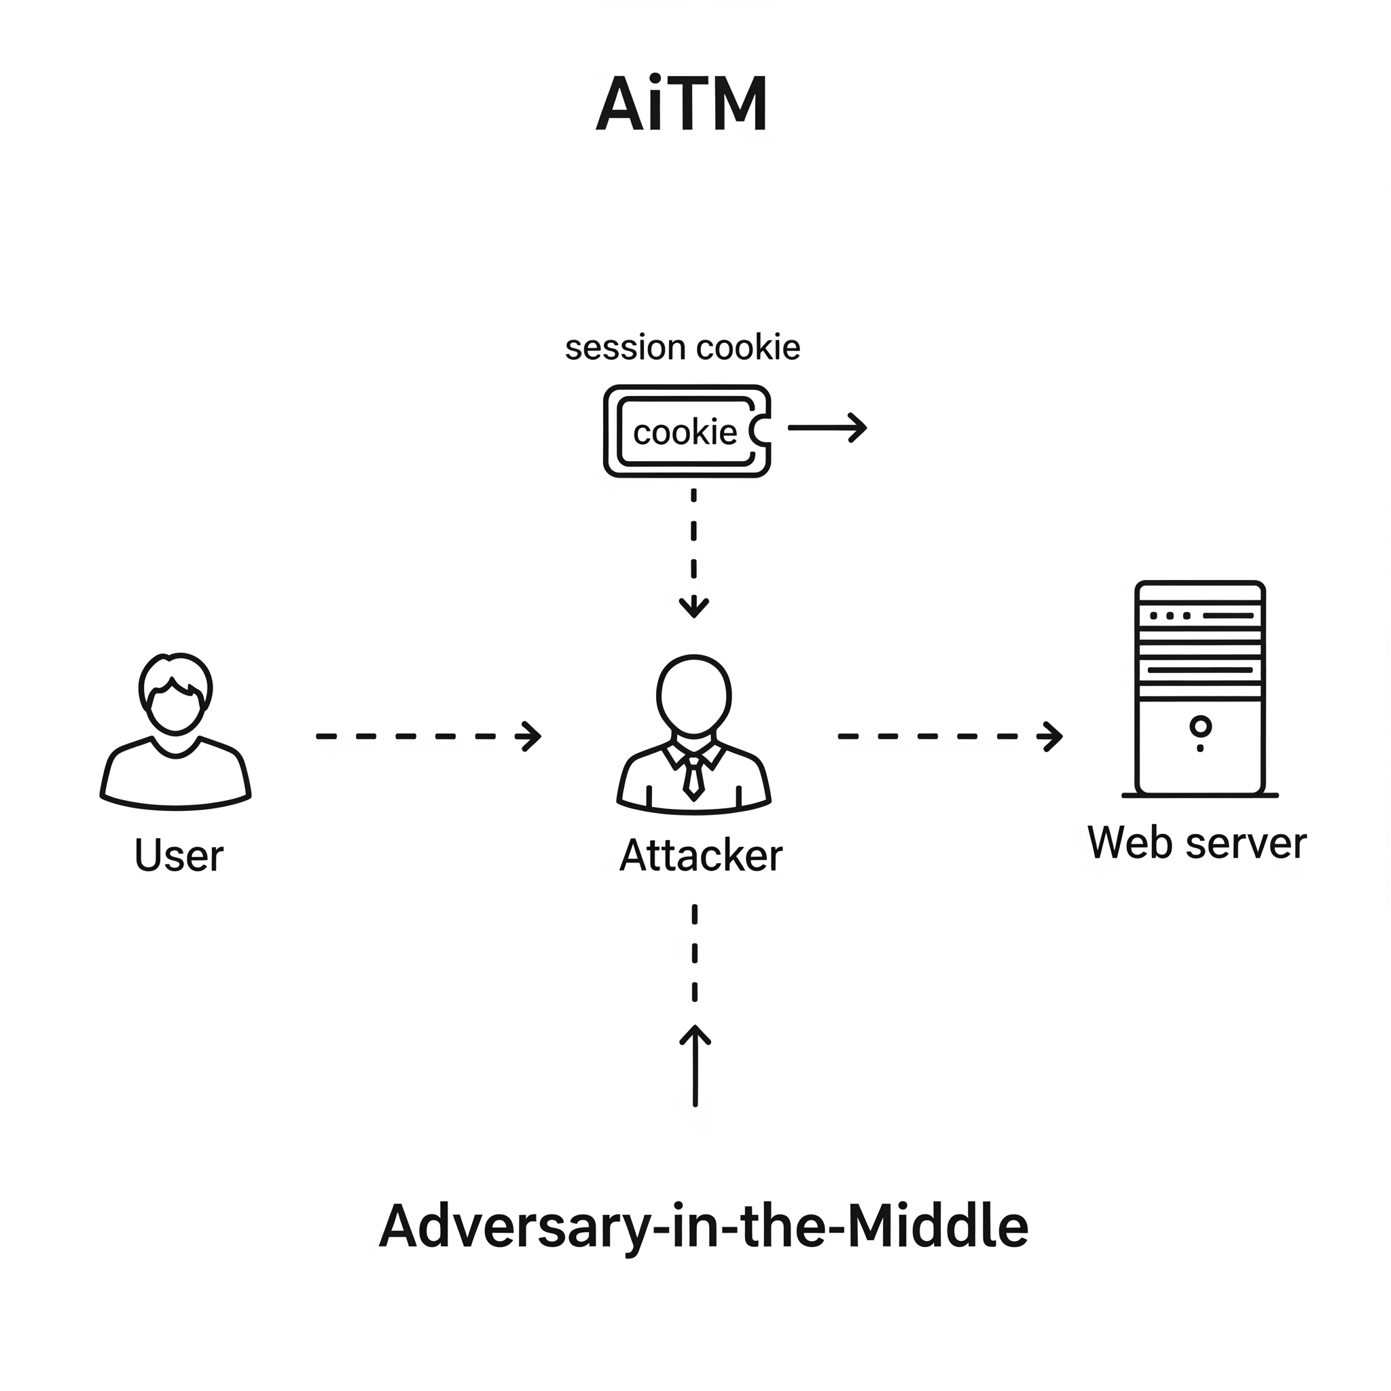
Problem Domain & Motivation
The Vulnerability of Static Authentication
Static authentication (Passwords, one-time MFA) only verifies identity at the point of entry.
The Active Threat Landscape
Susceptible to session hijacking, Pass-the-Cookie, and AiTM attacks.
The Zero-Trust Imperative
"Never trust, always verify." Requires continuous authorization without disrupting the user's workflow.

Slide 4
State-of-the-Art Analysis
TRADITIONAL MODELS
Rely on fixed-text passwords or require massive datasets to train unique classifiers per user
MODERN DEEP LEARNING
Achieve impressive laboratory accuracy (AUC > 0.99)
Inhibit real-world utility by requiring long observation windows
Demand 50 to 150 keystrokes before verification completes
THE ENGINEERING GAP
Translating research models into active corporate networks
Requires continuous, low latency execution
Demands minimal sequence lengths to ensure frictionless user access

Slide 5

Proposed Microservices Architecture
Vue 3 SPA
Telemetry Sensor
Vue 3
1
2
Spring Boot Gateway
Policy Enforcement
Spring Boot
3
Redis
Asynchronous Event Broker
Redis
4
Python / PyTorch
Isolated Inference Daemon
Python

Slide 6
Deep Metric Learning Implementation
Architecture & Features
Input: Dwell Time (DT) & Flight Time (FT).
Window: Fixed N=20 keystroke events.
Loss & Embedding Space
Loss: Triplet Margin.
Output: 128-dimensional latent embedding.
INFERENCE PIPELINE STAGES
01
Telemetry
Bivariate timing sequences (DT/FT).
02
Extractor
Dual 1D-CNN and GRU processing.
03
Embedding
128-D discriminative projection.
04
Evaluation
Euclidean distance & trust scoring.

Slide 7
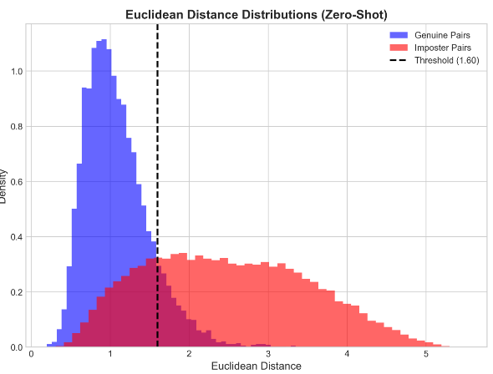
Empirical Results & Evaluation
Dataset: Aalto University 136M Keystrokes.
Discriminatory Power: Area Under the Curve (AUC) = 0.9000 under algorithmic stress
.
Operational Threshold: Euclidean distance ≈ 1.6 maps directly to a 70% Administrative Trust Score.

Slide 8
Live System Demonstration

Slide 9
Conclusions & Future Horizons
Impostor Detection: Achieved Zero-Shot detection accuracy with AUC = 0.9000.
Architecture Isolation: Engineered an event-driven, polyglot microservices system that enforces continuous Zero-Trust Network Access.
Multi-Modal Fusion: Incorporate additional behavioral biometrics including mouse dynamics.
Federated Learning: Privacy-preserving profile adaptation.

