Slide 1

FORVIA HELLA Internship Program 2022
Cristea Mihai
Craiova, 2022

Slide 2
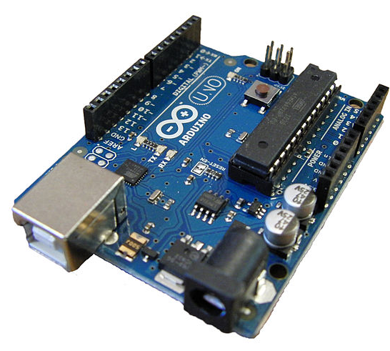
FORVIA HELLA Internship Program 2022
Project chosen
Project 2 – Rear Wing ECU
TO DO:
Given the following requirements, please create a system using an Arduino Uno Board (HW and SW) which mimics the functionality of a “Rear Wing ECU”.
Inputs: serial communication (UART or SPI) for simulation the actual speed of the car, 1 switch (on/off switch).
Outputs: 2x LEDs (one to show the Rear Wing is in “Extended” position and one to show the Rear Wing is “Retracted” position)
Description of the functionality :
If the switch is in position “Switch off” the Rear Wing functionality is inactive (both LEDs are OFF)
Via serial communication, we will send the “actual” speed of the car.
If speed >= 100Km/h then the Rear Wing is in “Extended” position (the corresponding LED should be ON)
If speed < 50Km/h then the Rear Wing is in “Retracted” position (the corresponding LED should be ON)

Slide 3
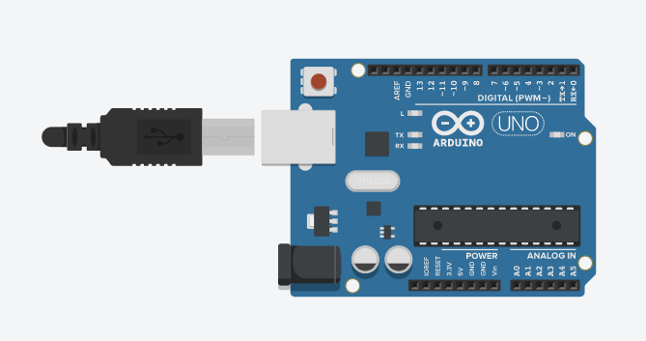
FORVIA HELLA Internship Program 2022
RESET BUTTON
Resets the Atmega microcontroller
Digital Pins
Use these pins with digitalRead(),digitalWrite()
PIN 13 LED
The LED built-in to your board and connected to pin 13
USB port
Used for powering your Arduino Uno
Poweer LED
Indicates that your Arduino board is receiving power
ATMEGA328 microcontroller
The heart of your board
TX and RX LED’S
These LED’S indicate communication between your Arduino and your computer
Power connector
This is how you power your Arduino when it’s not plugged into a USB port for power
GND and 5V pins
Use these pins to provide +5V power and ground to your circuits
Analog Pins
Use these pins wirh analogRead(),
analogWrite()

Slide 4
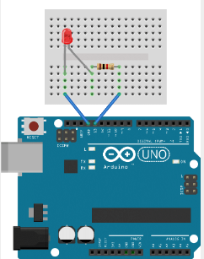
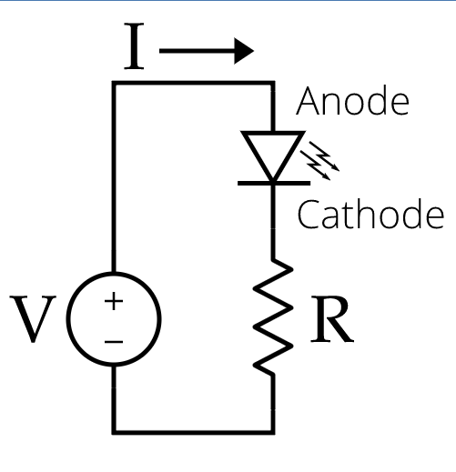
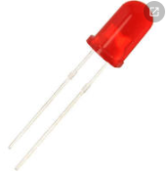
FORVIA HELLA Internship Program 2022
Led circuit arduino
Led circuit diagram
light-emitting diode
Ohm’s law
I= V/R

Slide 5
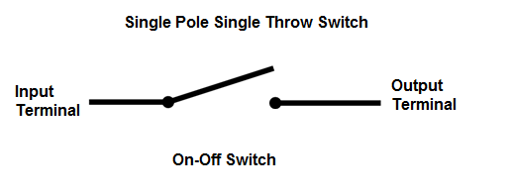
FORVIA HELLA Internship Program 2022
A Single Pole Single Throw (SPST) switch is a switch that only has a single input and can connect only to one output.
A Single Pole Single Throw switch serves in circuits as on-off switches:
-switch is closed, the circuit is on.
-switch is open, the circuit is off.

Slide 6
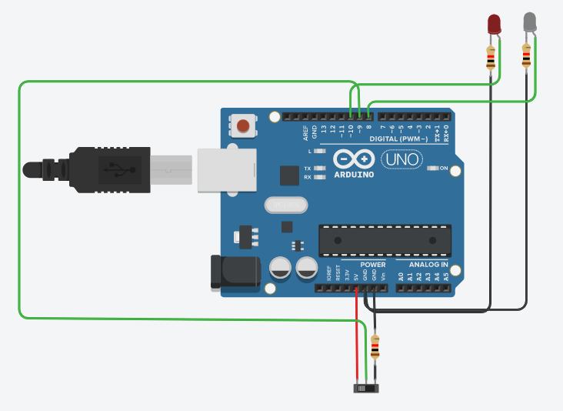
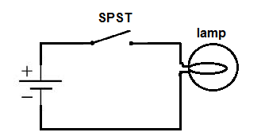
FORVIA HELLA Internship Program 2022
SPST with 2 LED’s
Single Pole Single Throw (SPST) Switch Circuit
When the SPST is closed, the circuit is closed and light from the lamp switches on. When the SPST is then opened, the light from the lamp goes out and the circuit is off.

Slide 7
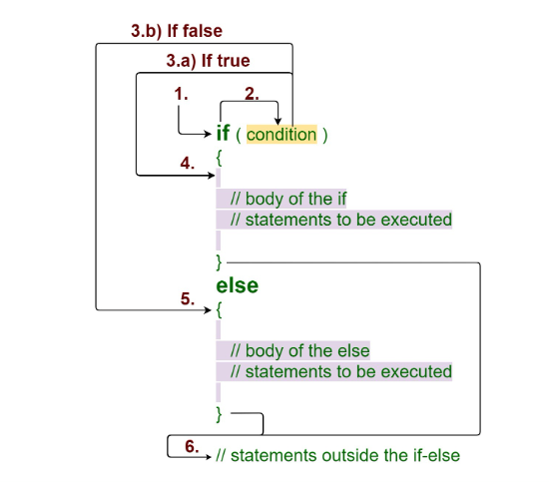
FORVIA HELLA Internship Program 2022
IF-Else statement

Slide 8
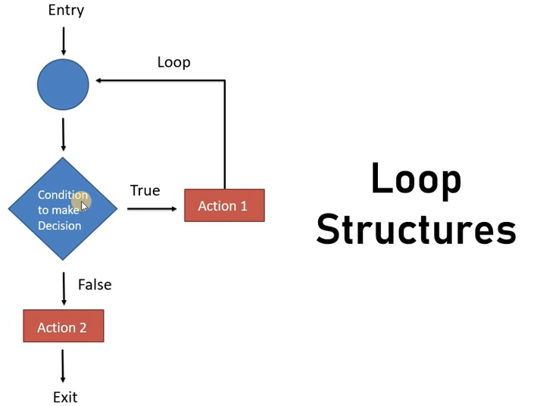
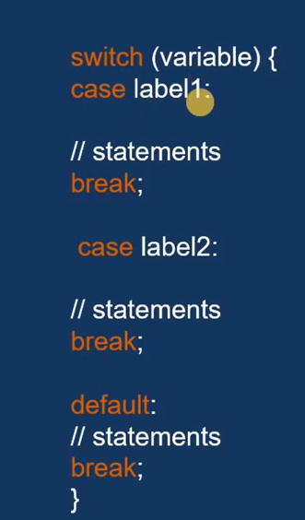
FORVIA HELLA Internship Program 2022
Switch case statement

Slide 9
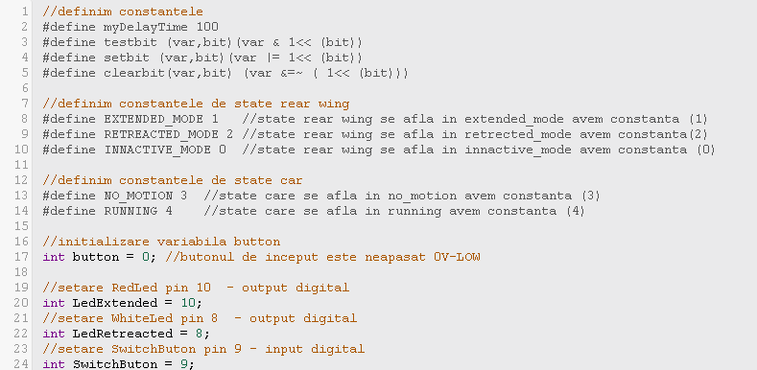
FORVIA HELLA Internship Program 2022

Slide 10
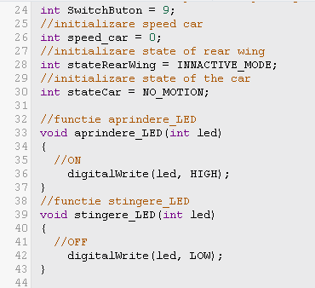
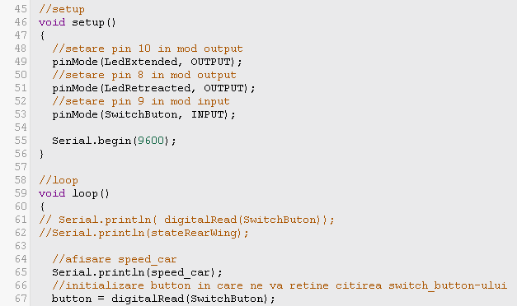
FORVIA HELLA Internship Program 2022

Slide 11
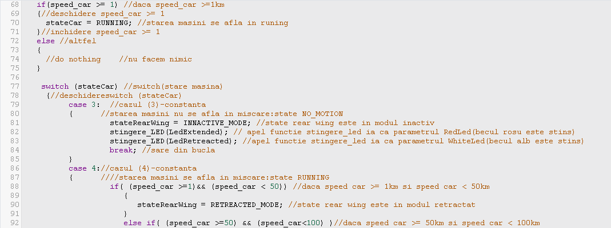
FORVIA HELLA Internship Program 2022

Slide 12
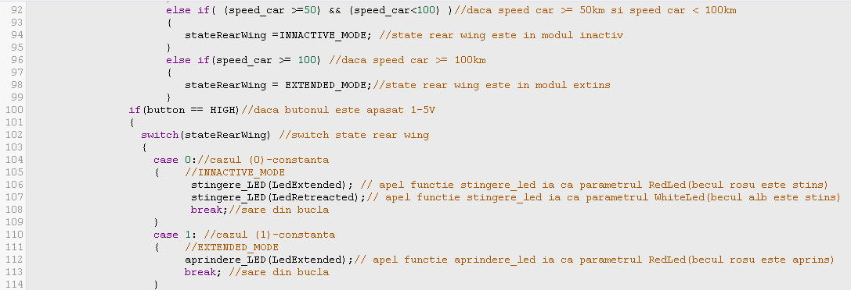
FORVIA HELLA Internship Program 2022

Slide 13
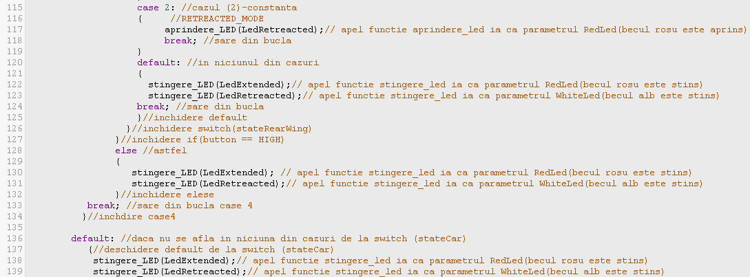
FORVIA HELLA Internship Program 2022

Slide 14
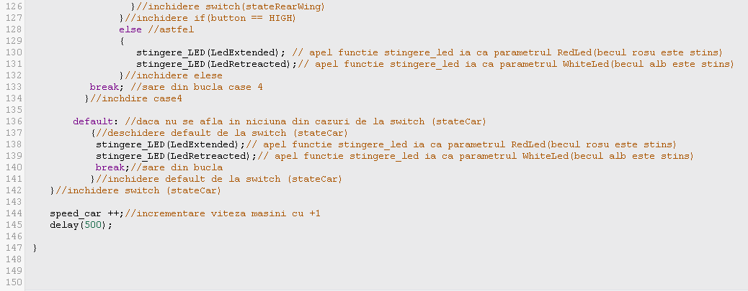
FORVIA HELLA Internship Program 2022

Slide 15
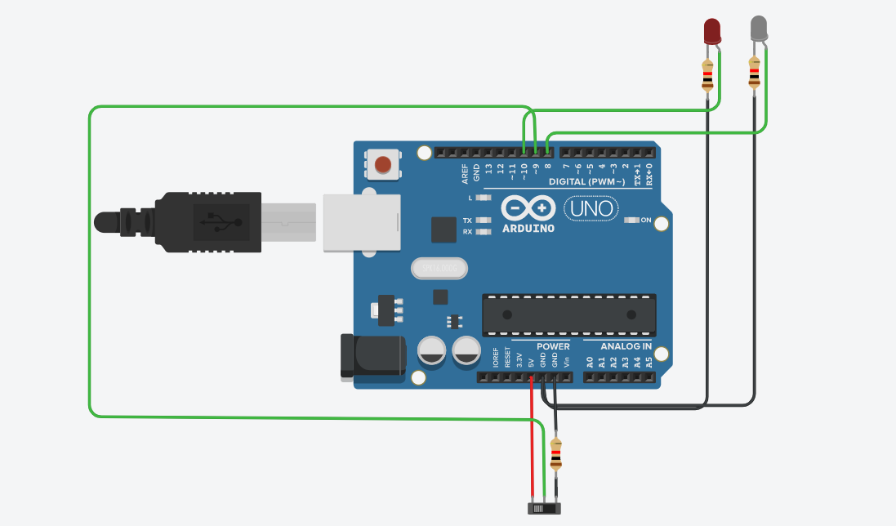
FORVIA HELLA Internship Program 2022
Link tinkercad:
https://www.tinkercad.com/things/8KZTHa5eliA-brilliant-maimu/editel?sharecode=XqxRS-fNMSX3SeqfNA7OjEnDOUCbGCxv8EXUcZI-g5g

