Slide 1
TBPB – Shop unit-tests
Toma Alexandru
Popescu Radu Andrei
Balosu Mihai
Bacioiu Alexandru

Slide 2
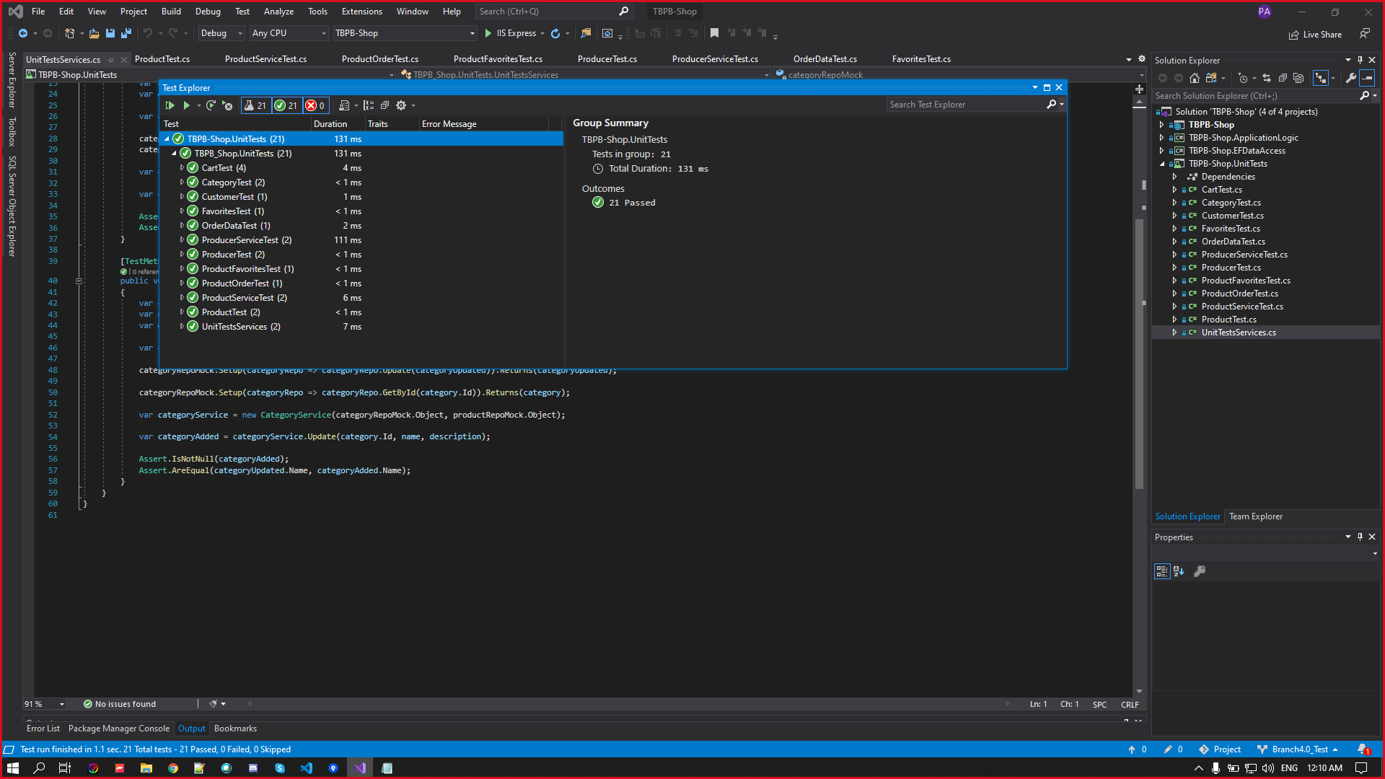
We successfully ran 21 tests

Slide 3
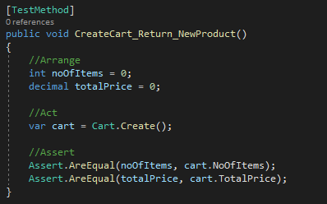
Create cart method test

Slide 4
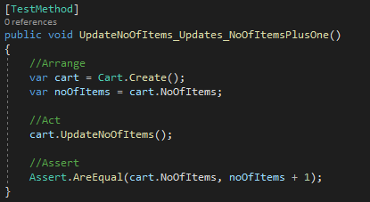
Update no of Items Method test

Slide 5
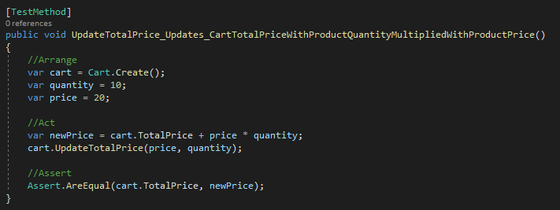
Update Total price method test

Slide 6
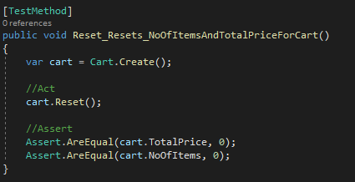
Reset method test

Slide 7
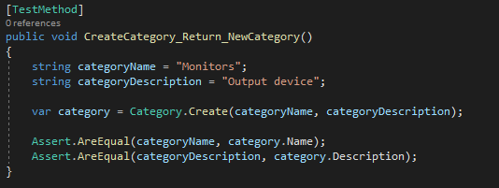
Create category method test

Slide 8
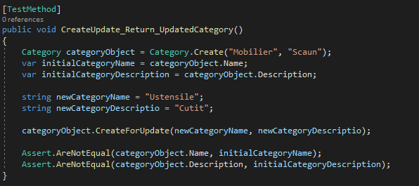
Update category method test

Slide 9
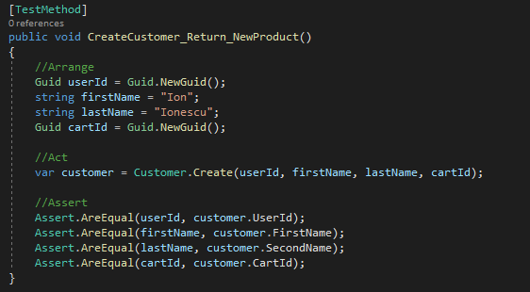
Create customer method test

Slide 10
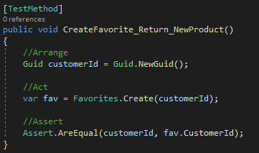
Create favorite method test

Slide 11
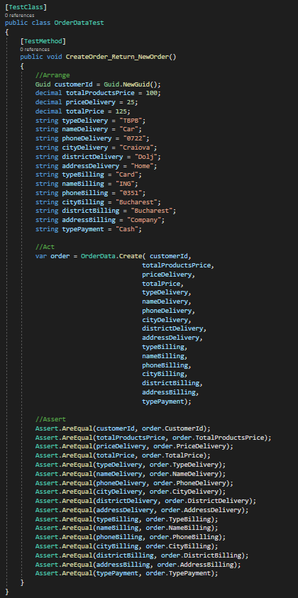
Create order method test

Slide 12
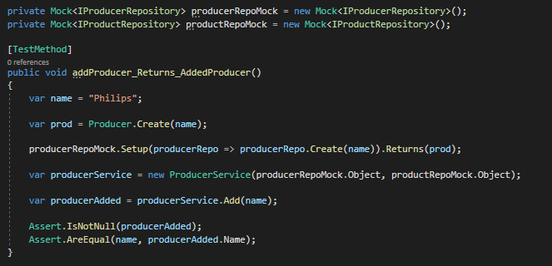
Add producer service test

Slide 13
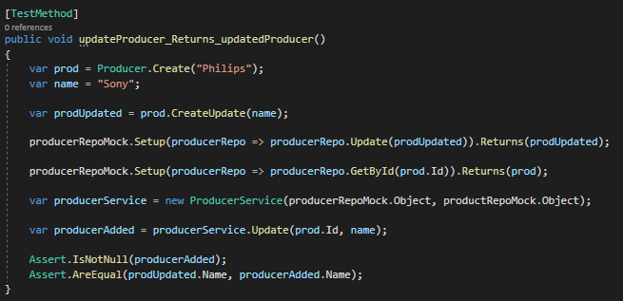
Update producer service test

Slide 14
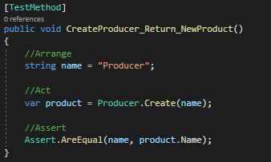
Create producer method test

Slide 15
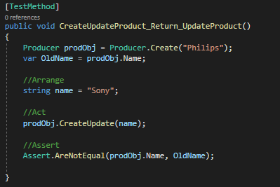
Update producer method test

Slide 16
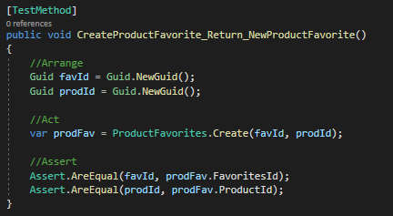
Create product favorite method test

Slide 17
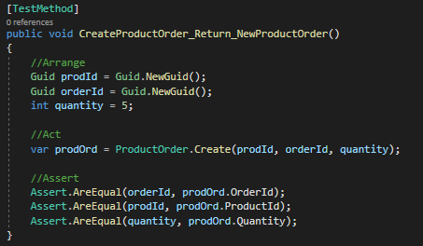
Create product order method test

Slide 18
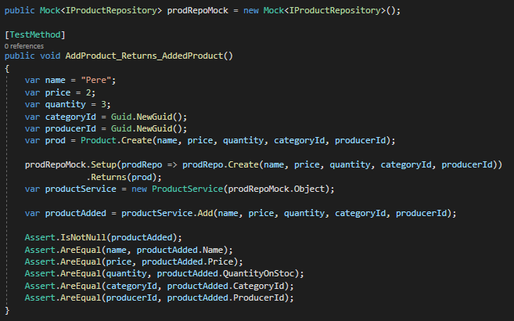
Add product service test

Slide 19
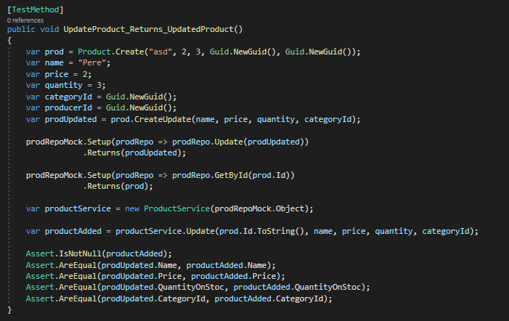
Update product service test

Slide 20
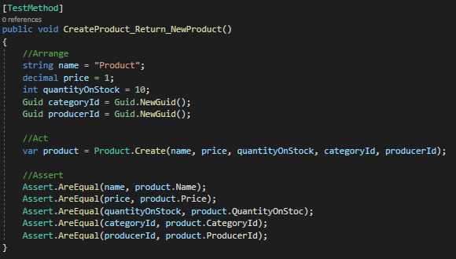
Create product method test

Slide 21
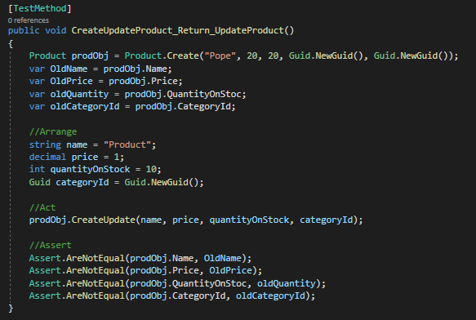
Update product method test

Slide 22
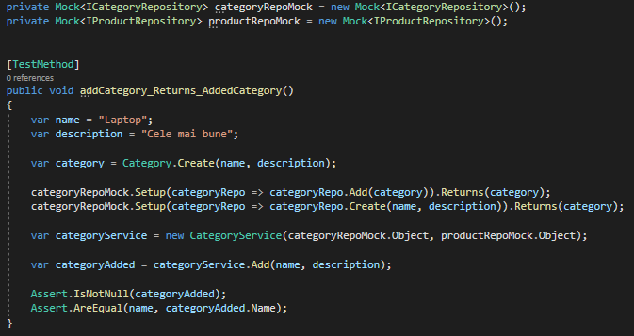
Add category service test

Slide 23
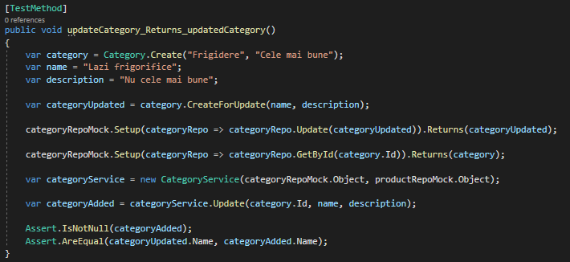
Update category service test

