Slide 1
Creational Design Patterns

Slide 2
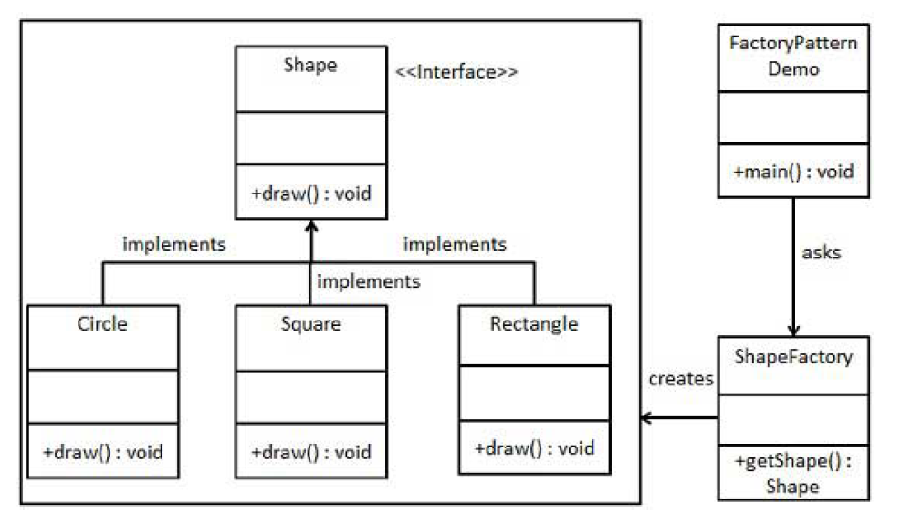
Factory

Slide 3
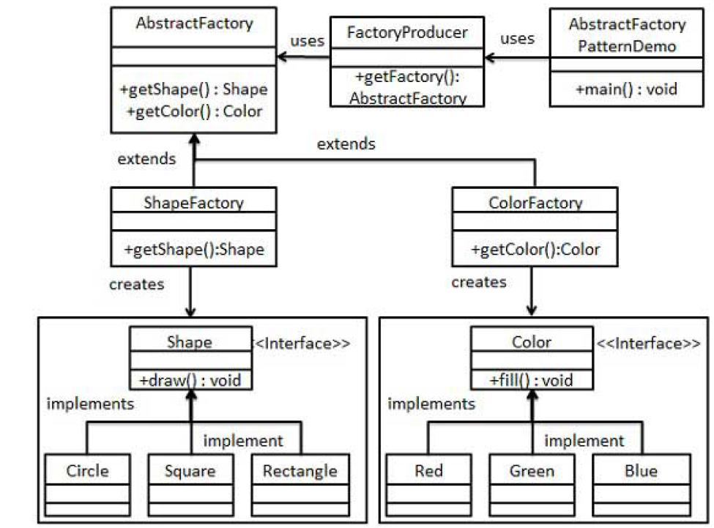
Abstract Factory

Slide 4
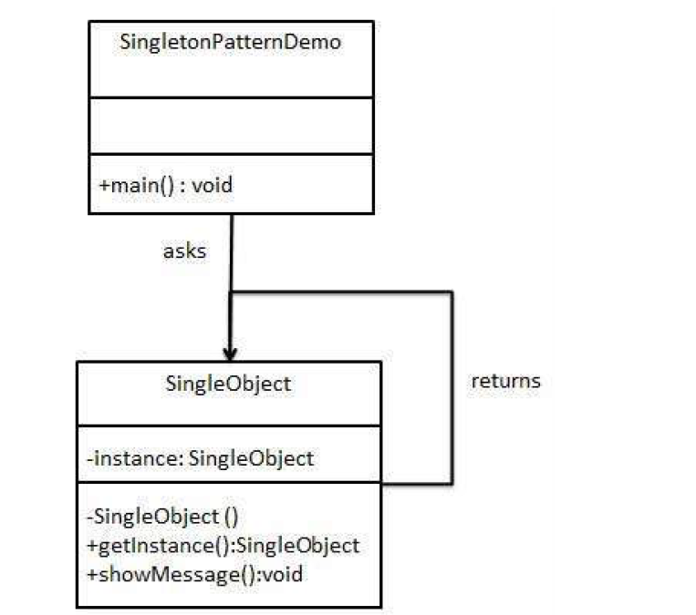
Singleton

Slide 5
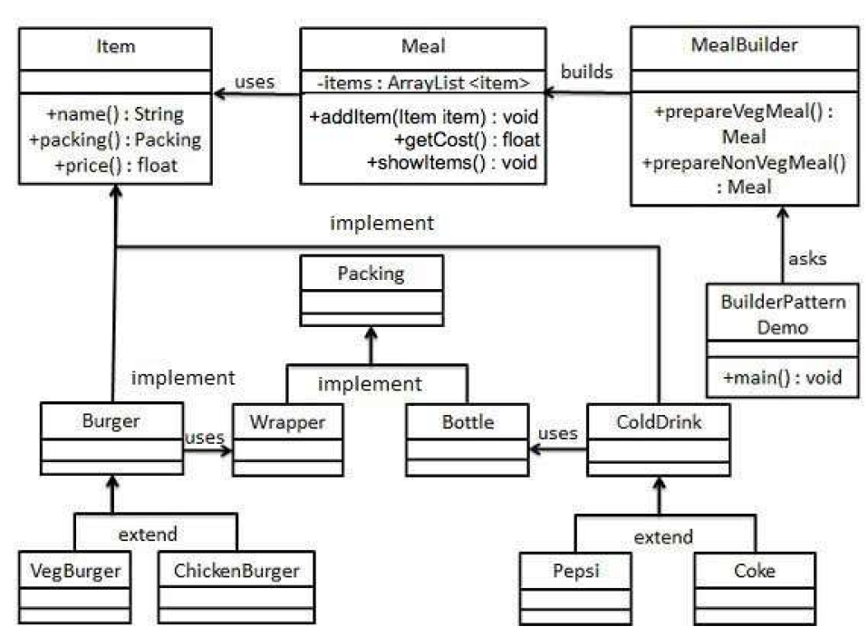
Builder

Slide 6
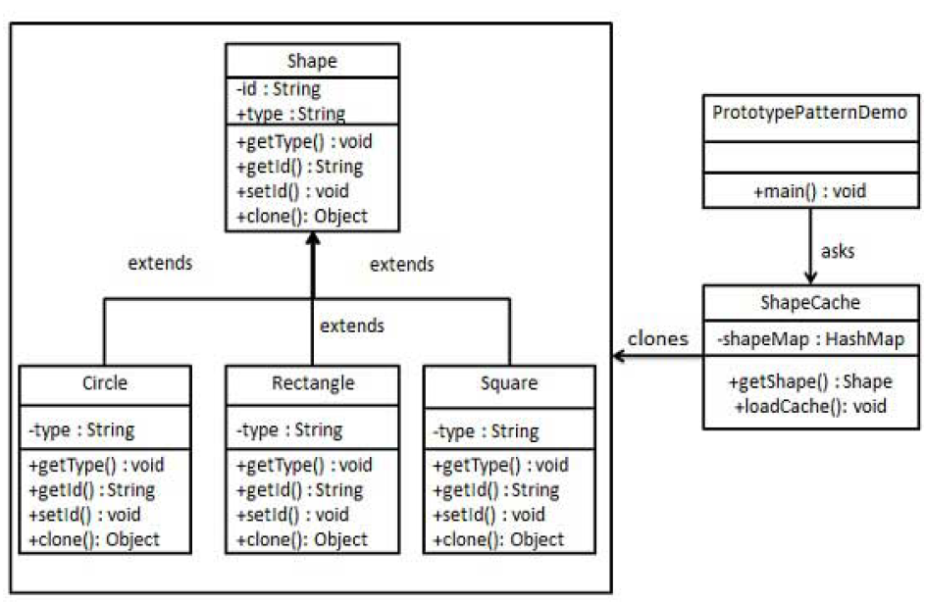
Prototype

Slide 7
Behavioral Design Patterns

Slide 8
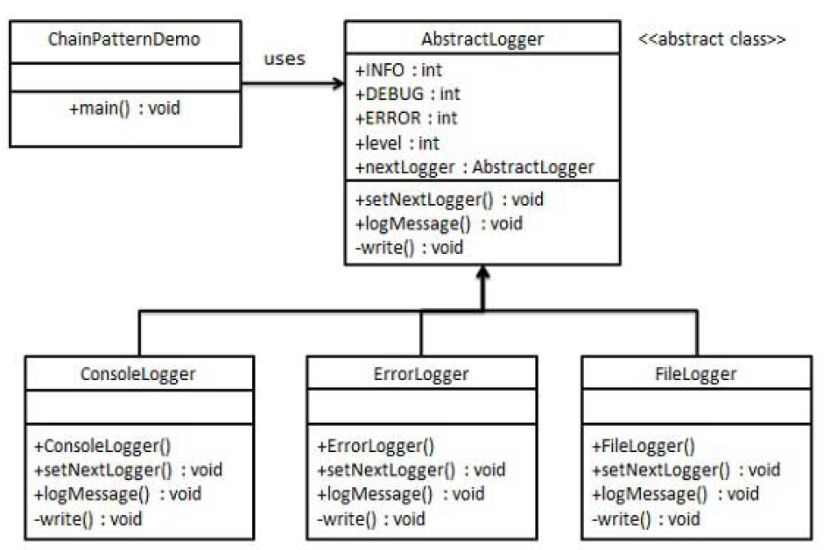
Chain of Responsibility

Slide 9
Structural Design Patterns

