Slide 1
Creational Design Patterns

Slide 2
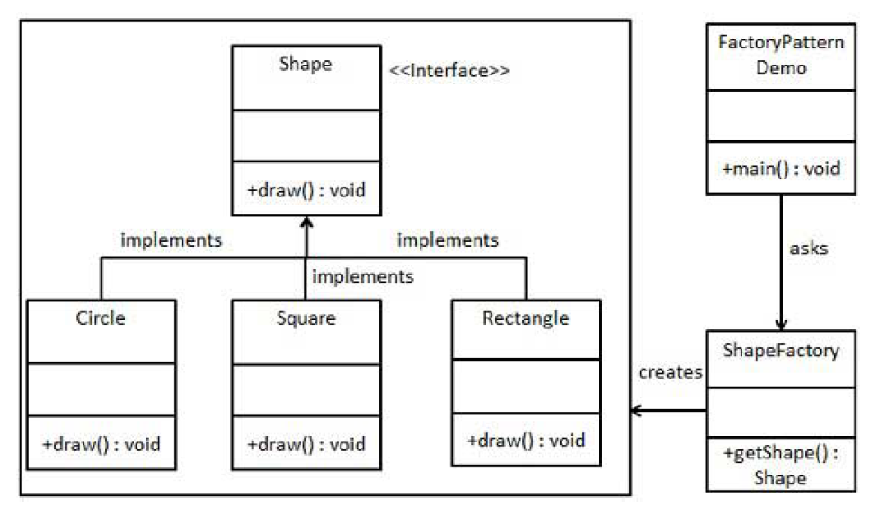
Factory

Slide 3
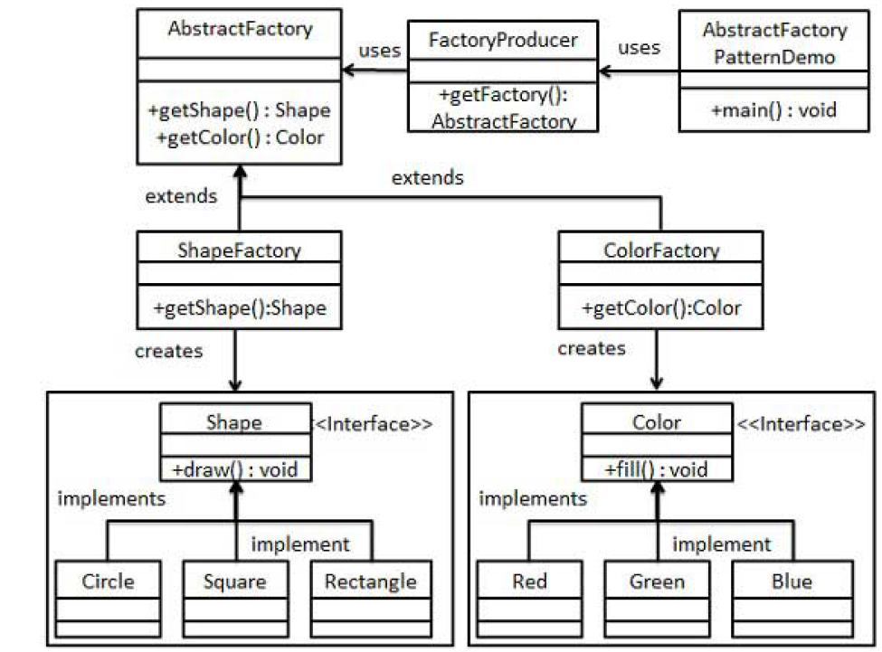
Abstract Factory

Slide 4
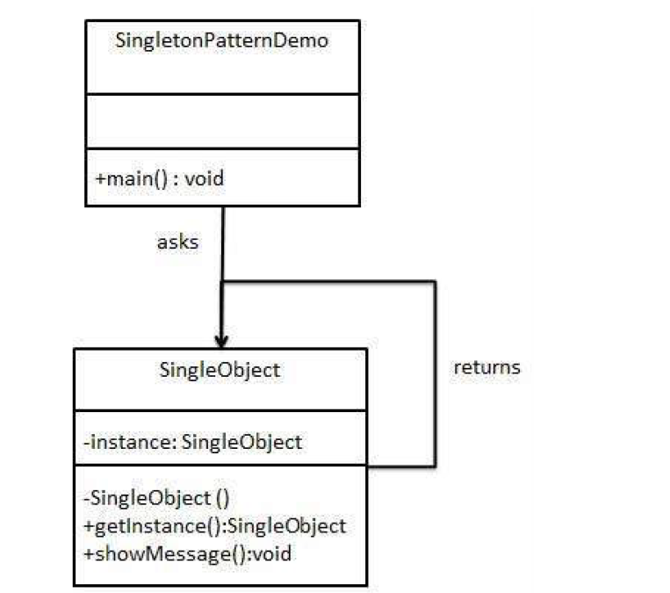
Singleton

Slide 5
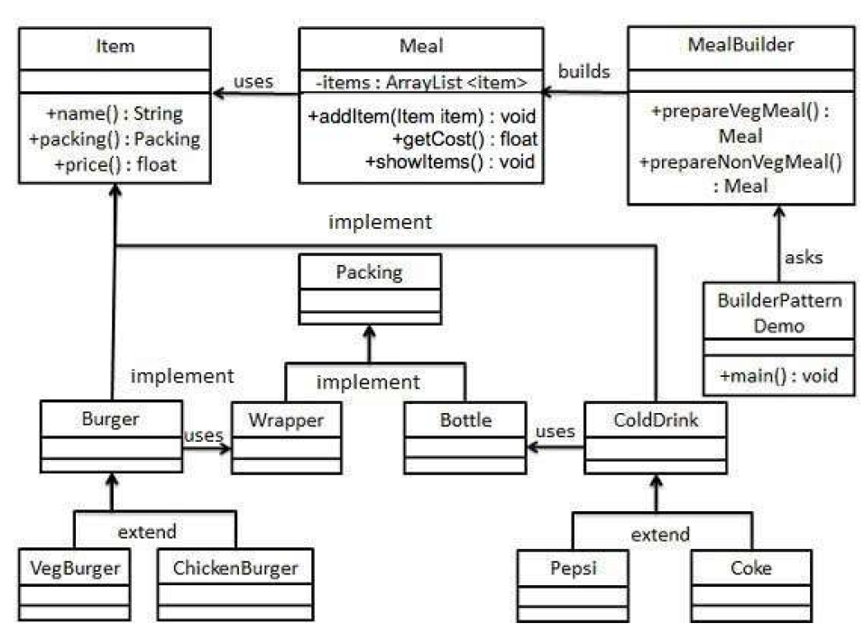
Builder

Slide 6
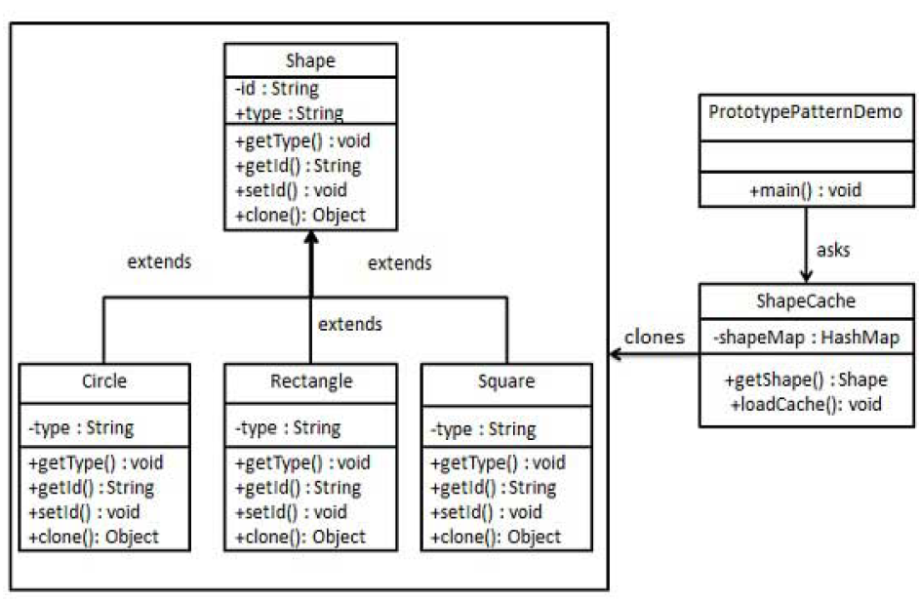
Prototype

Slide 7
Behavioral Design Patterns

Slide 8
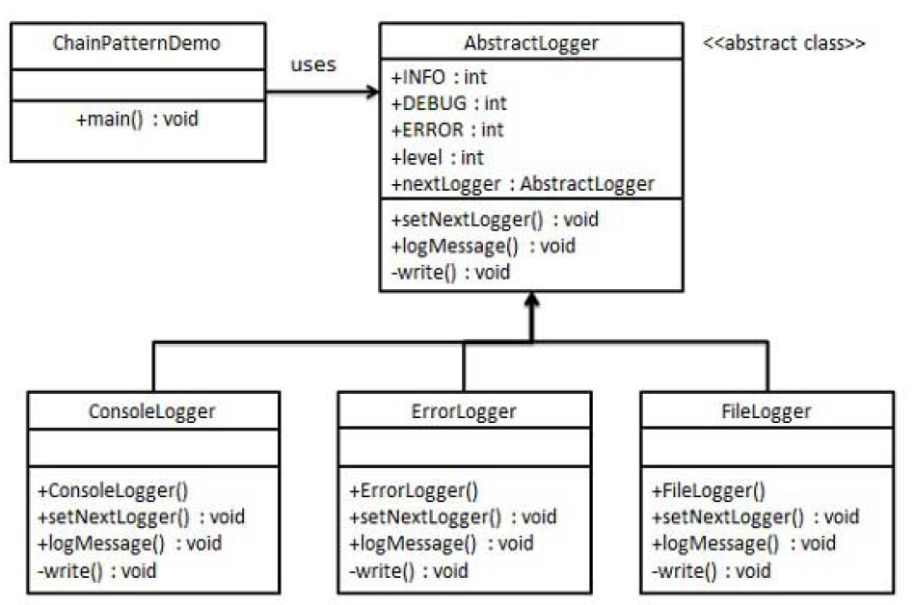
Chain of Responsibility

Slide 9
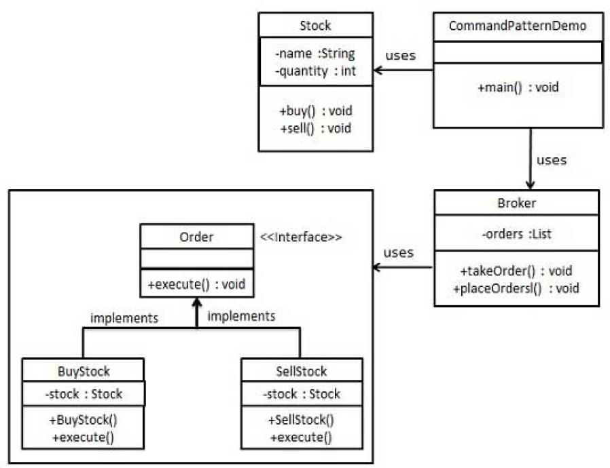
Command

Slide 10
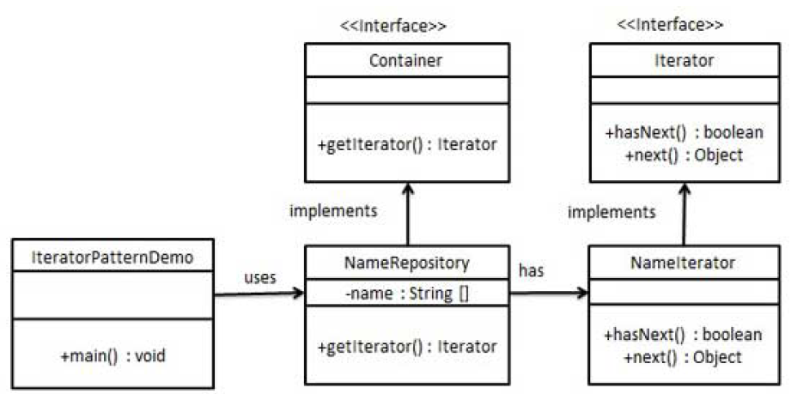
Iterator

Slide 11
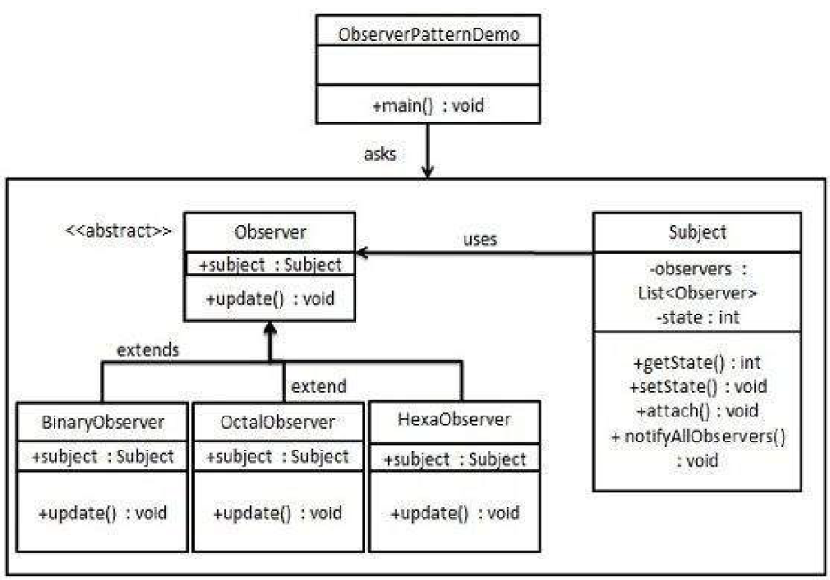
Observer

Slide 12
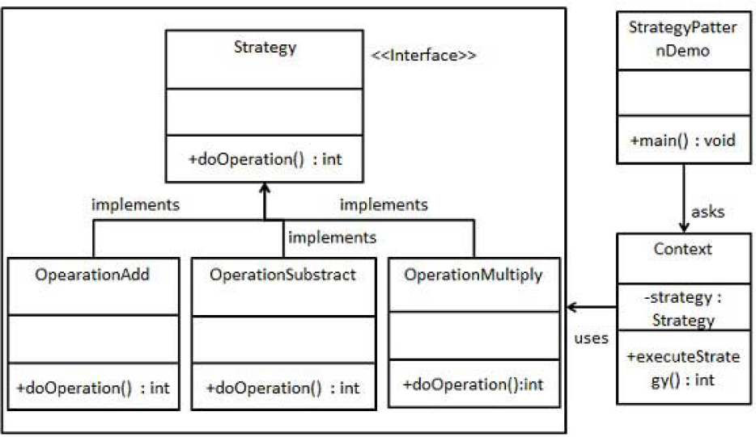
Strategy

Slide 13
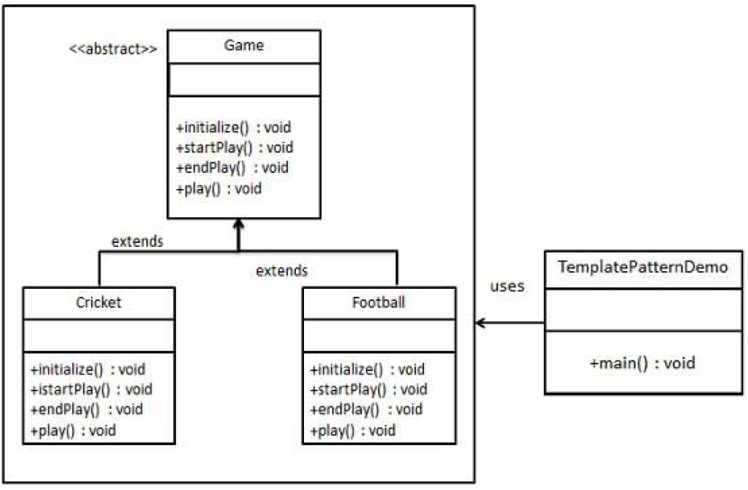
Template

Slide 14
Structural Design Patterns

Slide 15
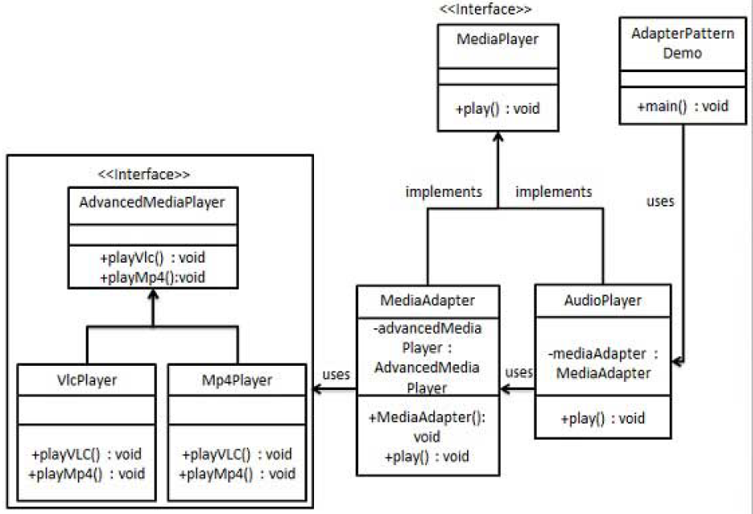
Adapter

Slide 16
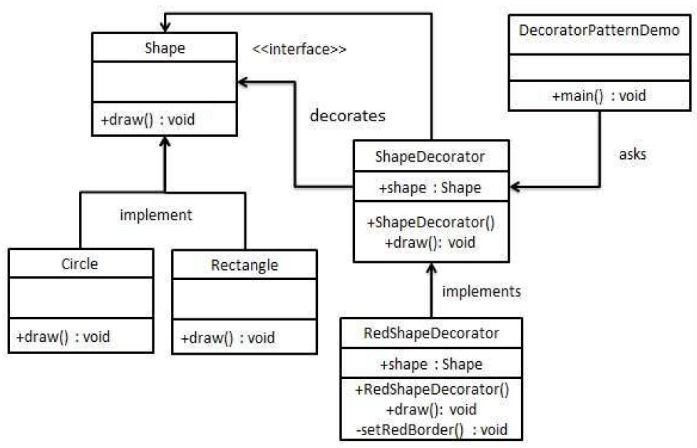
Decorator

Slide 17
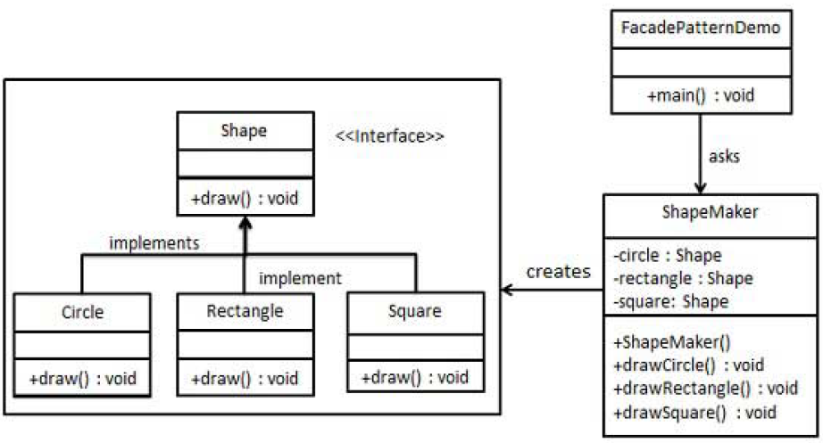
Façade - Service

Slide 18
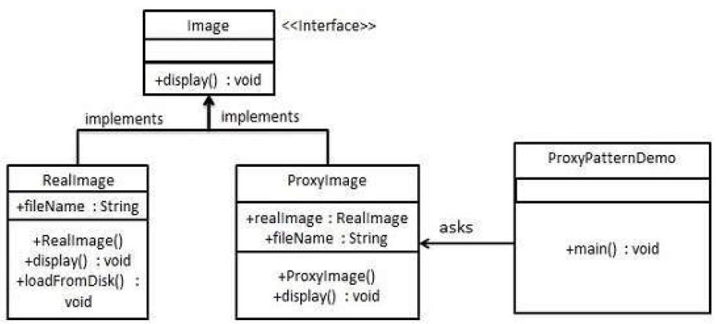
Proxy

Slide 19
Java EE

Slide 20
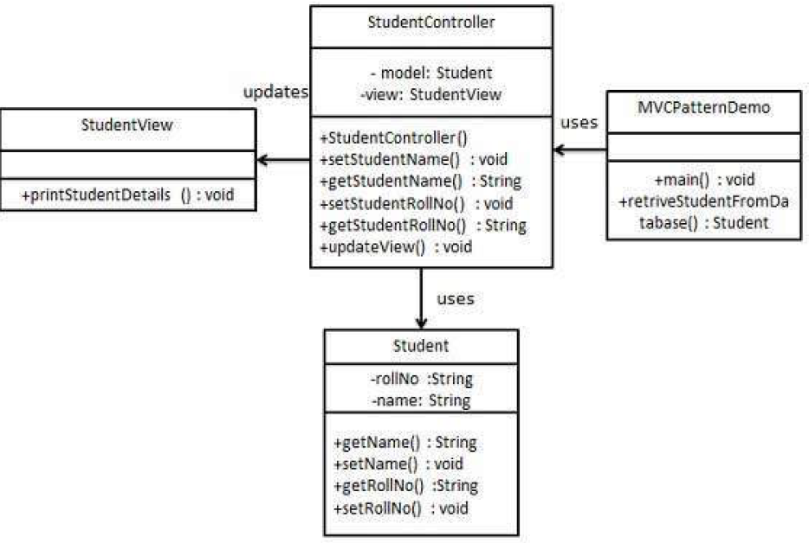
Model – View - Controller

Slide 21
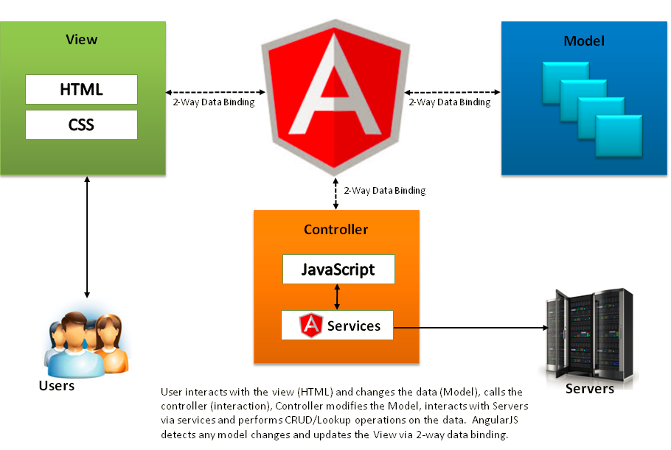
Model – View – Controller - Example

Slide 22
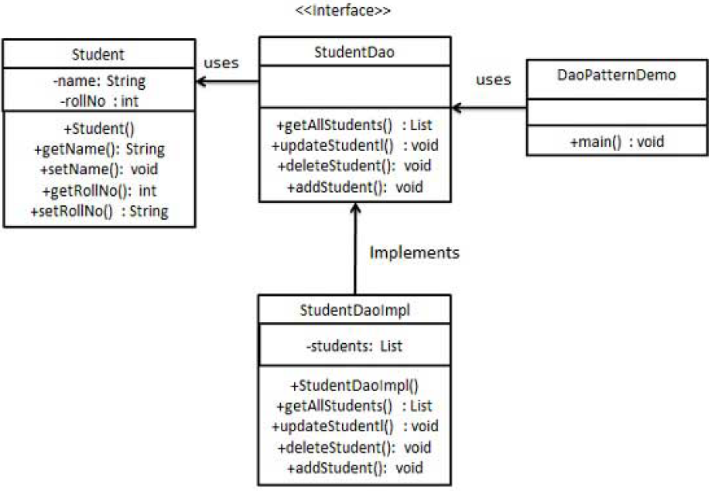
Data Access Object

Slide 23
Data Access Object - Example

Slide 24
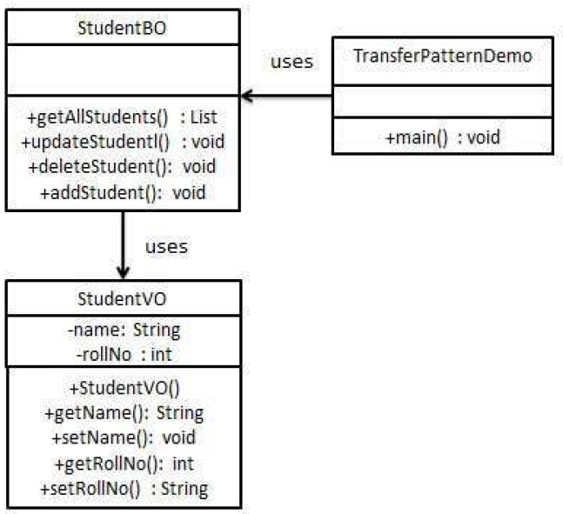
Transfer Object

Slide 25
Transfer Object - Example

